Slide 1
Final Report: 2022 OGWG Annual Survey
WRAP Technical Steering Committee
October 25, 2023​

Slide 2
The 3 W’s:
Why: Gather information from OGWG membership to help guide the workgroup’s focus.
What: Developed an inclusive survey that considered expertise, program approaches, cultural needs, and agency requirements across all WRAP member agencies (Tribal, state, local, and federal)
Survey Topics:
Oil and gas air quality management
Emissions inventories
Regulation and implementation
When: Summer 2022 – Summer 2023
Notes:
Why - The OGWG was interested in finding ways to better serve the WRAP membership most efficiently/effectively with limited resources in a changing global environment related to oil and gas, which is a hot topic in the West. This survey was intended to help coordinate/guide the work group to remain relevant and responsive to the WRAP membership.
What: Developed a survey that considered different levels of expertise, programmatic approaches, cultural necessities, and needs by all WRAP agencies (Tribal, state, local, and federal levels).
Three (3) main topic areas:
When: The OGWG Agency Survey is a snapshot in time from summer 2022, developed for WRAP agencies to address oil and gas industry challenges.
NOTE – not listed “the HOW”:
The OGWG had monthly focus group coordination calls to discuss the scope of work and get feedback on how best to tackle the tasks outlined for the work group for the year. This survey is a snapshot in time from summer 2022, and due to the speed at which some of these efforts are developing, some of the discussion is already out of date, and the agencies involved should be contacted directly for the latest information on such initiatives.
Project work began in January 2022
Monthly focus group calls
12 questions – accessible online and in MS Excel
Agencies had ~ seven weeks to respond
Responses were compiled by agency type

Slide 3
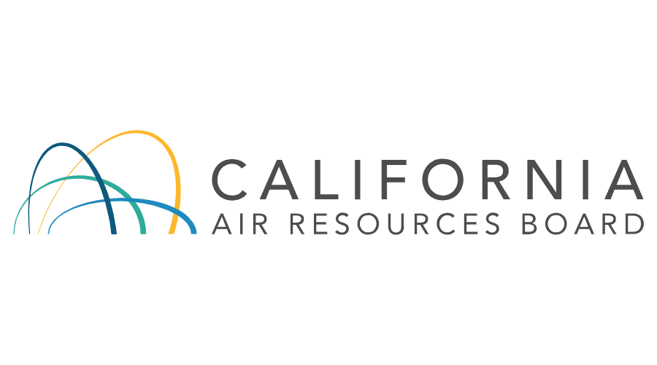
Federal Land Managers
EPA HQ, Regions 6, 8, & 9
States (8)
Tribes (2)
Notes:
Who: Federal Land Management Agencies: Bureau of Land Management (BLM), National Park Service (NPS), Fish and Wildlife (FWS), Forest Service

Slide 4
key takeaways Needs Related to Oil and Gas
All states and FLMS indicated a need to analyze basic data for their jurisdictions' upstream/midstream sectors.
Other top needs shared amongst states included:
operator surveys about engines, equipment, and practices
more resources for data collection and analysis
training
Additional O&G needs from all groups included:
BIL funding has made inspection, monitoring, plugging, and reclamation of abandoned and orphaned O&G wells a top priority
Programs to address new methane tracking/inventorying
Better coordination on emissions inventories
FWS is interested in analyzing how O&G emissions affect deposition to land and water
Reviewing proposed federal and state rules in a consultation capacity

Slide 5
Informing Future Work

Slide 6
Ways WRAP Can Provide Support
Emissions management and help in addressing proposed federal rules
All groups emphasized the following:
Grants for regional work and contractor-supported analysis.
Maintain the Intermountain West Data Warehouse (IWDW)
Collaboration on emissions inventory work
Surveys, technical virtual meeting discussions, training, & workshops
Coordination on oil and gas modeling, planning, methodology, & field studies
Being a regional voice on proposed rules/actions
States agreed that learning from other states' experiences and efforts to address oil and gas sources are essential.
Notes:
1. Grants to to benefit WRAP member agencies
2. Maintain a data distribution center, like the IWDW, to share important regional data including modeling, emissions inventories, and monitoring data.
3. Collaboration on emissions inventory work and help ensure consistency in emissions inventory information
4. Surveys, technical virtual meeting discussions, training, & workshops
5. More robust coordination on oil and gas modeling, planning, methodology, field studies, etc. would be helpful, including detailed surveys.
6. Being a regional voice on proposed rules would help EPA identify regional concerns and/or support.

Slide 7
Timeline
JUNE 2022
WINTER 2023
MAY 2023
SEPTEMBER 2023
Survey Responses Due
Drafted Summary Report
OGWG briefing on survey results
Present at EI Conference!
FEBRUARY 2022
FALL 2022
APRIL 2023
AUGUST 2023
Kicked off Survey Effort
Evaluated and Compiled Results
Summarized effort at WESTAR/WRAP Spring Meeting
OGWG Consensus on Report
Briefed TSC

