Slide 1
Barry Lefer
Tropospheric Composition Program Scientist
Earth Science Division
NASA Headquarters
barry.lefer@nasa.gov
Mike Falkowski
FireSense Program Scientist
Earth Science Division
NASA Headquarters
michael.falkowski@nasa.gov

Slide 2
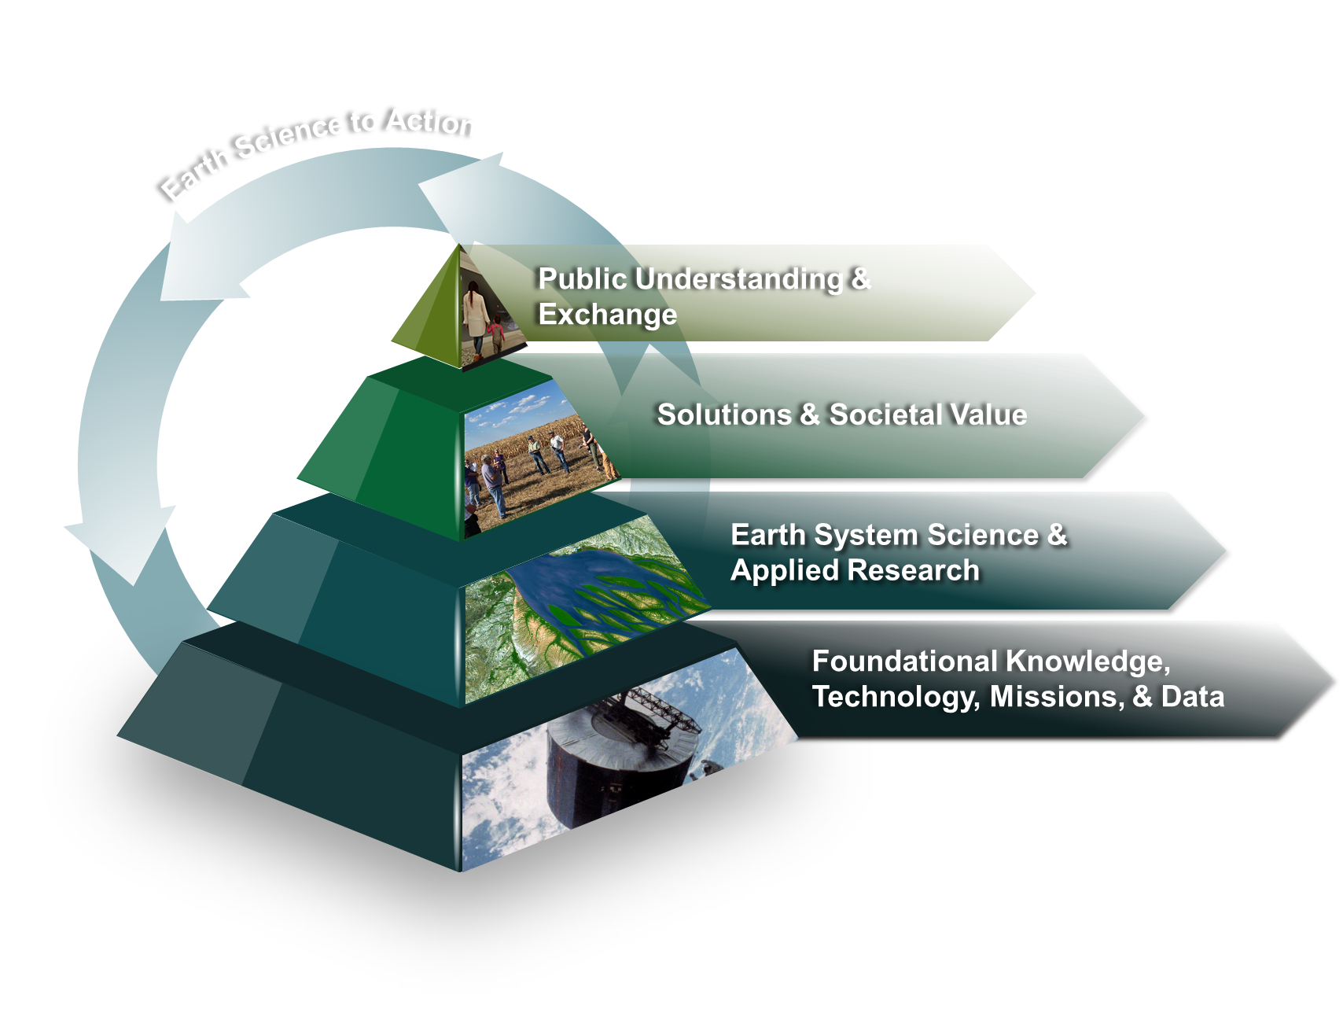
NASA ESD Wildland Fire Earth Science to Action Strategy
FireSense Project – Targeted implementation and transition of vetted wildland fire management solutions to operational agency stakeholders. US footprint. State and Federal partners.
Research and Analysis - Foundational research focused on understanding the role fire plays in the earth systems. Multiple programs contribute to this effort. Applied Science - Incubate and co-develop solutions to the wildland fire management problem. Global Footprint. Broad set of stakeholders.
Foundational earth observations used to characterize fire across its entire life cycle including pre-fire conditions, active fire properties, and post-fire impacts to ecosystems and communities.
Notes:
Base layer: foundational knowledge, technology, missions & data (building models) (Knowing)
2nd layer: Earth system science and applied research (improving models) (Learning)
3rd layer: Solutions & Societal Value (using models) (Doing) EIC moves to SSV?
Top layer: Public understanding & exchange (Teaching)
Name of program for budget line item: Solutions & Societal Value. It’s OK if not everything is in this line item in FY25 (Nancy Searby example)

Slide 3
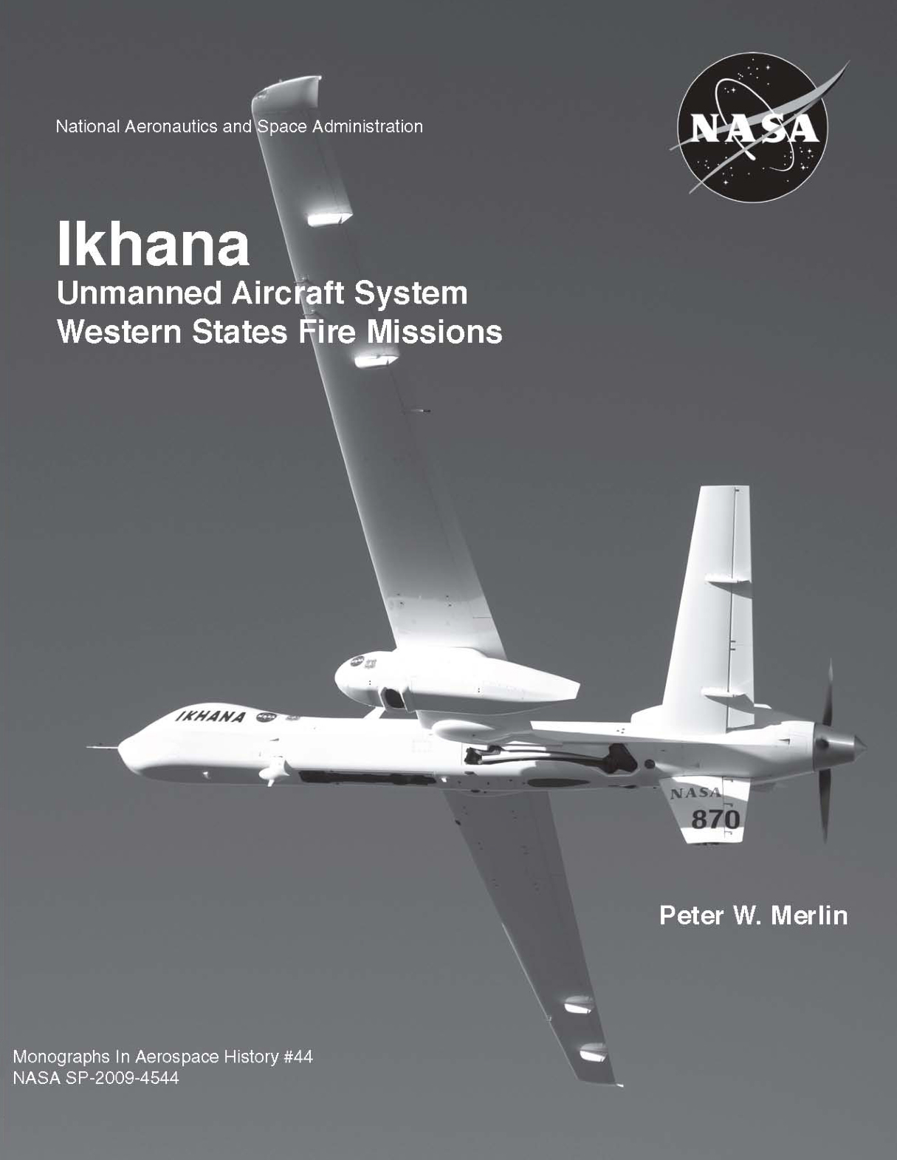
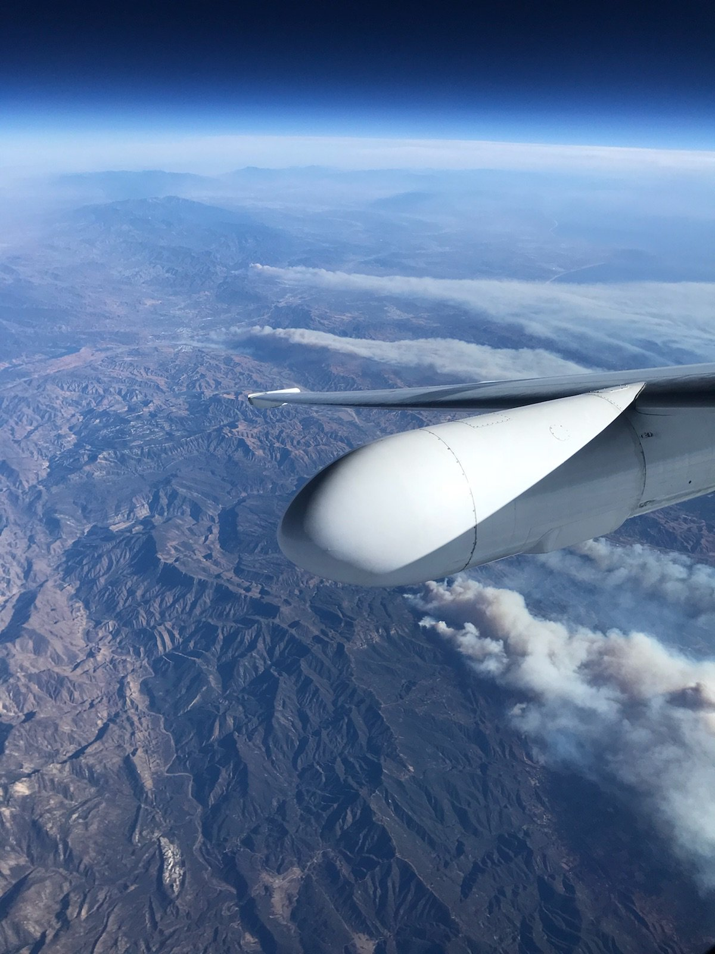
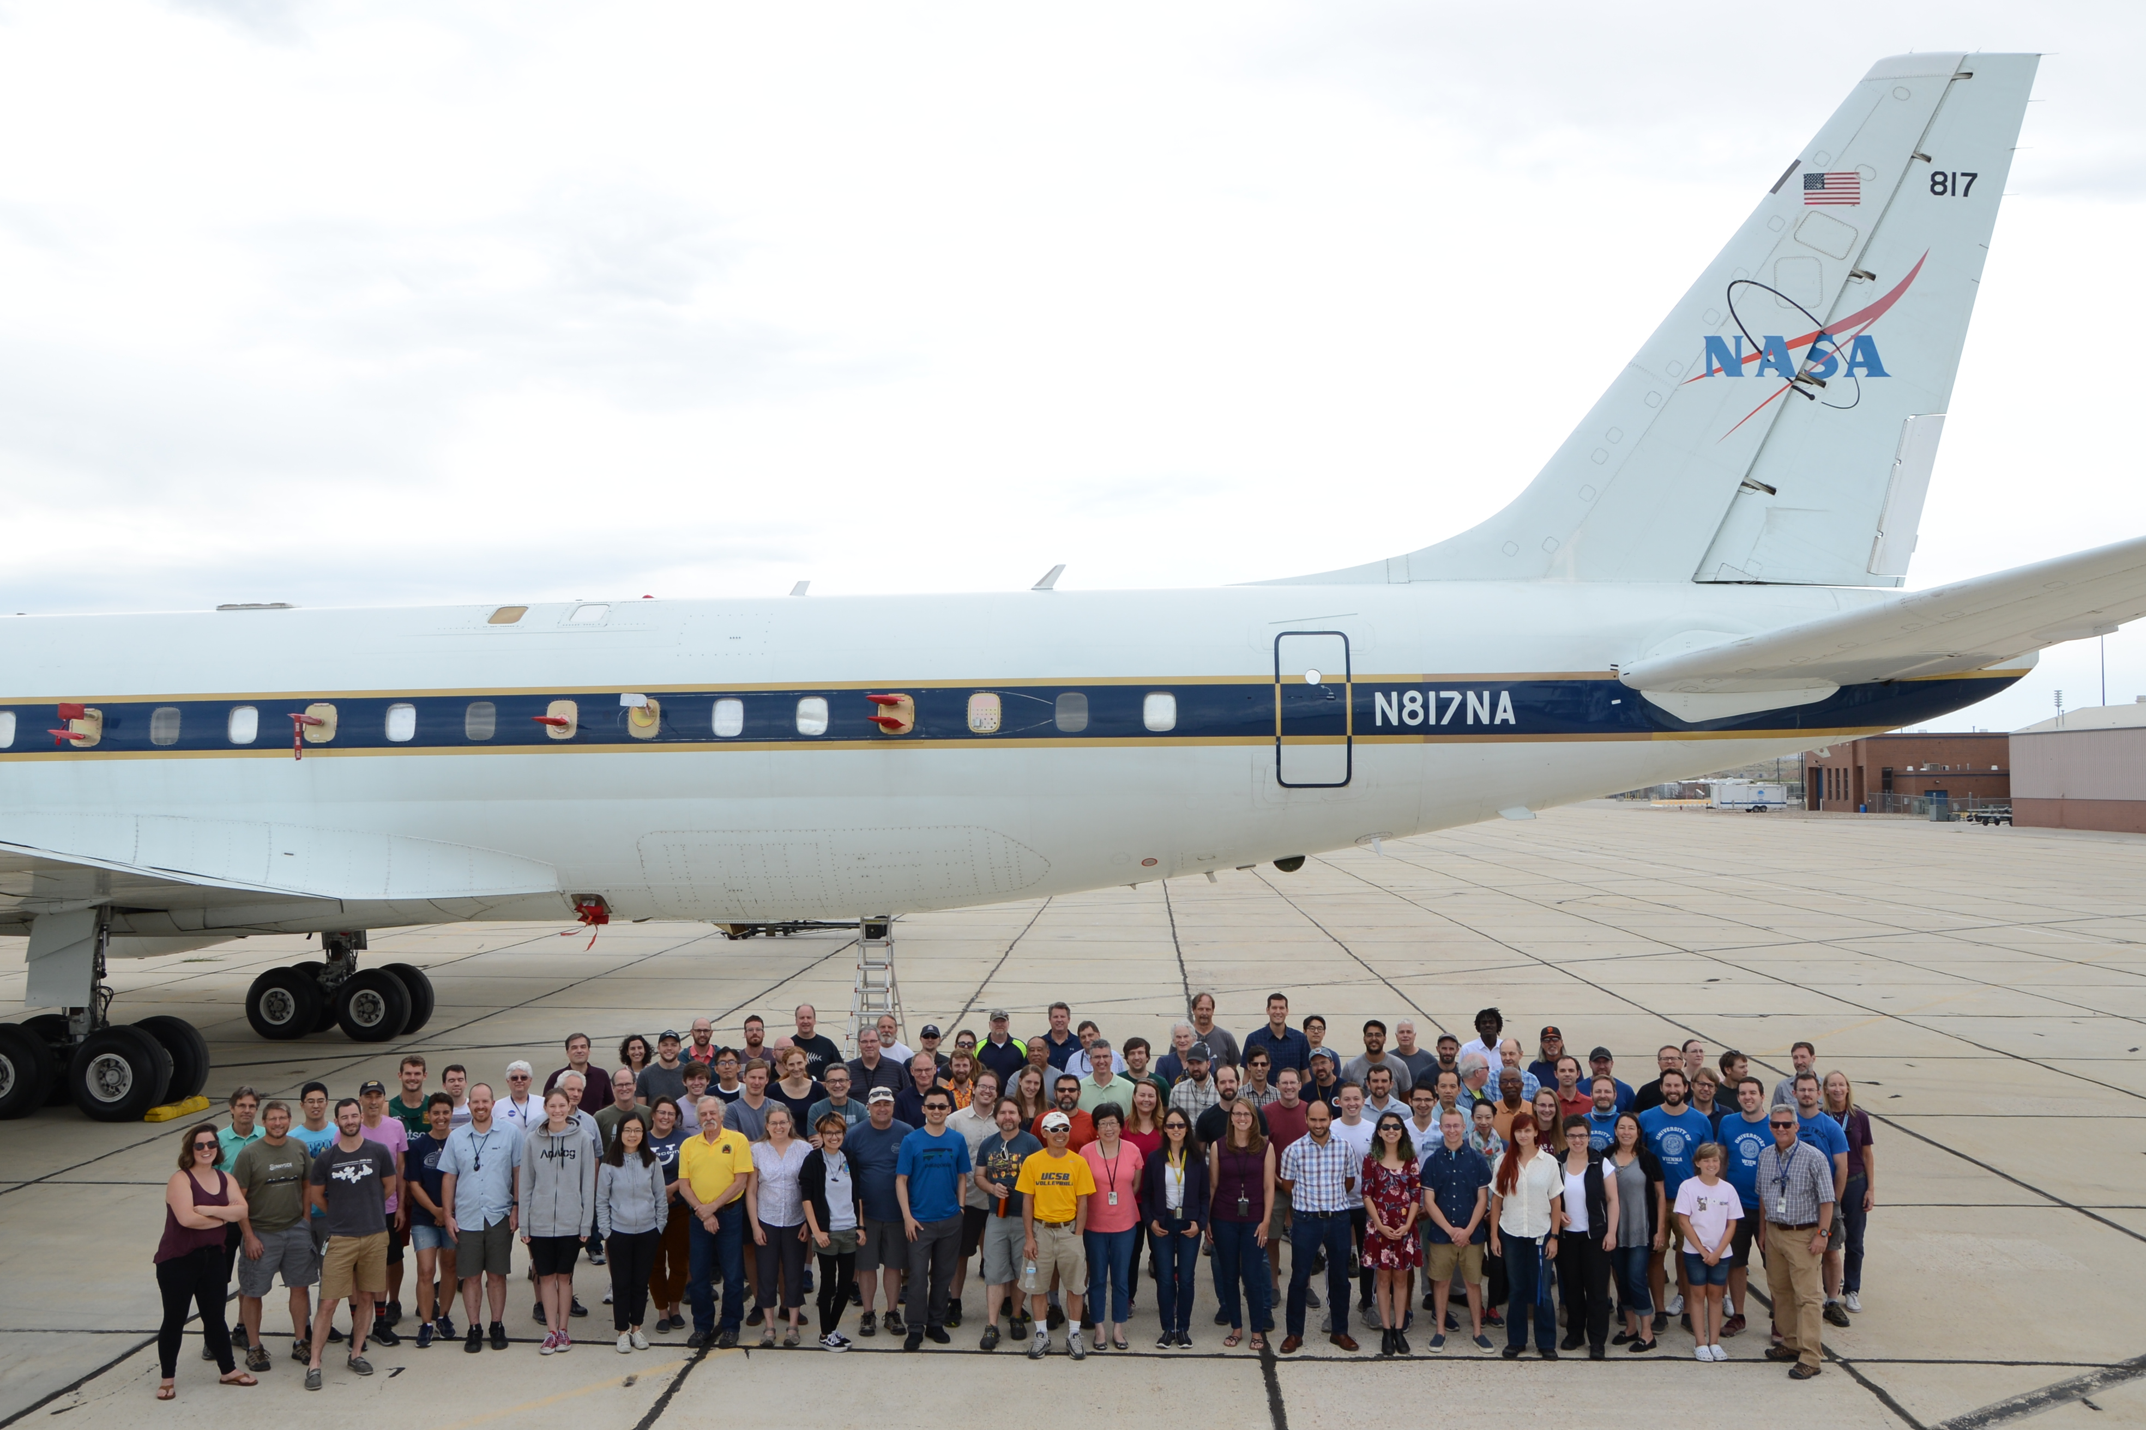
50+ years of NASA Fire Science and Applications
1972 - Landsat used for forest and fire scar inventory
1980 - AgRISTARS tech demos with USDA & DOI
1987 - Sentinel manuscript, hypothesized O₃ from fire
1986 - Prescribed Chaparral fire, California
1992 - SAFARI & TRACE-A (verified ozone chemistry)
1993 - Bor Island, Siberia
1994 - BOREAS, Canada
1998 - LBA, Brazil
1999 - MODIS 1st instrument design: fire detection,
measured fire energy / FRP
2001 - MODIS Rapid Response Active Fires (FIRMS)
2006 - Western States Fire Mission (IKHANA with AMS)
2013 - 1st Applied Sciences Wildland Fire Program
2014 - Arctic-Boreal Vulnerability Experiment (ABoVE)
2019 – FIREX-AQ (NASA and NOAA)
FIELD CAMPAIGNS
FIELD CAMPAIGNS

Slide 4
The NASA Science Mission Directorate (SMD) FireSense is focused on delivering NASA’s unique Earth science and technological capabilities to operational agencies, striving towards measurable improvement in US wildland fire management. The NASA SMD FireSense project is part of a larger NASA wide Wildland Fire Initiative involving SMD, the Aeronautics Research Mission Directorate (ARMD), and the Space Technology Mission Directorate (STMD).
The FireSense project will include an airborne science component (annual campaigns) where improved capabilities and technologies will be developed and evaluated, and ultimately demonstrated to agency stakeholders in a large capstone airborne campaign in year 5 of the project (2027-2028).
Through initial stakeholder engagement activities, the FireSense project will begin by focusing on four uses-cases focused on characterization and measurement of (i) pre-fire fuels conditions, (ii) active fire dynamics, (iii) post fire impacts and threats, and (iv) air quality impacts and forecasting, each co-developed with identified stakeholders.

Slide 5
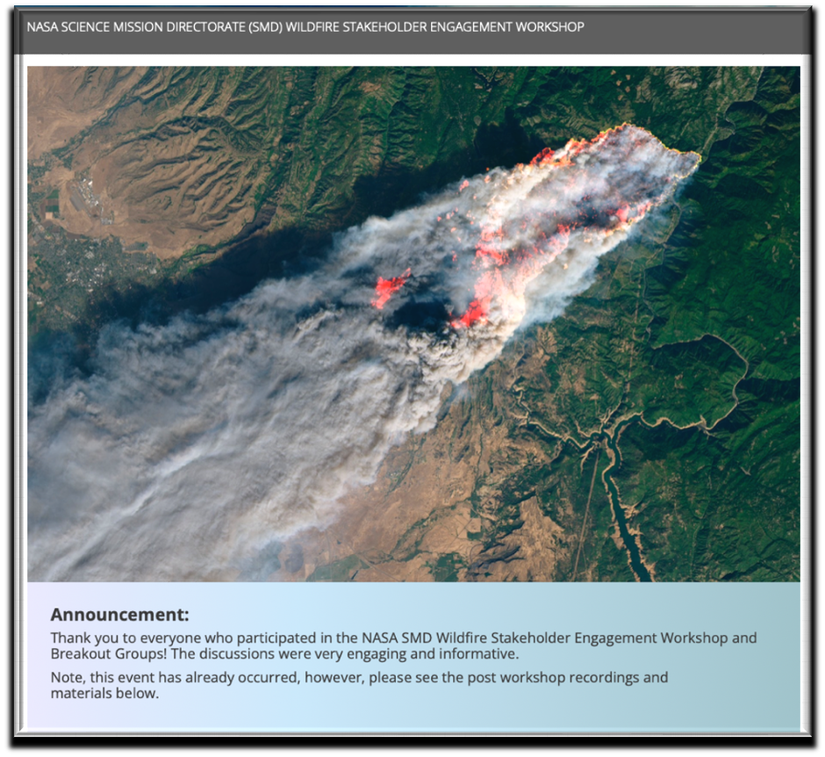
NASA FireSense is driven by Stakeholder Needs
NASA SMD Wildfire Stakeholder Engagement Workshop – Held Early Feb 2022
Workshop Purpose:
To hear wildland fire management stakeholders identify gaps and visions for successful wildland fire management.
Participants asked to identify the following:
Barriers the community has in integrating science, technology, and knowledge into the fire management problem.
Areas where NASA can help enable collaborative programs and partnerships across the fire lifecycle, including preparedness and adaptation, response, and recovery.
Key opportunities and priorities to make progress in pre-, active, and post-fire management.
Partners and programmatic activities that guide near- and long-term action in wildland fire management
Over 800 participants!

Slide 6
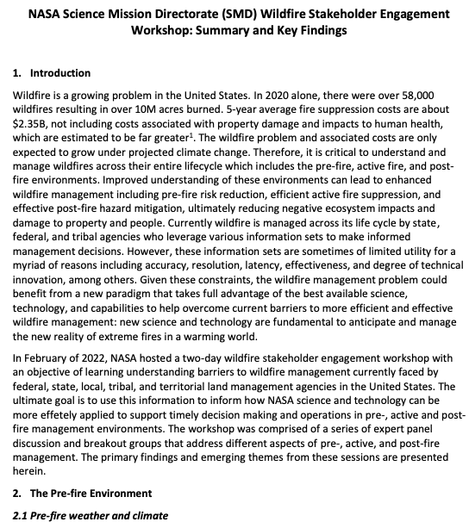
NASA FireSense is driven by Stakeholder Needs
Workshop Outcomes: Primary deliverable - whitepaper describing current barriers faced by agencies responsible for managing fire across its life cycle (pre-, active-, and post-fire).
Some of What we heard*:
Pre-fire –
Current fuels map of limited utility for operational management (increase accurate updates)
Fire behavior models do not have the necessary fidelity and/or timeliness to accurately predict fire behavior and fire spread
Current observations and forecasts of winds, humidity, and fuel moisture are insufficient for fire risk assessment and prediction
Active Fire –
Must reduce of time from ignition to detection and response
Need persistent (24/7) IR imagery of active fires to support fire management and monitoring (and fire science)
Lack of Reliable, high-speed communications/data
Need instruments capable of mass/power limitations of new suborbital platforms
Post-fire –
Improved mapping of forest burn extent and fire severity
Understand impacts to air and water quality and human health
Reduce debris flow prediction uncertainty: landslides, floods, impacts to watersheds
https://aam-cms.marqui.tech/aam-portal-cms/assets/ki2yd52vavkccskc

Slide 7
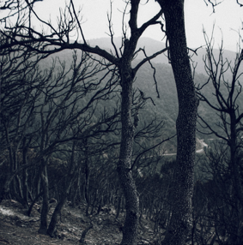
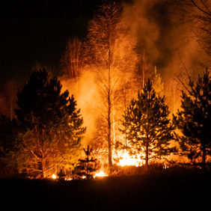
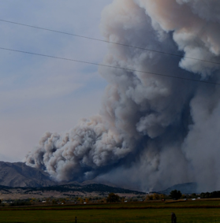
FireSense Use Cases
Pre-fire: Improved fire prevention by providing fire fuel maps with higher accuracy and resolution.
Provision of near real-time fire risks assessments based on fuel conditions, soil moisture, surface temperature, etc.
Stakeholders: USFS and USGS
Post-Fire: Improved maps of burn severity to aid in post-fire ecosystem rehabilitation efforts.
Predictions of post fire hazards and impacts including debris flow and landslide risks and water quality impacts.
Stakeholders: USFS and USGS
Active Fire: Better detection and tracking of fire via satellite and airborne imagery with higher spatial resolution and update frequency
Development of new, innovative sensors and models for precisely tracking and locating fires, fuels conditions, and smoke.
Stakeholders: USFS, CalFire, FEMA
Air Quality: Enhanced tracking and characterization of smoke plumes and smoke transport.
Improved forecasts of air quality impacts to human health and safety.
Stakeholders: NOAA and EPA

Slide 8
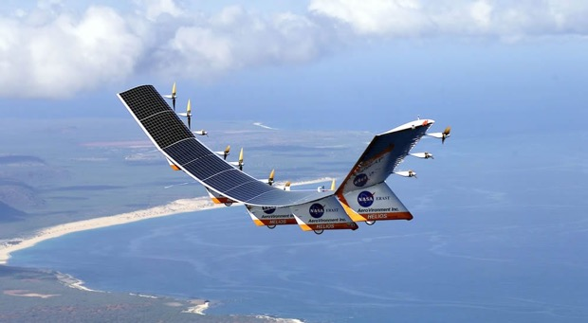
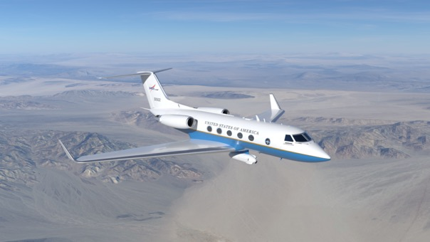
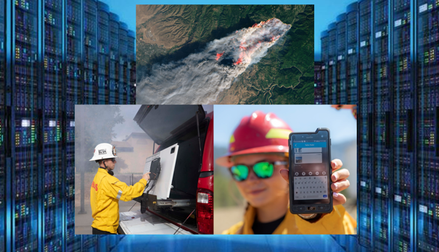
FireSense Implementation
Technology Development
Capability Demonstration
Capability & Information Delivery
Enhance existing instruments used for monitoring pre-fire, active-fire, and post-fire environments
Develop next-generation aerial platforms as well as instruments for small spacecraft and aerial platforms for wildland fire applications
Enable measurements from multiple vantage points through model-directed, coordinated observations
Address computational challenges for modeling and for data acquisition, fusion, and real-time processing
AI for creation new data products needed for wildfire management and for management of of observing platform constellations
Test existing and enhanced instruments used for monitoring pre-fire, active-fire, and post-fire environments
Evaluate existing and novel aerial platforms and next-generation instruments for wildland fire applications
Leverage airborne data to support research and application development in the for FireSense use cases
Demonstrate to key stakeholders the utility of existing and newly developed technology in the management of wildland fire across the pre-fire, active-fire, and post-fire environments
Work with stakeholders to develop wildland fire data systems and solutions that are flexible and aligned with desired capabilities
Ensure existing and new datasets (static and real-time) can be integrated into existing user-friendly web platforms (e.g., USFS WildfireSAFE, FIRMS, etc.)
Work with NASA ARMD and commercial and agency stakeholders to bridge the current communication gap in wildland fire management
Enable the seamless exchange of information between spaceborne, airborne, and in situ assets

Slide 9
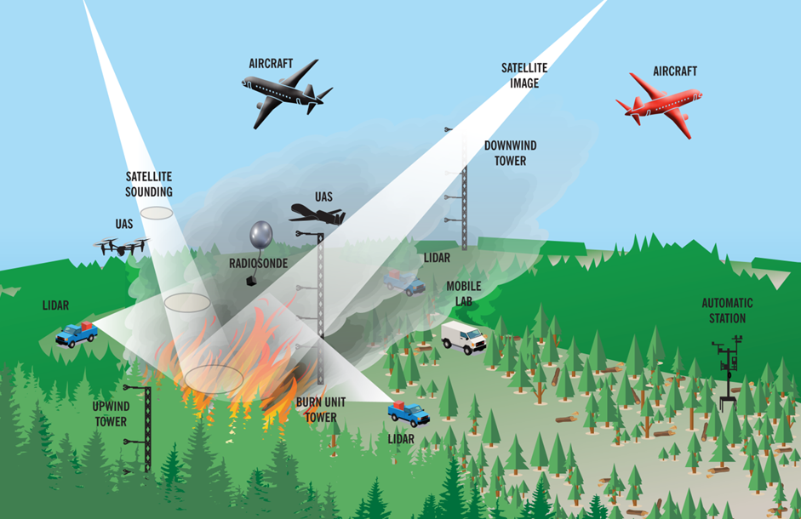
Demonstration Activities
Annual Field Campaigns (2023-28): Field campaigns will be conducted annually, with increasing sophistication in the sensors and platforms tested. Targeting areas across the US, not just western forests.
Capstone Field Campaign in Year 5 (2027-28): The Capstone Field Campaign will serve as a technology demonstration event for stakeholders to use/evaluate the tools, products, sensors, and capabilities developed during the first four years of FireSense.
The goal is that the success of the Capstone Field Campaign will enable the successful adoption/transition of
FireSense developed capabilities by our stakeholder/operational agencies.
Graphic from FASME

Slide 10
NASA’s Wildland Fire Initiative Multi-Disciplinary Collaboration in Wildfire
ARMD
Concept of Operations Development
Integrated Systems Architecture to ensure persistent communication and remote sensing
Airspace Management Technologies
UAS technology enabling communications, logistics, and 24-hour aerial suppression
Aircraft and operations safety technologies
SMD
Tools and technology to more effectively manage wildland fire across the entire fire life cycle (pre-, active, and post-fire)
Improved fire prevention via improved risk assessments
Better detection and tracking of fire
Improved predictions of post fire hazards
Improved monitoring and forecasting of air quality
STMD
Early-Stage Technology Development, Maturation, and Demonstration
SBIR / STTR
Prizes, Challenges, and Crowdsourcing
Transfer NASA Technology to spinoff products and service
Flight Opportunities for technology testing through the TechFlights solicitation, TechLeap prize, and OGA partnerships
Aerial Suppression, Safe Airspace Operations, and Logistics
Prediction, Detection and Tracking, Mitigation Support
Technology Advancement

Slide 11
FireSense Team
ESD FireSense Program (HQ)
Lead:
Michael Falkowski
Airborne Campaigns:
Melissa Martin and Barry Lefer, Research & Analysis
Modeling and Information Systems:
Michael Falkowski, Research & Analysis
Stakeholder Engagement and Capacity Building:
Michael Falkowski Applied Sciences
Technology Development and Demonstrations:
Haris Riris and Teresa Kauffman, Earth Science Technology
ESD FireSense Project
Project Manager (ARC): Matthew von Bargen
Project Scientist (ARC): Selection Announcement forthcoming
Systems Engineer (JPL): Justin Boland
FireSense Implementation Team:
FireSense Science and Applications team membership TBD (directed to NASA centers)
FireSense Partners
NASA Partner Organizations:
ARMD and STMD
External Partner Organizations:
EPA, NOAA, USFS, USGS, EDF, CalFire, Many Others

Slide 12
Thank You
Please contact Michael Falkowski for further information:
michael.falkowski@nasa.gov

Slide 13
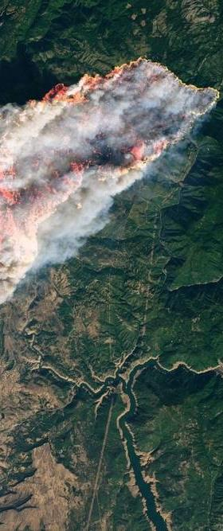
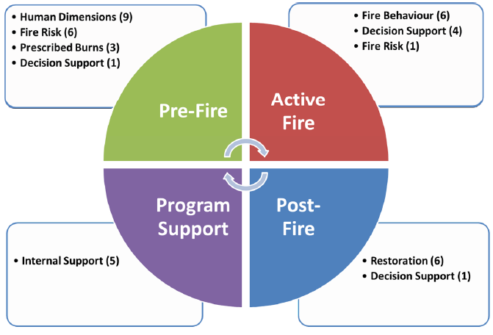
Rebirth of NASA ESD Wildland Fires: 2022-2023 Overview
40 projects selected & seeded across diverse wildland and prescribed fire community
Western, Central, Southern, Eastern U.S. + International

Slide 14
NASA ESD Wildland Fires Program
VISION
Advance community-centered applications to enhance and solve (prescribed and) wildland fire challenges.
MISSION
Cooperatively co-develop information and knowledge that improves wildland fire management through transitioning science, data, models, and technology.
VALUES
Transparency
Respect
Kindness
Integrity
Collegial
Discipline
Honest
Straightforward

