Slide 1
Digital Media Advertising
to promote Wood Stove Program
April 13, 2023

Slide 2
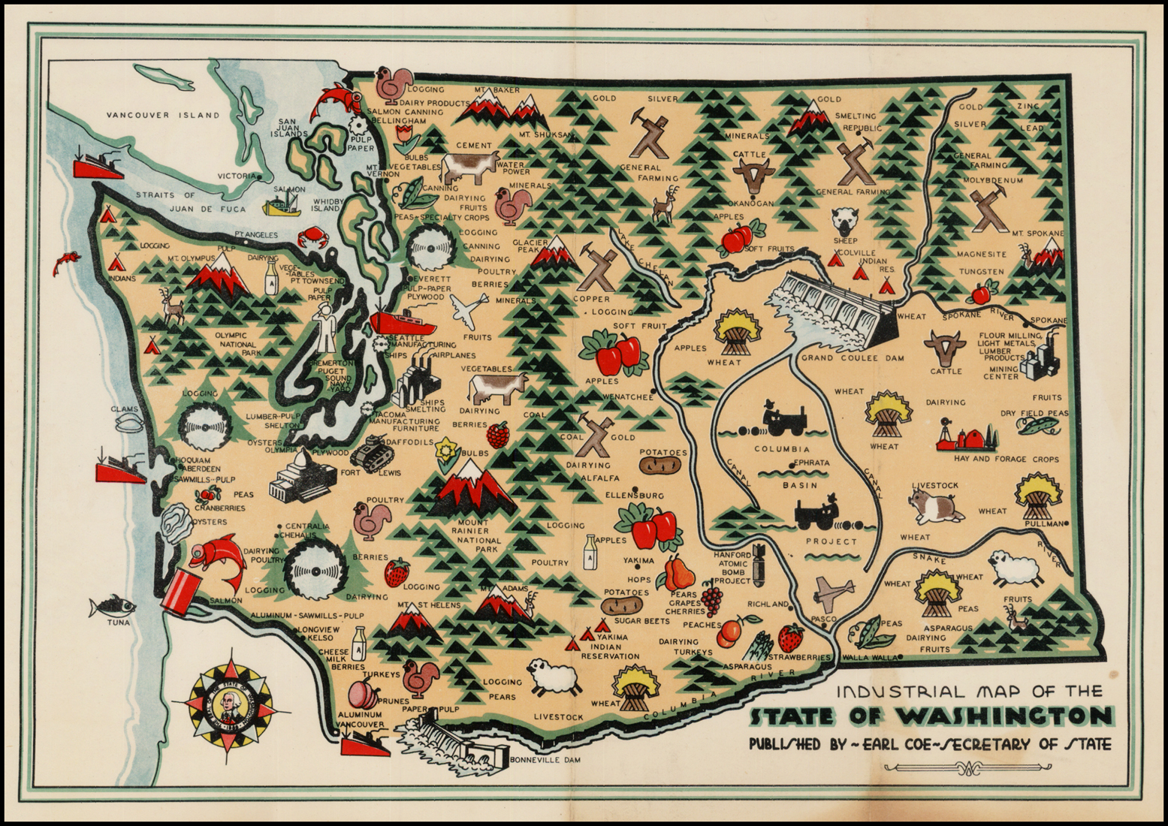
Image credit: Barry Lawrence Ruderman Antique Maps Inc.
https://www.raremaps.com/gallery/detail/32019/industrial-map-of-the-state-of-washington-coe
Notes:
-orient audience
-draw attention to saws/logging

Slide 3
Puget Sound Clean Air Agency
We preserve, protect, and enhance air quality and public health, enforce the Clean Air Act, support local policies that reduce climate change, and partner with communities to do this work equitably.
Notes:
The Agency is a special-purpose, regional government agency chartered by state law in 1967. Our jurisdiction covers King, Kitsap, Pierce, and Snohomish counties, home to over half the state’s population.
Compliance division and Clean Air division
Clean air division activities (monitoring, forecasting, clean air initiatives)

Slide 4
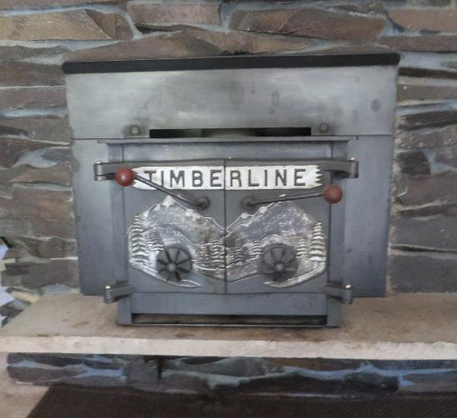
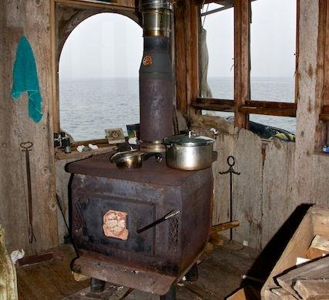
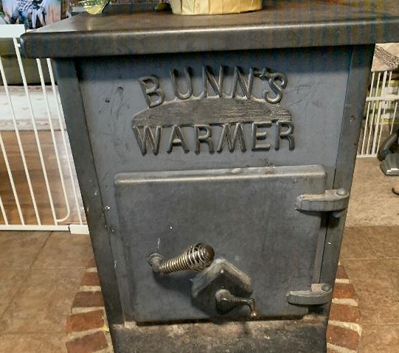
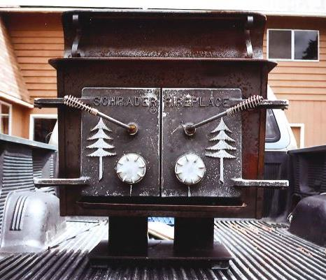
Wood Stove Program
16 years
6,250+ old stoves removed
~$9 MILLION in incentives
Current Program:
$350 recycling incentive
$1,500-$2,000 replacement discount

Slide 5
Wood Smoke Outreach Strategy
Optimize website, update messaging for other channels: social media, newsletter, email, etc.
Leverage existing relationships, strengthen collaboration with contractors, explore partnering with realtors, utilities and Hispanic CBOs
Promote consumer issue awareness, leverage research stats, share seasonal tips, expand to Spanish outlets
Hyper targeted digital and social media advertising, direct mailings
Paid
Earned
Owned
Shared
Program-specific outreach strategy:
Clean Burning
Burn Bans
Wood Stove Program

Slide 6
Wood Smoke Outreach Strategy
Optimize website, update messaging for other channels: social media, newsletter, email, etc.
Leverage existing relationships, strengthen collaboration with contractors, explore partnering with realtors, utilities and Hispanic CBOs
Promote consumer issue awareness, leverage research stats, share seasonal tips, expand to Spanish outlets
Hyper targeted digital and social media advertising, direct mailings
Paid
Earned
Owned
Shared
Program-specific outreach strategy:
Clean Burning
Burn Bans
Wood Stove Program

Slide 7
Media Approach & Tactics
Digital as exclusive paid tactic
Look for segmenting opportunity
Location, search terms, etc
Monitor campaign tracking
Concentrate media flights & align with other efforts
In tandem with ‘owned’, ‘shared’, and ‘earned’ tactics
Notes:
Given constrained budget, digital ads were recommended as exclusive PAID tactic

Slide 8
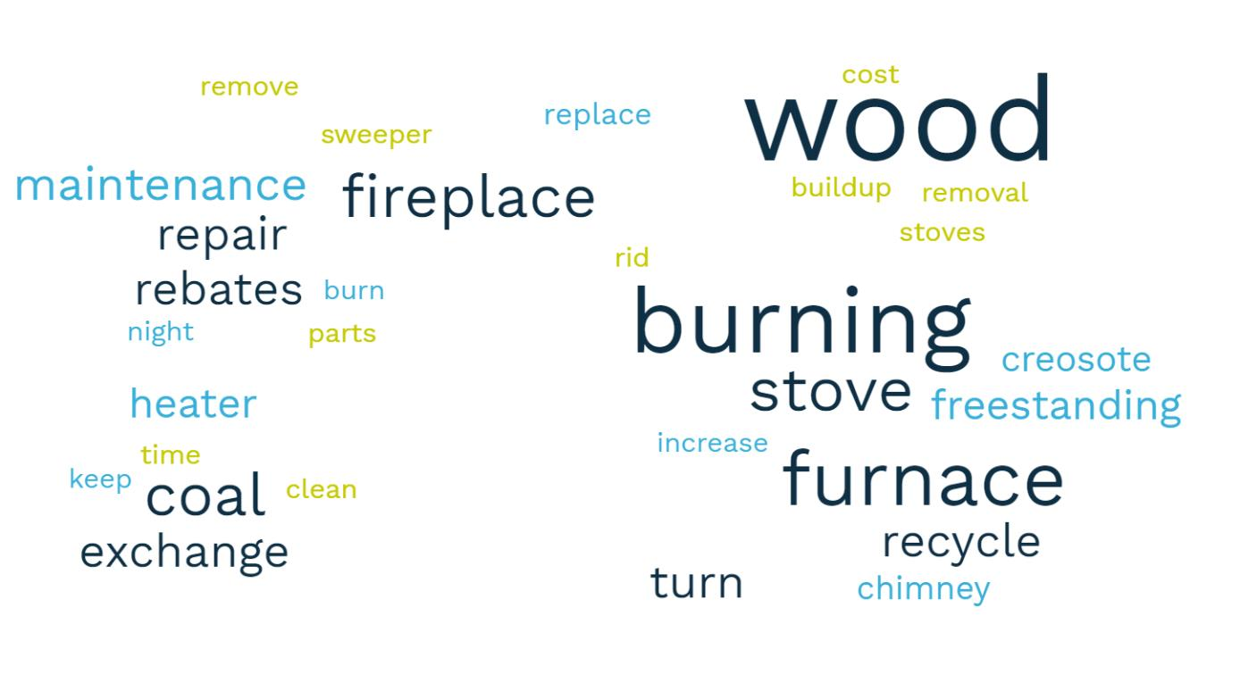
Digital Media Campaign Segmenting
Notes:
Segments:
New homeowners
Age: 24-49
Focus on Key area codes (AQ reasons)

Slide 9
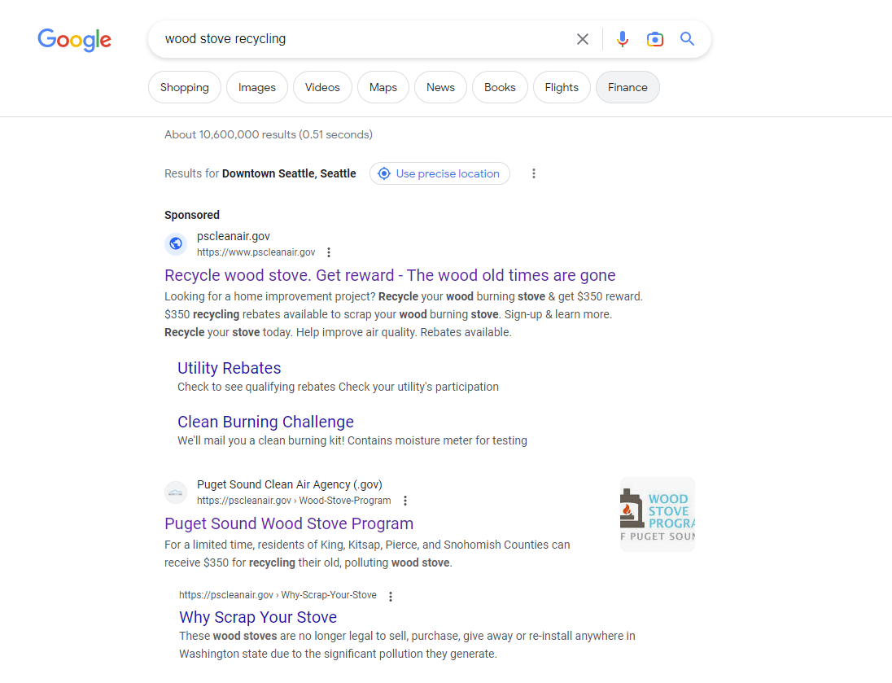
Paid Search Ads
Notes:
Google PPC targeting at a county-level to drive county-specific rebate language in responsive text ads.
Keywords included terms people use while shopping for, maintaining, or replacing a wood stove.

Slide 10
Digital Display Ads
Notes:
Leveraged an ad platform to serve display ads to a targeted audience programmatically, meaning the person is targeted, not the content served.
Targeted homeowners in the counties served based on their interests, location, and estimated age of house.
Both ads were run as an A|B test to see which message worked better.

Slide 11
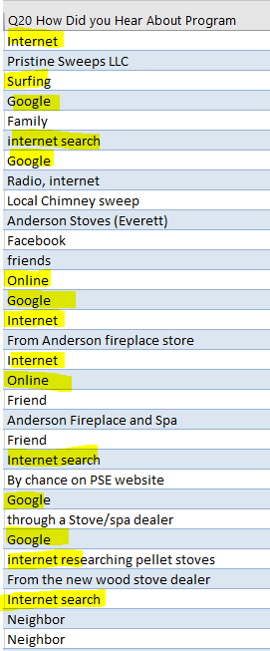
Campaign Results (so far)
Metric | Campaign 1st Half | Campaign 2nd Half
Impressions | 1,474,714 | 3,587,327
Clicks | 11,430 | 26,178
Click Rate | 0.7% | 0.7%
Click Cost | $0.58 | $0.28
Average of 84 program enrollments per month
Notes:
While campaign was in flight regular optimizations were performed to ensure maximum conversion rate with lowest possible click cost.
Traffic increased in the 2nd half of the campaign by 130% while click costs were reduced by 51%.
Due to tracking limits campaigns were optimized for engagement and volume than conversion or conversion rate.

Slide 12
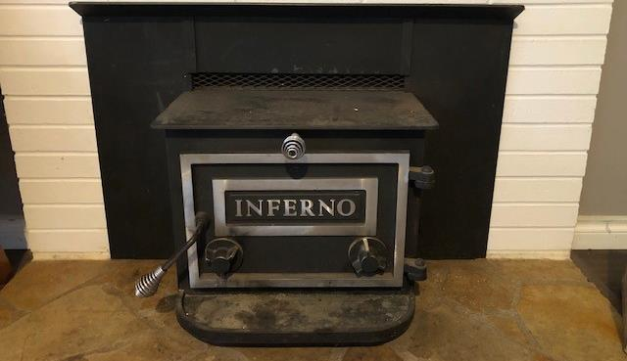
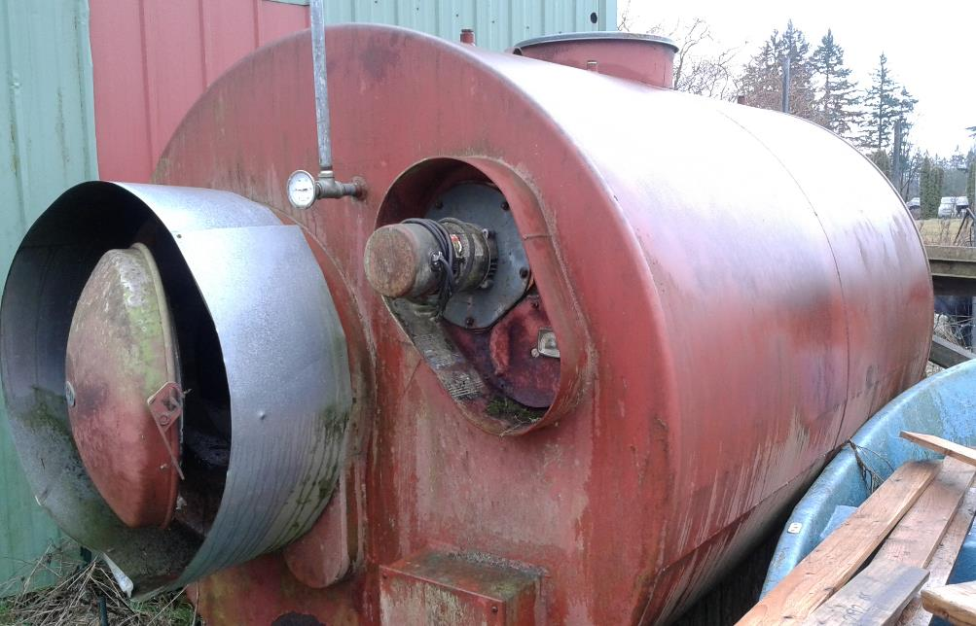
Successes & Challenges
Successes
Consistent program engagement
Increase program follow through
Challenges
Large analytics gaps
Social media

Slide 13
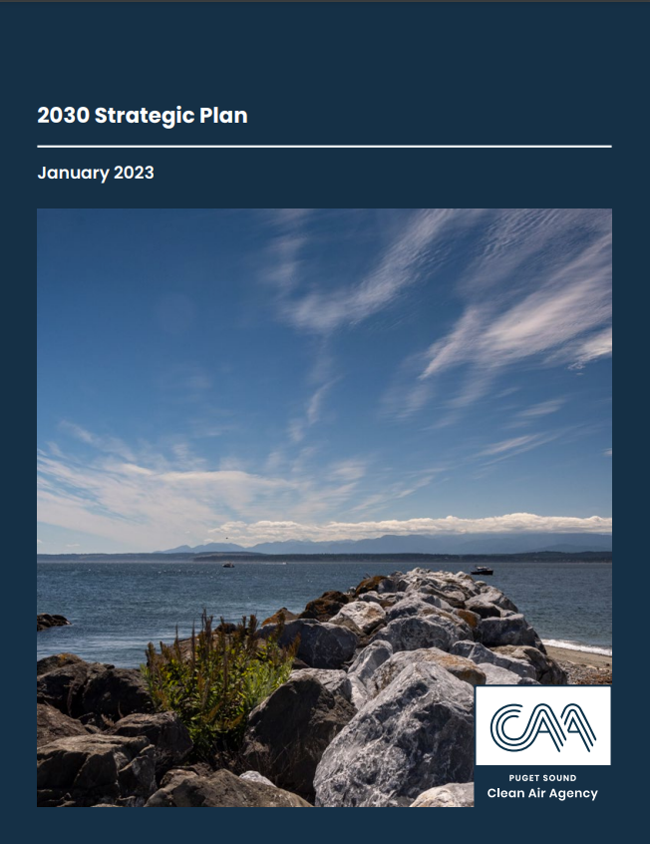
Next steps
Final reporting and analysis based on follow through
Propose continue funding in next grant cycle
Improve tracking & analytics abilities
Social media?
New Strategic Plan & IRA incentive opportunities

Slide 14
Thank you!
Questions?

