Slide 1
Oakridge Air, a multi-faceted approach to improving wintertime air quality. National Residential Wood Smoke Training Workshop Thursday, April 13, 2023
Travis Knudsen Public Affairs Manager

Slide 2
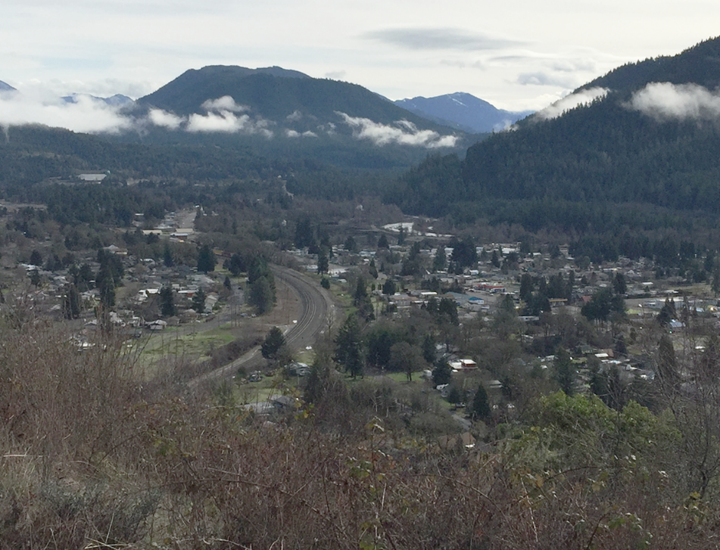
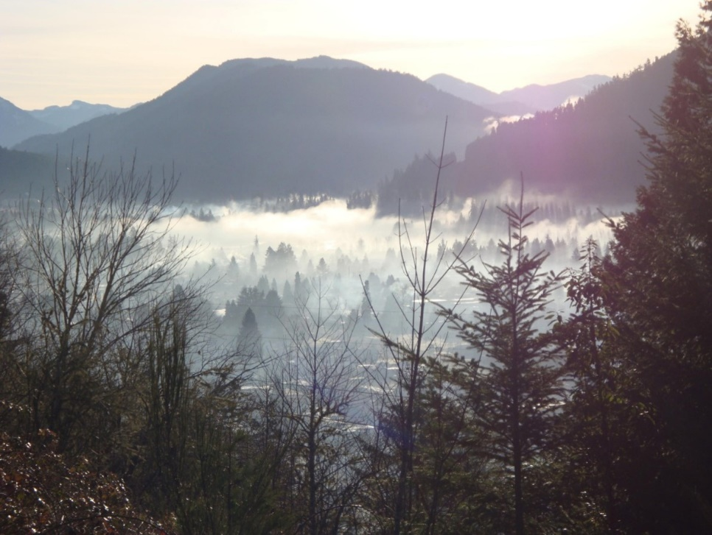
The Oakridge-Westfir Airshed
Oakridge
without
AM inversion
Oakridge
with
AM inversion
Oakridge, in Lane County, Oregon, is prone to temperature inversions due to its topography. With no natural gas access and unreliable electricity during winter storms, the community has historically relied on wood heat, leading to increased smoke pollution from uncertified stoves and improper burning. Consequently, the Oakridge-Westfir airshed has struggled to meet National Ambient Air Quality Standards for PM2.5 and PM10 pollution.

Slide 3
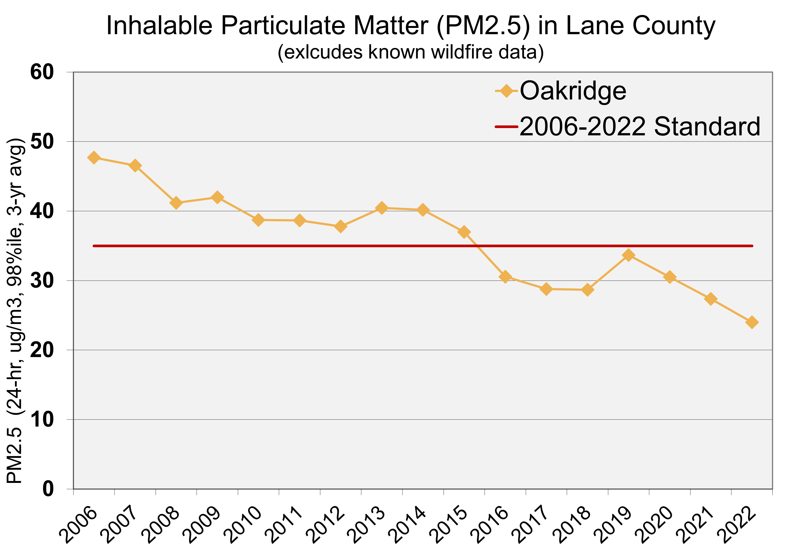
The Oakridge-Westfir Airshed
Oakridge-Westfir Airshed
2006
U.S. EPA adopts more protective PM_{2.5} standard.
2009
Airshed designated “nonattainment” for PM_{2.5} during worst winter days.
2016
Oakridge-Westfir airshed achieves PM_{2.5} standard for 2014-2016.
2018
U.S. EPA recognized compliance with PM_{2.5} standard, approves attainment plan.
2021
LRAPA adopts redesignation request, maintenance plans, and rule amendments.
2022
Submittal to EPA, publication in the Federal Register, and effective September 21, 2022.

Slide 4
Oakridge’s Road to Attainment
Warm Homes Clean Air wood stove change-out program
Oakridge NAAQS Attainment Workgroup
Community Firewood Program Launched
Oregon Solutions workgroup assesses funding strategies
Woodsmoke Mitigation Coordination funded by ODEQ
1st Targeted Airshed Grant (TAG 1.0) $4.9 million
Community Response Plan for Smoke “Smoke Safety Plan”
2nd Targeted Airshed Grant (TAG 2.0) $2.7 million

Slide 5
The Oakridge Air Partners

Slide 6
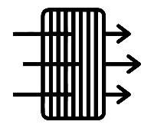
Oakridge Air’s Programs
Home Heating Upgrades
Community Firewood Program
Community and School Education
Air Filters in Homes and Schools
Code Enforcement
Auxiliary PM Reduction Efforts

Slide 7
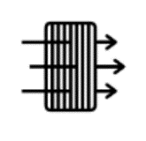
Program Timeline – TAG 1.0
Program Development
Pilot Program
Full Program Implementation (~40 Homes Per Year)
Program Upgrades
Sourcing, Hauling and Seasonal Delivery
Curriculum Development
Coordination and Delivery
Program Creation
Need Based Distribution
Yearly Filter Replacement & Program Monitoring
Coordination
Monitor & Assist in Diversion Program Implementation
2020
2021
2022
2023
2024
We Are Here

Slide 8
Program Timeline – TAG 2.0
Program Development
Pilot Program
Full Program Implementation (~40 Homes Per Year)
Program Upgrades
Sourcing, Hauling and Seasonal Delivery
Curriculum Development
Coordination and Delivery
Program Creation
Need Based Distribution
Yearly Filter Replacement & Program Monitoring
Public Building Filter Replacement & Program Monitoring
Coordination
Monitor & Assist in Diversion Program Implementation
Community Education and Outreach Coordinator
Yard Waste Program, Woodsheds, Chimney Sweep Vouchers, Moisture Meters & Woodstove Thermometers
University Research on Indoor Air Quality and Communications
2020
2021
2022
2023
2024
2025
2026
2027
We Are Here

Slide 9
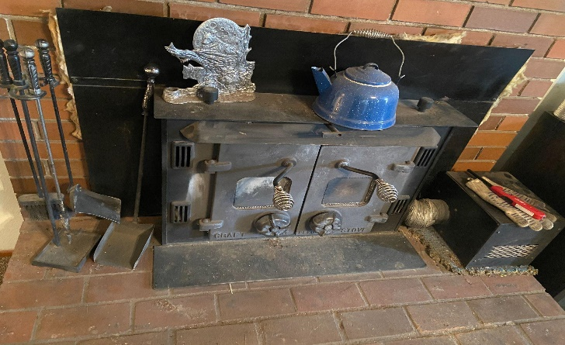
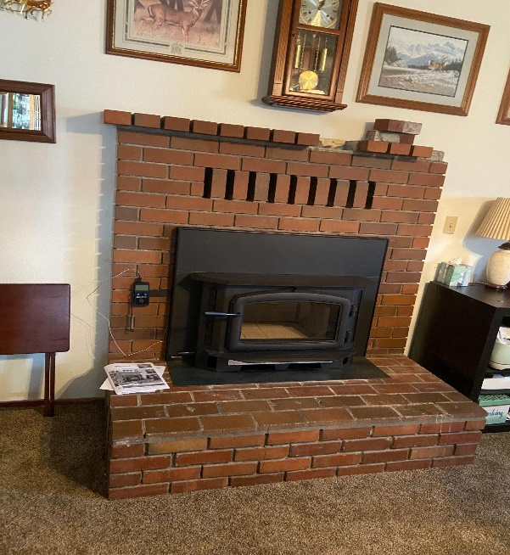
Home Heating Upgrades
Provide homes with (1) certified woodstoves, (2) ductless or ducted heat pumps, (3) and weatherization or small home repairs.
Qualification Questionnaire: 371 homes
Home currently enrolled: 62
Initial Home Energy Audits: 54
Wood Stoves installed: 25
Ductless heat pumps Installed: 29
Homes weatherized: 31
Completed Homes: 21
- As of April 6, 2023.

Slide 10
Home Heating Upgrades
1
Fill out the qualification questionnaire
2
Complete a home energy pre-audit
Complete ~40
per year.
New cohort of ~10 homes each quarter.
Obtain bids from pre-approved vendors
Approx. 1 year to complete
3
4
Install the needed home Interventions
5
Complete a final home audit

Slide 11
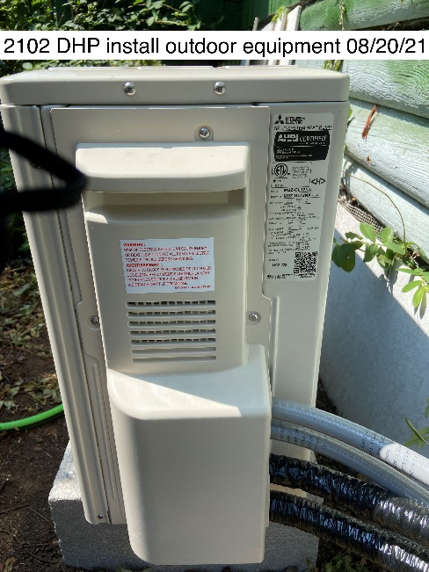
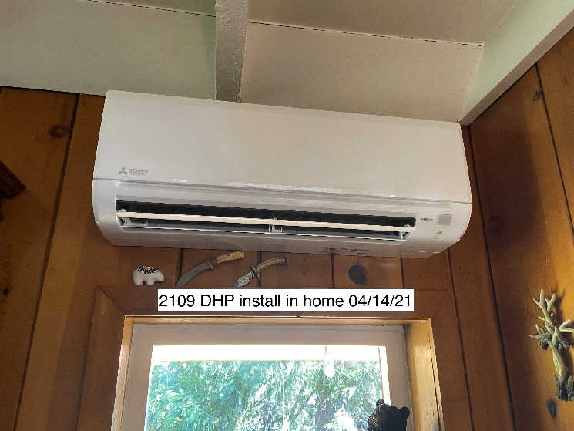
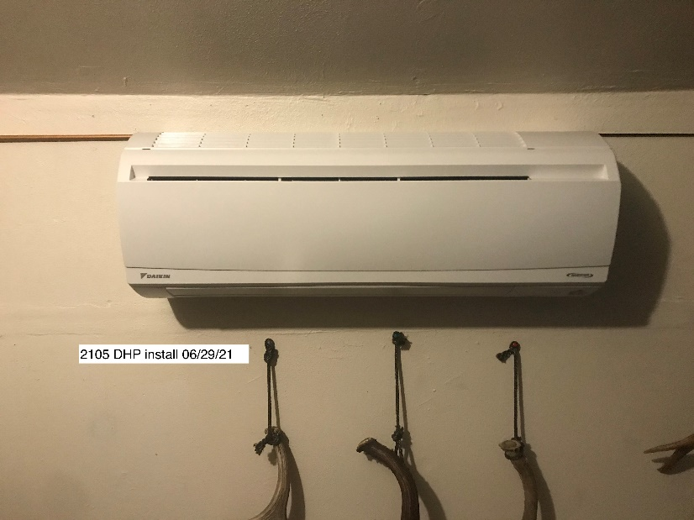
Home Heating Upgrades
“We like it because it's quiet and it helps heat what the woodstove won't, and we also like that it cools. We're real pleased with it. They were on time, good communication, and easy to get along with.”

Slide 12
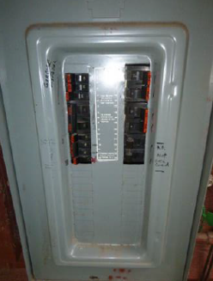
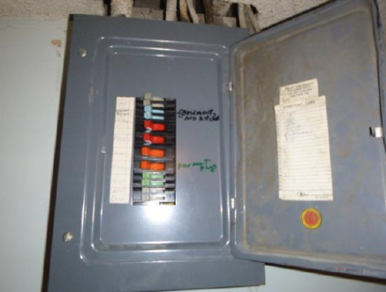
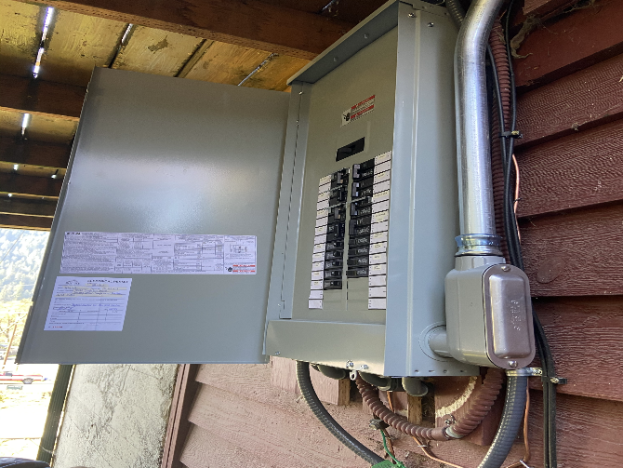
Home Heating Upgrades
Weatherization supports electrical upgrades for DHPs.
Old
New
Many older homes require electrical upgrades to support a ductless heat pump. Weatherization dollars are often needed for this upgrade.

Slide 13
Home Heating Upgrades
Up to $20,000 is available per home.
EPA Certified Wood Stove
Weatherization funds may be used to cover cost overages
$6,500 cap
Review woodstove contractor list and select stove.
EPA Certified Wood Stove
Electric Heat
Installation of ductless heat pump or other electric heating system.
$4,750 cap
Review HVAC contractor list and select bid.
Electric Heat
Weatherization
Weatherization funds may not completely address all needs.
$8,500 cap
Review weatherization contractor list and select bid.
Weatherization
Intervention Type
Funding Limit
Homeowner Involvement

Slide 14
Home Heating Upgrades
Asbestos abatement costs need to be considered!
Additional funds also needed for home auditing
Asbestos Abatement
$6,900 cap
Review abatement contractor list and select bid.
EPA Certified Wood Stove
$6,500 cap
Review woodstove contractor list and select stove.
Electric Heat
$4,750 cap
Review HVAC contractor list and select bid.
Weatherization
$8,500 cap
Review weatherization contractor list and select bid.
Intervention Type
Funding Limit
Homeowner Involvement

Slide 15
Home Heating Upgrades
Challenges in implementing home heating upgrades.
The pandemic
Increasing costs
Supply chain delays
Limited contractor interest
Delayed program outreach
Limits the number of interventions
Increase time homes remain in program
Difficulty hiring contractors to perform work
Virtual coordination
Prioritize greatest need homes
Transparent timeline expectations
Increase contractor incentives
Issue
Impact on Program
Mitigating Step

Slide 16
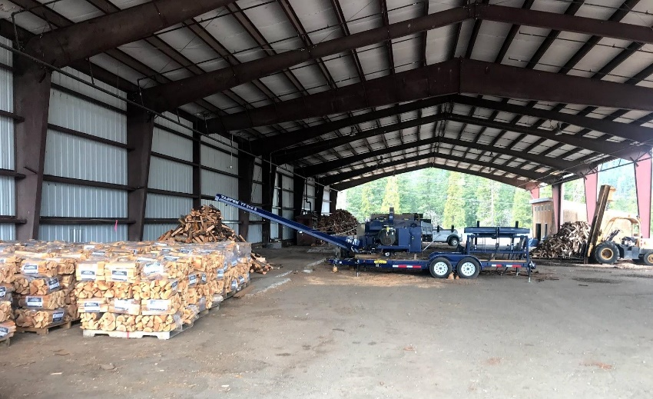
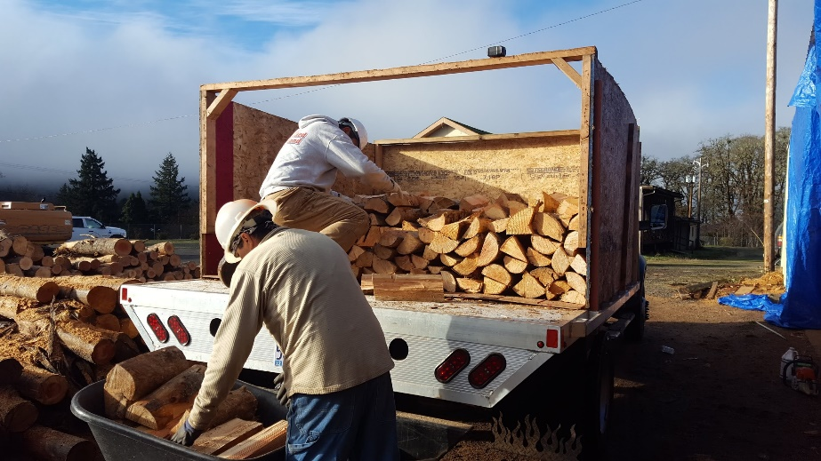
Community Firewood Program
Provide community dry seasoned wood to older adults, low-income, and disabled.
Provides dry firewood, under 20% moisture content.
At least 80% of sales are to low income, older adults, and disabled residents.
This effort has proven challenging to make self sustainable due to the cost of transporting sourced wood.

Slide 17
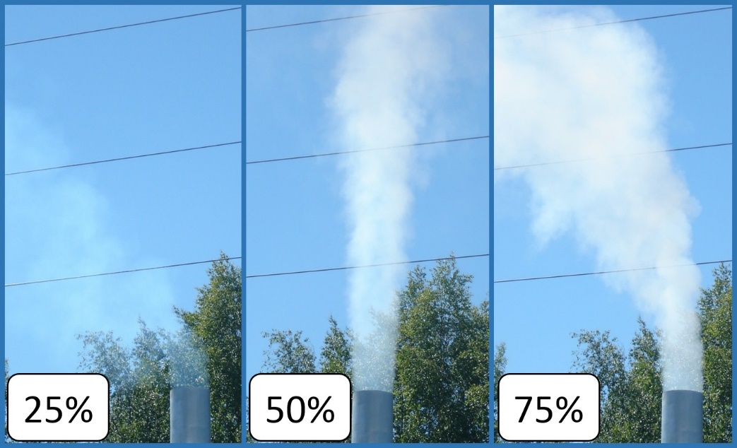
Code Enforcement
Provide funding to the City of Oakridge to enforce the city’s smoke opacity ordinance and expand the city’s education focused diversion program.
This grant funding source provides the Oakridge Police Department with $71,000 a year through 2027.
OPD can provide a prompter response to smoke complains from wood stoves and outdoor burning.

Slide 18
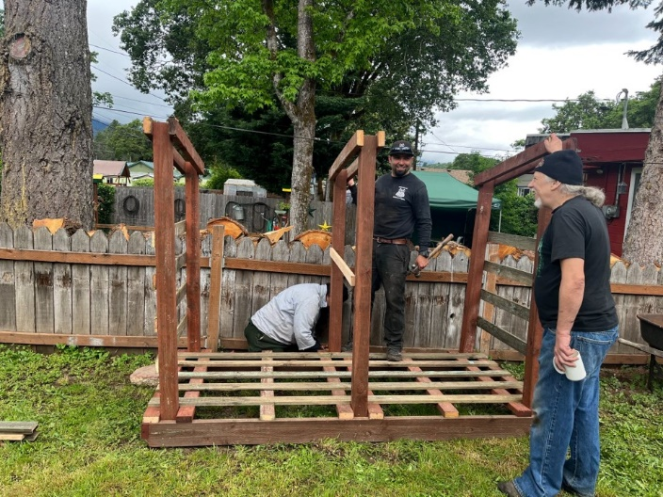
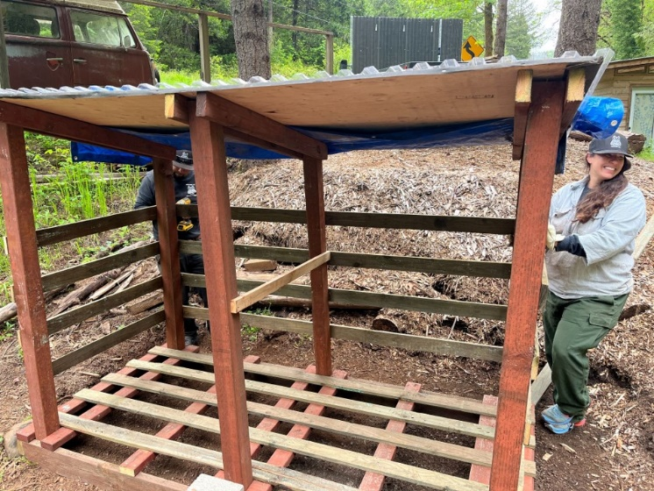
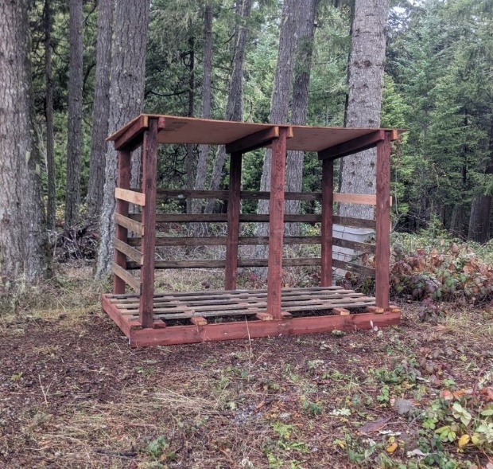
Community and School Education
Craft and share air quality school curriculum.
Collaborating with Oakridge School District to integrate air quality and smoke education in classrooms and partnering with the Oakridge Library for a check-out program.
Woodsheds made by students at the Junior Senior High School and Inbound LLC.
46 woodsheds delivered throughout the community!
The pandemic and lack of continuity among teaching staff
have made sharing curriculum challenging.

Slide 19
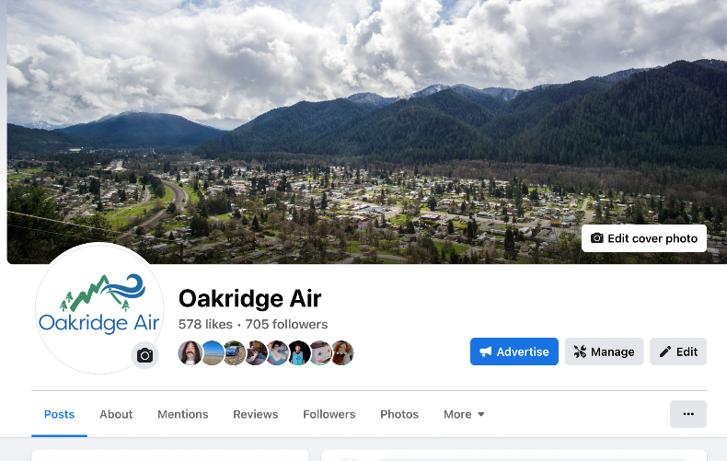
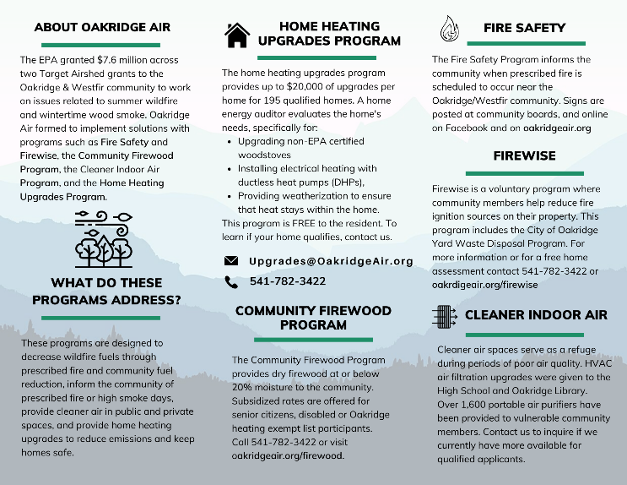
Community and School Education
Communicate the health impacts of degraded air quality and educate on air quality solutions.
Social Media
Print Fliers
Digital Newsletter
As well as community engagement events, and readerboards!

Slide 20
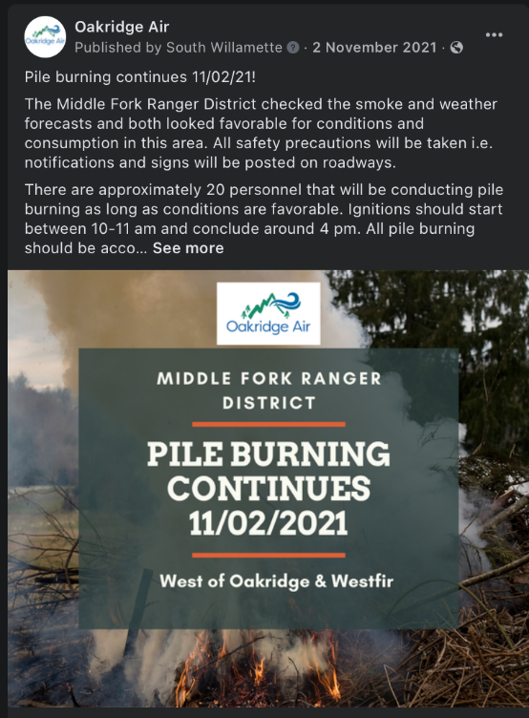
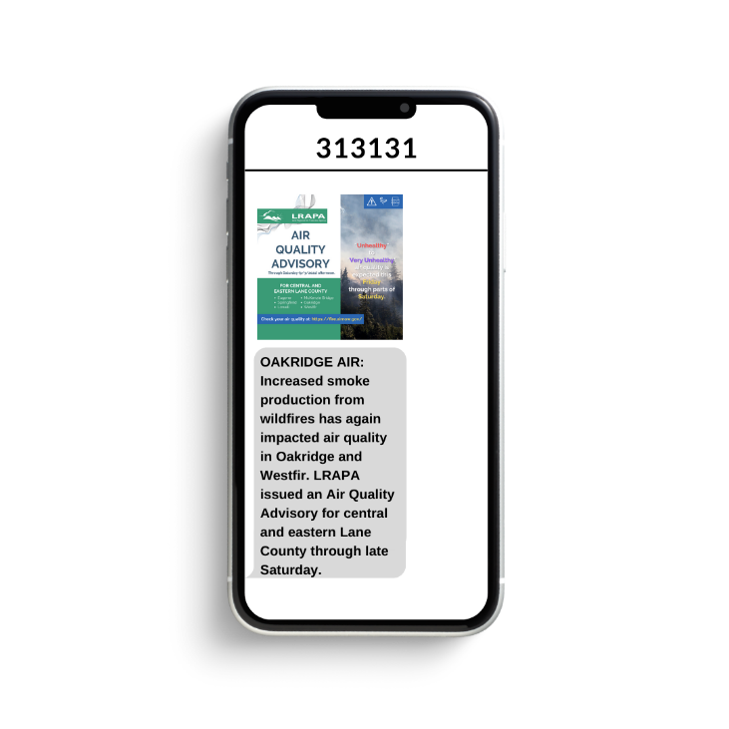
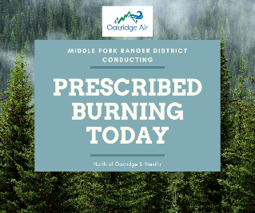
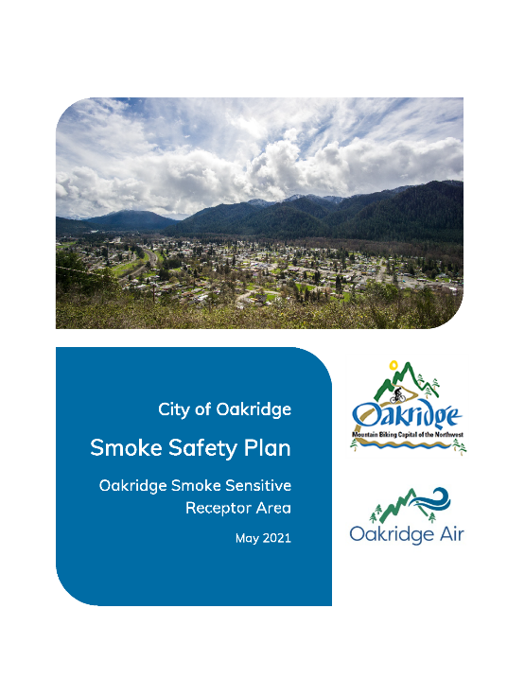
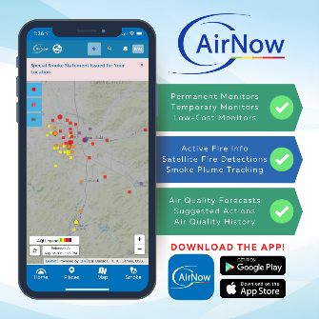
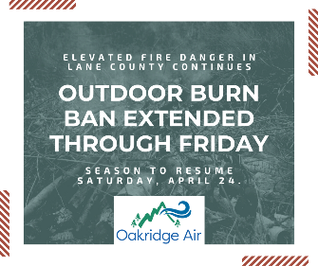
Community and School Education
Facilitate the community's Smoke Safety Plan, which includes text message notifications.
Smoke Safety Plan coordination.

Slide 21
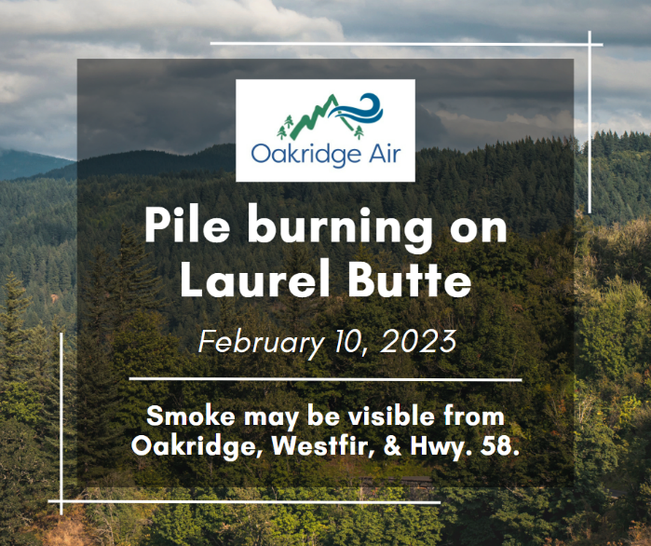
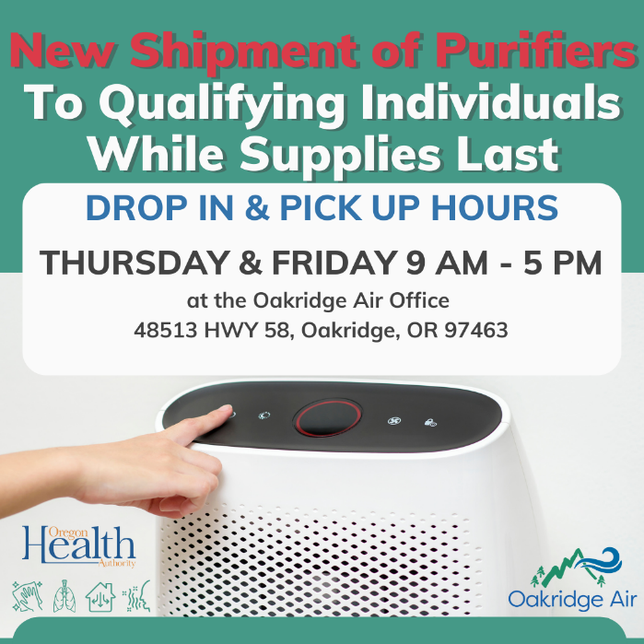
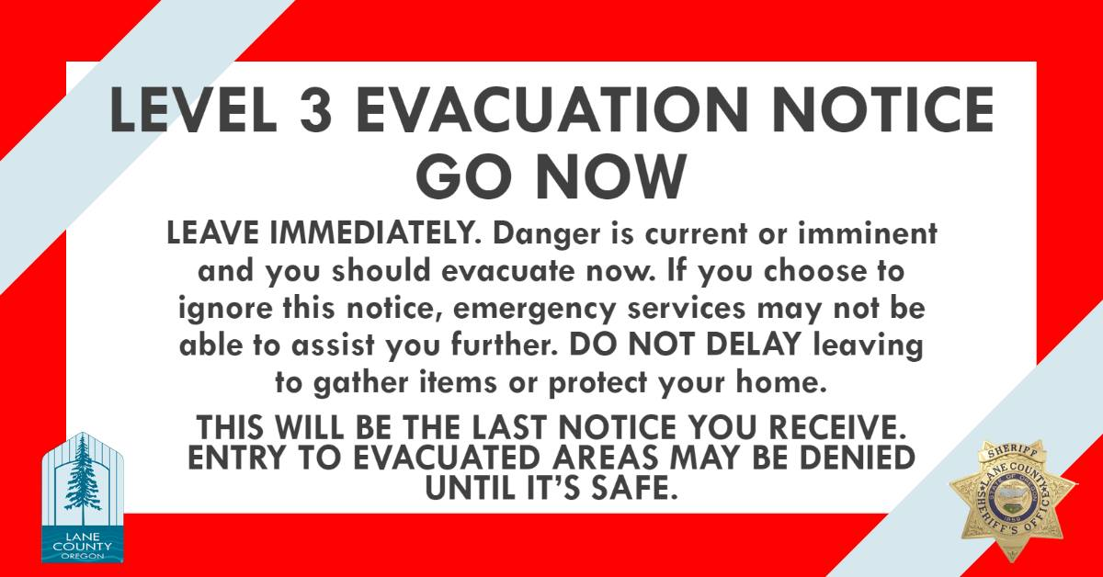
Community and School Education

Slide 22
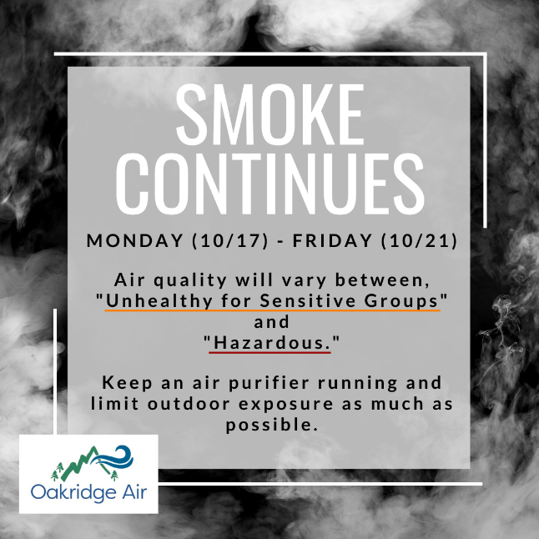
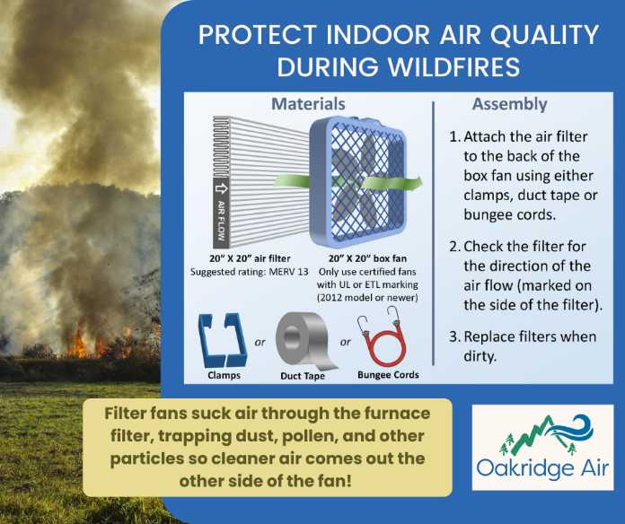
Community and School Education
Good and consistent messaging
to the community
from the community
builds brand
recognition and trust
within the community.

Slide 23
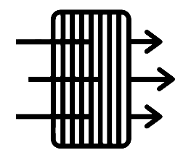
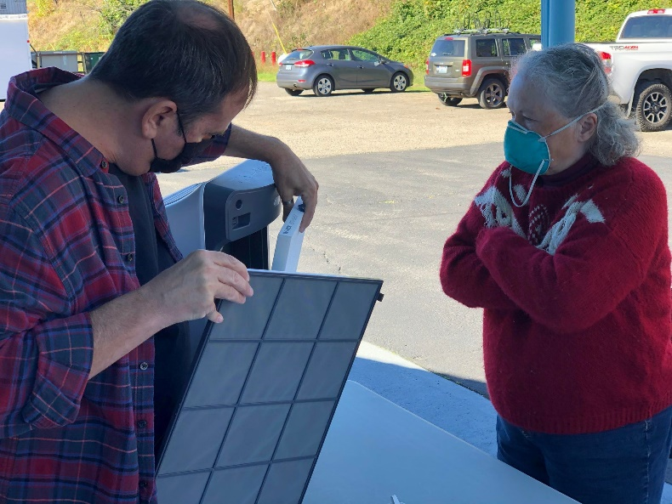
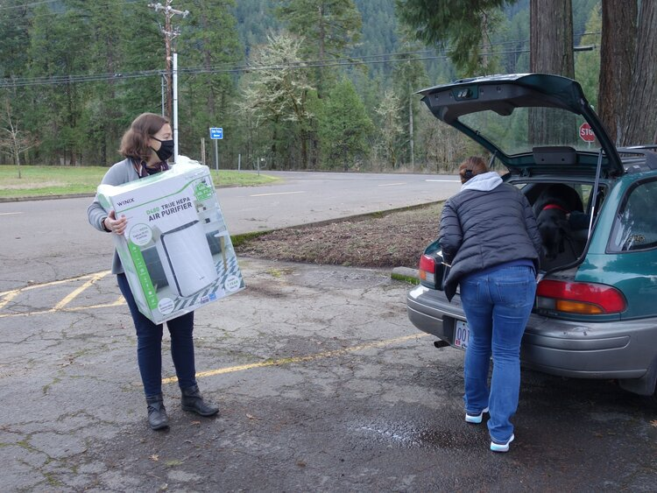
Air Filters in Homes and Schools
Provide HEPA air purifiers to the community and fund HVAC retrofits and air filter installs at Oakridge High School, Elementary School, and Oakridge Library.
Over 450 air purifiers distributed throughout Oakridge and Westfir. The program is no longer offering air purifiers, but it is providing annual replacement filters with remaining funds.

Slide 24
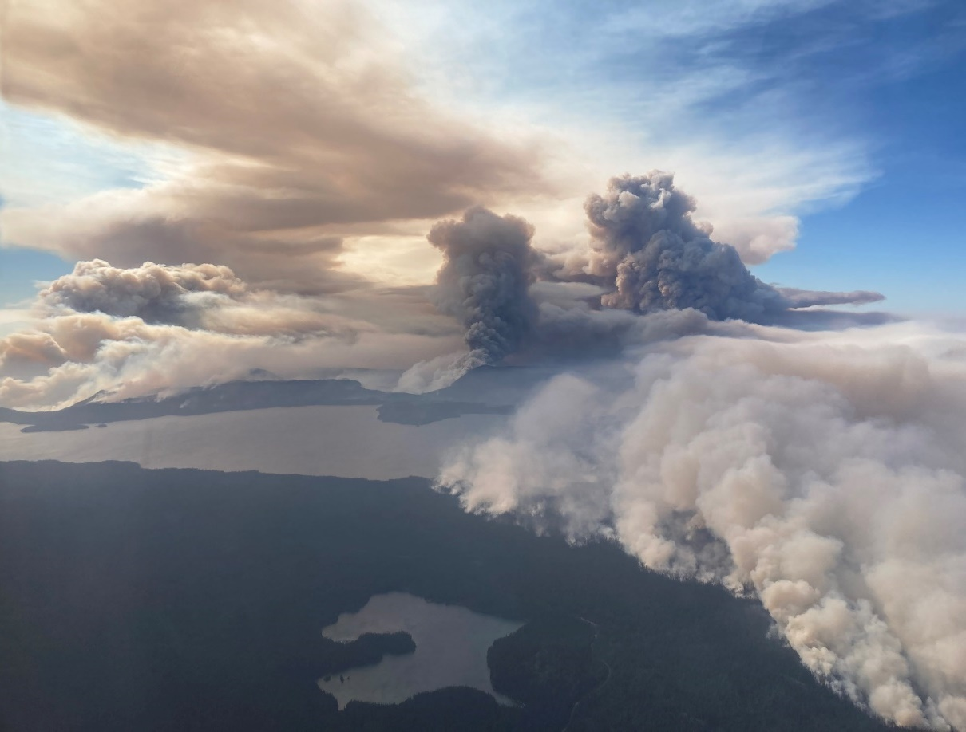
Oakridge Air and Wildfire Smoke
The Cedar Creek Fire
Was ignited on August 1, 2022, by lightning.
Began 15 miles east of Oakridge.
Caused a LEVEL 3 (GO NOW) evacuation order to be issued for Oakridge on September 9, 2022.
Burned 127,283 acres in the Willamette and Deschutes National Forests.
Photo taken by Air Tactic Group Supervisor Justin Wood on Friday, September 9, 2022. This picture is looking west southwest over Waldo Lake in the afternoon.

Slide 25
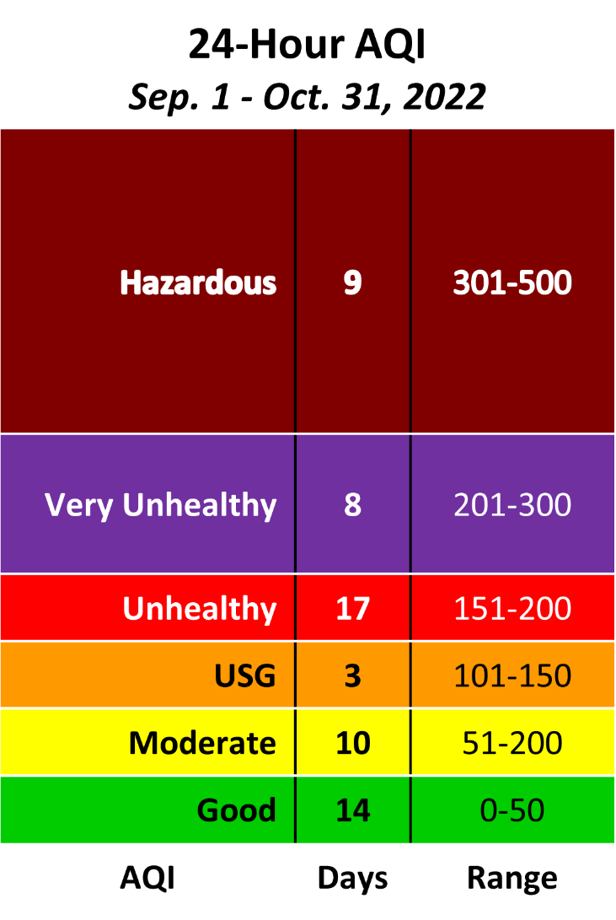
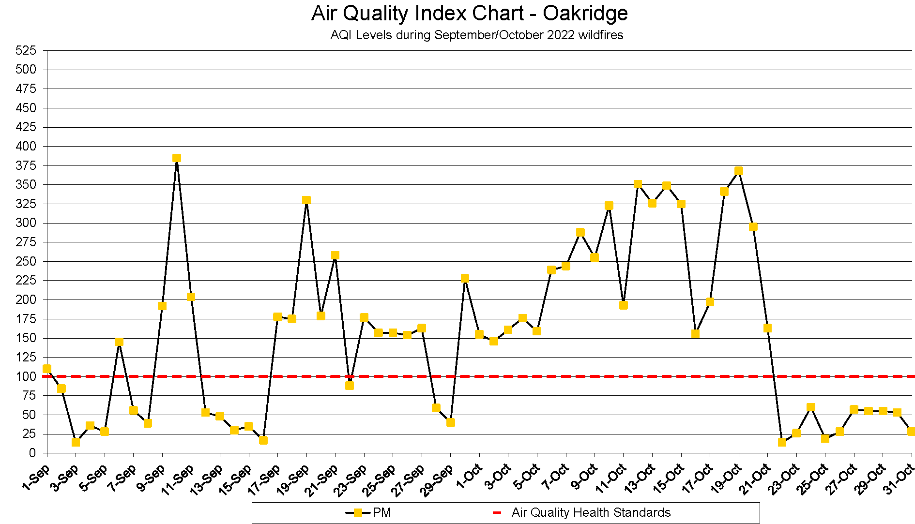
Oakridge Air and Wildfire Smoke

Slide 26
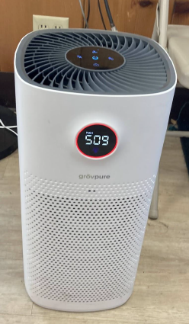
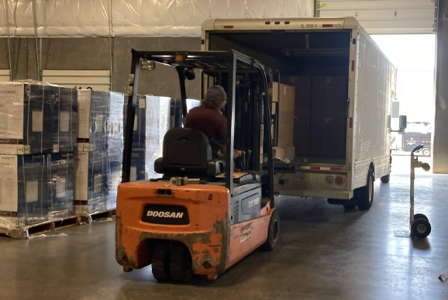
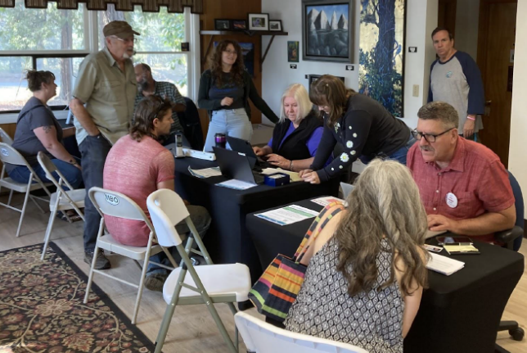
Community Emergency Response
Photos of Oakridge Air’s
air filter distribution work.
Oakridge Air distributed 1,113 air purifiers (provided by Oregon Senate Bill 762) to Medicare or Medicaid patients with a qualifying health concern.
The response came at a substantial cost to South Willamette Solutions, the non-profit implementing the Oakridge Air program. Over 500 hours of staff time had to be reallocated for this important work.
This successful model is only possible with significant support and funding of local partners in Smoke Sensitive Receptor Area communities.

Slide 27
Community Emergency Response
This work and effort built significant awareness, interest, goodwill, and participation from Oakridge residents in our many programmatic efforts.
Frequent and extended wildfire smoke intrusions have shifted the community's perception of smoke, leading to an increased desire to minimize all smoke exposure.
Promoting health information and offering community resources during wildfire smoke intrusions supports the EPA's mission to safeguard human health and the environment by reducing exposure to harmful PM_{2.5} pollution.
Oakridge Air partners are pursuing funding to expand this important and needed wildfire related work.

Slide 28
Thank you!
Travis Knudsen Public Affairs Manager Travis@LRAPA.org 541-736-1056 x217 1010 Main St. Springfield, OR 97477

