Slide 1
Why should you be interested in PM Advance? Program?
Mia South
Office of Air Quality Planning and Standards, US EPA

Slide 2
Overview
What is the Advance program?
What areas are currently participating in PM Advance?
Why are areas are joining the program?
What programs or projects are areas using to keep in attainment?
What are the program requirements and improvements?
Will being in the program protect my area from designations?
Questions

Slide 3
What is the Advance Program?
A voluntary, collaborative initiative between EPA, state and local governments, and tribes​
Areas designated as attainment for the Ozone and/or PM2.5 NAAQS develop plans and take actions in their communities to proactively reduce emissions, improve air quality, and remain in attainment
Program offers opportunities for addressing climate, toxics, and environmental justice concerns consistent with Administration priorities.
Currently there are 51 areas participating from state, local and tribal government
Notes:
One unique thing about the program is that about two-thirds of Advance partners are local entities (i.e. city government, county govt, council of government, regional planning commissions, etc.) that typically do not have a direct relationship with EPA on air quality issues
Number of partners has grown by about 20% since Jan 2020

Slide 4
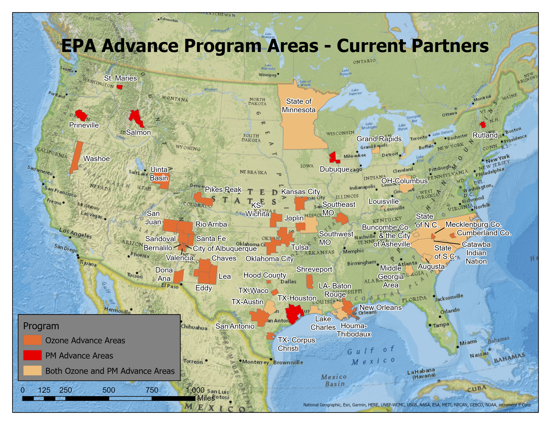
51 Areas
(28 Ozone, 8 PM2.5, 15 Both)
Greater than 54 million population

Slide 5
Why Areas Join the Advance Program
Cost of remaining in attainment is less than cost of meeting nonattainment/maintenance area requirements
Learn best practices from other Advance areas through collaboration, and with EPA database of partner program and projects
Participation with EPA provides credibility and demonstrates the area’s clean air commitment
Access to EPA expertise and technical assistance opportunities
Promotes positive actions by industry, government, public stakeholders
Commitment to update Advance annual plan serves as a driver for action and stakeholder input
Provides forum for community and stakeholder collaboration on clean air and related issues
Multi- pollutant emphasis

Slide 6
Program Requirements
Within one year, submit the initial “Path Forward” plan for the area, in consultation with EPA.
3
Provide an annual Advance plan revision.
4
Identify your lead governmental organization(s).
1
Conduct stakeholder meetings and identify priority emission reductions.
2

Slide 7
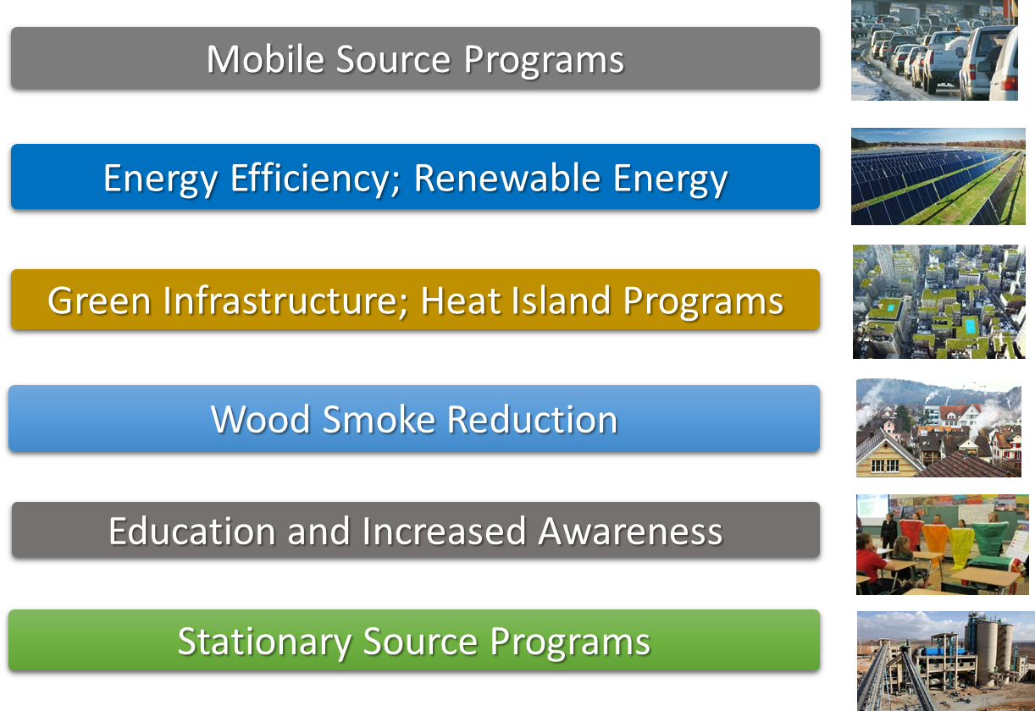
Programs and initiatives in Advance plans
All plans submitted to EPA on SharePoint

Slide 8
Recent Improvements
Advance Program Tool that shows emissions, design values and air quality changes
Advance Database that details programs and projects, metrics, EJ considerations, Climate consideration and pollutant reductions
Monthly webinars and collaboration with other Advance areas
Streamlined reporting process
Expanded community and stakeholder collaboration on clean air and related issues
Website Redesign

Slide 9
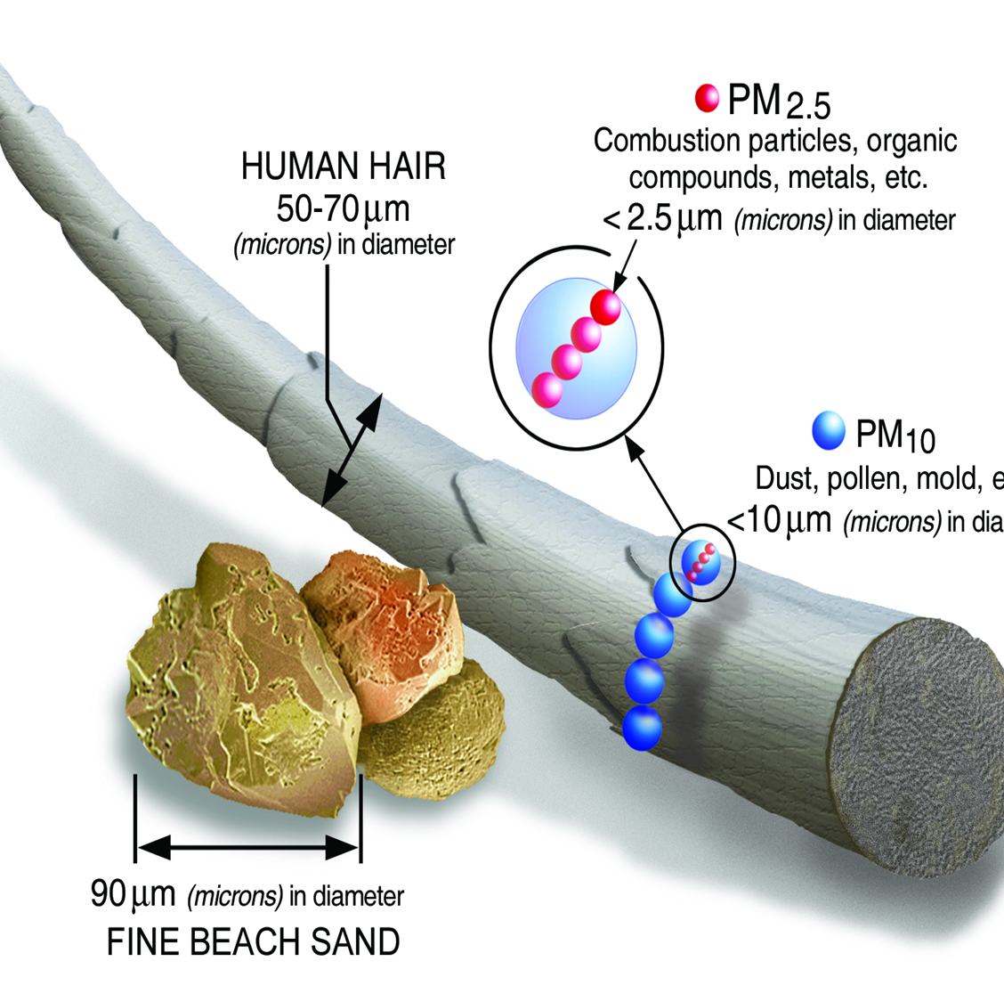
Why is PM a concern?
Very significant health effects caused by or likely caused by exposure to PM2.5, esp. compared to O3
Lack of clear harm thresholds for exposure to PM2.5
Disproportionate exposure by race/ethnicity and socioeconomic status

Slide 10
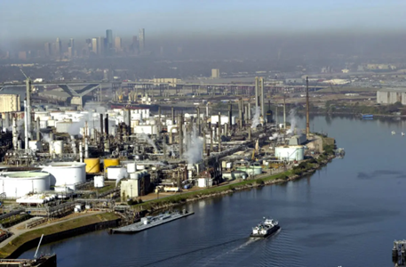
Will PM Advance Protect My Area from a Nonattainment Designation?
Signing up for PM Advance will NOT guarantee that your area will avoid future designations.
Taking robust, expeditious actions could help some areas clean up their air quality enough to affect designations.
Areas that are eventually designated can also benefit from early actions taken to reduce PM.

Slide 11
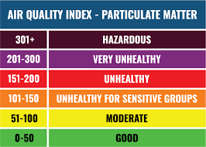
Questions to consider about evaluating PM for your area
What can the Advance Program Tool tell us about PM 2.5 in our area?
The tool displays Tier 1 emissions, emissions trends, point source emissions, wood smoke emissions, and design values.
What can models tell about PM 2.5 in my area?
What can your community do now to better control PM?

Slide 12
Questions?
Mia South
south.mia@epa.gov
919-541-5550
www.epa.gov/advance

