Slide 1

Contribution of Wintertime Wood Smoke to Nonattainment Areas in California under the Proposed NAAQS
Kasia Turkiewicz
National Residential Wood Smoke Workshop,
Denver, April 11-13, 2023

Slide 2
Presentation Overview
PM2.5 Monitoring Requirements
Portola PM2.5 Case Study
Impact of Proposed PM2.5 NAAQS in California
Home Heating

Slide 3
PM2.5 Monitoring Requirements
Number of required monitors depends on population and PM2.5 levels
PM2.5 monitors are not required in low-population areas
Many communities with wood smoke problem may not have regulatory PM2.5 monitors
MSA Population | Design Value >=85% NAAQS | Design Value <85% NAAQS
> 1,000,000 | 3 | 2
500,000 - 1,000,000 | 2 | 1
50,000 - < 500,000 | 1 | 0

Slide 4
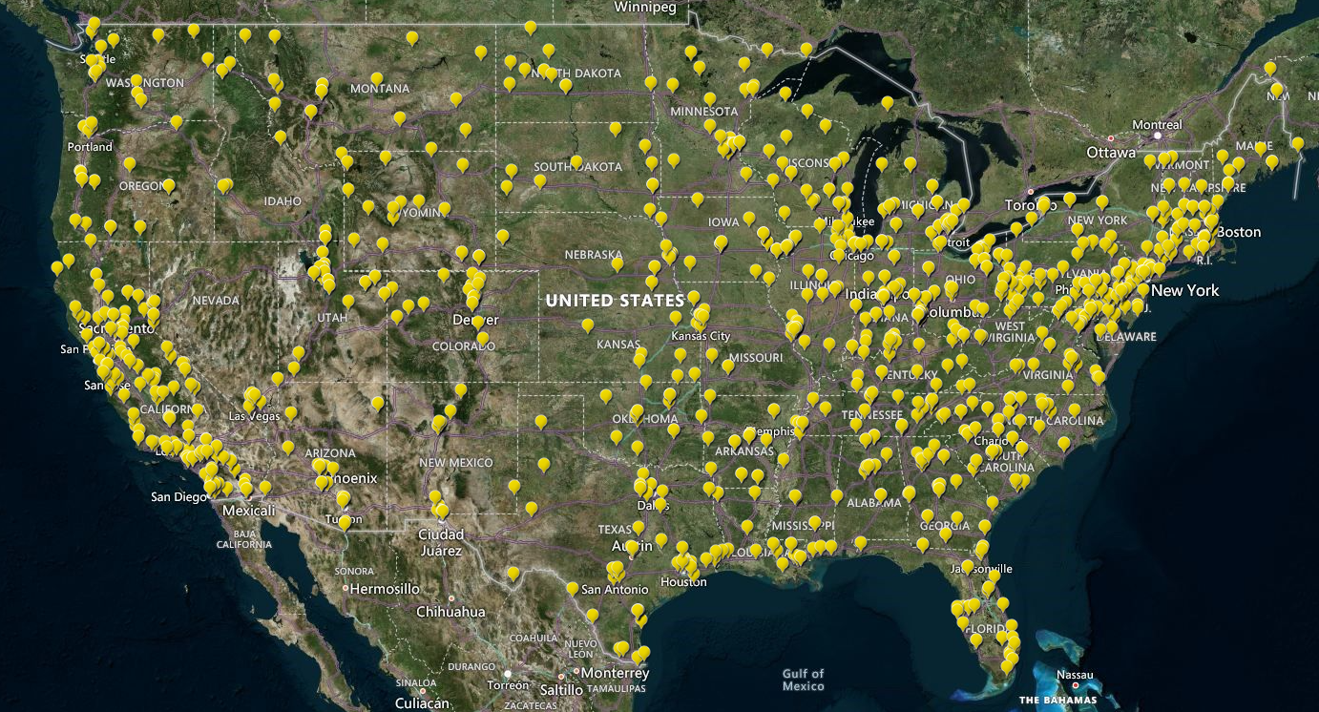
PM2.5 Monitoring Network in the US

Slide 5
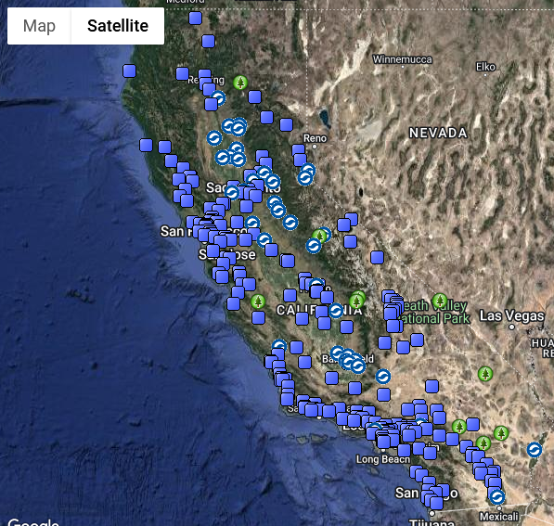
PM2.5 Monitoring Sites in California

Slide 6
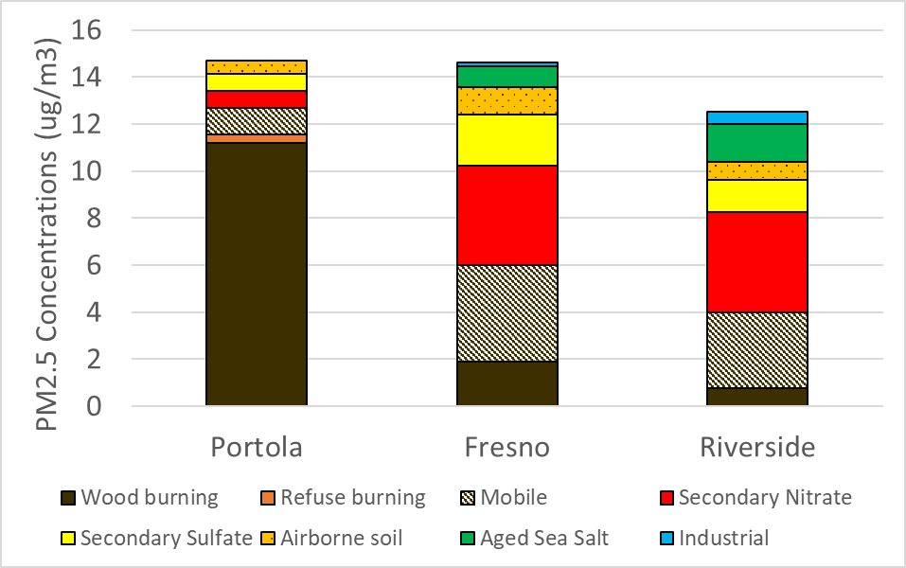
Nature of PM2.5 Pollution Across California
Regional variability influenced by climate, socioeconomic factors, and local regulations and incentives
Mountains
Central CA
Southern CA
Notes:
At the end of this slide pivot to say that now I am going to focus on Portola PM2.5 nonattainment area.

Slide 7
Portola PM2.5 case study

Slide 8
Nature of PM2.5 Problem in Portola
Mountain valley
No access to natural gas
Potential loss of electricity during storms
Easy access to free or inexpensive wood
Limited income

Slide 9
Portola Home Heating Landscape
Households by Heating Fuel
Devices Subject to Change-out

Slide 10
Portola Percent Composition
2018-2021 Annual Average
2017-2022 Exceedance Day

Slide 11
Portola Annual Average Composition
Notes:
When it comes to home heating, the activity during covid pandemic increased due to people working and studying from home and the need to keep that home warm during the day.

Slide 12
Portola PM2.5 Seasonality
Notes:
From May through September the average monthly low temperatures are above 30, but the rest of the year, they are below 30.

Slide 13
Impact of Proposed new PM2.5 NAAQS in California

Slide 14
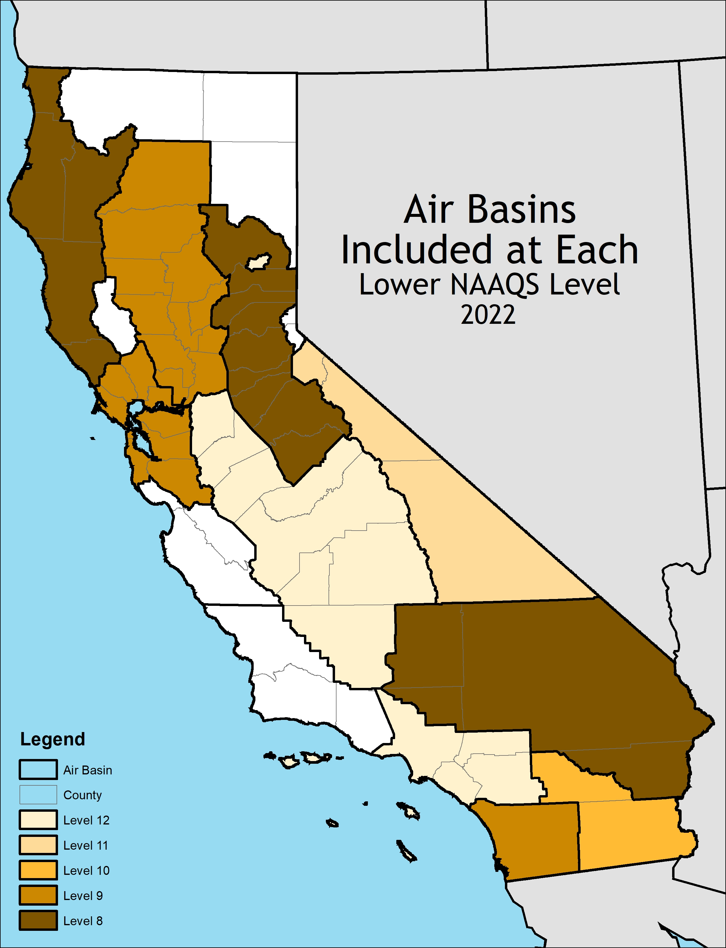
Potential Nonattainment Areas in California under Different NAAQS Levels
12 (ug/m3) | 11 (ug/m3) | 10 (ug/m3) | 9 (ug/m3) | 8 (ug/m3)
SC | SC | SC | SC | SC
SJV | SJV | SJV | SJV | SJV
Portola | Portola | Portola | Portola | MC
 | GBV | GBV | GBV | GBV
 |  | SS | SS | SS
 |  |  | SD | SD
 |  |  | SFB | SFB
 |  |  | SV | SV
 |  |  |  | MD
 |  |  |  | NC

Slide 15
Levoglucosan Levels Across the State

Slide 16
2019-2021 Winter Average Composition

Slide 17
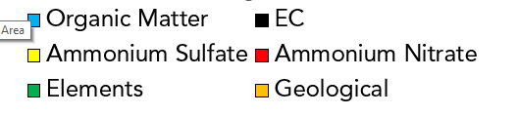
Wintertime Percent Composition

Slide 18
Home heating

Slide 19
Future of Home Heating
Ultimate goal - transition to low-carbon fuels
Interim goal - reduce emissions from wood heating through change-out programs
  Statewide - California Climate Investment Woodsmoke Reduction Program
  Local - Funded locally or with U.S. EPA Targeted Airshed Grant funds
  Need U.S. EPA cooperation and support to ensure certified devices reduce emissions

Slide 20
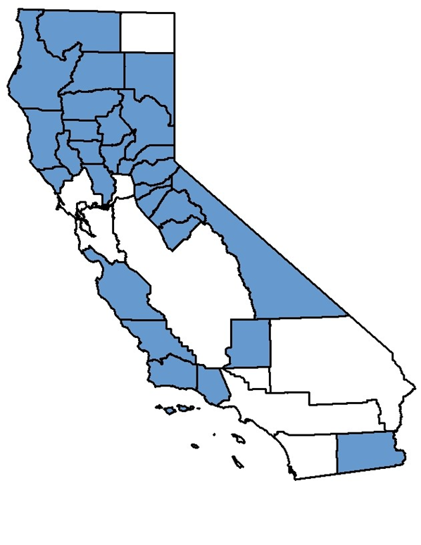

Woodsmoke Reduction Program
$18 M allocated
$7.8 M implemented
$6.2 M benefiting priority populations
2,260 stoves changed-out
Notes:
28 out of California’s 35 air districts participated in 2018-2019 program

Slide 21
Summary
PM2.5 monitoring in low population areas impacted by wood smoke is not required
Annual PM2.5 levels in wood-burning communities may be higher than in large metropolitan areas
Wood smoke contributes to PM2.5 nonattainment areas across California and in some areas it’s a sole contributor
Deficiencies in the current U.S. EPA certification program delayed PM2.5 attainment
Robust certification program will be essential for reaching attainment in wood smoke dominated areas
Notes:
Woodsmoke contributes to PM2.5 nonattainment areas across California and in some areas it’s a sole contributor. The current framework of the U.S. EPA certification program may have delayed attainment. U.S. EPA U.S. EPA needs to do a better job in ensuring that the reductions in emissions from change-out programs are in line with the emission factors which are factored into attainment modeling.

