Slide 1
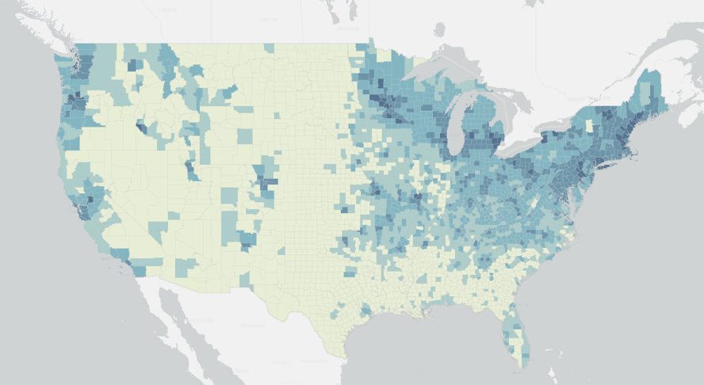
2020 NEI – PM2.5 from Residential Wood Combustion
For the Residential Wood Smoke Training Workshop
April 2023
Denver, CO

Slide 2
Outline
NEI background
Residential Wood Combustion (RWC) Sector
EPA’s Approach to estimating RWC emissions
PM25 emissions & RWC contributions
RWC PM emissions by appliance type
Notes:
First I will give you a brief overview of EPA’s national emissions inventory, then Residential wood combustion sector – what’s in it, I’ll briefly describe the approach EPA uses to estimate emissions, and then we’ll look at the results for PM2.5, how the RWC PM2.5 compares with other source sectors and with the previous NEI

Slide 3
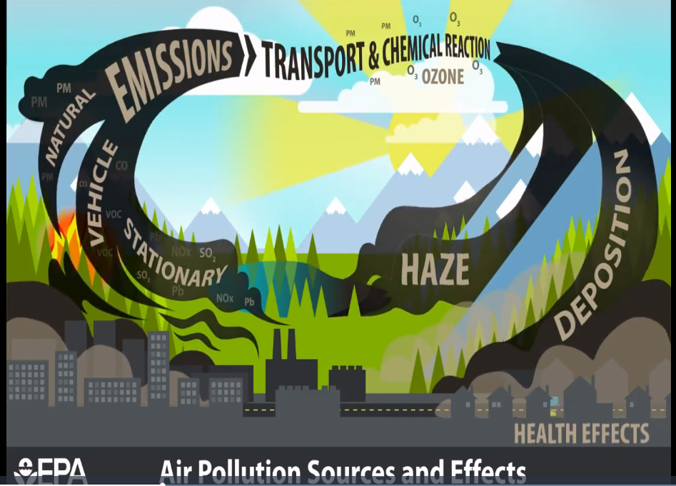
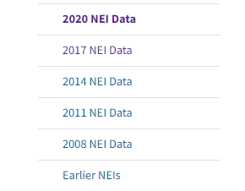
EPA’s National Emissions Inventory (NEI)
Released every 3 years
www.epa.gov/air-emissions-inventories
Just
Released
Notes:
The NEI or national emissions inventory is released every 3 years – the most recent version is 2020 and it was released just a few weeks ago. You can get the data and documentation on our website.

Slide 4
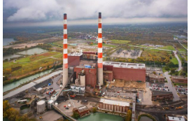
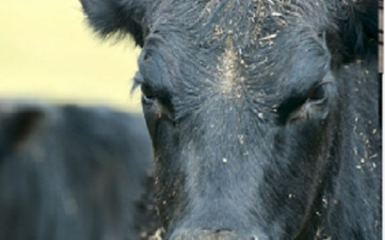
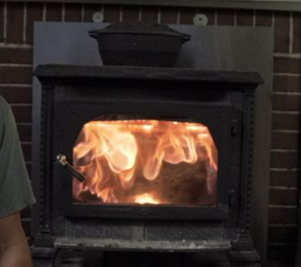
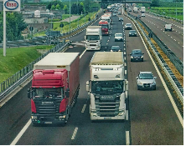
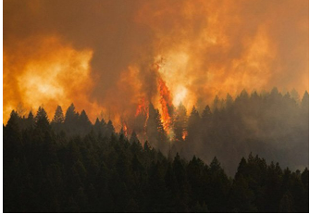
Emissions Sources
Stationary Sources (point and nonpoint)
COW
Mobile Sources
Biogenic & Wildfires
biogenic
wildfire
Notes:
The NEI covers all emission sources –
Stationary sources – both point such as large industrial facilities with known locations and nonpoint – smaller sources typically so numerous that they are inventoried at county level. A few examples of nonpoint sources are agricultural emissions– this is a cow, consumer products, and residential heating including with wood.
Onroad and offroad mobile sources – cars & trucks, planes trains and ships and large and small nonroad equipment like pavers and lawn mowers.
The NEI include natural sources –emissions from vegetation and soils, and wild fires.

Slide 5
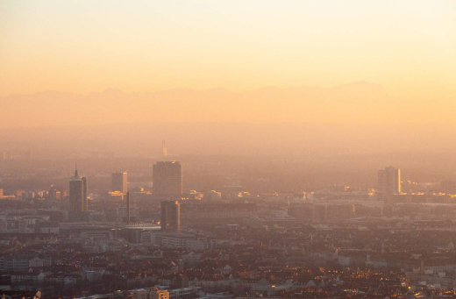
Multiple types of pollutants
Criteria Pollutants and Precursors
Carbon monoxide, Sulfur dioxide, Nitrogen Oxides, Volatile Organic Compounds, Particulate Matter, Lead , Ammonia
Hazardous Air Pollutants (HAPs)
~ 188 listed HAPs such as: benzene, formaldehyde, polycylic aromatic hydrocarbons, mercury, nickel, cadmium
Greenhouse Gases – for some source sectors
CO2, CH4, N2O, fluorinated gases
OTHER: E.g., components of PM2.5 such as Organic carbon and Elemental carbon

Slide 6
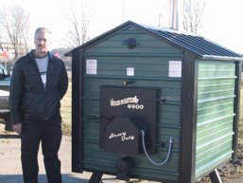
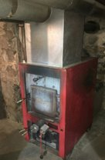
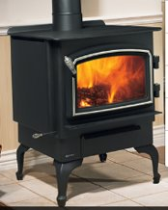
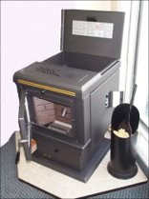
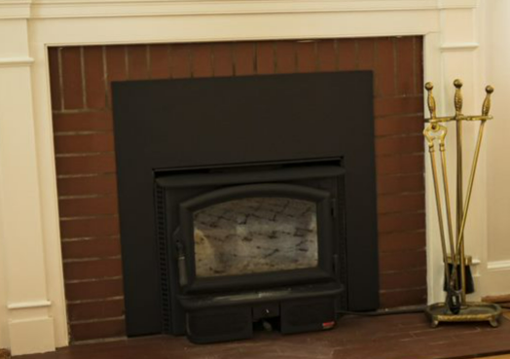
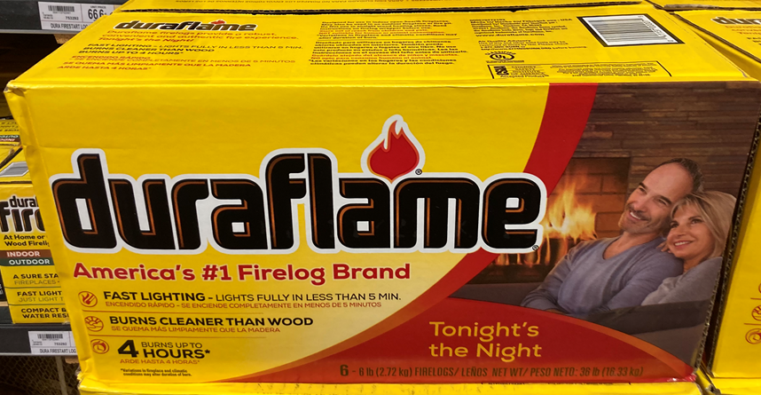
Residential Wood Combustion (RWC) Sector in NEI
Room heaters: Stoves and Inserts
Central heaters: Hydronic heaters and Furnaces
Firelogs
Residential Outdoor wood burning
Fireplace

Slide 7
Overall approach- to generate county level emissions for each pollutant for RWC
E_{poll,SCC,county} = Wood burned_{County,SCC} X EF_{SCC,poll}
Where:
E_{SCC,poll} is the pollutant-specific emissions (county level)
EF is the emissions factor in lbs of pollutant emitted per ton of dry wood burned
Wood burned_{County} is computed based on:
# of occupied homes, the cordwood density
fraction of homes having each type of appliance
distribution of appliance type to source classification code (SCC)
amount of wood burned per appliance,,
adjustment factors
*Adjustments not applied for outdoor (chimneas or firepits) or firelogs or where states submitted inputs to the equation
Notes:
The overall approach to compute emissions is reflected by this deceptively simple equation, as both terms on the right are difficult to estimate.
The EF in addition to be a function of the SCC and pollutant also depend on the wood including species, moisture content, size, user operation and we don’t have EFs at that level of detail. The wood burned is computed based on all these highlighted terms some of which which are derived from surveys and for some SCCs we apply adjustment factors for consistency with the wood consumption data developed by the Energy Information Administration

Slide 8
2020 RWC Data updates and State/local/tribal emissions submissions
Data Updates
EFs for certified wood stoves/inserts changed to AP-42 Phase II
State-level Adjustment factors based on the Energy Information Administration’s 2020 State Energy Data System (SEDS)
Occupied housing units (based on the 2016-2020 American Community Survey 5 year estimates)
Cord Wood density (used USDA data on firewood data by tree species)
SLT PM2.5 emissions submissions
States: Alaska, California, Idaho, Minnesota
Local: Maricopa County – Arizona, Washoe County – Nevada
Tribes: Kootenai Tribe of Idaho, Nez Perce Tribe of Idaho. Coeur d’Alene Tribe of the Coeur d’Alene Reservation, Idaho, Shoshone-Bannock Tribes of the Fort Hall Reservation of Idaho, Northern Cheyenne Tribe of the Northern Cheyenne Indian Reservation, Montana

Slide 9
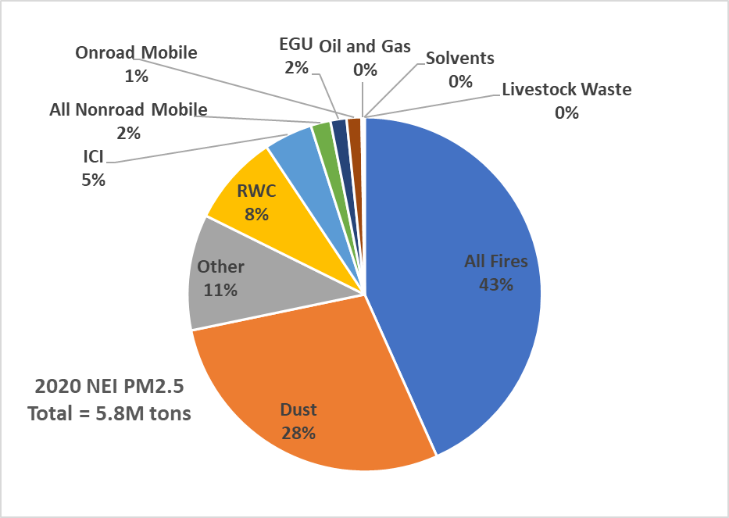
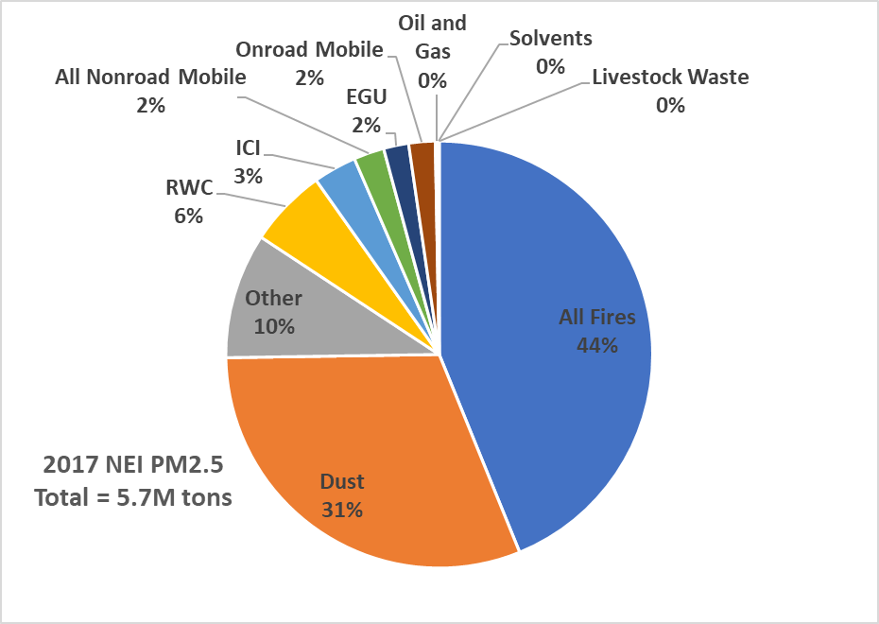
2020 vs 2017 PM2.5 Sectoral Composition
RESULTS --- 2020 vs 2017 PM2.5 Sectoral Composition
2020 RWC: 485,000 tons
2017 RWC: 337,000 tons
RWC 6%
RWC 8%
Notes:
RWC 44% increase, so in 2020 it is 8% of the total, nationally and annually.
Expect to be a lot higher proportion in some areas of the country and also in the winter season.
Fun fact – in this sector, the emissions of VOC and PM is the same – 460,000 tons of VOC from RWC in 2020 NEI

Slide 10
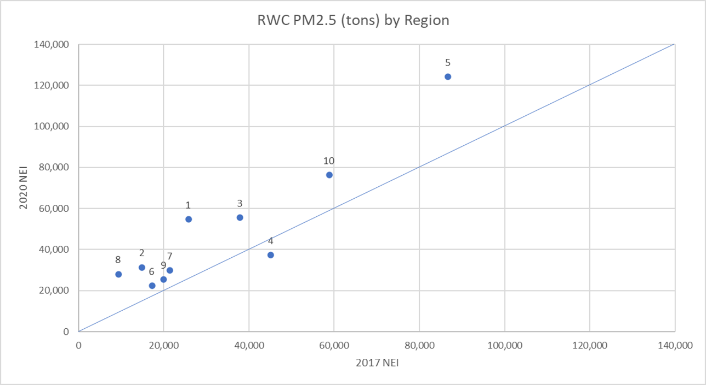
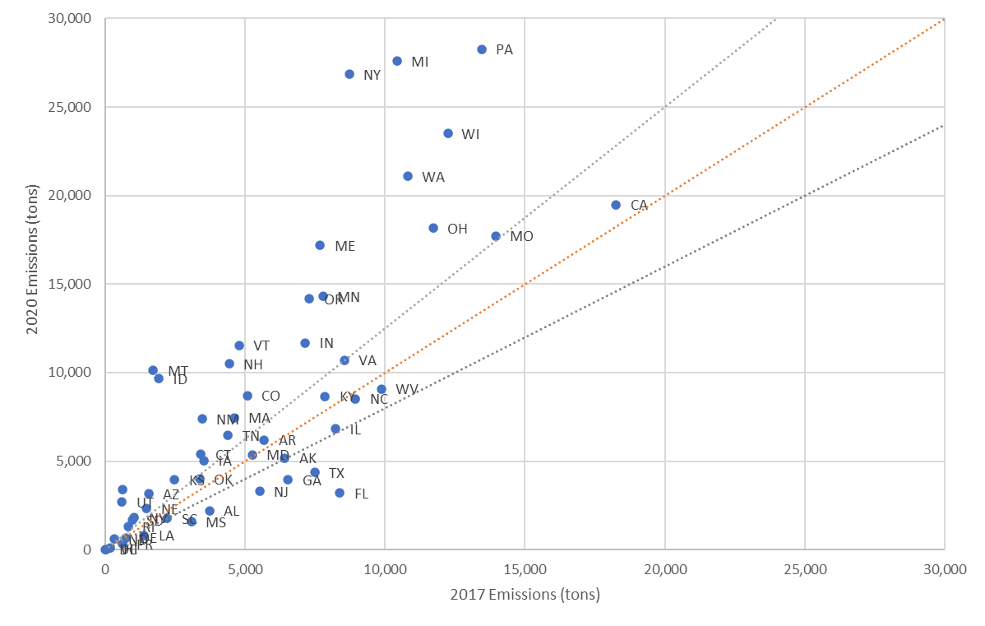
RWC PM_{2.5} emissions by Region and State
Notes:
Very interesting activity data changes for RWC –upward revision to certified wood stove EFs also factored in. Even within regions (2 for example), NY vs NJ from updated SEDS methodology. NJ 40-50+% decrease all appliance types except outdoor rec burning and firelogs; NY 3-5x greater in 2020 most of RWC. Nationally, 337K (2017) to 485K in 2020 (EPA tools=441,689 in 2020 from 281,150 in 2017=57% increase) with ~47K (would by 40% increase with old EF) due to increase in PM EFs.

Slide 11
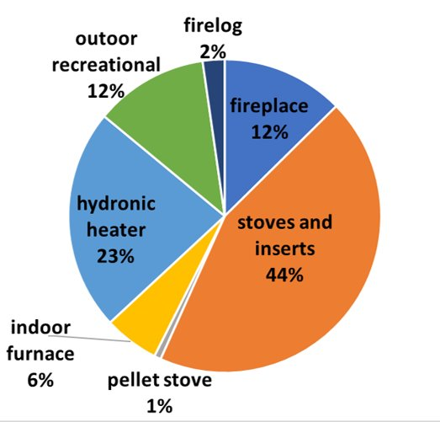
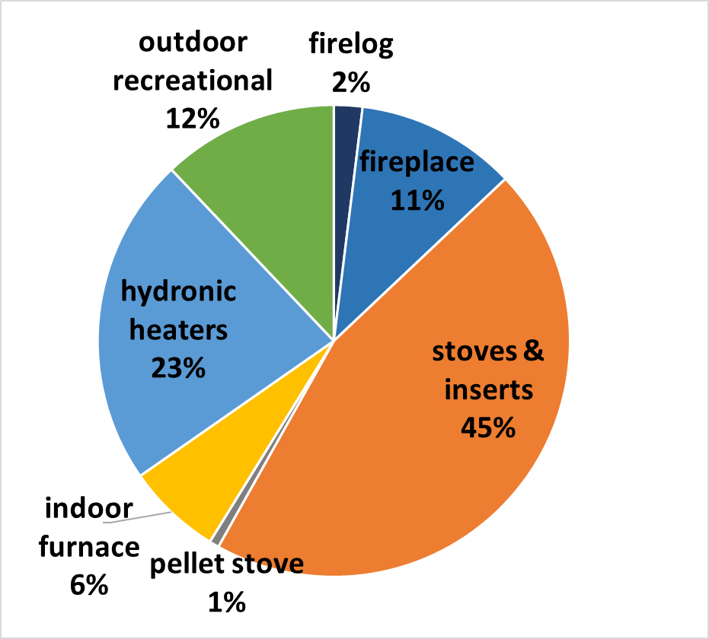
RESULTS --- 2020 vs 2017 PM2.5 by Appliance
RWC PM2.5 Emissions, 2020 NEI
Total = 485,000 tons
RWC PM2.5 Emissions, 2017 NEI
Total = 337,000 tons

Slide 12
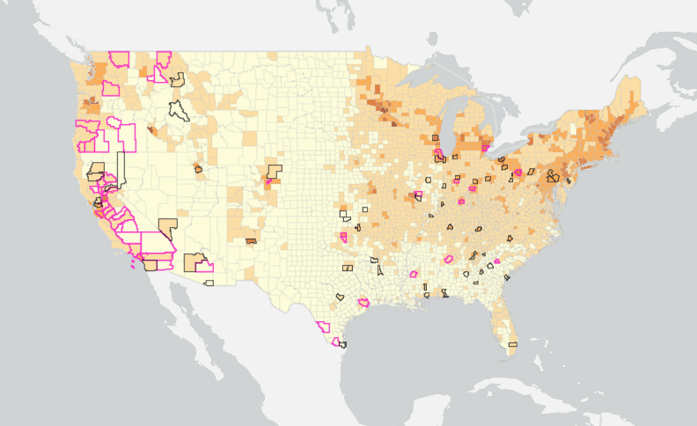
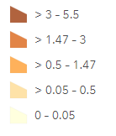
2020 RWC PM2.5 Emission Density
Tons PM2.5/Sq. mile
Counties with 2021 DV >9 ug/m3
Counties with 2021 DV >10 ug/m3

Slide 13
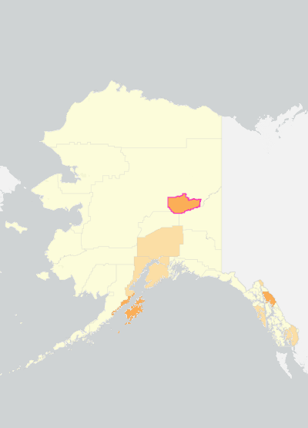
2020 RWC PM2.5 Emission Density
Tons PM2.5/Sq. mile
Counties with 2021 DV >9 ug/m3
Counties with 2021 DV >10 ug/m3
Notes:
For AK, the one county Fairbanks North Star has a design value greater than 10 and it has one of the larger emission densities of RWC

Slide 14
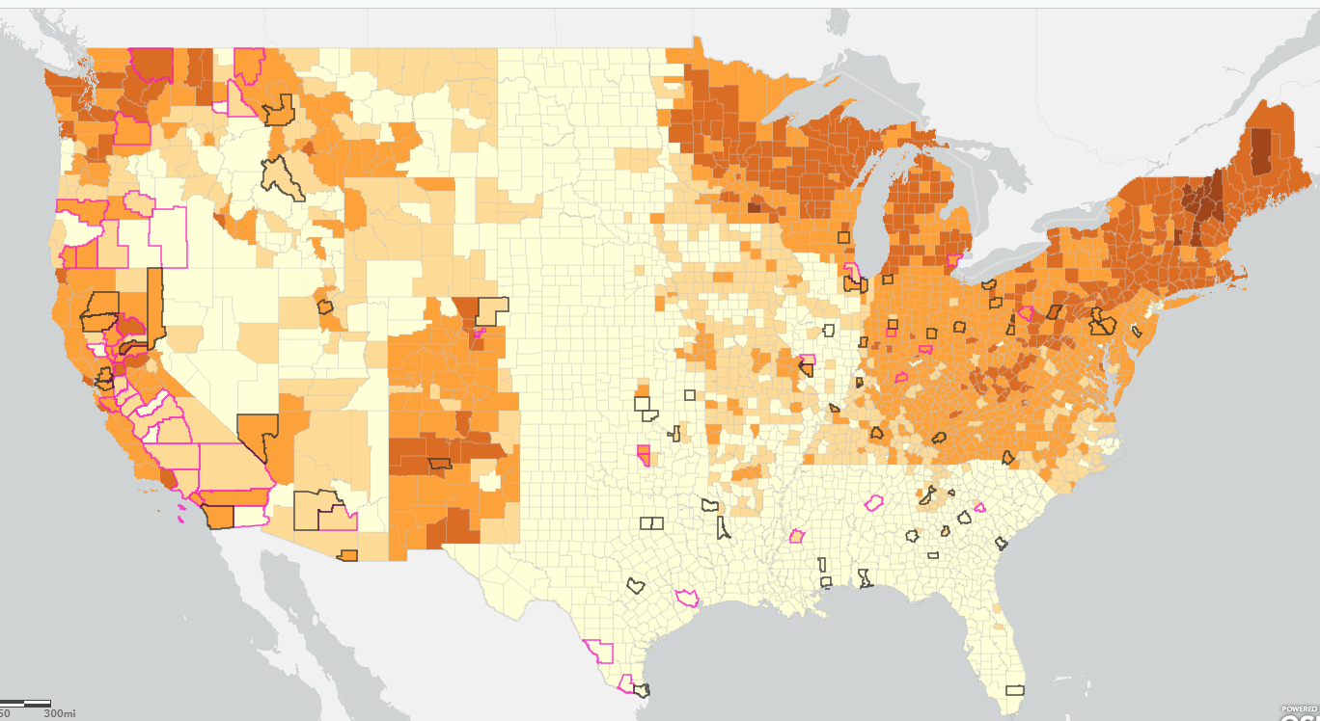
2020 RWC Annual Contribution to PM2.5 Emissions
(excludes wildfires from total)
Counties with 2021 DV >9 ug/m3
Counties with 2021 DV >10 ug/m3

Slide 15
What’s Next?
2023 International Emissions Inventory Conference in Seattle, Sept 26-29!
Theme is smoke, and plan to have a dedicated RWC session (if enough abstracts come in)
Submit abstracts at https://www.epa.gov/air-emissions-inventories/2023-international-emissions-inventory-conference-nexus-climate-air
New Easy Data Download Tool for 2020 NEI
Search by SCC, Pollutant, state & county
Download Emissions
Available May– will be at https://www.epa.gov/air-emissions-inventories/2020-national-emissions-inventory-nei-data
2023 NEI Planning
Considering updates to RWC emissions approach
Working with SLT

Slide 16
Preview – Easy Data Download Tool for 2020 NEI
https://www.epa.gov/air-emissions-inventories/2020-national-emissions-inventory-nei-data
Search/filter By: SCC, Pollutant, State or County
State and County Info
Emis (tons)
SCC 2
SCC 3
SCC 4

Slide 17
Thank You!

