Slide 1
RTOWG Update to TSC/WG, 2/24/21
Weekly coordination calls with Ramboll
Discussion with EPA OAQPS leads on Regional Haze and modeling on WESTAR-WRAP glide slope end-point adjustments – 2/16
Final draft of procedures document with options for visibility projections and glide slope end-point adjustments
Upcoming meetings
RTOWG meeting on March 2nd at 130 pm MST to cover methodology and examples for:
a) 3 projections options for selecting a 2028 RPG,
b) End-of-Glidepath Adjustment options, and
c) Dynamic Modeling Evaluation and Modeling Glidepath
March 9th at 200 pm MST - Results meeting to review 2028 projections and end-of-glidepath adjustment display tools and options on TSS
End of March – Results meeting for TSS displays of Future Fire Scenarios, Dynamic Modeling Evaluation, and Low-Level Source Apportionment

Slide 2
Overview of Modeling Status and Schedule
Left to complete with TSS delivery/display:
2002-RepBase2-2028OTBa2 Dynamic Evaluation and Modeling Glidepath of U.S. Anthropogenic reductions
Future Fire Scenarios 1 (climate change-forced wildfire activity) and 2 (implementation of FLM scenario of wildland Rx fire activity)
Left to complete both modeling and TSS delivery/display:
Low-Level 2028OTBa2 Source Apportionment (state by source sector for WESTAR-WRAP region)
Left to complete for TSS tools and results:
cleanup efforts through April

Slide 3
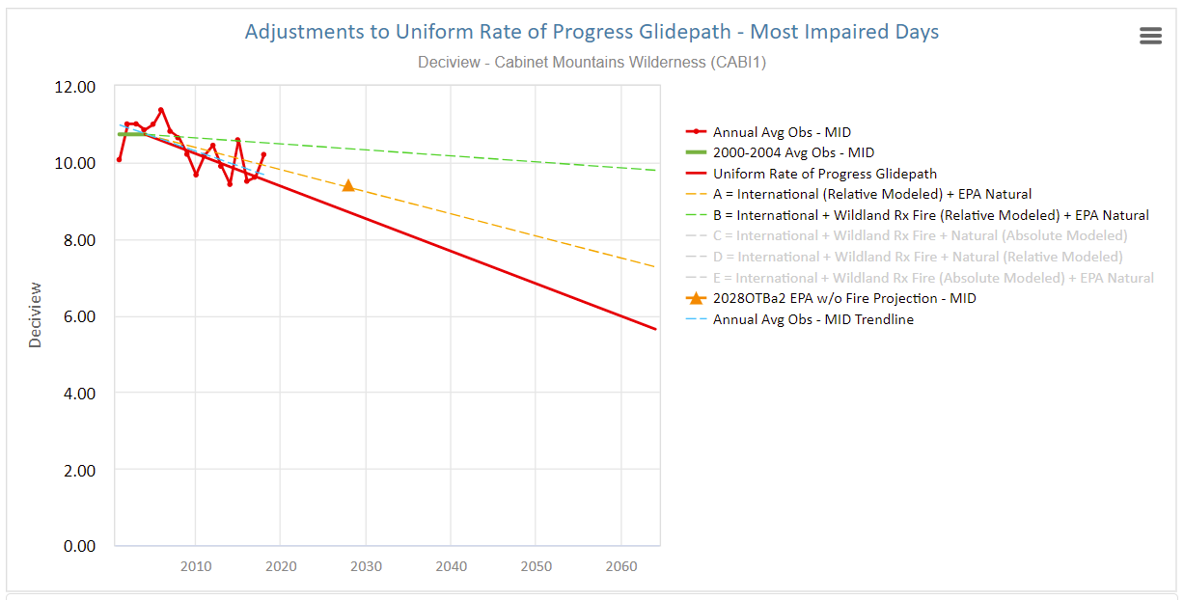
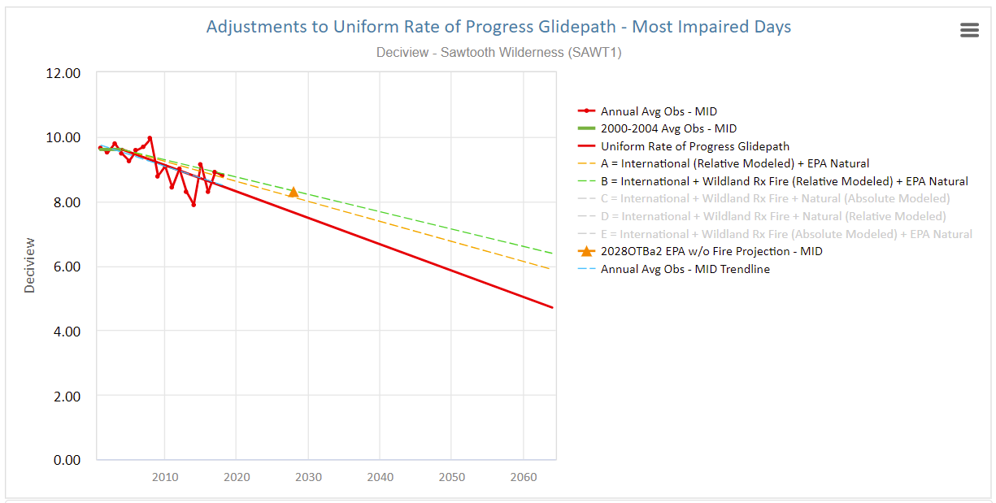
WRAP Glidepath Adjustments
At Cabinet Mountain WA and Sawtooth WA,
adjustment for Wildland Prescribed fire adds to
International contributions.

Slide 4
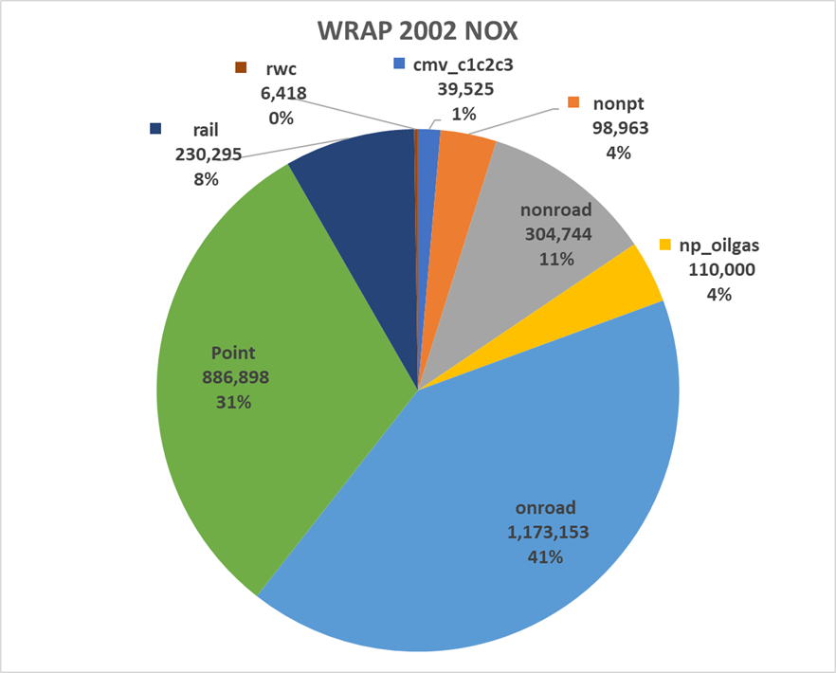
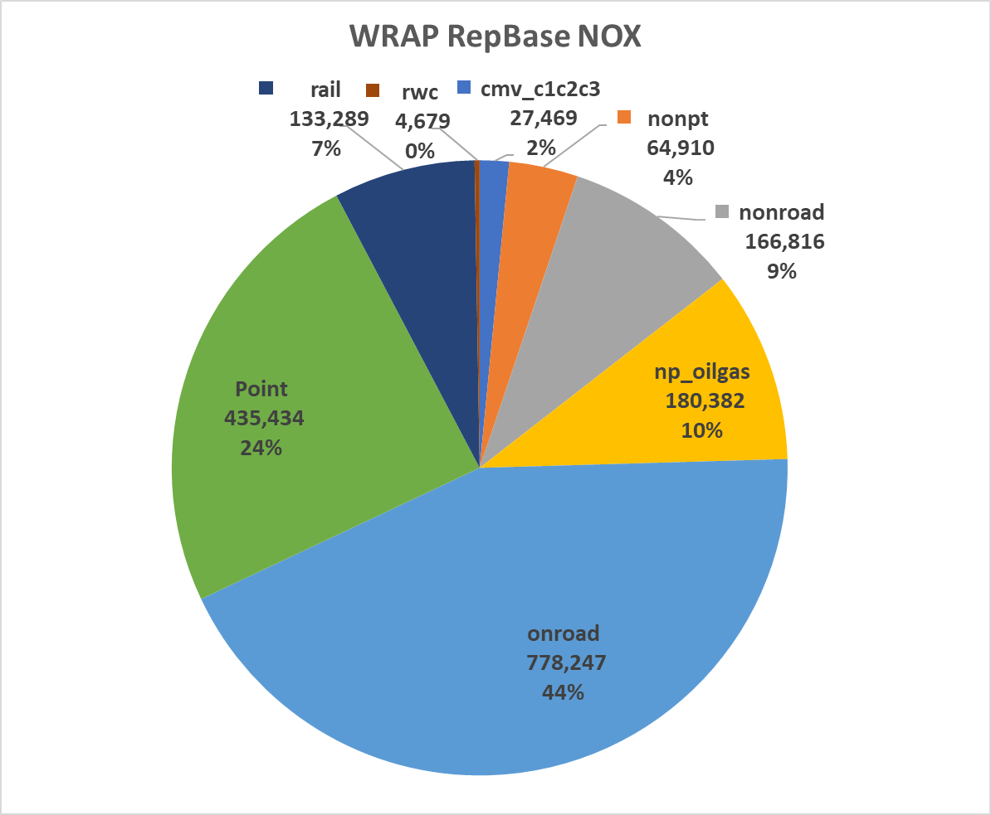
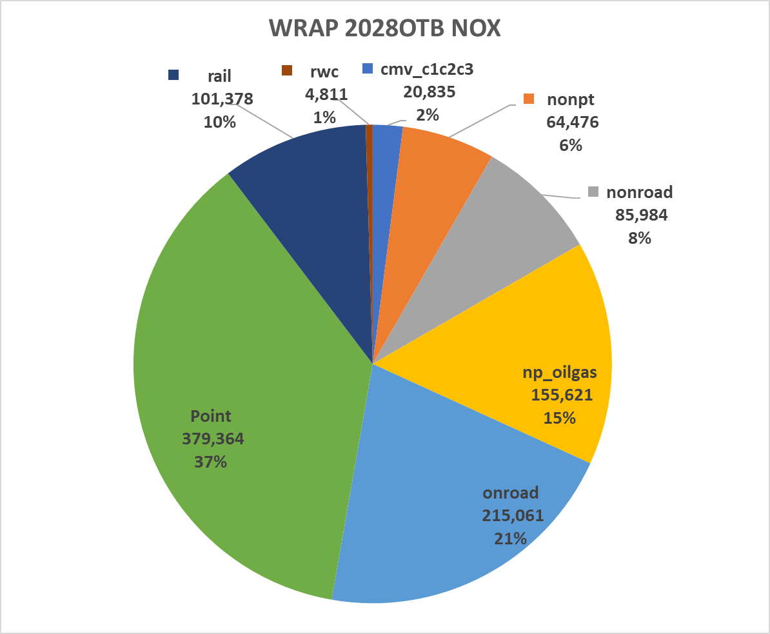
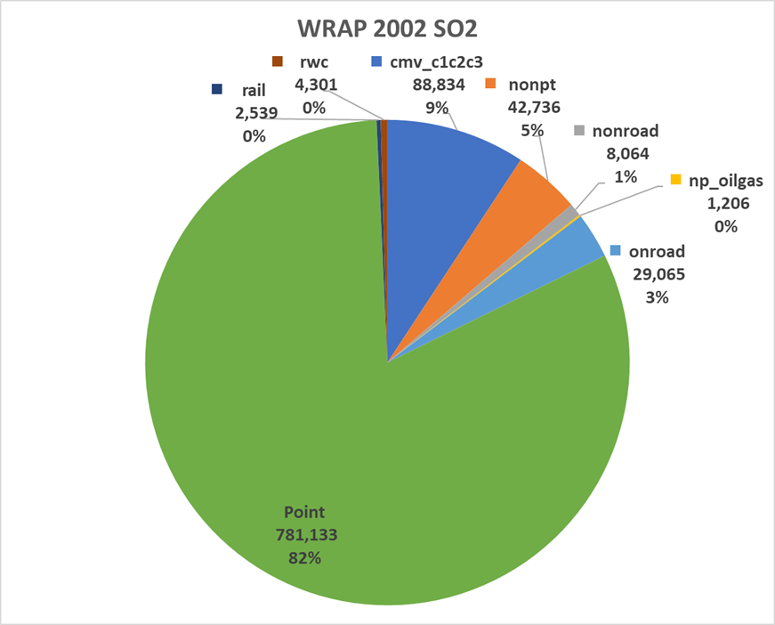
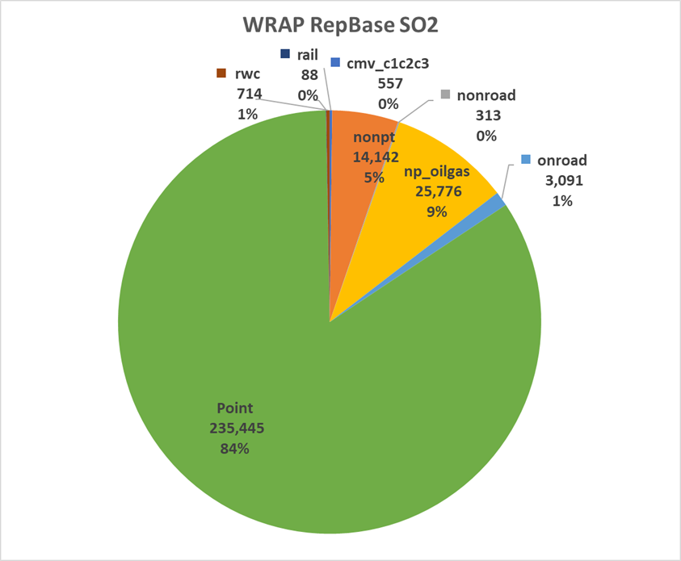
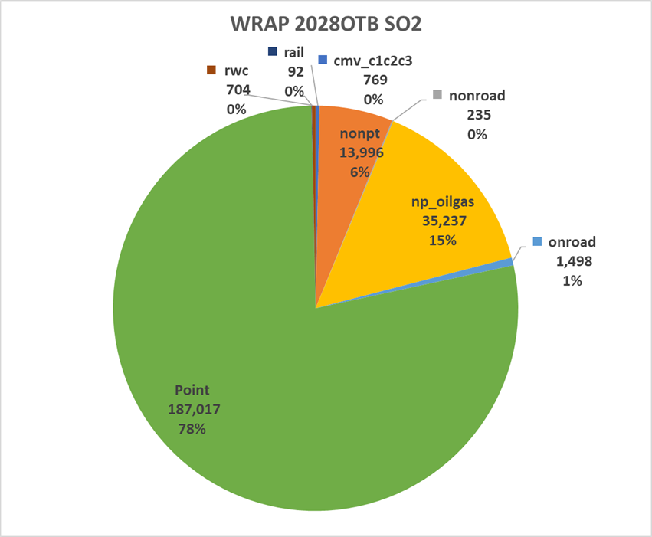
2002DE, RepBase, and 2028OTB NOx and SO2 emissions
2002DE NOx 47% higher than 2014v2
Point 57%
On-Road 50%
Total: 2,849,996 tpy
Total: 1,791,227 tpy
Total: 1,027,530 tpy
2002DE SO2 177% higher than 2014v2
Point 253%
CMV 749%
Total: 957,878 tpy
Total: 280,127 tpy
Total: 239,546 tpy

Slide 5
Example USAnthro Extinction Glidepath Calculation
Mount Rainier, WA
Coastal State
Year | USAnthro | CMV-US | SOAA | BC-US | Ag-US | Tot-US | 2028 Glidepath
2002 | 32.40 | 11.08 | 3.84 | 0.28 | 0.00 | 47.60
RepBase2 | 16.52 | 1.25 | 3.47 | 0.29 | 0.00 | 21.53 | 36.85
2028OTBa2 | 8.06 | 0.82 | 2.63 | 0.29 | 0.00 | 11.80 | 27.64
2064 | 0 | 0 | 0 | 0 | 0 | 0

