Slide 1
RTOWG
Modeling schedule
  Processing updated emissions (Task A&B)
  Source apportionment runs (Task C&D)
  Visibility projection and glidepath adjustment (Task E)
Example graphics for TSS
  Model projections for future visibility
  Glideslope adjustments
  Dynamic model evaluation
Model verification study
  Confirm that all components of modeling platform are transferred to IWDW and that simulation can be replicated

Slide 2
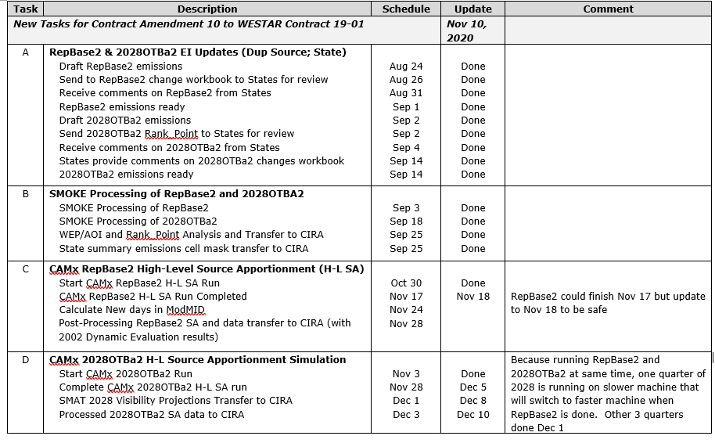
modeling timeline

Slide 3
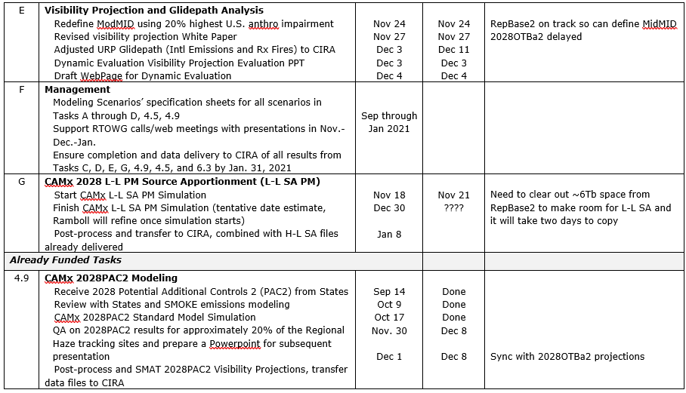
modeling timeline

Slide 4
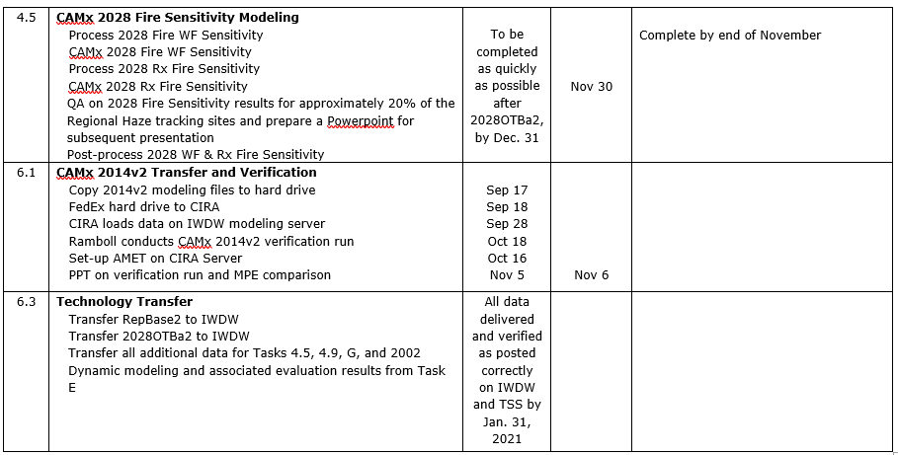
modeling timeline

Slide 5
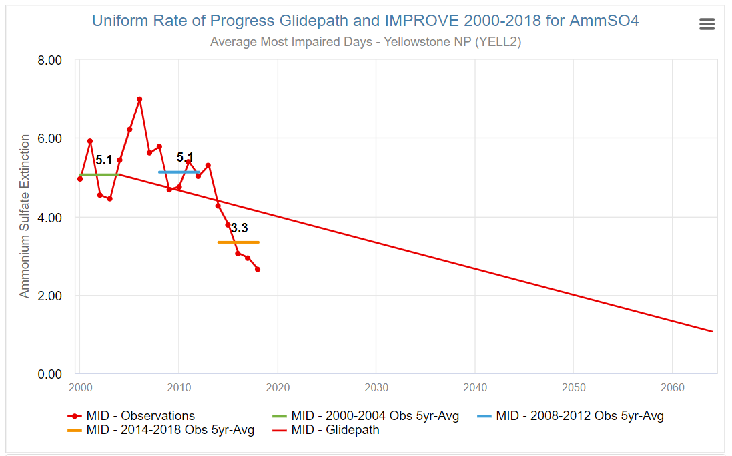
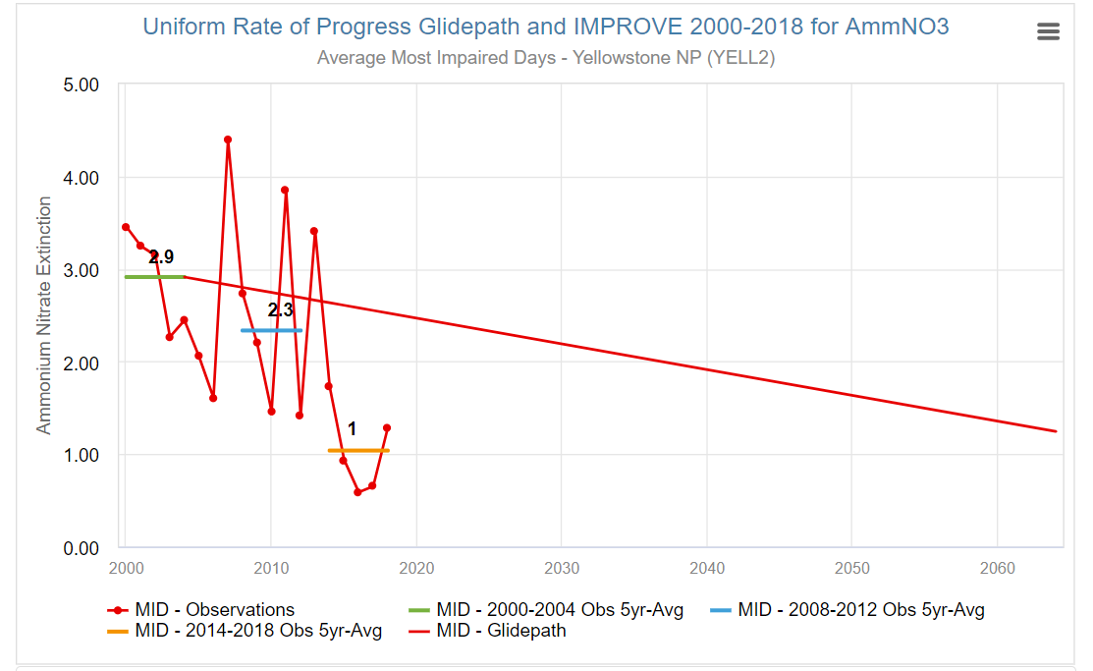
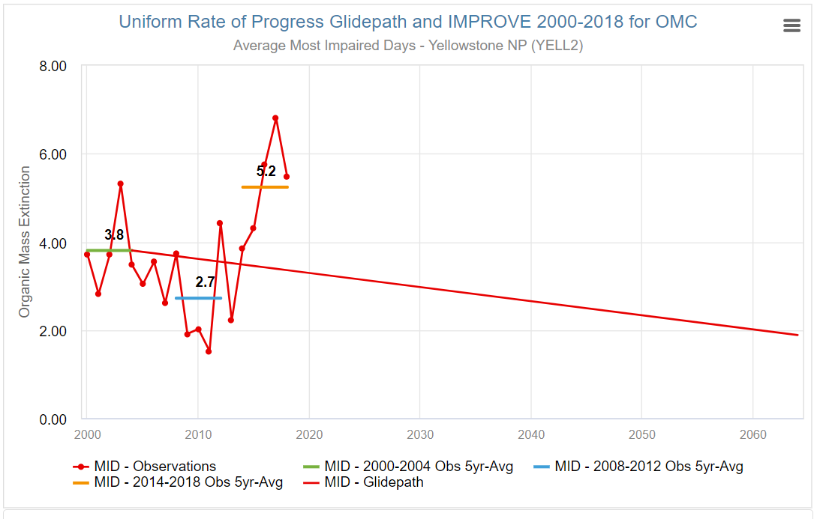
Example 2028 visibility projections accounting for fire impacts
Modeling Data Analysis Chart 4 selection menu:
User Selection sets what data is graphed and listed in labels
Group: 1 or 2
Most Impaired
Clearest
Scenario: 1 or 2
2028OTBa2
2028OTBa2+PAC2
Projection method: 1, 2, or 3
EPA
EPA without fire
Modeled MID
Uniform Rate of Progress Glidepath and 2028 Projections – Most Impaired and Clearest Days – Deciview – Yellowstone NP
2000-2004 ave obs
2014-2018 ave obs
Annual ave MID obs
2028OTBa2 (EPA projection MID)
2028OTBa2 (EPA without fire MID)
2028OTBa2 (Modeled MID)
2028OTBa2+PAC2 (EPA projection MID)
2028OTBa2+PAC2 (EPA without fire MID)
2028OTBa2+PAC2 (Modeled MID)
Annual ave Clearest days obs
2028OTBa2 – EPA projection method
2028OTBa2+PAC2 – EPA method
Yellowstone (YELL2) also represents Grand Teton NP, Teton WA, and Red Rocks Lake NWR
AmmSulfate
AmmNitrate
Organic Carbon

Slide 6
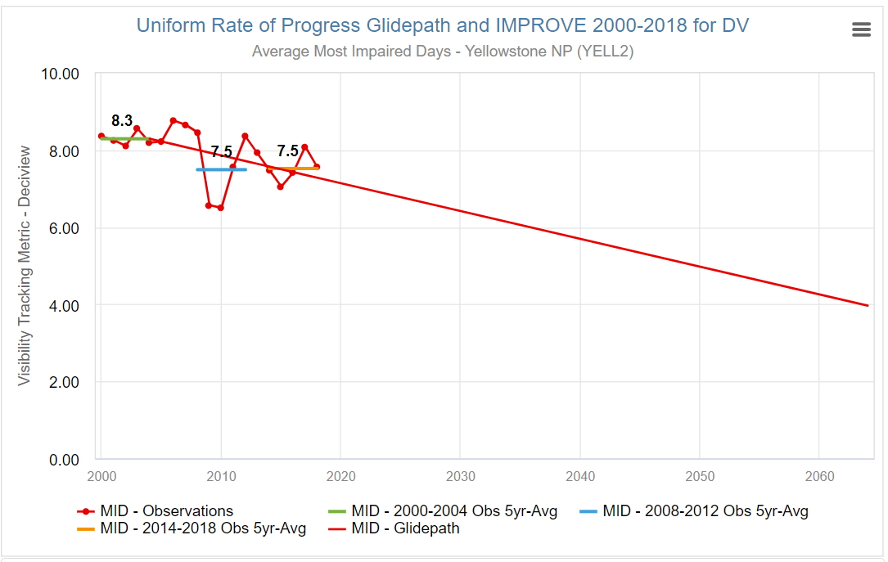
Example glideslope adjustments
Modeling Data Analysis Chart 5 selection menu:
Scenario:
2028OTBa2
2028OTBa2+PAC2?
Projection method:
EPA
EPA without fire
Modeled MID
2064 Adjustment:
EPA Default
A) Relative Intntl+RxFire+EPANatural
B) Relative Intntl+RxFire+ModNatural
C) Absolute Intntl+RxFire+EPANatural
D) Absolute Intntl+RxFire+ModNatural
2064 adjustments
Annual ave MID observations
2000-2004 5-yr ave MID observations
2000-2018 observation trend
Uniform Rate of Progress glidepath
Glidepath adjustment A
Glidepath adjustment B
Glidepath adjustment C
Glidepath adjustment D
A
D
B
C
Yellowstone (YELL2) also represents Grand Tetons NP, Teton WA, and Red Rocks Lake NWR

Slide 7
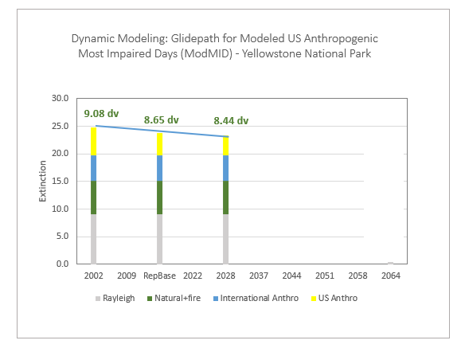
Example dynamic model evaluation

Slide 8
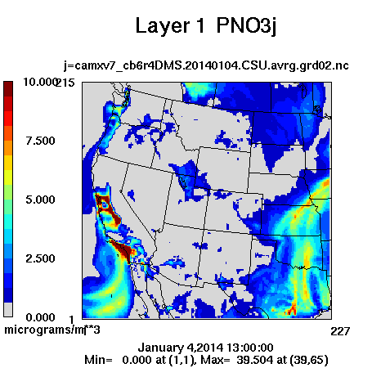
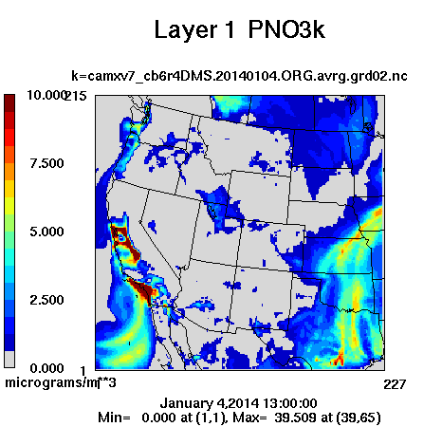
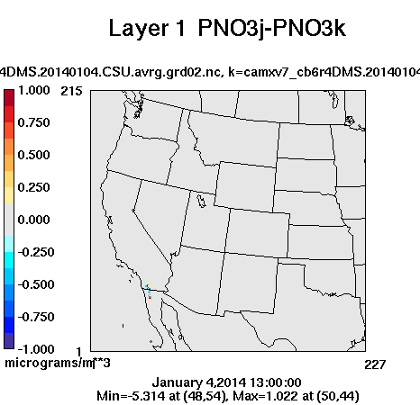
Comparison on days of Maximum differences: PNO3
Difference
CSU - Ramboll
CSU Modeling
Ramboll Modeling

Slide 9
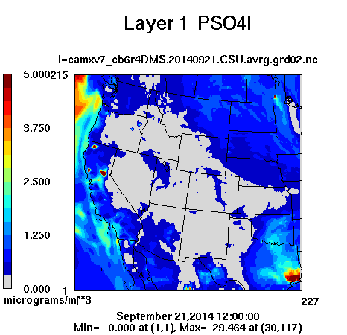
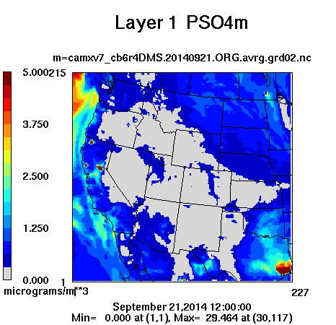
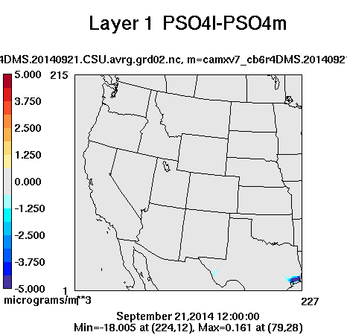
Comparison on days of Maximum differences: PSO4
Difference
CSU - Ramboll
CSU Modeling
Ramboll Modeling

