Slide 1
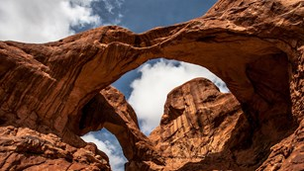


WRAP Workplan Deliverables for Regional Haze Planning
July 23, 2020 Results Meeting

Slide 2
Fire & Smoke Work Group (FSWG)
Work Products
  WRAP FSWG 2017 Workplan
  Exceptional Event Data Resource List
  WRAP region map with Smoke Management Programs
  2014 Actual, Representative Baseline and Future Fire Scenarios Report | Summary Presentation from May 20th Results Meeting
    Representative Baseline and Future Fire Scenarios Working Group Scope

Slide 3
Oil & Gas Work Group (OGWG)
Work Products:
  Summary of OGWG Work Completed for Regional Haze results meeting - May 20, 2020
  Additional Reasonable Control Strategies for Oil and Gas Emission Sources in the WESTAR-WRAP region and Control Strategies Analysis Reporting Template
  Summary of State Regulations Applicable to Oil and Gas Sources in the WESTAR-WRAP Region (PDF) and companion spreadsheet (XLS)
  Final Work Products - Low and High Emissions Scenarios
    WESTAR-WRAP region Future Year Oil and Gas Emission Inventories for Two Additional Scenarios: Declined Vertical Wells and Increased Horizontal Wells Memorandum
    Future Year Lower Scenario Inventory Spreadsheet
    Future Year Higher Scenario Inventory Spreadsheet
  OGWG Projected Emissions from Baseline Year Emissions Inventory
    Final Report (March 5, 2020) and Inventory Spreadsheet (final version of March 5, 2020) for the “Continuation of Historical Trends” projection inventory. These data will be used in modeling and control analyses for Regional Haze planning.
    State of Colorado projections methodology (PDF) (January 2, 2020, data are included in the Final Report and Inventory Spreadsheet above).
    State of New Mexico updated projections data from early Feb. 2020 are included in the Final Report and Inventory Spreadsheet above.
  OGWG Baseline Year Alaska and Intermountain Region Emissions Inventory revised final deliverables – Sept. 2019
    The Revised Final Report and Inventory Spreadsheet were completed in mid-Sept. and posted on Sept. 23, 2019. These files completely replace the previously posted July 2019 report and spreadsheet, while the gas profile information posted in July is unchanged. The July report and spreadsheet files have been removed to avoid confusion. The Revised Final Report includes updates from the July postings to include the: 1) Colorado O&G emissions based on new inventories provided by Colorado Department of Public Health and Environment and Southern Ute Indian Tribe and 2) Williston Basin casinghead gas emission inventory to correct emissions that were biased low based on EPA O&G Tool inputs.

Slide 4
Oil & Gas Work Group (OGWG), continued
OGWG Emissions Survey for State Air Agencies and O&G Operators
  Complete survey (January 2019)
  Fleet turnover and controls-focused survey (January 2019)
OGWG Road Map: Phase I Report (Consensus on April 16, 2018) – Appendix A (On-the-Books Regulations Tables)
WRAP OGWG Road Map Scope of Work (Consensus on October 10, 2017)
  Identification and Review of Oil & Gas Specific Projection Methodologies and Work Products
  Base Year and Future Year Oil & Gas Emissions Inventories
  Identification and Review of Member Agency Oil & Gas Programs and Emissions Management [
  WRAP OGWG Oil and Gas Emission Sources (Consensus on October 17, 2017)
WRAP OGWG 2017 Workplan (Consensus on January 10, 2017)

Slide 5
Tribal Data Work Group (TDWG)
Communication Framework for Regional Haze Planning final on Sept. 3, 2019
WRAP region map with Tribal Resources
WRAP Tribal Outreach (April 18, 2019) WebEx recording (MP4 format) Presentation (PPTX)
WESTAR-WRAP Air Quality Data and Decision Support Systems at CSU/CIRA (December 4, 2019) Webinar recording (MP4 format) Presentation (PDF)

Slide 6
Tribal Data Work Group (TDWG), continued
ITEP / EN3 Work Products for TDWG
Task 1.1 General WRAP Outreach to Tribes Status: Complete
  Sub-Task 1.1.1 Regional Haze materials for Tribal professionals
  Fact Sheet Presentation
  Sub-Task 1.1.2 WRAP Processes and Procedures for Tribes
  Fact Sheet Presentation
  Sub-Task 1.1.3 Tribal Contacts in the WRAP Region Status: Complete (spreadsheet Dec. 2019, outreach letter drafted, to be sent in 2020)
  Sub-Task 1.1.4 WRAP Tribal Maps Status: Complete
  Updated main WRAP map page and TDWG map are the same, at: https://www.wrapair2.org/Map.aspx
  Task 1.2 Tribal AQS Data Gap Study Status: Complete
  EN3's technical report Tribal AQS Data Gap Study was completed and submitted on November 23, 2018. A comprehensive Excel spreadsheet showing tribal and tribally-related air monitoring activities accompanied this report.
  Task 1.3 Tribal NEI Data Gap Stud Status: Complete
  EN3’s technical report that presents the results and conclusions of this work. Tribes with Point Sources spreadsheet
  Task 1.4 Tribal Oil & Gas Emissions Inventory Status: Complete
  EN3 has completed a compilation of principal oil and gas (O&G) producing tribes in the WRAP region.
  Final Report Comments on Draft Report
  Task 1.5 Consultation Protocol Status: Complete
  Process used: EN3 engaged in frequent communications with TDWG leaders and the WRAP Consultation & Coordination (C&C) Subcommittee. The Subcommittee has prepared a Draft WRAP Communication Framework for Regional Haze Planning. EN3 has reviewed this document and shared comments with TDWG in preparation for the upcoming meeting. (Notes document) EN3 suggested that the TDWG, C&C Subcommittee and broader WRAP leadership decide whether to modify and expand this "Framework" document to include Tribal consultation or, alternatively, prefer to have a separate complementary product. Using comments from ITEP and EN3, the TDWG, Coordination and Glide Path Subcommittee, and the Regional Haze Planning Work Group have all reviewed and completed the final CommunicationFramework for Regional Haze Planning Sept. 3, 2019.
  Task 1.6 Webinars Status: Complete
  EN3 completed materials on Regional Haze (Task 1.1.1) and "Tribes, WRAP and Regional Haze" (Task 1.1.2). These materials were used in webinars as posted above (WRAP Tribal Outreach (April 18, 2019) WebEx recording (MP4 format) Presentation (PPTX), and WESTAR-WRAP Air Quality Data and Decision Support Systems at CSU/CIRA (December 4, 2019) Webinar recording (MP4 format) Presentation (PDF).

Slide 7
EGU Emissions Analysis Project for Regional Haze Round 2 planning
The Center for the New Energy Economy (CNEE) at Colorado State University conducted an analysis of current and future air emissions from fossil-fueled electricity generating units (EGUs) in 13 western states for the Western States Air Resources Council (WESTAR) and Western Regional Air Partnership (WRAP). WESTAR and WRAP representatives have participated in discussions with WEST Associates, a group comprised of major Western electric utilities, to develop parameters for this study, including information needed for Western regional air quality analyses and planning under the federal Clean Air Act.
Developing a comprehensive and up-to-date data set for EGU emissions has emerged as a top priority among Western state and utility officials. The information developed through this project will be used in regional analysis affecting all Western states and utilities as part of the ongoing implementation of the Regional Haze Rule and for ozone analysis and planning. The project which has two major objectives and deliverables:
  A comprehensive database of information on the fleet of fossil-fired EGUs in 13-Western states (circa 2014-2018) that contains information on the plants operating characteristics and emissions; and
  A projection of future plant utilization and emissions based on expected plant closures, re-powering plans, and additional controls required under a “rules on the books” scenario that includes any controls required by permit or consent decree during the period 2014 (base year) to 2028 (target year).
Final Report (PDF)
File 1 - Net Generation Data
File 2 - 1998-2018 CAMD Data
File 3 - 2018 Charts
File 4 - Western Coal Units
File 5 - 2028 coal scenarios
File 6 - 2018 and 2028 gas units
File 7 - non-CAMD units
File 8 - 2018 and 2028 by state
File 9 - scatter plots
File 10 - gas 2014-18

Slide 8
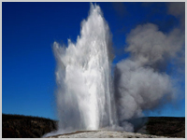
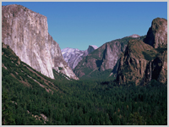
Visibility Projections
Alternatives to EPA Default Method:
EPAwoF – EPA Method without Fire
ModMID – Modeled Most Impaired Days

Slide 9
Three EPAwoF Projection Methods to Limit Fire Influences
EPAwoF method removes fire contributions using source apportionment
  Crater Lake, Oregon Example – 2014 IMPROVE MID – RepBase Source Apportionment Results
  Leaves only Anthropogenic, Natural and BC →
Measured Species on “Most Impaired Days”
Source Apportionment
← Rx Fire
← WF Fire
Source Apportionment

Slide 10
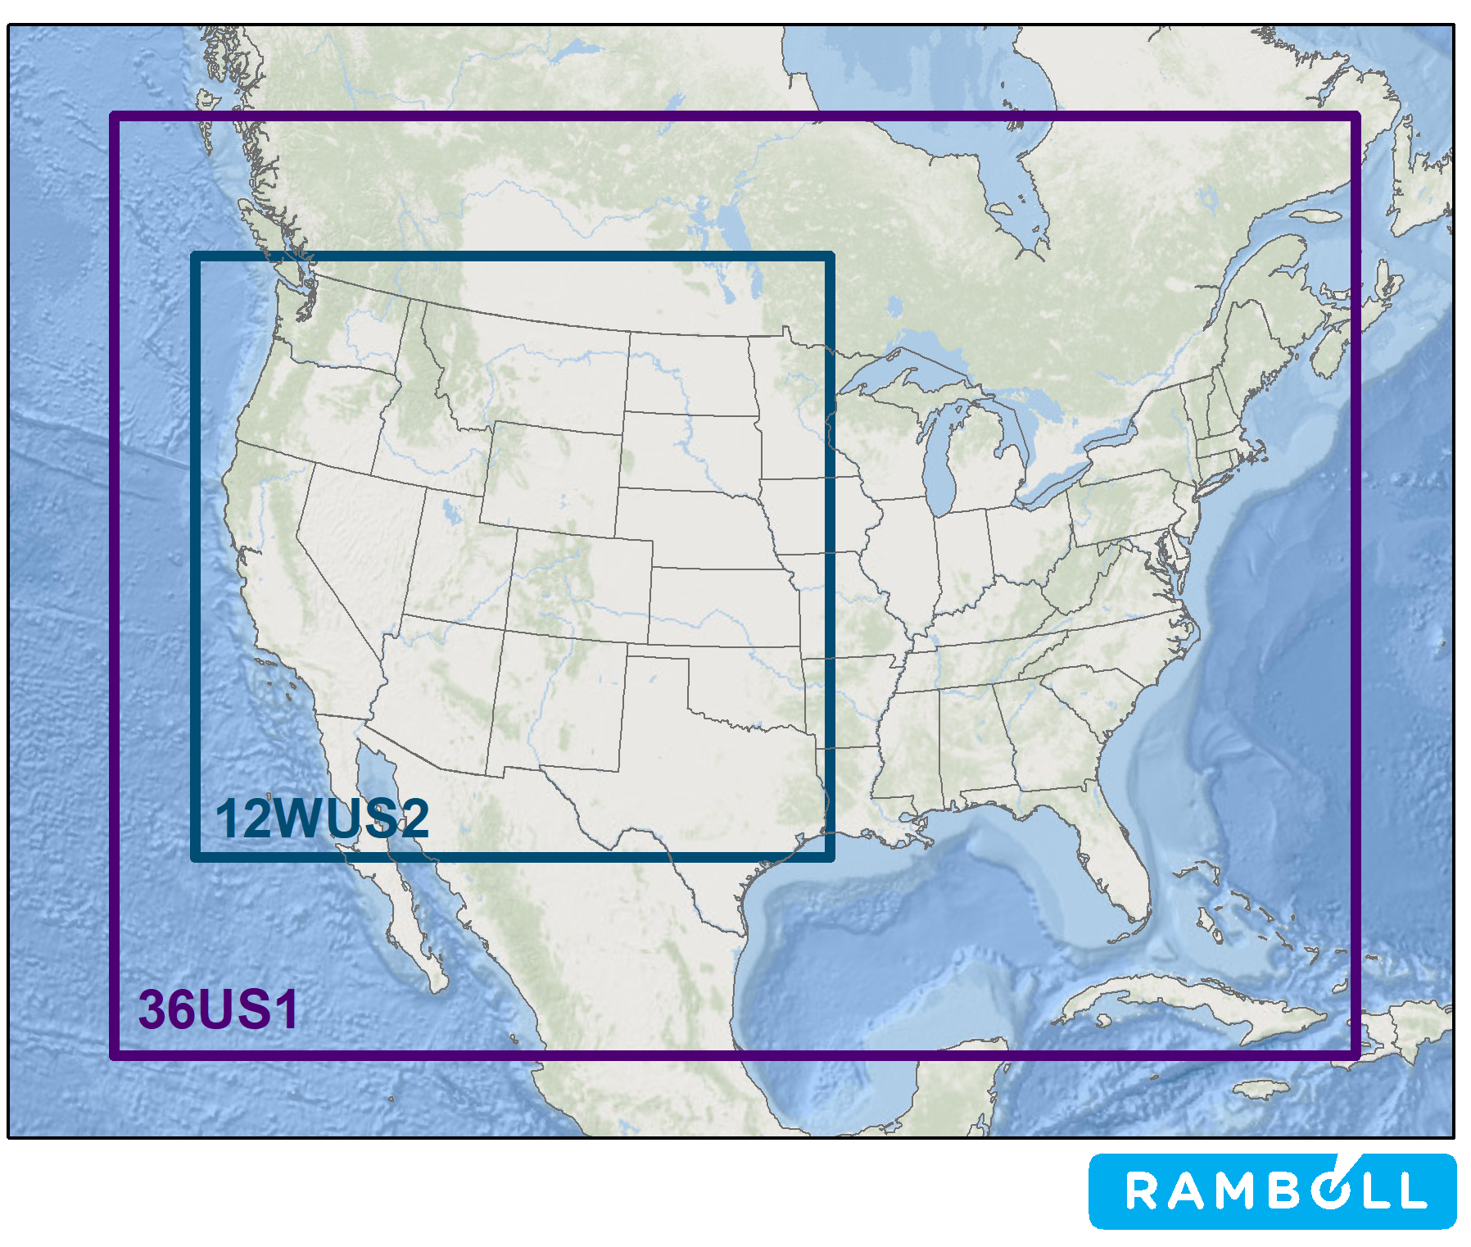
CAMx Modeling Used to Make 2028 Visibility Projections
2014v2: 2014 actual base case simulation using actual 2014 fire emissions
RepBase: Representative Baseline using anthropogenic emissions representative of 2014-2018 and RepBase fires.
  Includes Source Apportionment (SA) modeling
2028OTBa: 2028 On-the-Books w/ RepBase fires
  Will include Source Apportionment (SA)
2028OTBb: 2028 OTB using 2014 fires
PAC1: Potential Additional Controls w/ 2028OTBa
Paired current/future simulations to make 2028 visibility projections:
  2014v2/2028OTBb w/ 2014 actual fires
  RepBase/2028OTBa w/ RepBase fires
  RepBase/2028PAC1 w/ RepBase fires

Slide 11
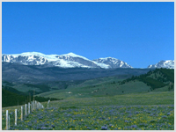
Adjusting the Uniform Rate of Progress “Glidepath”
Procedures for Adjusting the URP Glidepath to Account for Anthropogenic International Emissions and Wildland Prescribed Fires

Slide 12
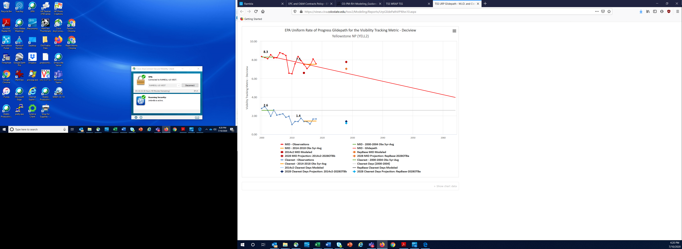
Background – Uniform Rate of Progress (URP) Glidepath
Clean Air Act Section 169A
  Prevent and remedy any existing visibility impairment at Class I Areas (CIA) due to man-made air pollution
Regional Haze Rule Goals:
  Trend toward natural conditions on worst visibility impairment days (called “Reasonable Progress”)
  No worsening of visibility on clearest days
Most Impaired Days (MID) visibility tracking metric
  Statistical technique to screen out days influenced by fires and dust
  20% MID assume to be primarily influenced by anthropogenic emissions
URP Glidepath
  2000-2004 IMPROVE MID Baseline
  2064 Natural Conditions End-Point
  Linear reduction from Baseline to Natural Conditions

Slide 13
Adjustments to URP Glidepath
From RHR Jan. 2017 changes, EPA guidance (2018) describes approach to adjust URP Glidepath to account for contributions from international anthropogenic emissions (“international emissions”) and wildland prescribed fires (“Rx fire”)
  The international emissions and Rx fire contributions are added to the 2064 natural conditions end-point to make an adjusted URP glidepath
EPA recommends Chemical Transport Models (CTMs) be used to estimate contributions of international emissions and Rx fires
  Model a current (e.g., 2014 or 2016) or implementation period end-date (i.e., 2028) year
  Use zero-out emissions (e.g., Zero Rest of World, ZROW) or source apportionment to isolate contributions of international emissions and/or Rx fire
  Recommend use consistent approaches for making 2028 visibility projections and estimating contributions from international emissions and Rx fire

Slide 14
How to determine international and Rx fire impacts?
Apply CAMx source apportionment tools to ‘tag’ emissions and their haze impacts at CIAs
Use the 2028OTBa simulation for the source apportionment run
Result: concentrations for international and Rx fire
Source Group | 2028OTBa High-level Source Apportionment | 2028OTBa Low-Level Source-Sector Apportionment
US Anthropogenic | US Anthropogenic | EGU Point
 |  | All Other Point
 |  | Oil & Gas Point + Nonpoint
 |  | Mobile Non-Road + On-Road, including rail, airports, and commercial marine
 |  | All Other US Anthro: Agricultural (NOx only) Fugitive Dust Residential Wood Remaining Nonpoint
 |  | US Agricultural Fire
 | US Wildland Prescribed fire | US Wildland Prescribed fire
Natural | US Wildfire | US Wildfire
 | Natural + Non-US fire | Non-Fire Natural (everything else plus Canada/Mexico fires)
International Anthropogenic | Canada- Anthro | Canada-Anthro
 | Mexico- Anthro | Mexico- Anthro
 | Commercial Marine | Commercial Marine
 | Boundary-International | Boundary-International

Slide 15
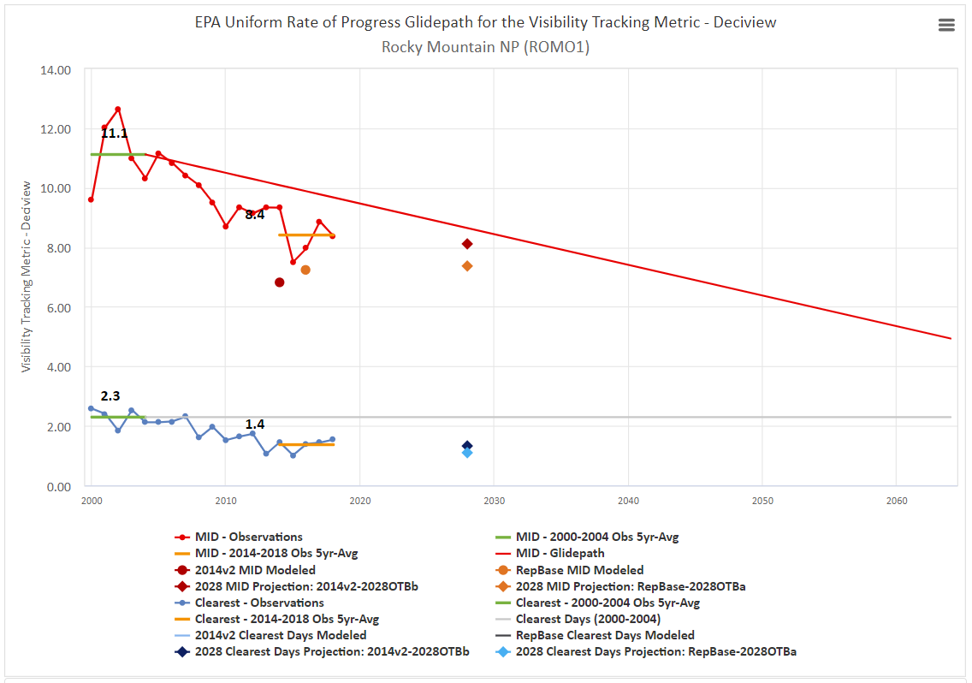
Rocky Mtn. NP example: Adjust the glide path for international & Rx fire
Adjusted URP that accounts for international and prescribed wildland fires (ESTIMATED -NOT FINAL)
Contribution from international and Rx fire
Unadjusted URP

Slide 16
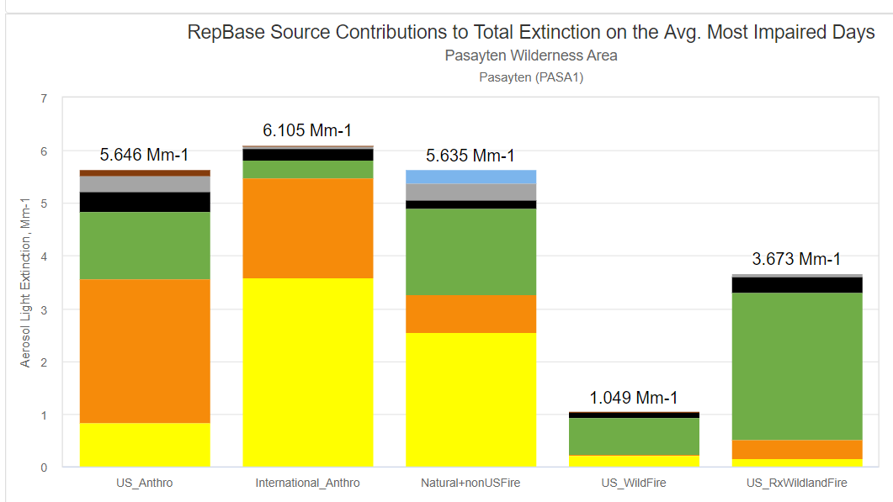
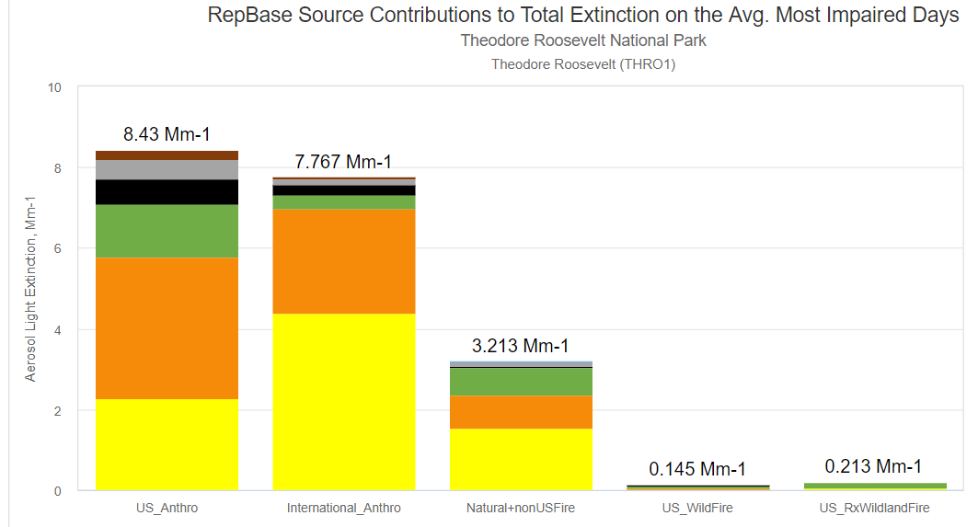
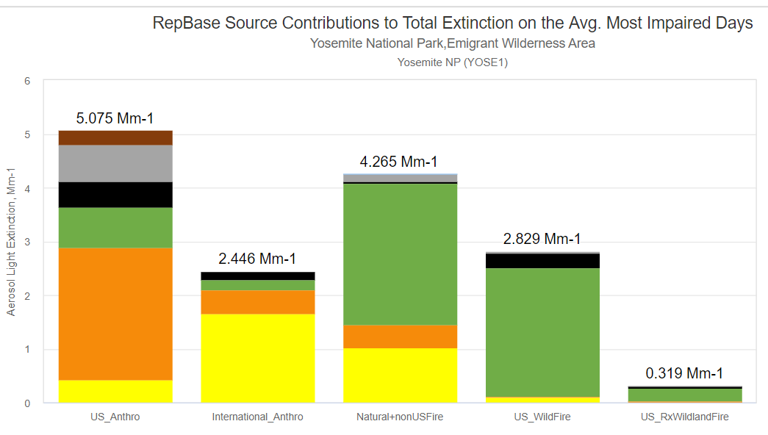
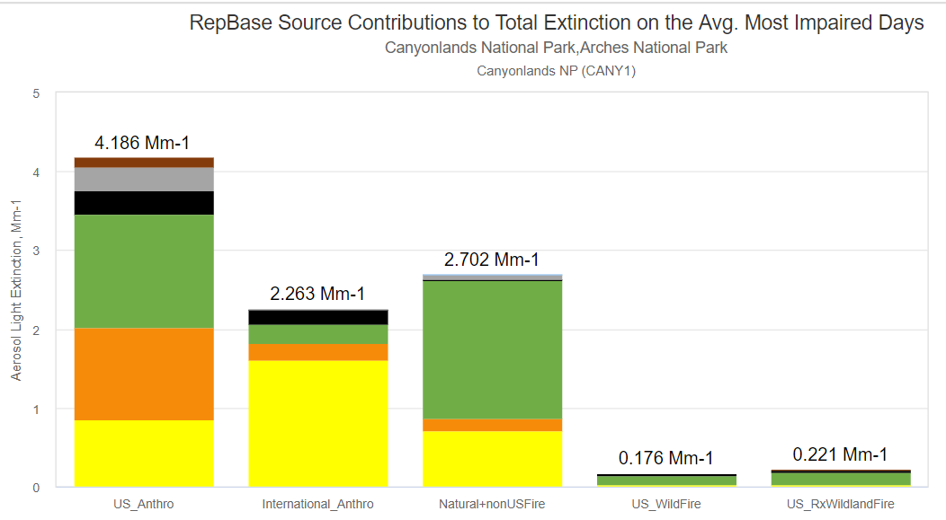
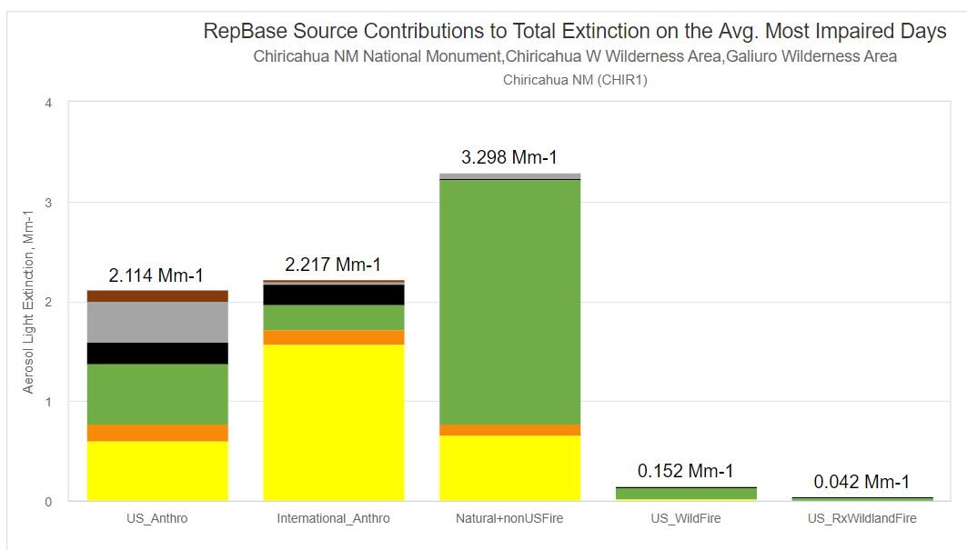
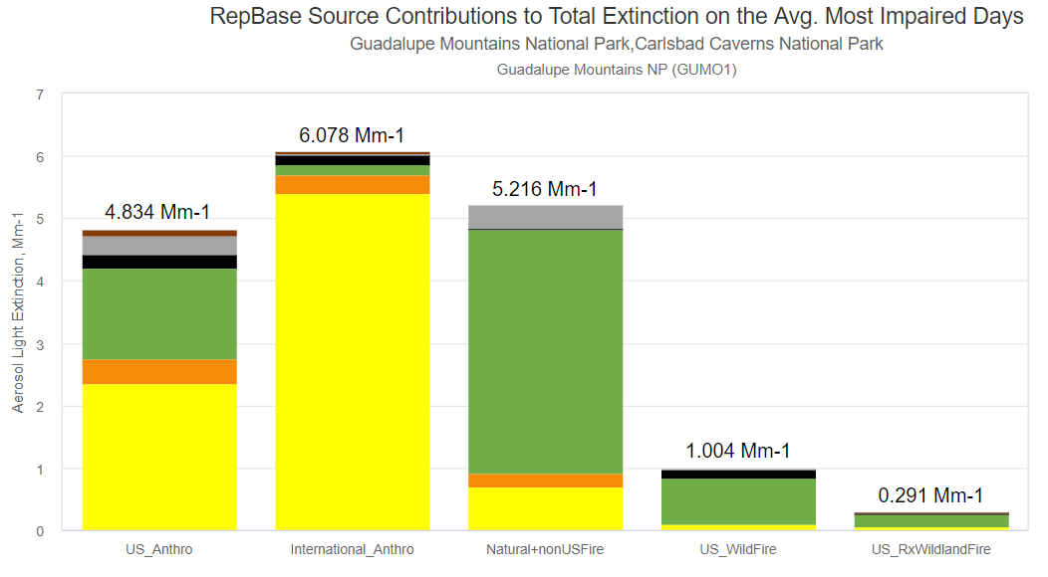
Examples of high-level source apportionment at other sites

Slide 17
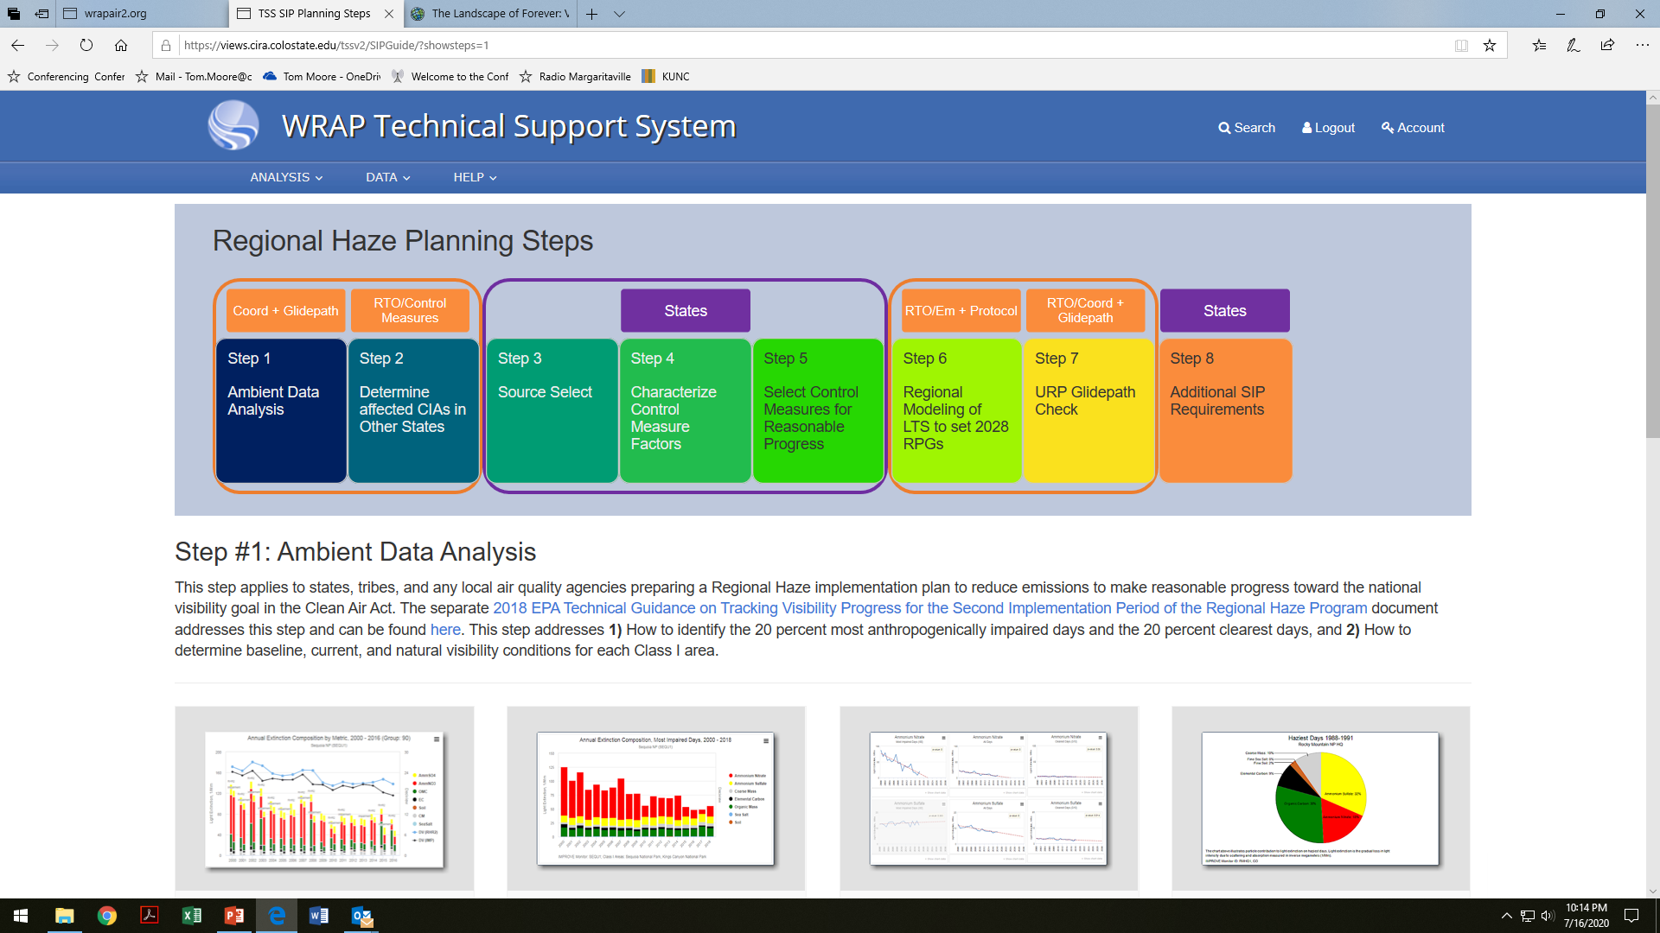
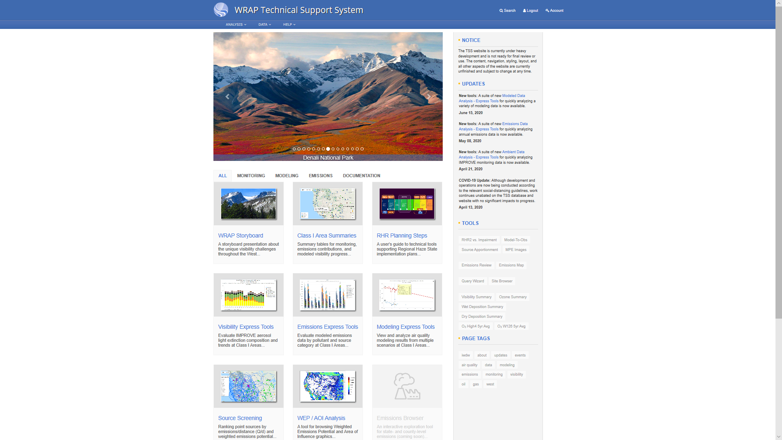
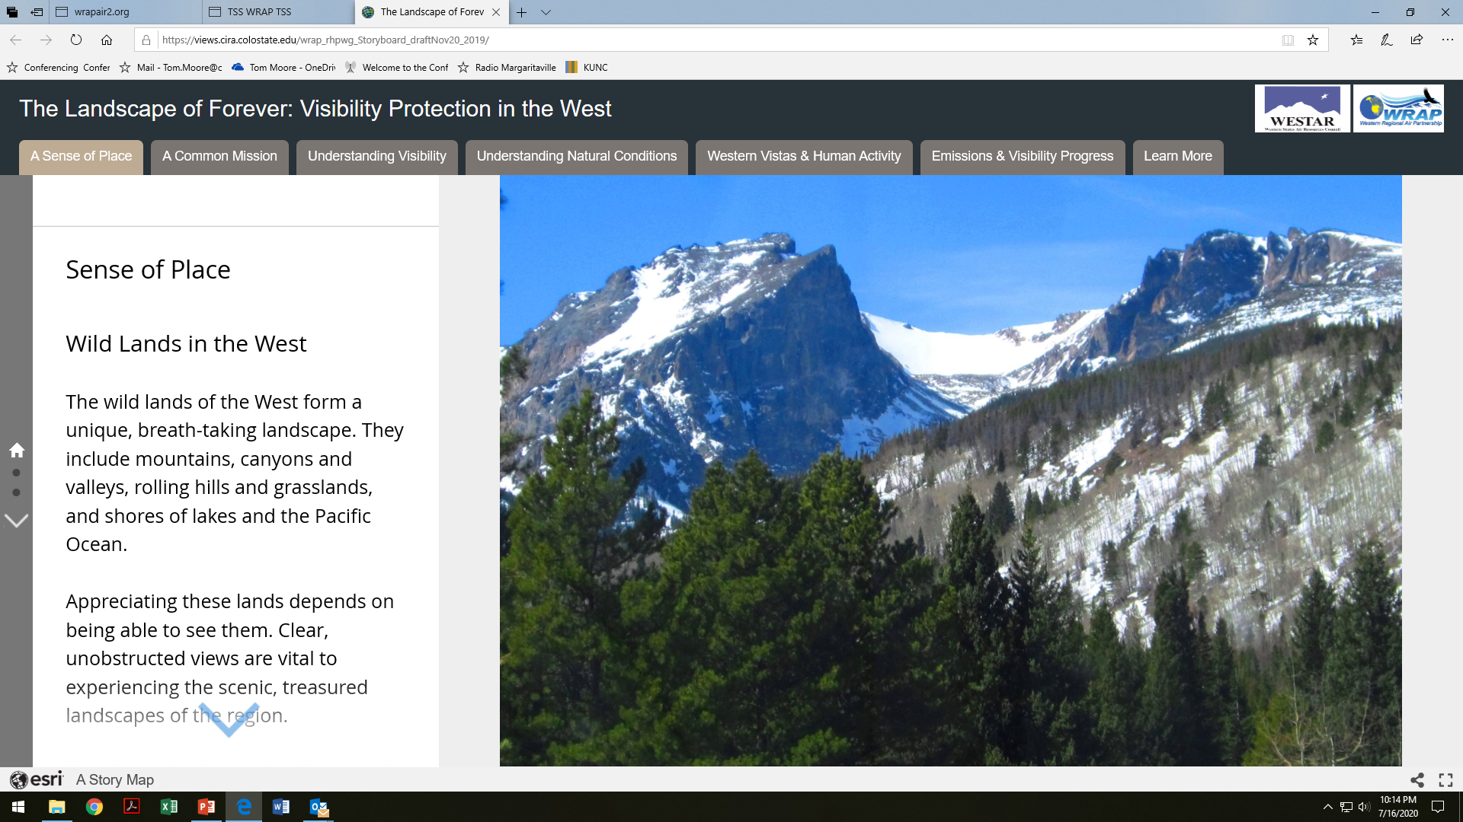

Slide 18
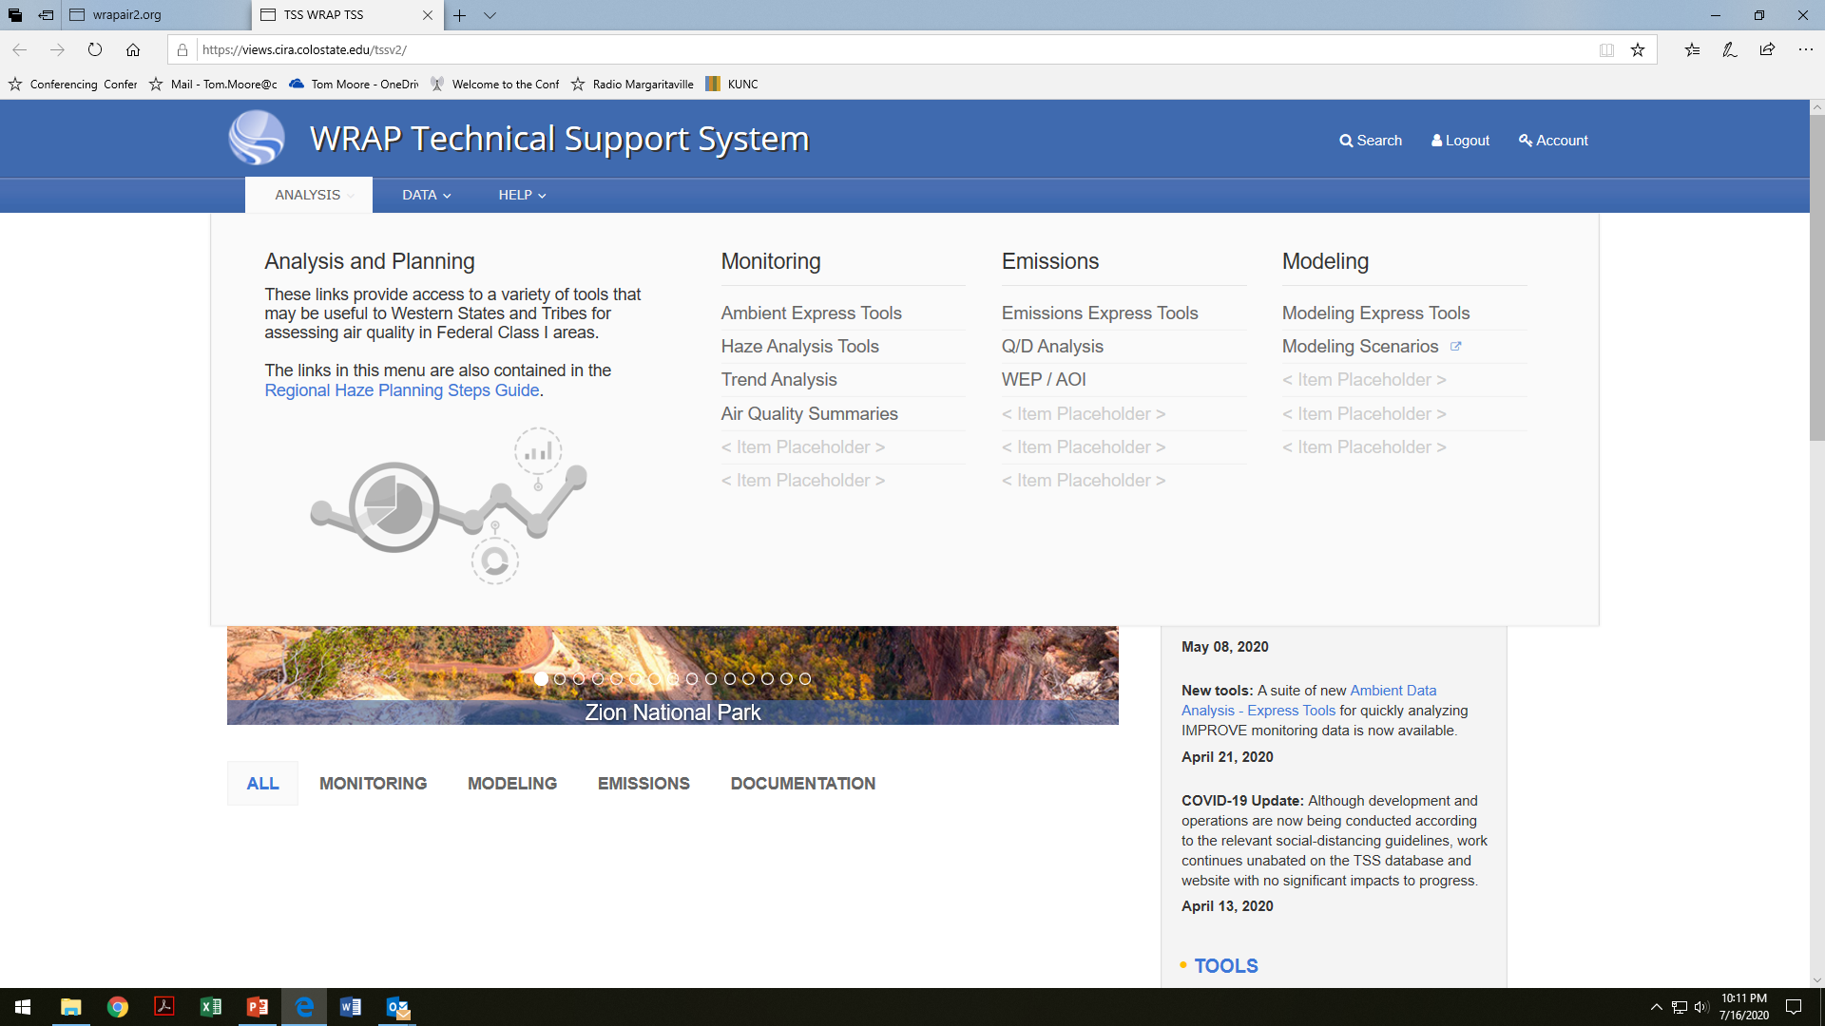
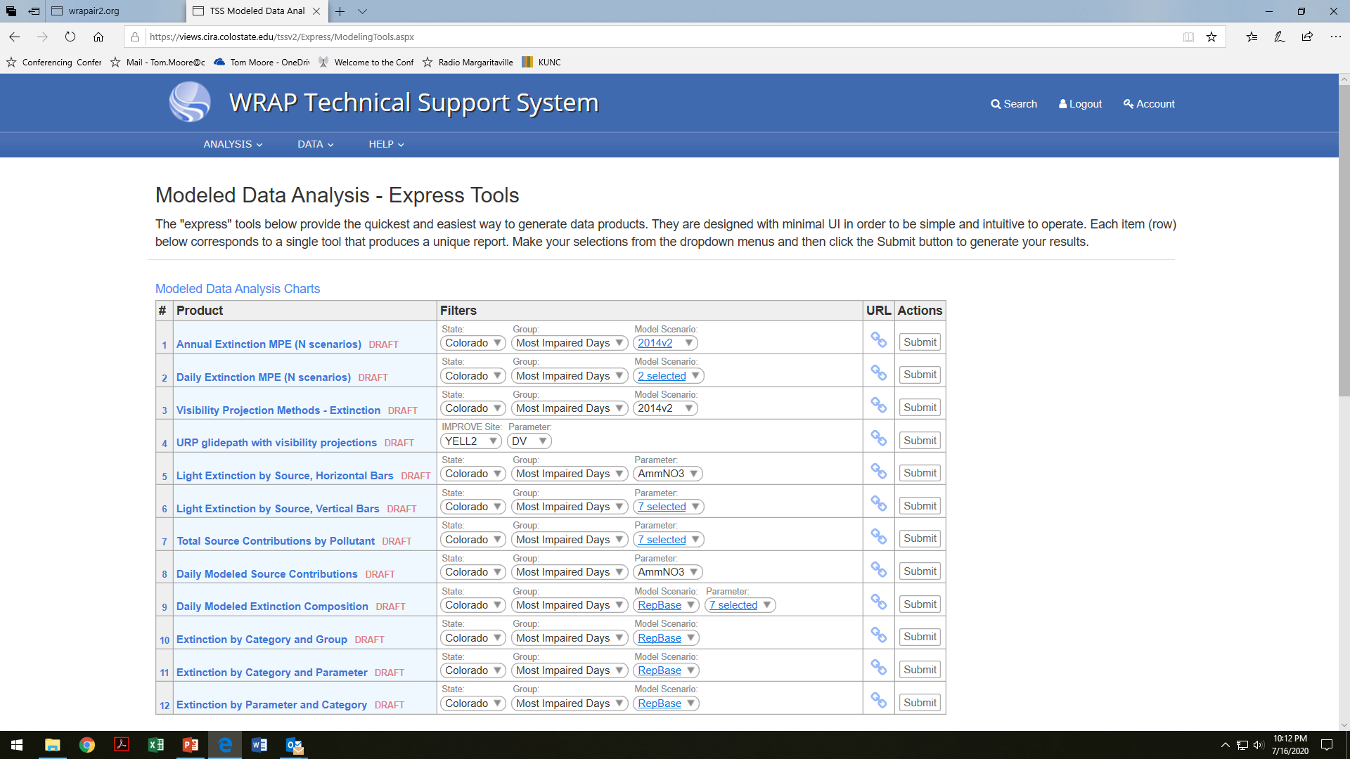

Slide 19
RTOWG and RHPWG deliverables
Regular reports in Summer 2020 Results and semi-annual WESTAR-WRAP Business meetings
More info listing these WGs’ deliverables on July 30th
RTOWG Co-Chairs:
  Mike Barna mike_barna@nps.gov or Mike.Barna@colostate.edu
  Gail Tonnesen Tonnesen.Gail@epa.gov
  Kevin Briggs Kevin.Briggs@state.co.us
RHPWG Co-Chairs:
  Jay Baker jbaker@utah.gov
  Amber Potts amber.potts@wyo.gov
  David Stroh destroh@nd.gov

Slide 20
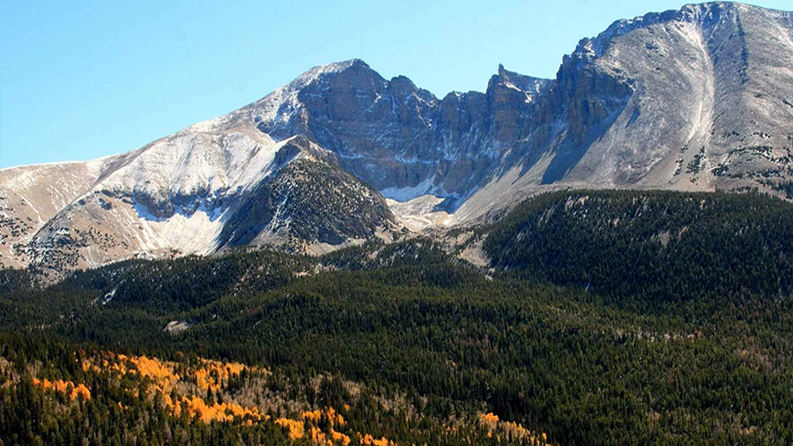
Questions and Discussion

