Slide 1
Monthly Update on 2018-2019 WRAP Workplan February 26th, 2020 TSC and Work Group Co-Chairs Call
Tribal Data WG
Fire and Smoke WG
Oil and Gas WG
Regional Technical Operations WG
Regional Haze Planning WG

Slide 2
Tribal Data Work Group

Slide 3
Workplan Progress by Tribal Data Work Group
Workplan Progress over the Last Month
Participation letter draft reviewed & adopted by TDWG
EN3 Oil & Gas Report final draft addressing comments from OGWG; comments and report/revisions reviewed & adopted by TDWG; updated web list of projects for completion
TDWG review of 2020 ITEP SOW
Workplan Tasks for the Next Two Months
Distribute letter using new tribal contacts email for WRAP
Docket approved OG report, any other remaining reports
Draft 2020 TDWG Workplan section/appendix- discuss on next call

Slide 4
Proposed Future Projects - TDWG
SOW for 2020 work provided by ITEP; discussion on TDWG calls of focus for 2020 activity: technical assistance for tribes with state SIP (or related) reviews
Continued updating of tribal contacts list
Outreach to tribes
Consider NTF presentation

Slide 5
Fire and Smoke Work Group

Slide 6
Workplan Progress by Fire and Smoke Work Group
Workplan Progress over the Last Month
Held workgroup call on 2/24
FFS EI:
Contractor wrote a draft final report on fire emissions inventory work for Regional Haze modeling
Contractor completed preparation of Future Fire Scenario Wildfire and Rx EIs for RH modeling. Data will be sent to Ramboll by the end of this week.
FETS transition action plan:
Matt and Tom cooked up a plan to incorporate FETS into Intermountain Data Warehouse platform
Sara tried to promote FETS revival through communications with NW-AIRQUEST consortium. ID-MT Airshed Group and WA willing to share data.
Review of final tasks in WRAP workplan:
Final task is “Wildfire coordination between states, tribes, and feds”
Tom suggested using the task as a jumping off point to reorganize the workgroup going forward. Plan is to meet quarterly as a discussion group that could cover topics like wildfire coordination, exceptional events, smoke management, air sensors…

Slide 7
Workplan Progress by Fire and Smoke Work Group
Workplan Tasks for the Next Two Months
Members to review draft EI report and send Matt feedback
Matt will revise FETS Action Plan to include new plan to incorporate with IDW
Draft a list of bullet points to summarize self assessment and outline the future of the workgroup
Final, valedictory workgroup call will be on April 6.

Slide 8
Proposed Future Projects - FSWG
Continuing quarterly calls for Fire and Smoke WG (draft bullets)
Provide a venue for federal, state, and tribal fire and smoke people to discuss matters relevant across agencies
Wildfire and Rx coordination across agencies and jurisdictions
Documentation and data sharing for exceptional events due to wildfire or Rx burns
Maintain a link between regional haze planning and operational fire and smoke people
Emissions inventory approaches, remote sensing, and other technical issues involving air quality and fire and smoke

Slide 9
Oil and Gas Work Group

Slide 10
Workplan Progress by Oil and Gas Work Group
Workplan Progress over the Last Month
OGWG and Project Management Team (PMT) review and feedback
Final Revisions (CO & NM information changes): Task 2 – Forecast Scenario (OTB & OTW - Medium Emissions Scenario)
Final Revisions (CO & NM information changes): Task 2 – Forecast Scenarios (OTB & OTW - Low and High Emissions Scenarios)
Consensus Approval February 11, 2020: Task 4 – Agency Program Review
Seeking Consensus Approval: Task 3 – Additional Reasonable Controls
Tasks for the Next Two Months
OGWG Self-Assessment
Coordination - Integration for WRAP OGWG Base and Future Year Emissions Inventories in National Collaborative Platform

Slide 11
Proposed Future Projects - OGWG
Potential Additional Future Project/s
February 11, 2020 OGWG Bi-Monthly Call initiated Self-Assessment to determine future direction and needs of OGWG in the upcoming year
OGWG Co-Chairs to discuss best way to seek input from members/advisors
Additional discussion planned April 14, 2020 OGWG Bi-Monthly Call

Slide 12
Regional Technical Operations Work Group

Slide 13
Workplan Progress by RTOWG Work Group
Workplan Progress over the Last Month
Weekly co-chair coordination calls
Weekly calls with Ramboll to keep track of modeling progress
Initial comparison of 1) 2014v2 and 2) representative baseline model results for IMPROVE most impaired days (MID)
Example at Canyonlands for IMPROVE, 2014v2,
and representative baseline on most impaired days

Slide 14
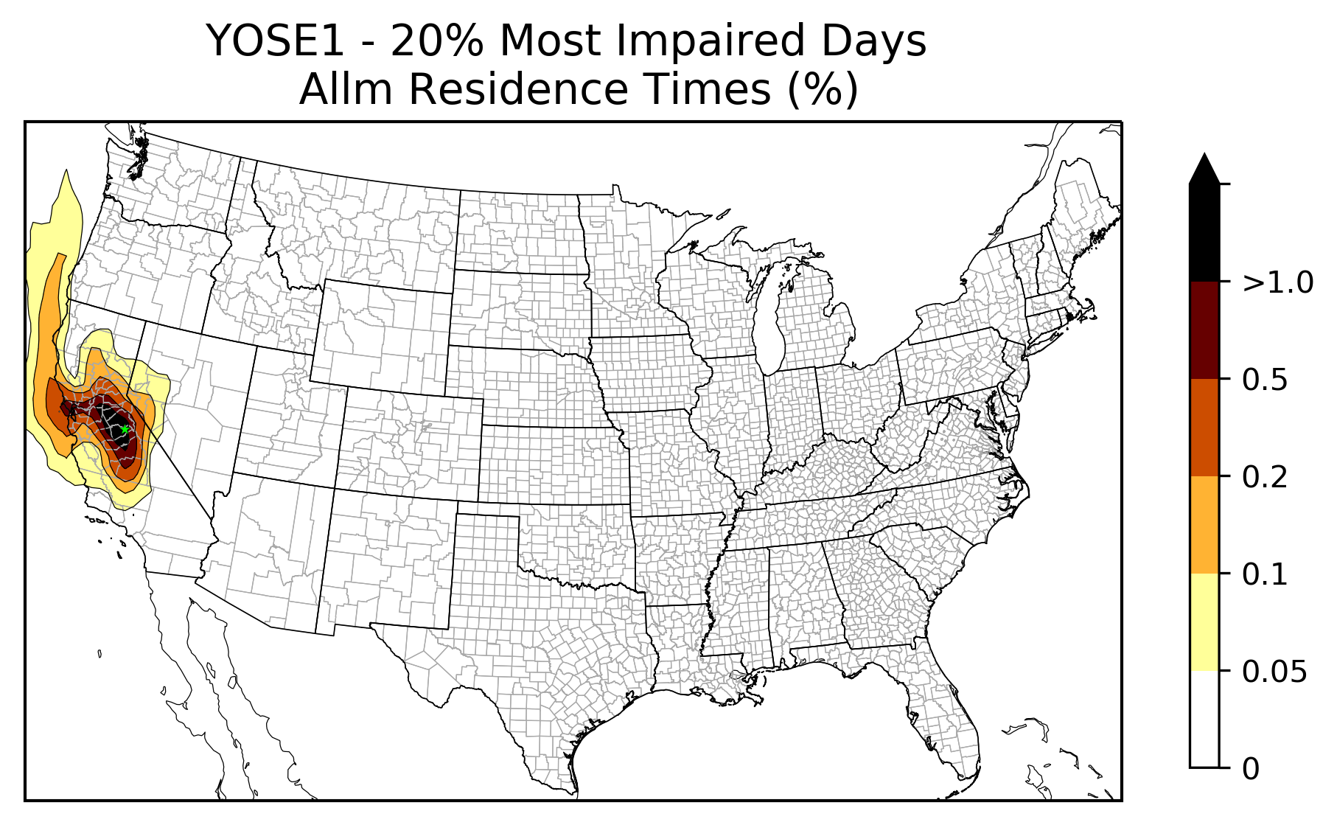
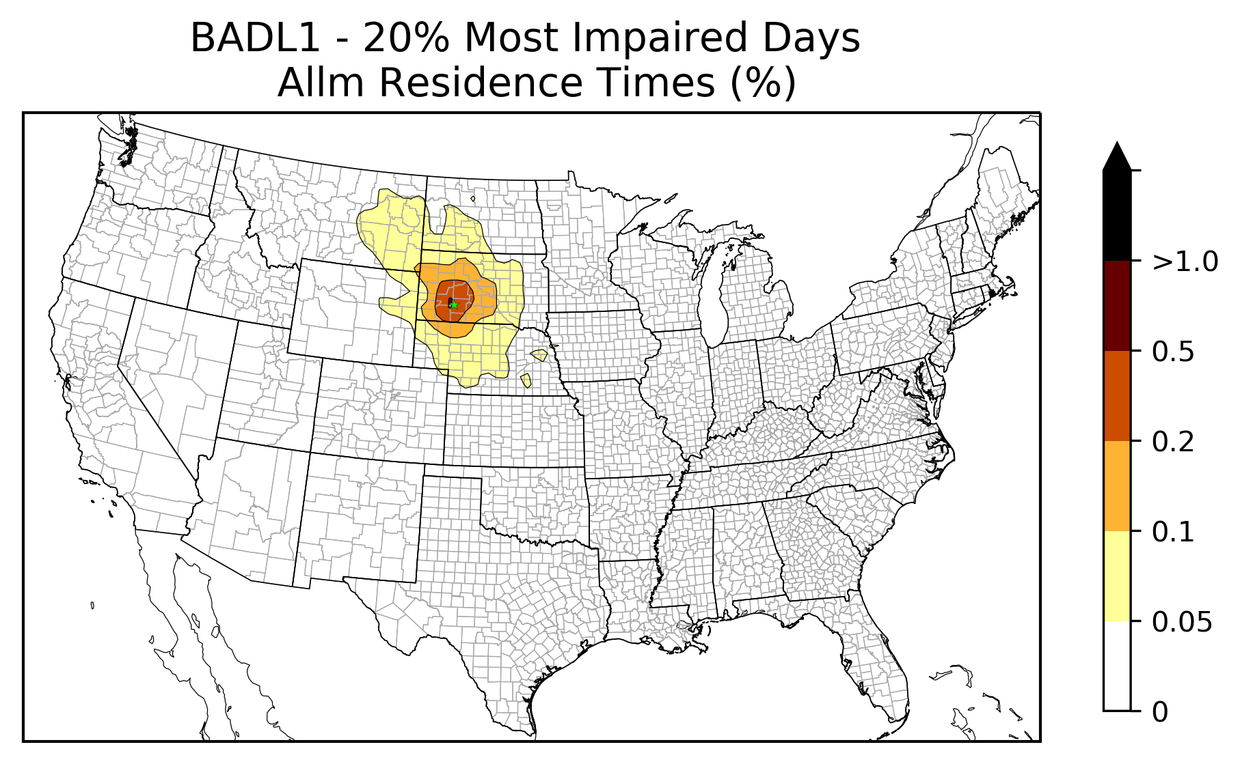
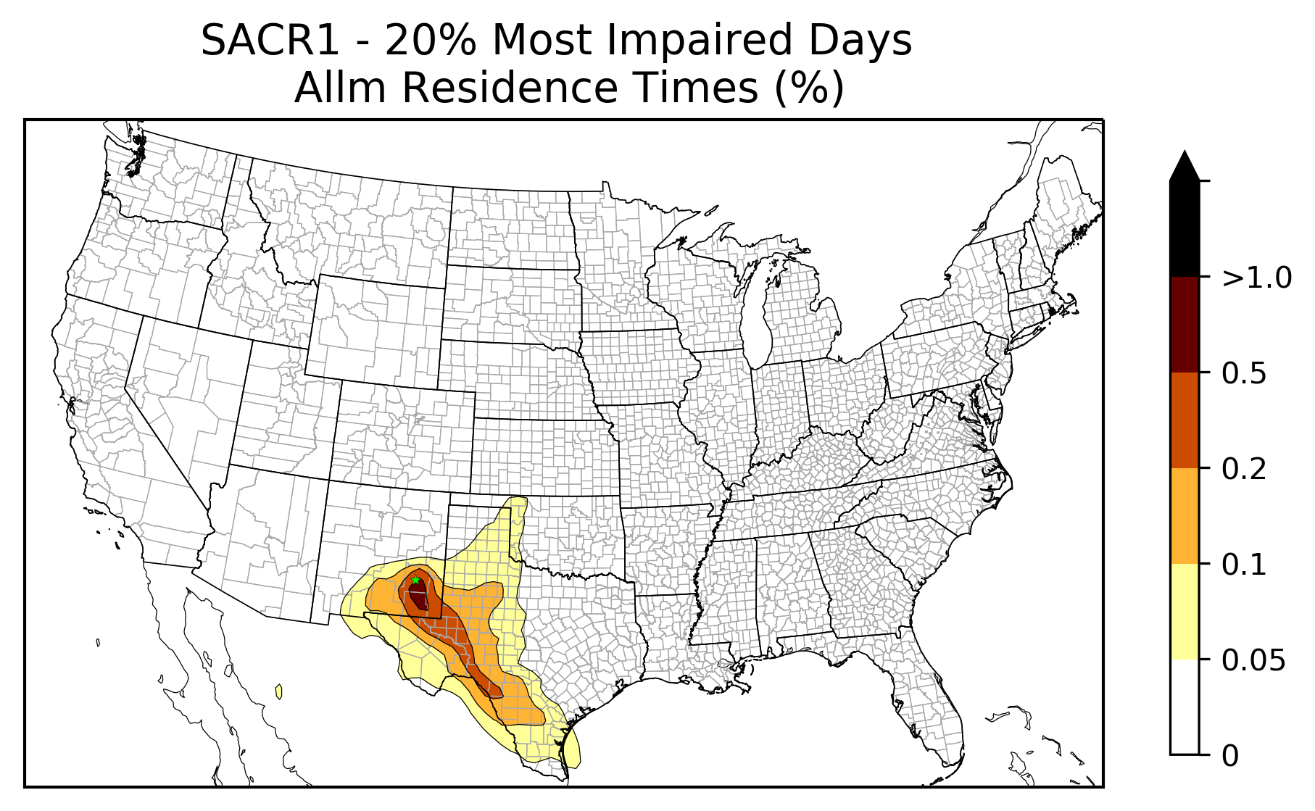
Workplan Progress by RTOWG Work Group
Workplan Progress over the Last Month
Transfer of modeling files to CIRA
Finishing processing of 2028 emissions, should be done by next week
Weighted Emissions Potential/Area of Influence (WEP/AOI) analysis started
Trajectory residence time analysis done, need 2028 emissions for WEP

Slide 15
Workplan Progress by RTOWG Work Group
Workplan Progress over the Last Month
A series of “Run Specification Sheets” is available for review
Natural (NAT) and No International (ZROW) GEOS-Chem/CAMx
RepBase Source Apportionment Modeling (NAT/ANT & U.S./Intl)
RepBase and 2028 On-the-Books (2028OTB) Modeling
Dynamic Evaluation: CAMx 2002 Modeling
WEP/AOI Analysis

Slide 16
Workplan Progress by RTOWG Work Group
Workplan Tasks for the Next Two Months
Future year (2028) CAMx simulations
2028 on-the-books emission controls with 2014 fire emissions
2028 on-the-books emission controls with representative baseline fire emissions
2028 potential additional emission controls with representative baseline fire emissions
2028 adopted additional emission controls with representative baseline fire emissions
2028 on-the-books emission controls with future wild fire emissions
2028 on-the-books emission controls with future prescribed fire emissions
2028 on-the-books emission controls with future boundary conditions
2028 on-the-books emission controls with 2014 fire emissions (CMAQ – optional)

Slide 17
Workplan Progress by RTOWG Work Group
Workplan Tasks for the Next Two Months
Future year (2028) CAMx source apportionment simulation
Continue development of evaluation tools for emissions and model results
Calculate and display 2028 Reasonable Progress Goals (RPG)
Finish WEP/AOI analysis
Dynamic Model Evaluation

Slide 18
RTOWG Remaining Workplan Tasks

Slide 19
Regional Haze Planning Work Group

Slide 20
Workplan Progress by Regional Haze Planning Work Group
Workplan Progress over the Last Month
No Large Work Group call in February – Subcommittee calls
Workplan Tasks for the Next Two Months

Slide 21
Workplan Progress by RH Planning Work Group – Control Measures Subcommittee
Workplan Progress over the Last Month
February Call discussion on providing emission reduction estimates to WRAP by March 16th deadline
A few states (AZ, ND & NM) further along in the 4-factor review intend to provide emission reduction estimates for the 2028 control run
Several states (CO, ID, MT, OR, UT, WA) further behind in the 4-factor review will likely rely on OTB/OTW reductions in the 2028 baseline
Couple states (CA & NV) may provide emission reduction estimates
Workplan Tasks for the Next Two Months
States to continue 4-factor review work
States to review WEP analysis when it becomes available

Slide 22
Workplan Progress by Coordination and Glide Path Subcommittee
Workplan Progress for February
TSS FAQ Document Finalized
TSSv2 Delivery Update Presentation
ARS Data Substitution and IMRPOVE December Patch Presentation
Storyboard Update
Workplan Tasks for the Next Two Month
Continue overview of TSSv2 development
Gain consensus on TSS Glossary
Support creation of RH Storyboard
TSS Prioritization

Slide 23
Workplan Progress & Coordination by RHPWG Emissions Inventory & Modeling Protocol SC
Workplan Progress over the Last Month
Coordinated with other subcommittees, states, and contractor as needed to review/update emissions as needed.
Finalized OTW/OTB emissions inputs from states
Shared info with states/locals about progress on 4-factor analyses and submitting emissions reductions for the controls scenario modeling inputs
Workplan Tasks for the Next Two Months
Reports on results of base & future year visibility, source apportionment modeling, and model performance evaluation
RTOWG contractor-supported report on Reasonable Progress Goals
RTOWG – contractor supported Weighted Emissions Potential (WEP) analysis that will provide WEP maps of source areas impacting each Class I area

Slide 24
End of Workplan Progress Update

