Slide 1
Monthly Update on 2018-2019 WRAP Workplan January 30th, 2019 TSC and Work Group Co-Chairs Call
Tribal Data WG
Fire and Smoke WG
Oil and Gas WG
Regional Technical Operations WG
Regional Haze Planning WG

Slide 2
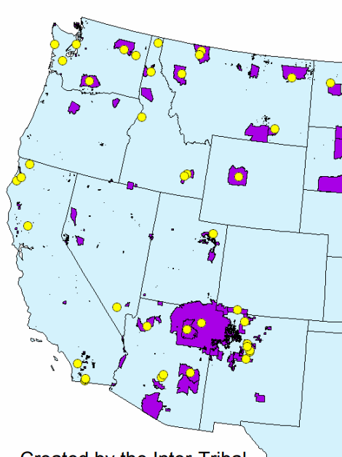
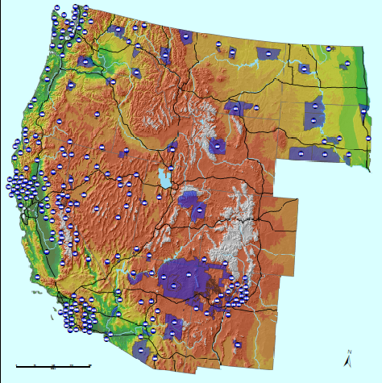
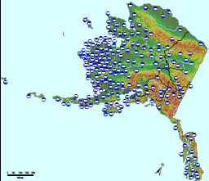
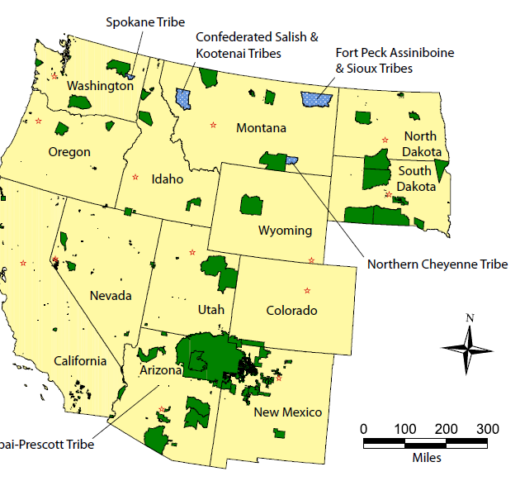
Tribal Data Work Group

Slide 3
Workplan Progress by Tribal Data Work Group
Workplan Progress over the Last Month
Worked with ITEP and EN3 on the contracted tasks
Documents are available on the RH TDWG page in draft form
Workplan Tasks for the Next Two Months
Schedule webinar dates
Organize WRAP and TDWG participation at the National Tribal Forum on Air Quality
Finalize all products from the ITEP and EN3 work at next TDWG Call

Slide 4
Workplan Coordination Activities by Tribal Data Work Group
Workplan Coordination Occurring over the Last Month
Consultation & Coordination (C&C) Subcommittee – ITEP, EN3 and TDWG, how does our products fit into framework document and scheduling of webinars
Oil and Gas Workgroup – ITEP, EN3 and TDWG drafted Tribal oil and gas related emissions
Workplan Coordination Needed over the Next Two Months
Same groups as mentioned above
National Tribal Forum on Air Quality – breakout session and networking clubhouse organization
EPA for the WRAP area Tribal contact list

Slide 5
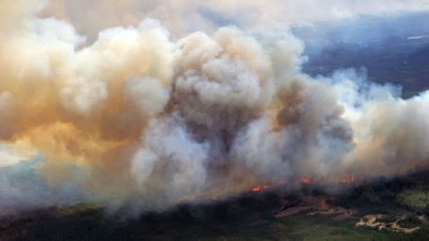
and
Fire and Smoke Work Group

Slide 6
Workplan Progress by Fire and Smoke Work Group
Workplan Progress over the Last Month
Provided draft workplan update to workgroup prior to deadline
Received zero feedback from workgroup
Submitted workplan update to Frank anyway
Workplan Tasks for the Next Two Months
Finalize workplan update
Submit base year Fire EI to Ramboll ✔
Scheduled call: Utah Smoke Management Plan presentation
Identify methodologies to determine future year and multi-year baseline fire emissions for RH modeling

Slide 7
Workplan Coordination Activities by Fire and Smoke Work Group
Workplan Coordination Occurring over the Last Month
None.
Workplan Coordination Needed over the Next Two Months
Need to coordinate with Emissions Inventory and Modeling Protocol Subcommittee and RTOWG on preparing the baseline and future year fire EIs

Slide 8
Oil and Gas Work Group

Slide 9
Workplan Progress by Oil and Gas Work Group
Workplan Progress over the Last Month
OGWG Survey deliverables for O&G operator distribution by State Agencies
Draft OGWG Workplan Review & Update out for review for Jan. 22 call
Workplan Tasks for the Next Two Months
OGWG O&G Operator Surveys – Late February - Completion
Task 1: Base Year Inventory - Late February - Survey compilation memo
Task 2: Forecast 2028 Inventory (On-the-books controls) - February - Forecast scenarios

Slide 10
Workplan Coordination Activities by OGWG
Workplan Coordination Occurring over the Last Month
January 9 Project Management Team & S,L,T Agencies Call
Check-In OGWG Survey
Assistance from Agencies on OGWG Survey distribution to O&G operators
January 22 OGWG Special Call
Mid-Course Workplan Review & Update
Workplan Coordination Needed over the Next Two Months
February 12 OGWG Bi-Monthly Call
Agenda under development
Assistance from Agencies / O&G operators to complete OGWG Survey
OGWG and PMT review of draft work products

Slide 11
Regional Technical Operations Work Group

Slide 12
Workplan Progress RTOWG
Workplan Progress over the Last Month
Western Modeling Shakeout Coordination call with Contractors on January 2
Monthly RTOWG Call on January 11th
2014 Shakeout Western Modeling project deliverables and progress report
NPS/CIRA project to apply 2014 western modeling platform to focus on NH3 simulation and improvement
Plans for updates to the RTOWG portion of the Workplan
Workplan Coordination Occurring over the Previous Month
RTOWG Co-Chairs Participated in the:
RHPWG call on January 8
O&G WG Workplan call on January 22
Workplan Coordination over the Next Two Months
Updated 2014 Base Year Emission Inventory from the RHPWG-EI MP
Next RTOWG Workplan call is January 31 at 10:00-10:30 MST
Next “Shakeout” call with contractors is January 31 at 2:00-3:30 MST
Next Regular Monthy RTOWG call is February 12 at 10:30-12:00 (subject to change)

Slide 13
Workplan Tasks for the Next Two Months: 2014 Platform Development and Shake-Out Study.
Work Item | Draft | Final
Phase I 2014 Shake-Out Modeling Plan | Dec 2018 | Jan 2019
Single-Source Visibility Modeling Webinar | Dec 2018 | Dec 2018
Single-Source Visibility Modeling Memorandum | Jan 2019 | Feb 2019
2014 Emission Inputs | Jan 2019 | Feb 2019
2014 36-km CONUS Domain Boundary Conditions | Jan 2019 | Jan 2019
2014 Meteorological Inputs | Jan 2019 | Jan 2019
2014 WRF and Biogenic PGM Sensitivity Tests | Feb 2019 | Feb 2019
2014 Annual CAMx and CMAQ Platforms | Feb 2019 | Feb 2019
Phase II Illustrative Modeling Plan (WAQS/WestJumpAQMS) | Feb 2019 | Mar 2019
2014 Annual CMAQ and CMAQ Base Case and MPE | Mar 2019 | Mar 2019
Transfer 2014 Platform to IWDW | Feb 2019 | Mar 2019
2014 Shake-Out Close-Out Meeting | Mar 2019 | Mar 2019
2014 Shake-Out Report | Mar 2019 | Mar 2019

Slide 14
Regional Haze Planning Work Group

Slide 15
Workplan Progress by Regional Haze Planning Work Group
Workplan Progress over the Last Month
Finished SIX “White Papers” (Subcommittee Deliverables)
Will circulate as “drafts” to help SIP writers & other Work Groups pending Federal partners returning for consensus & docketing
Provided Updates & Revisions to 2018-2019 Work Plan for first draft
Workplan Tasks for the Next Two Months
See Subcommittee reports
Discern Training & Outreach Needs for New Over-Arching Task 6
Get Consensus for WorkPlan revisions and Updates

Slide 16
Workplan Coordination Activities by Regional Haze Planning Work Group
Workplan Coordination Occurring over the Last Month
TSC conference call in December
Individuals sit on other Work Group calls
Increase Work Group conference calls to once a month in 2019
Workplan Coordination Needed over the Next Two Months
Better exchange of information with RTOWG on forecasting and modeling
Refocus on training and outreach (coordinate with C&C and SDb)
Work closely with TSC, Subcommittees, and States to understand what contracting can be funded; what Subcommittees can reasonably be expected to do; what states must do on their own
Identify gaps between feasible deliverables and needs/expectations of State SIP writers

Slide 17
RHPWG EI & MP Subcommittee
Workplan Progress over the Last Month
Provided state emissions updates to contractor for base-year “shakeout” modeling
Emissions Processing underway
Workplan Tasks for the Next Two Months
Final review for base-year EI White Paper on Jan 31
Will forward for docketing after subcommittee comments are collected
Review “shakeout” emissions summaries from contractor
Prepare for second round of base-year modeling
Point source representativeness?
Subcommittee Coordination
Work with modeling contractor Ramboll (past & future)
Coordinate through WGs or contractor for O&G or F&S inventory data? (future)
Coordinate with RTOWG on categories for Source Apportionment

Slide 18
RHPWG MD & GP Subcommittee
Workplan Progress over the Last Month
Finished White Paper on Most Impaired Days Selection
Webinar with EPRI on International Emissions for 2064 endpoint adjustment ideas
Workplan Tasks for the Next Two Months
White Paper to Work Group membership as “draft” pending return of Federal partners for consensus and docketing
Awaiting ARS completion of Data Substitution and Patching
Subcommittee Coordination
Members participate heavily in SDb Sc (past & future)
Increased coordination with RTOWG and EI & MP Sc to determine methods for international transport URP adjustment (future)
May increase interaction with EPA and with IMPROVE Subcommittee to develop method for determining Glide Path 2064 endpoint (future)

Slide 19
RHPWG CM Subcommittee
Workplan Progress over the Last Month
Finished Screening Guidance White Paper
Finalized contract for Q/d screen and priorities for culling 4-factor analysis candidates
Workplan Tasks for the Next Two Months
White Paper to Work Group membership as “draft” pending return of Federal partners for consensus and docketing
Distribute results of contractor screening perhaps as webinar
Further Discussions of Area Sources and four-factors
Further Discussions of Visibility as a factor if states still considering it
Subcommittee Coordination
Work with Q/d contractor Ramboll (past & future)
Coordinate with C&C Sc for Webinar on source screening process using contractor deliverable (future)
Coordinate with O&G WG will Q/d contract pick up O&G sources in every state; can be area or stationary (future)

Slide 20
RHPWG C&C Subcommittee
Workplan Progress over the Last Month
White Paper for three-tiered “Framework” finished pending coordination with TDWG on additional description of informal consultation with tribes
Workplan Tasks for the Next Two Months
White Paper to Work Group membership as “draft” pending completion and return of Federal partners for consensus and docketing
Complete timeline of key milestones for states
Begin work on “new” outreach task
First coordination webinar postponed to March
Subcommittee Coordination
Work with TDWG and ITEP on “coordination” contacts (past & future)
Coordinate with SDb Sc on new “training & outreach” task (January and beyond)
Work with all Subcommittees and Work Groups to determine which has deliverables to showcase in first quarterly regional haze webinar (future)

Slide 21
RHPWG SDb Subcommittee
Workplan Progress over the Last Month
Finished Overview of SIP Process White Paper
Working on In formational/Instructional text for TSS v.2.
Workplan Tasks for the Next Two Months
White Paper to Work Group membership as “draft” pending return of Federal partners for consensus and docketing
Begin work on “new” outreach task
Subcommittee Coordination
Work with CIRA as sounding board for TSSv.2 development (past & future)
Coordinate with C&C Sc on new “training & outreach” task (January and beyond)
Work With C&C subcommittee to coordinate Webinar timing for periodic “Progress Reports” on TSS v.2 functionalities

Slide 22
End of Workplan Progress Update

Slide 23
Workplan Progress by (insert name) Work Group
Workplan Progress over the Last Month
Example bullets
Draft report out for review
Provided feedback to contractor regarding IMPROVE data substitution
Workplan Tasks for the Next Two Months
Example bullets
Finalize draft report
Review final contractor recommendations on data substitution

Slide 24
Workplan Coordination Activities by (insert name) Work Group
Workplan Coordination Occurring over the Last Month
Who did you coordinate with, what topics were discussed, and when did it occur (replace this text with you own)
Workplan Coordination Needed over the Next Two Months
What activities do you need to coordinate on, with whom, and expected timeframe (replace this text with you own)

