Slide 1
WRAP TSC/Co-Chairs Call Workplan Progress Update September 26, 2018
Tribal Data WG
Fire and Smoke WG
Oil and Gas WG
Regional Technical Operations WG
Regional Haze Planning WG

Slide 2
Tribal Data Work Group

Slide 3
Tribal Data Work Group
Co-Chairs: Kris Ray (Colville Tribes) and Emma Ruppell (Bishop Paiute Tribe)
Call Schedule: as needed
Website: http://www.wrapair2.org/tdwg.aspx (under development)
Current Tasks/Projects
Working on the Tasks in the 2018 to 19 workplan
Data analysis
Outreach

Slide 4
Tribal Data Work Group Work Products and Next Steps
TDWG Road Map Scope of Work (Institute for Tribal Environmental Professionals)
General WRAP outreach, contact list, and map updating
Tribal AQS data gap study
Tribal NEI data gap study
Tribal oil and gas EI studies
Consultation Protocol
WRAP webinars
Next Steps
Kick-off call
Leverage ITEP work to connect with National Tribal Air Monitoring Support Center and National Tribal Air Association
Most products completed within 10 week of contract

Slide 5
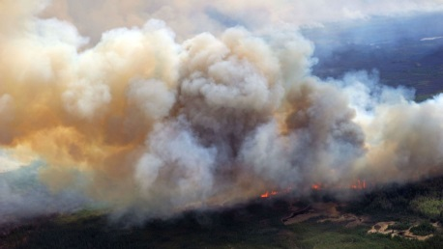
and
Fire and Smoke Work Group

Slide 6
Fire & Smoke Work Group
Co-Chairs: Sara Strachan, Josh Hall
Call Schedule: monthly
Website: http://www.wrapair2.org/FSWG.aspx
Current Tasks/Projects
2014 WRAP FNEI data review
National 2016 Emissions Modeling Platform – Fires WG support for WRAP region
Steady update/maintenance work on WRAP FETS website and database

Slide 7
Status Report for Fire & Smoke Work Group
Approach: 4 tasks in 2018-19 by Air Sciences, Inc. (contracted work)
evaluation of the 2014 NEI, evaluation of adjustments for sensitivity testing, and evaluation of usefulness of 2016 EPA inventory effort for understanding the role of fire;
using year specific inventory to develop inventory representative of 5-year baseline;
scaling the representative inventory for sensitivity testing; and
updating the Fire Emissions Tracking System (FETS)
Status
Next FSWG call scheduled October 29
Milestones
Align with modeling input file milestones
Coordination and Next Steps
Oct. 17 deadline for 2014 FNEI feedback
Oct. 29 call

Slide 8
Status Report for Fire & Smoke Work Group
2014 WRAP FNEI data review
Approach
Build an evaluation framework for states/tribes to review inventory
Follow up individually as needed to solicit feedback
Summarize results in a memorandum with recommendations for holistic inventory updates
Status
Evaluation tool and background documents distributed to state experts and state RH contacts
Engaging with feedback, troubleshooting access issues
Milestones
Oct. 17, 2018 – feedback due
Coordination and Next Steps
Incorporate feedback into inventory
Coordinate with modelers about format
Decide about new SCC categories to include, plume rise algorithm, pile burning, etc.

Slide 9
Status Report for Fire & Smoke Work Group
2016 Platform Fire NEI data review
Approach
Participate in fire workgroup process
Apply 2014 evaluation framework to beta version (2016b)
Draft recommendations for national fire workgroup based on evaluation
Status
Some western states and tribes contributed data to beta inventory (ID, Nez Perce, WA, CO)
Jeff Vukovich gave status summary of beta inventory progress on Sept. 24 call
Milestones
Q3 2018 – apply evaluation framework to 2016b
Expect to have recommendations by December 2018
Coordination and Next Steps
Continue participation in fire workgroup monthly calls
Consider having George Pouliot present Ag fire emissions processing to FSWG

Slide 10
Oil and Gas Work Group
Co-Chairs: Amanda Brimmer, Mark Jones, and Darla Potter
Call Schedule:
OGWG - 2nd Tuesday, every other month @ noon MT
October 9, 2018
December 11, 2018
OGWG Project Management Team (PMT) Calls – as needed
September 10, September 28
Website: https://www.wrapair2.org/OGWG.aspx
Current Tasks/Projects
Road Map Phase II:
Task 1: 2014 Base Year O&G Emissions Inventory
Task 2: 2028 Forecast O&G Emissions Inventory (based on 2023)
will include on-the-books (OTB) and on-the-way (OTW) controls

Slide 11
Status Report for Oil and Gas Work Group
Task 1: 2014 Base Year O&G Emissions Inventory
Approach: Contractor (Ramboll) performing work on following tasks: | Status/Deliverables
Inventory Compilation, Reconciliation, Data Gaps | Spreadsheet* + WG Discussion 8/14
2014 O&G Activity | Spreadsheet* + WG Discussion 8/14
Identify Emission Factors and Speciation Profiles for Oil and Gas Sources | PMT Discussion 8/20
State and industry survey | PMT Discussion 9/10 & 28
Technical Improvements and Reporting | PMT Discussion 8/20
SMOKE-ready Emission Inventory Files | No work yet
Milestones:
Sept. 2018 – Literature review PowerPoint
Oct. 2018 – Survey finalized to send out
Apr. 2019 – SMOKE-ready 2014 O&G emissions inventory files
Coordination and Next Steps:
Assistance needed from States to complete survey (coordinate with local industry if needed)
OGWG and Project Management Team (PMT) review of draft work products
* Posted on OGWG webpage

Slide 12
Status Report for Oil and Gas Work Group
Task 2: Forecast 2028 (OTB & OTW Controls) Oil & Gas Emissions Inventory
Approach: Contractor (Ramboll) performing work on following tasks: | Status
Identify historic growth, supply, demand, and production decline | No update
Identify a Range of Forecast Year Oil and Gas Scenarios | “
Identify Rule Penetration and Effectiveness for Oil and Gas Sources: National, State, Local, Tribal | “
Implement Regionally-Consistent 2028 Forecast (OTB & OTW controls) Emissions Inventory | “
SMOKE-ready Emission Inventory Files | “
Milestones:
May 2019 – Final Report
June 2019 – SMOKE-ready 2028 O&G emissions inventory files
Coordination and Next Steps:
OGWG and Project Management Team (PMT) review of draft work products

Slide 13
Regional Technical Operations Work Group

Slide 14
RTOWG Work Group
Co-Chairs:
Gail Tonnesen (EPA R8)
Kevin Briggs (CO CDPHE)
Mike Barna (NPS ARD)
Call Schedule:
Previous workgroup call: 9/20/18
Next workgroup call: 10/18/18
RTOWG co-chairs participating in other workgroup calls
RHPWG
RHPWG Emissions & Modeling subcommittee
Website:
http://www.wrapair2.org/RTOWG.aspx

Slide 15
Status Report for RTOWG
Presentation from Mark Zondlo (Princeton) “Ammonia in Colorado: insights from in-situ, mobile, and satellite”
Mark has a NASA HAQAST project to study ammonia
New tools to 1) evaluate emission inventory development and 2) model performance (both regional and global)
Overview of Emissions Inventory and Modeling Protocol Subcommittee’s 2014 NEI v2 data review results
EPA presentation of 2016 modeling platform to MJO’s
H-CMAQ v. GEOS-Chem
EPA Regional Haze Reform Road Map overview

Slide 16
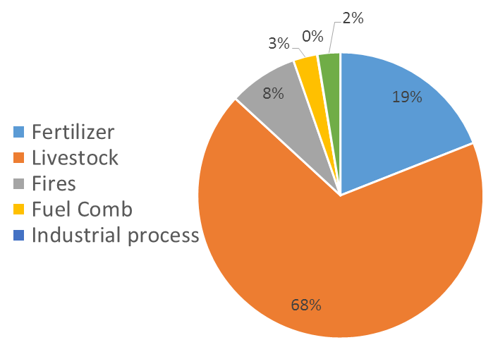
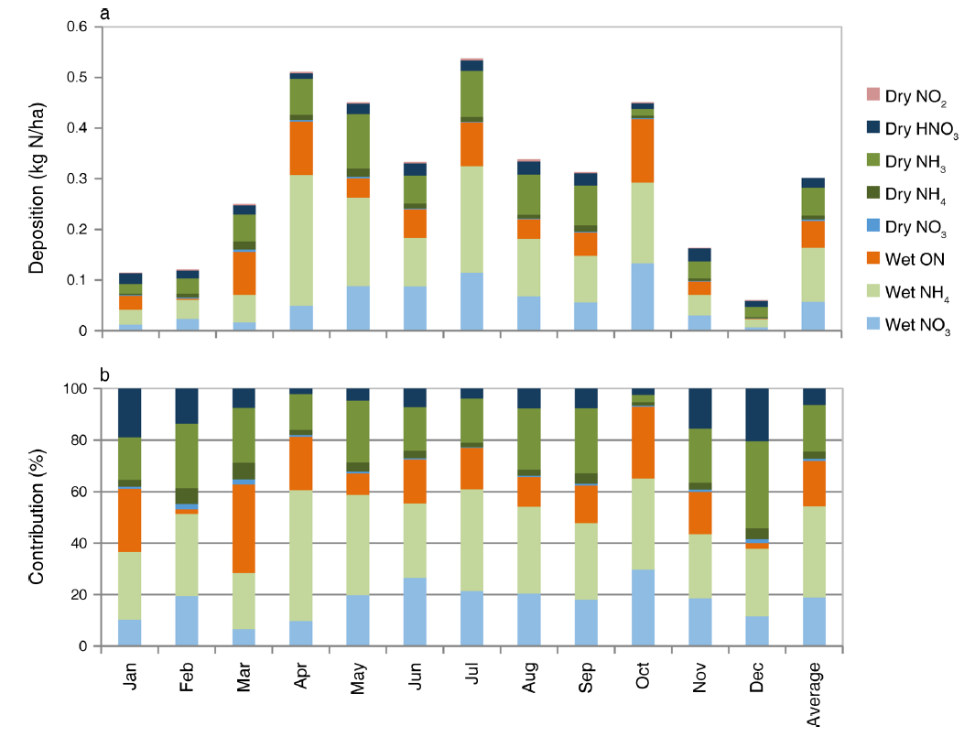
Motivation
Reactive nitrogen deposition in Rocky Mtn. Natl.. Park.
• 3 kg N ha⁻¹ yr⁻¹ critical load
• 3.65 kg N ha⁻¹ yr⁻¹observed
• NH₃ dry deposition modeled at 20% of total
(Bowman et al., 2012; Benedict et al., 2013)
NH₃ in Colorado
• CAFOs 68% of NH₃ in CO (NEI, 2011)
• 2-60% losses within 2 km of farm in CA (Loubet et al., 2009)
Challenges
• NH₃ incredibly difficult to measure
- low mole fractions (~ pptv-ppbv)
- large dynamic range / short lifetime
- sampling problems (inlets, phase)
Where is the NH₃ coming from? What are spatiotemporal variations?
How can in-situ and remote sensing measurements at vastly different scales be synthesized for a broader understanding?
From Mark Zondlo’s 9/20/18 presentation to RTOWG

Slide 17
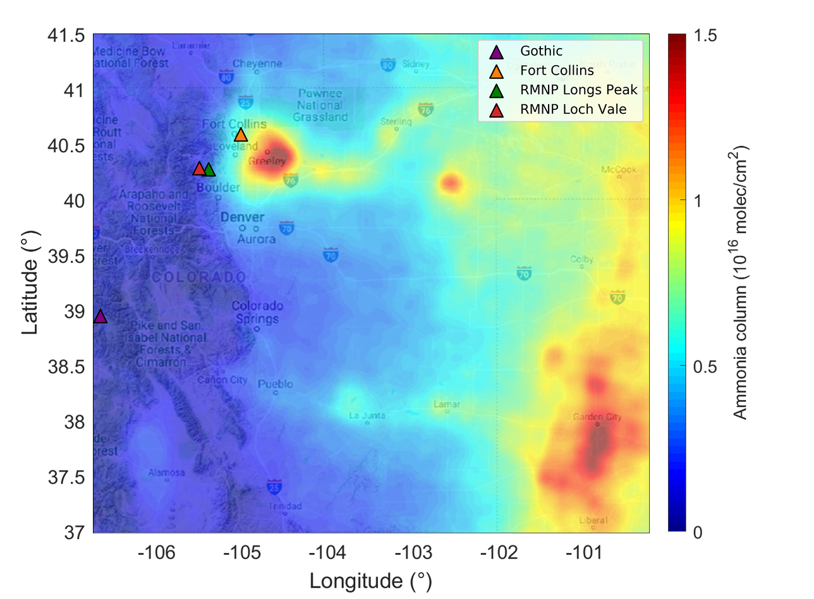
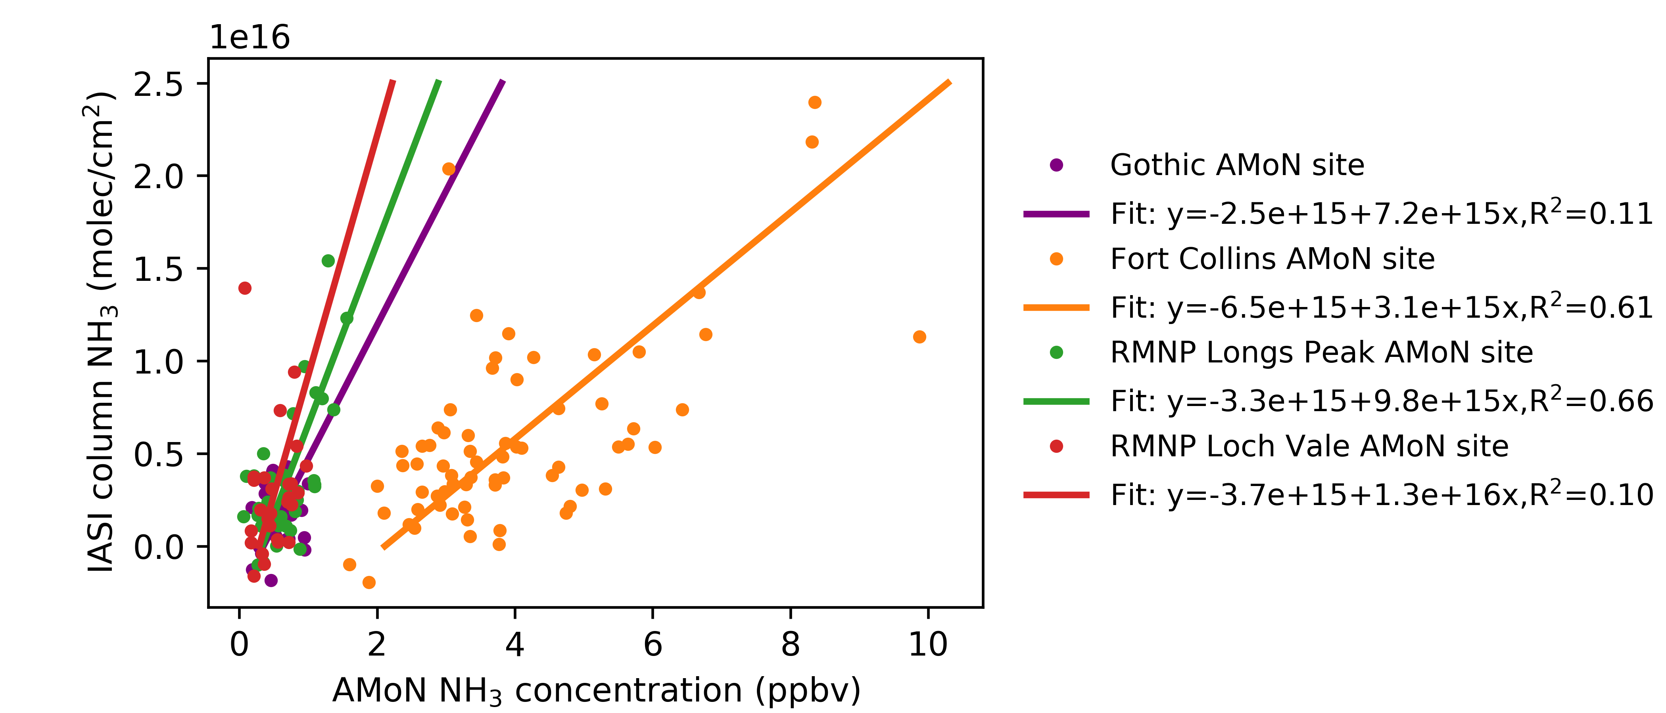
AMoN and IASI comparison in Colorado
From Mark Zondlo’s 9/20/18 presentation to RTOWG
Selecting IASI and AMoN observations for the comparison (2008 – 2015):
4 AMoN sites in Colorado located near Gothic, Fort Collins, RMNP Longs Peak, RMNP Loch Vale
Spatially confined to 25 km
Averaging IASI data for AMoN sampling period
Valid IASI data covering 50% of the time
AMoN and IASI show moderate correlation, stronger
in regions of higher NH₃

Slide 18
Regional Haze Planning Work Group

Slide 19
Regional Haze Planning Work Group
Co-Chairs: Tina Suarez-Murias (CARB) & Jay Baker (UT DEQ)
Call Schedule: 1st Tuesday every even month, noon-2PM Mountain Time
Website: https://www.wrapair2.org/RHPWG.aspx
Current Activities:
All related to State Regional Haze SIP preparation, tasks in 2018-2019 Work Plan, and training with SIP preparation tools
Presentation to Air Directors at WESTAR Business Council September 19, 2018
Upcoming bi-monthly call on October 2, 2018
Special Webinar on TSSv.2 - Friday, October 5, 1:00-2:30 PM Mountain Time
Notes:
The Work Group is lengthening its bimonthly call to 2 hours. As a matter of necessity, the large Work Group is evolving into a classroom where everyone is brought up to speed for SIP preparation.
The smaller subcommittees and other Work Groups and contractors are developing products, tools, and deliverables needed to write the SIPs.
As we start to roll out some of the tools, etc. we may have additional meetings, depending on the complexity of the items we need to explain.

Slide 20
Regional Haze Planning Work Group
EPA “Road Map” posted September 11, 2018
Principles: States have lead in program implementation & EPA will help
EPA Rule Revisit will go to Public Notice in future
EPA Final Guidance released in stages
Most Impaired Days (MID) selection Fall 2018
Revised Natural Conditions
Modeling Platform Summer 2019
Control Analysis might include visibility impact factor
Some FIPs replaced with SIPs
Notes:
The Work Group is lengthening its bimonthly call to 2 hours. As a matter of necessity, the large Work Group is evolving into a classroom where everyone is brought up to speed for SIP preparation.
The smaller subcommittees and other Work Groups and contractors are developing products, tools, and deliverables needed to write the SIPs.
As we start to roll out some of the tools, etc. we may have additional meetings, depending on the complexity of the items we need to explain.

Slide 21
Regional Haze Planning Work Group

Slide 22
Regional Haze Planning Work Group Control Measures Status Report
Approach
Develop Protocols for States to use to target emissions reductions from Non-Mobile Anthropogenic Sources within their State
Develop means to demonstrate these reductions improve visibility in Class I Areas
Status
Interpret EPA proposed guidance for 80% of non-mobile anthropogenic sources (facility/unit/source category)
Propose screening tools (e.g. Emissions/Distance threshold from Class I Area Q/d > x; source emissions Q > y TPY)
Utilize WRAP/WEP
Milestones
Develop and circulate schedule for States’ input to other Work Groups and contractors (pending)
Draft WRAP Reasonable Progress Source Identification and Analysis Protocol to be shared with RHPWG
Coordination and Next Steps
Circulate Screening Techniques “menu” as working draft to states for use as guidance selecting “target sources”
Review four-factor methods and options
Work with other Work Groups on multi-year emissions averaging if needed for cost-benefit analysis or modeling
Reconcile Area Source Emissions categories vs. Stationary Source facilities with multiple units for control analysis
Determine needs for contractor assistance
Notes:
-Control Measure subcommittee is reviewing a draft screening techniques protocol. Although subcommittee members are adding to it now, it will remain a Working Draft when released. It will describes a menu of techniques that states can use to select sources for which a four-factor analyses can be applied.
-For screening to identify potential sources for further review states can use:
Existing tools, such as the existing Land Use maps from the Causes of Haze, accessible through the TSSv.1 webpage
Future Weighted Emissions Potential or WEP, that results from modeling
Q/d or emissions over distance – which may be more or less than 10, depending on the state geography
-Next steps are to work on the four-factor method and differentiate between point and area sources.

Slide 23
Regional Haze Planning Work Group Emissions Inventory & Modeling Protocol Status Report
Approach
Collect and collate emissions data from all states (2014 and future forecasts)
Photochemical modeling for CONUS western states
Status
All states have verified 2014 data, some still making adjustments
Photochemical modeling contract reviewed before release
Milestones
Identified categories needing further attention (unpaved road dust, unreported minor sources)
Considering categories to be grouped for source apportionment (e.g. residential woodsmoke)
Coordination and Next Steps
Set deadline to grid out 2014 inventory for regional photochemical modeling
Work with RTO Work Group to secure contractor for baseline and future year modeling
Get 2014 data from Oil & Gas and Fire & Smoke Work Groups model-ready by Spring 2019
Coordinate with Fire & Smoke Work Group on multi-year averages to use for future year modeling
Notes:
This subcommittee has not met since the last TSC meeting.
Members are chasing down emissions inventories from states that have not confirmed or changed their 2014 inventories
Several members are also on the RTO Work Group and are working on modeling protocols with that group.

Slide 24
Regional Haze Planning Work Group Shared Database Status Report
Approach
Assure that publically accessible database has useful information for states to use in SIP preparation
Work with CIRA contacts to share state needs and evaluate design of TSS v.2
Status
Reviewing presentation options for monitoring data
Comments compiled for CIRA collaborator’s monthly response
Milestones
Reviewing graphical comparison of haziest and most impaired days
TSS v.2 Progress Report Webinar for future users scheduled for October 2018
Coordination and Next Steps
Developing a trend tool to allow states to assess 2000-2016 monitoring data trends with MID relative to revised Glide Path
Assist with development of Glossary for TSS v.2
Coordinating with Monitoring Subcommittee regarding the visualization tool and will coordinate with Emissions and Modeling subcommittee regarding additional functionalities
Notes:
The Shared Database Subcommittee is working with the contractors at Colorado State on Technical Support System v2. with the hope of presenting it to the Regional Haze Work Group at the October 2 Conference Call of the Regional Haze Work Group.
They caution that the algorithms behind the display might change the final values displayed as the Monitoring and Glide Path subcommittee and the contractors verify the input values.
Some data patching and substitution may be needed at some monitors, if they do not have a complete year that is critically needed.

Slide 25
Regional Haze Planning Work Group Monitoring Data & Glide Path Status Report
Approach
Evaluate proposed EPA tracking metric with alternative extreme episodic event (E3) thresholds and other options for selecting the 20% Most Impaired Days (MID) in the west
Set up Excel spreadsheet and R code analysis to test variables on 26 representative IMPROVE sites
Each State can use these R and Excel tools to analyze their IMPROVE sites using FED dataset
Status
Prepared draft list of alternative approaches to MID metric with pros and cons for each and working on
Preparing documentation of the analytical approaches evaluated
Continue to review ongoing analyses of data by IMPROVE Committee and Federal Agencies
Milestones
Evaluation data and tools posted for wide review
https://azdeq.sharefile.com/d-s3e0afe94b844e70a
Contractor to prepare report documenting data patching and data substitution
Coordination and Next Steps and Tasks
Present findings to TSC and then to SIP/TIP writers through RHPWG
Draft Report for feedback from RHPWG (all states, FLMs, tribes, EPA)
Evaluate changes to redo Baseline and adjust 2064 Natural Conditions (Glide Path slope and endpoints)
Consider tools that might help differentiate natural and anthropogenic sources
Notes:
The Monitoring Subcommittee encourages all to review the R and Excel tools they have developed to compare methods to calculate Most Impaired Days for each state’s IMPROVE monitors.
Next on the agenda is reviewing Natural Conditions and redoing the baseline.
Any recommendation for a single MID process will be presented to the TSC and then the Regional Haze Work Group.
Coordinating with the Shared Database Subcommittee.

Slide 26
Regional Haze Planning Work Group Consultation and Coordination Status Report
Approach
Recommend framework for State/State, State/Local Air Agency, State/ FLM consultation and for coordination with EPA and Tribes
Potential ideas for future communication and outreach with stakeholders & the public
Status
Updating webpage with links to key resources for states/locals/tribes
Drafting timeline that recommends occasions for informal consultation during SIP development
Milestones
List of contacts at all agencies for informal conversations during SIP development and for formal review of draft SIPs posted on webpage, to be updated later this year with list of tribal contacts from TDWG
General Contract ($25,000) includes formal consultation requirements related to states’ public review procedures & schedules (State SIP Readiness)
Coordination and Next Steps
Coordinate with subcommittees on timing of final work products
Review recommended tiered approach to consultation and timeline of informal consultation junctures
Draft white paper that provides the “how,” including consultation/coordination protocols (e.g. for state/local air agency coordination on control measures and state/state negotiation regarding upwind state reductions)
Notes:
The Consultation and Coordination Subcommittee is completing their list of contacts and working on a white paper that will link consultation to key points in the SIP development process.
New contacts from the Forest Service and the Fish and Wildlife Service and EPA have just joined the Subcommittee.

