Slide 1
September 29, 2021 Work Group Update

Slide 2
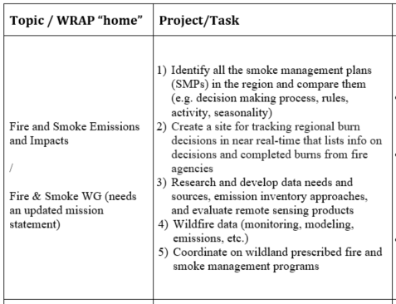
Fire & Smoke Work Group Progress Update 12/1/2020 Board Approved Work Topics
September 2021
No FSWG call & 1 EE support team call
3) → Exceptional Events Support Team:
Sept. 15 call
Featured presentation by Dan Jaffe (UW) on his O3 from wildfire work.
Recording and ppt posted to FSWG web page.
Next call, Nov. 17.
Call will feature Andy Langford (NOAA) on summer 2021 TOPAZ lidar measurements and identification of O3 from fires.
1), 2), 4), 5) No updates
Workshop: Fire Data Warehouse for Long-Term Datasets – October 21
Next FSWG call – Monday October 25

Slide 3
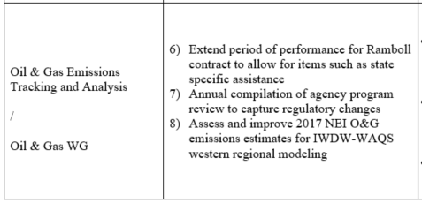
Oil & Gas Work Group Progress Update 12/1/2020 Board Approved Work Topics
August/September 2021 Update and Next Steps
August 3, 2021 - 2:00 p.m. (MDT) – Quarterly call
Ramboll memo comparing WRAP OGWG activity/emissions projections methods
Discussed upcoming solicitation for feedback from WG on revising scope.
Survey sent to agencies; responses collected and integrated into a draft OGWG scope w/additional work group subgroup definitions.
Sept 30, 2021 - 2:00 p.m. (MDT) - Draft Work Plan Scope Special Call
Call Agenda (posted on OGWG website):
Survey Results Overview
Draft Work Plan Scope (want feedback by October 15, 2021)
Discuss Potential New Subgroups:
Air Quality management needs
Develop Emission Inventories and Track Control Strategies​
Discuss Rules/Tracking/Enforcement/Compliance​
Oct. 27, 2021 - Present revised scope to WESTAR/WRAP TSC
Nov. 30, 2021 - 12:00 p.m. (MST) - Next Regular OGWG Call
OGWG is piloting Teams channel for collaboration

Slide 4
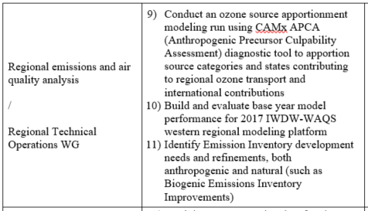
RTO Work Group Progress Update 12/1/2020 Board Approved Work Topics
Need to revisit feasibility of Tasks 9-11
2017 may not be most viable candidate for future modeling platform
Base new platform on 2020 NEI?
Ozone source apportionment modeling could be developed in next platform iteration
Other future topics?:
Modeling of exceptional events
Impact of potential lowering of PM NAAQS
Discuss options with RTOWG during November call
Draft updated RTOWG workplan scope

Slide 5
Tribal Data Work Group Progress Update
August & September 2021
Update Workplan Scope – no actions
Internal and External coordination / topics – no changes
Coordination with contractor (dates) – attempt for ITEP to update tribal contacts list ongoing.
Work Group calls (8/26/21): In August, the TDWG had a member (and invitees) call with a demonstration of the updated WRAP map website. There were 7 attendees on the call.
Question: How would the FSWG like to receive tribal requests for links to be added to the smoke resources map layer?

Slide 6
RHP Work Group Status Update August & September 2021
WRAP products completed in summer 2021
Draft RH SIPs have since been completed for many
Moved into FLM consult or public comment
Potential for future meetings to discuss comments

Slide 7
WESTAR/WRAP Progress Update 12/1/2020 Board Approved Work Topics
Updated status and work topic reorganization
Review separate doc dated Sept. 24, 2021
Use new doc with Board
Review and comment from TSC and WG Co-Chairs.

Slide 8
Work Group Preparation for December 9 WRAP Board Meeting
Workplan Scopes
WG development to reflect Board approved / prioritized project topics
Oct 27 TSC call – WG draft review
WG refinement, as needed
Nov 3 Board call – Status update
Nov 23 TSC call – TSC approval
Dec 9 Board mtg – Present WG Updates incl. Workplan Scopes
Reformat WG webpage to Workplan Scope
Convene WG per Workplan Scope
Nov 23 TSC call – WG Updates
(accomplishments past 9 months & plan for next 4 months)
Membership Lists
Update to reflect current members, advisors, other participants
Recruit additional representation, as needed
TSC approval of new members
Post on Work Group webpage
See for example TSC & WG Co-Chairs List updated July 23, 2021

