Slide 1
March 31, 2021 Work Group Update
FSWG
OGWG
RTOWG
TDWG
RHPWG
WESTAR/WRAP

Slide 2
Learn Fire Safety Now.
Fire & Smoke Work Group Status Update October 2020 thru March 2021
Tasks / Coordination / Meetings
Reformulated the WG under a new work plan scope
WG calls – 2 meeting so far, scheduled monthly into the future
Outreach – expand the WG to include more state, tribal and FLM members
Ongoing meetings of the team working on the Conceptual Model for Long-term Fire Data Support
Plan to send out a survey to get feedback on topics of interest (SMP, Exceptional Events, Rx to Wildfire nexus, Education, Outreach and Training)
Educate.
Inspect.
Invest.
Double check.
Plan.

Slide 3
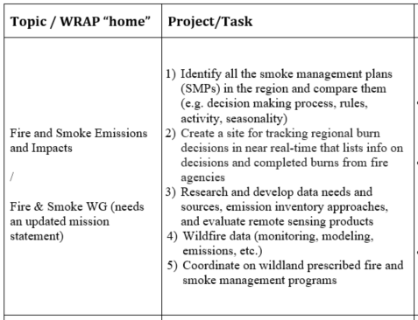
12/1/2020 Board Approved Work Topics Fire & Smoke Work Group Progress Update
February/March 2021
Activities to date –
Kickoff call (Feb. 18)
Conceptual Modeling (task 3)
SMP map (task 1 & 5) proposed team to refine map and related information
Tasks 2 & 4 to be discussed in future calls
Update Workplan Scope
Plan to hold teach-ins on topics of interest
Work Group calls monthly into the future

Slide 4
Oil & Gas Work Group Status Update October 2020 thru March 2021
Tasks / Coordination / Meetings
Work Group calls (Every four months; call held March 30, 2021)
Recurring Topic: Roundtable
State/Local/tribe: Initiatives/Rulemaking/Legislative changes; Regional Haze and/or Ozone SIP-related analyses related to Oil & Gas
Federal: Initiatives/Rulemaking/Legislative changes; Initial thoughts on Regional Haze submittals to date related to Oil & Gas
Other Topics:
Mar. 2021 (upcoming)
WRAP Region Oil & Gas: Recent Activity Trends and Emission Inventories
Emissions Inventory:
2017 Outline – Strengths/Weaknesses for Western Modeling Platform (Ramboll)
2020 NEI Development Plan (EPA)
Oct. 2020
CARB Report on Venting, Fugitive, and Flaring Emissions from Natural Gas
2014 Colorado Model Evaluation Database Package (EPA)
Coordination with contractor (infrequent)

Slide 5
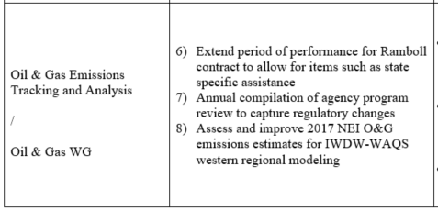
12/1/2020 Board Approved Work Topics Oil & Gas Work Group Progress Update
February/March 2021
Update Workplan Scope
Kickoff call: TBD
Work Group calls
Mar. 30, 2021
Aug. 10, 2021

Slide 6
Regional Technical Operations Work Group Status Update October 2020 thru March 2021
Tasks / Coordination / Meetings
RepBase2 and 2028OTBa2 simulations for estimating reasonable progress goals (RPG) using three different methods, recommend using ‘EPA wo fire’ approach
Regional source apportionment run for use in adjusting glideslopes to account for anthropogenic emissions and prescribed wildland fire
Dynamic model evaluation to assess regional air quality model’s response to changes in US anthropogenic emissions for 2002, present day (2014-2018), and 2028
Model verification study of 2014v2
Workgroup calls: 12/16/20 and 3/2/21
Weekly coordination calls with modeling contractor (Ramboll)
Documents: Procedures for Making Visibility Projections and Adjusting Glidepaths using the WRAP-WAQS 2014 Modeling Platform (3/1/21)
Transfer of regional haze results to TSS and modeling files to IWDW
By state and source group apportionment run

Slide 7
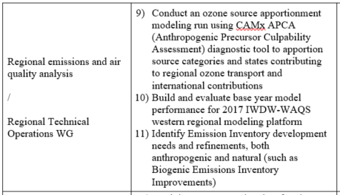
12/1/2020 Board Approved Work Topics RTO Work Group Progress Update
February/March 2021
Discuss with RTOWG to refine work topics
Update Workplan Scope
Kickoff call
Topical discussion / roundtable
Internal and External coordination / topics
Coordination with contractor
Work Group calls

Slide 8
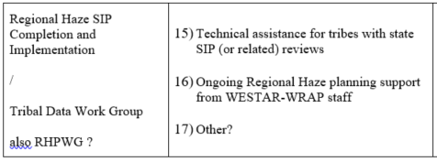
Tribal Data Work Group
Status Update (Past 6 Months)
Completed RH Workplan tasks in Summer 2020
No additional meetings due to lack of bandwidth from COVID-19 Pandemic disruptions
Progress Update (Next 6 Months)
Update the Tribal Contacts list made in 2019
Identify needs from WRAP Board Approved Work Topics
Work with TSC and other Work Groups to support tribal representation

Slide 9
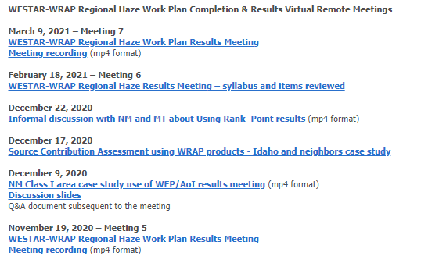
Regional Haze Planning Work Group Status Update October 2020 thru March 2021
Modeling Results Meetings
November – March
Next April 1st
State-State coordination call
April 13th

Slide 10
12/1/2020 Board Approved Work Topics RHP Work Group Progress Update
Currently nothing identified for RHPWG to assist with

Slide 11
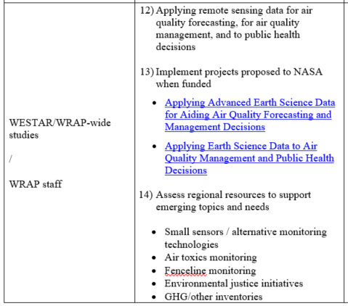
12/1/2020 Board Approved Work Topics WESTAR/WRAP Progress Update
12) Conceptual Model for Long-Term Fire Data project: itemizing remote sensing inputs for annual fire EIs
13) Proposal not selected by NASA for funding
14) Formation of small sensors subgroup to the WESTAR Technical Committee

