Slide 1
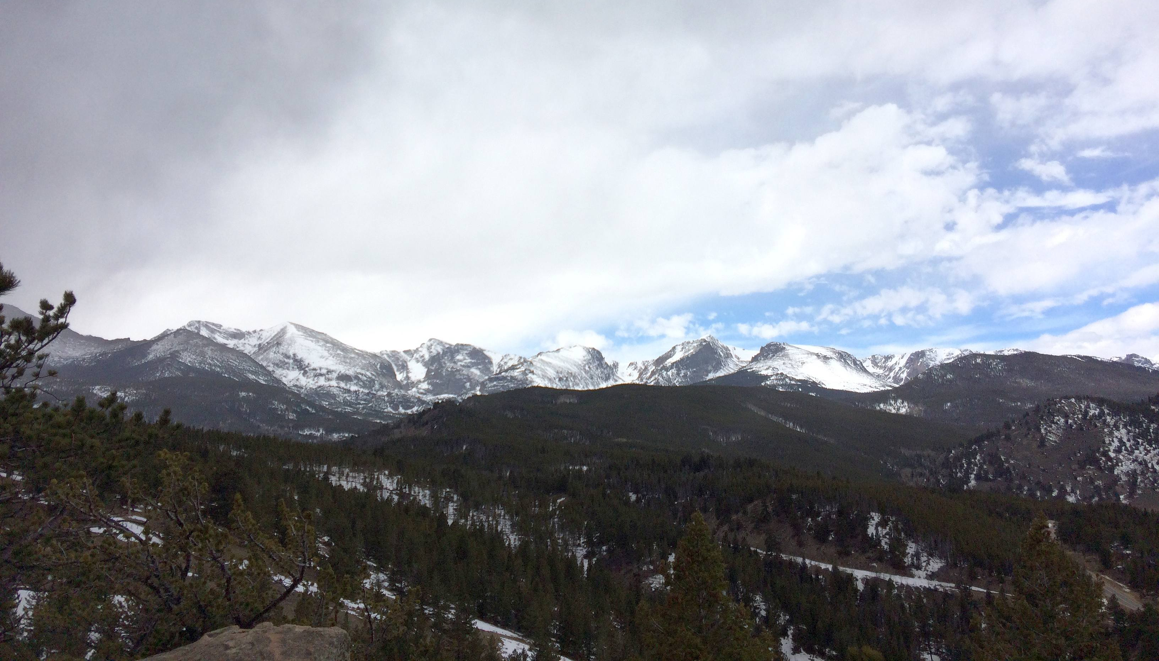
Western Regional Modeling and Analysis Platform
2014 Modeling Update for April 29, 2020
Ralph Morris, Pradeepa, Vennam, Marco Rodriguez, Jung Chien, Jeremiah Johnson, Tejas Shah and B.H. Baek (UNC)
WRAP RTOWG Webinar
April 29, 2020

Slide 2
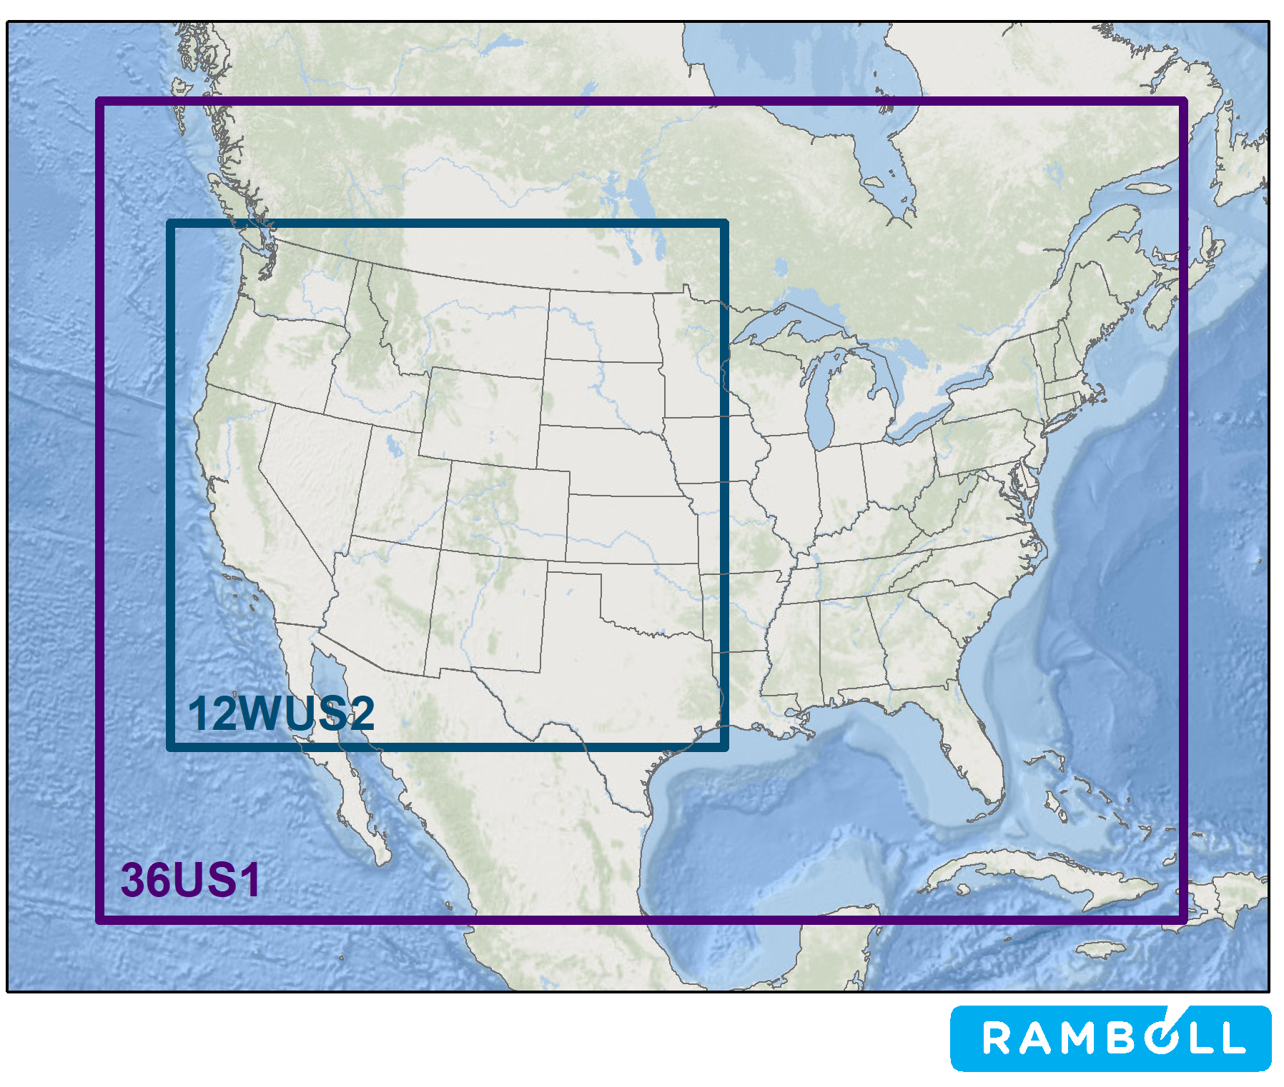
CAMx 36/12-km Annual (2014) Simulations Conducted
2014v2: Actual Base Case Simulation
  2014 Actual Fires
RepBase: Representative Baseline
  Emissions representative of 2014-2018
  RepBase Fires
2028OTBa: RepBase Fires
2028OTBb: 2014 Actual Fires
ZROW: Zero-Out Rest of World
  No International Anthropogenic Emissions
NAT: Natural Sources
  No Anthropogenic Emissions
RepBase SA: Source Apportionment
  Contributions of 16 Source Groups to Visibility

Slide 3
2028 Visibility Projections
Two sets of Current Year and Future Year Modeling Runs Available to Make 2028 Future Year Visibility Projections at IMPROVE Sites/Class I Areas
  2014v2/2028OTBb using 2014 Actual Fires
    Project 2012-2016 IMPROVE MID to 2028
  RepBase/2028OTBa using RepBase Fires
    Project 2014-2018 IMPROVE MID to 2028

Slide 4
Spreadsheet to Explore Modeled Visibility Results
Example for Redwood on Coast in Northern California
Observed, 2014v2, RepBase, ZROW, NAT
Daily MID
Average Across Most Impaired Days (MID)
Monthly Average
e.g., SO4 = 4% ZROW; 72% NAT; 24% US

Slide 5
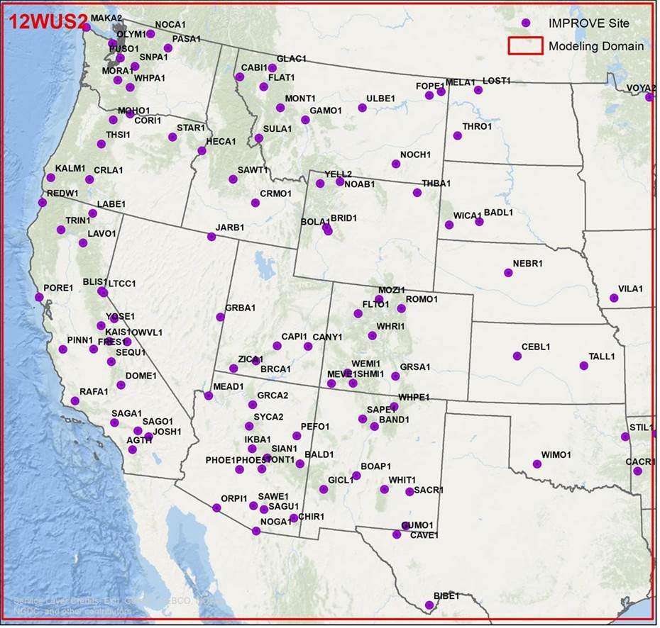
Exampled Results at IMPROVE Sites Moving Inland
2014 IMPROVE Most Impaired Days (MID) for 5 Scenarios:
  Observed
  2014v2
  RepBase
  ZROW
  NAT
Six IMPROVE Sites from West to East:
  REDW1 (Coast of NorCal)
  TRIN1 (Inland NorCal)
  JARB (Nevada/Idaho Border)
  BRID (Southwest Wyoming)
  MOZI (North Colorado)
  VILA1 (Western Iowa)

Slide 7
Currently Processing RepBase Source Apportionment Run
Obtained Contributions due to 16 Source Groups:
Nine Emission Source Groups in CAMx
  Natural Emissions
    Bio, SSA/DMS, LNOx, WBD, Mex/Can Fires
  Wildfires (US)
  Prescribed Burns (US)
  Agricultural Burning (US)
  U.S. Anthropogenic
  Mexico Anthropogenic
  Canada Anthropogenic
  Off-shore CMV within 200 nautical miles
    i.e., ECA region
  Offshore CMV > 200 nautical miles
Initial Concentrations (IC)
Four Types of Boundary Conditions (BC)
  International Anthropogenic
  U.S. Anthropogenic
  Natural
  Top Concentration
Can Be Used for Numerous Types of Analysis
  US Anthro Contributions
  Identify Modeled MID
  International Anthro Contributions
  Rx Fire Contributions
  etc.

Slide 8
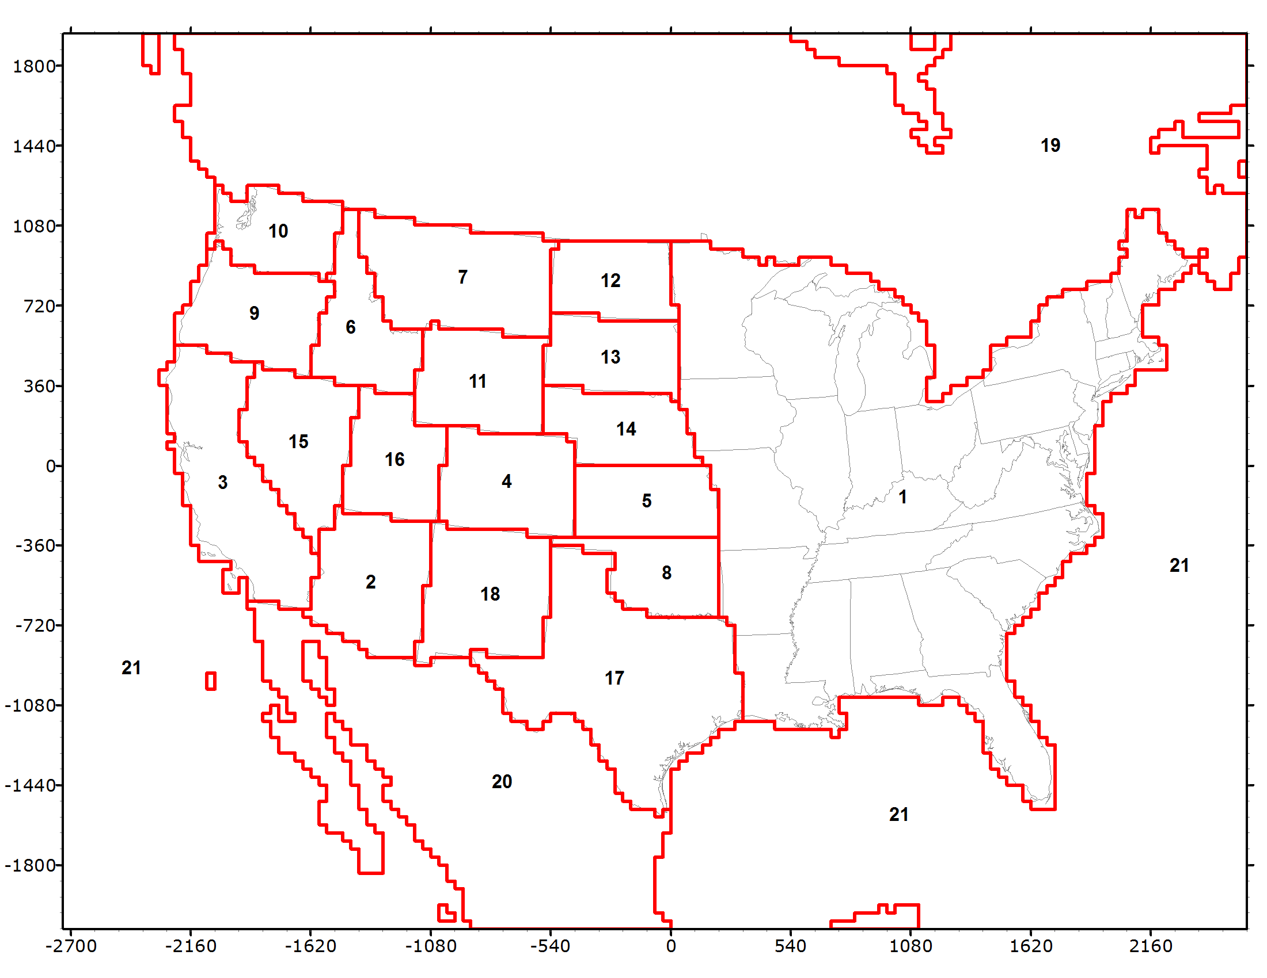
Next Steps (April 29, 2020)
2028 Visibility Projections using Alternative Projection Approaches than EPA (2014 MID)
  EPAwoF, EPAwoD, Mod-MID, MPE
Dynamic Evaluation (2002)
  US Anthro 2002, 2014-2018, 2028
  Evaluate Visibility Projection Approaches
2028 WF and 2028 Rx Fire Sensitivity
2028OTBa Source Apportionment
  Anthropogenic/Natural and WRAP States by Source Sectors
Re-process 2014 and 2028 California Emissions to Obtain Source Sector
  Redo Weighted Emissions Potential (WEP) Analysis with Consistent Source Sectors
  Use in 2028OTBa Source Apportionment Run
Potential Additional Control Scenarios [PAC1 and PAC2 (August)]
  SMOKE Emissions and CAMx Photochemical Modeling
Transfer/Documentation on TSS and IWDW

