Slide 1
WRAP 2014 Platform development and Shake-Out project Overview
Ralph Morris, Tejas Shah, Marco Rodriguez, Jeremiah Johnson, Pradeepa Vennam, Ramboll
B.H. Baek, UNC
WRAP 2014 Shake-Out Close-Out Meeting
Denver, Colorado
April 5, 2019

Slide 2
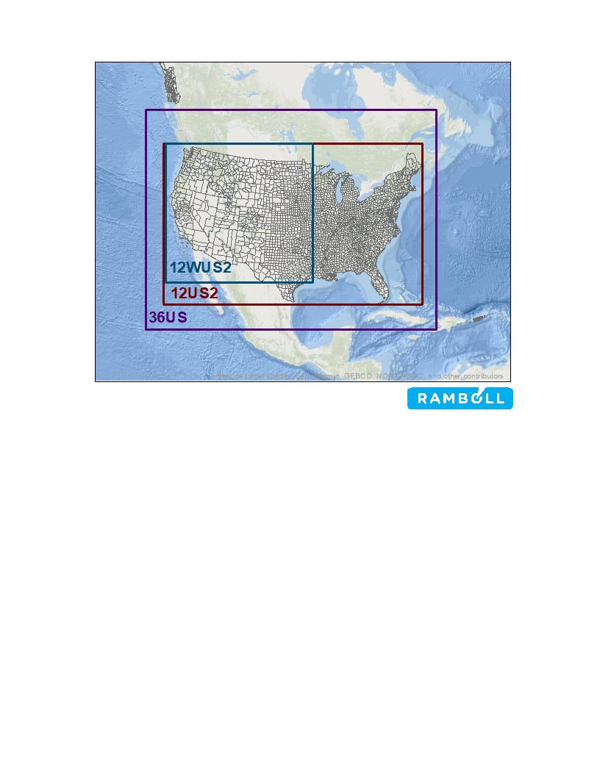
WRAP 2014 Shake-Out Objectives
Use existing information to develop a 2014 PGM modeling platform for western U.S. and provide initial testing
  3.5-month project
    Jan-Mar 2019
CAMx and CMAQ Photochemical Grid Models (PGMs)
Standard “RPO” 36-km Resolution CONUS modeling domain
Two 12-km Domains Considered:
  WAQS 12WUS2 (WESTUS)
  EPA 12US2 (USA)

Slide 3
WRAP 2014 Shake-Out Available Data
Boundary Conditions (BC) – Defines transported pollutants (international) coming in through boundaries of the 35-km CONUS domain:
  EPA’s 2014 GEOS-Chem global chemistry model simulation
Meteorology – 3-D Transport, Temperature, Moisture, etc. fields within 36/12-km domains
  Two 2014 simulations of the Weather Research Forecast (WRF) model:
    Western Air Quality Study (WAQS) 36-km CONUS and 12-km 12WUS2 WESTUS domains
    EPA 12-km 12US2 (USA) domain (used for EPA’s 2014 12US2 NATA Modeling Platform)
Emissions – Point and Surface Anthropogenic and Natural Emissions
  Version 2 of the 2014 National Emissions Inventory (2014v2)
    2014v2 updates to Point and Non-Point sectors in western States
  Biogenic emissions using MEGAN and BEIS
  Sea Salt (SSA), Lightning NOx (LNOx), Windblown Dust (WBD), Dimethyl Sulfide (DMS)
    CAMx processors and CMAQ in-line algorithms for SSA, LNOx and WBD

Slide 4
WRAP 2014 Shake-Out Approach
Process EPA’s 2014 GEOS-Chem to generate BCs for 36-km CONUS domain
  Evaluate adequacy and make adjustments to improve
Process WAQS and EPA 2014 WRF meteorology using WRFCAMx and MCIP:
  WAQS 36-km CONUS Domain PGM meteorological inputs
  WAQS 12-km 12WUS2 and EPA 12-km 12US2 Domains
  Determine “best” performing 12-km meteorology for final 2014 CAMx/CMAQ annual Shake-Out simulations
2014 36/12-km CAMx/CMAQ emission inputs
  SMOKE processing of 2014NETv2 for 36-km CONUS domain
  SMOKE processing of 2014v2 Point and Non-Point updated for western states
  EPA 2014 12-km model platform for other source sectors (including BEIS biogenic)
  Natural emissions development (MEGAN, SSA, LNOx, WBD, DMS)
Develop other CAMx/CMAQ ancillary inputs (landuse, ozone column, photolysis rates, etc.)

Slide 5
WRAP 2014 Shake-Out Approach
Conduct CAMx 2014 Jul/Jan Sensitivity Tests to evaluate best performing model inputs for final CAMx/CMAQ 2014 36/12-km annual Shale-Out simulations and MPE
  2014 GEOS-Chem Boundary Conditions (BCs) – adjustments to improve representation of international transport
  WAQS 12-km 12WUS2 vs. EPA 12-km 12US2 WRF meteorological inputs
  MEGAN vs. BEIS biogenic emissions
Based on CAMx 2014 Jan and Jul sensitivity tests select best performing model configuration:
  Conduct final CAMx and CMAQ 36/12-km Shake-Out simulations
    Model Performance Evaluation (MPE) (limited by time and resource constraints)
  Deliver all CAMx and CMAQ 2014 Shake-Out modeling databases to IWDW
    2014 36-km CONUS domain
    2014 12-km WAQS 12WUS2 (WESTUS) domain
    2014 12-km EPA 12US2 (USA) domain
Final report with MPE and lessons learned

Slide 6
2014 Shake-Out Tasks -- Overview to Follow
Bold Tasks Have More Details Later Today
Task 1: Modeling Plan
  No Task 2
Task 3: 2014 Base Year Emissions Process
Task 4: 2014 WRF Meteorology MPE
Task 5: 2014 GEOS-Chem BCs
Task 6: 2014 PGM Modeling
  Subtask 6a: Sensitivity Modeling (BC, 12-km Meteorology, Biogenic)
  Subtask 6b: CAMx/CMAQ Annual 2014 36/12-km Shake-Out Run and MPE
Task 7: Single-Source Visibility Modeling
  No Tasks 8, 9 and 10
Task 11: Data Transfer to IWDW
Task 12: Management

Slide 7
Task 1: Modeling Plan
Draft 2014 Platform Development and Shake-Out Modeling Plan dated December 31, 2018
  Asked for comments by January 22, 2019 and received four comments
Updated Draft 2014 Modeling Plan to address comments submitted it February 2, 2019 along with Response-to-Comments document
  Additional comments received from EPA (R8 and OAQPS)
Second Updated Draft 2014 Modeling Plan submitted March 9, 2019 along with Response-to-Comments document
  2014 Modeling Plan complete and posted on IWDW
Modeling Plan Addendum on lessons learned from 2008/2011 and preliminary 2014 modeling that can be accounted for in 2014v2 Platform Update to be submitted shortly
  Highlights of content discussed today

Slide 8
Task 3: 2014 Emissions Processing
Start with EPA’s Version 2 of the 2014 National Emissions Inventory (2014v2) and EPA’s CMAQ-ready emissions for the 12-km 12US2 modeling domain from the 2014 Platform
WRAP Western States update 2014NEIv2 Point and Non-Point Source sectors
2014v1 Shake-Out Anthropogenic Emissions
  SMOKE Processing for 36-km 36US1 Domain
  SMOKE Processing of 2014 Point and Non-Point with western state updates
  Use EPA 2014 Platform 12-km 12US2 domain CMAQ-ready emissions for other source sectors
    EGU Point (2014 CEM Hourly), on-road and non-road mobile, BEIS biogenic, off-shore CMV and O&G
2014 36/12-km Natural Emissions Modeling (MEGAN Biogenic, LNOx, SSA/DMS, WBD)
Updated 2014 BlueSky Fires (2014NEIv2) from Air Sciences (Fire & Smoke Work Group)
  Designed for CMAQ, very labor and resource intensive for CAMx
CMAQ-ready 2014 annual emissions for WAQS 36-km CONUS and EPA 12-km 12US2 domains
  Window emissions for WAQS 12-km 12WUS2 domain
  CMAQ2CAMx processor to generate CAMx-ready emissions

Slide 9
Task 4: 2014 WRF Model Evaluation
Results presented at Jan 31, 2019 RTOWG Conference Call
  WRF MPE products transferred to IWDW in February
Two WRF 12-km Datasets:
  EPA 12-km 12US2 and WAQS 12-km WUS2
Quantitative Evaluation using Surface Met
  Wind Speed, Wind Direction, Temperature and Humidity
  Evaluate for WUS, by State and by Site (make available on IWDW)
Qualitative Evaluation of Precipitation using PRISM Data
  Monthly and Daily Evaluation
Will present some results today as part of EPA vs. WAQS WRF 12-km CAMx sensitivity modeling

Slide 10
Task 5: 2014 GEOS-Chem Boundary Conditions
Process EPA’s 2014 GEOS-Chem to generate BCs for CAMx and CMAQ 25-layer 36US domain
  Update species mapping in GC2CAMx and GC2CMAQ
Conduct inert with deposition (wet & dry) BC-only CAMx 36-km 36US1 and 12-km 12US2 domains simulations, analyze spatial plots and evaluate against measurements
  As BC-only without emissions, expect underestimation tendency when compared to observations
  Found potential issues with: overestimated summer SO4/SO2; some episodic fine and coarse crustal periods; year-round overstated ozone
    Account for overstated summer SO4/SO2 through cap on SO4/SO2 Jun/Jul BCs
    Episodic high fine and coarse crustal also in observations – some timing and magnitude issues
    Year-round ozone overestimation a persistent problem
EPA identifies problem with their 2014 GEOS-Chem simulation that included emissions from large 2009 volcano in Jun/Jul resulting in overstated SO4/SO2 western BCs
  EPA reruns 2014 GEIS-Chem Jun/Jul w/o volcano eruption emissions whose resultant BCs we were able to incorporate into the final WRAP 2014 Shake-Out annual CAMx & CMAQ simulations

Slide 11
Task 6: 2014 PGM Modeling
Subtask 6a: PGM Set-Up and Initial Sensitivity Modeling (CAMX Jan/Jul)
  BC Sensitivity (2014 GEOS-Chem w/ and w/o volcano eruption emissions)
  WRF 12-km Sensitivity (EPA 12US2 vs. WAQS 12 WUS1)
  Biogenic Sensitivity (MEGAN vs. BEIS)
  Select configuration for 2014 Shake-Out Runs
Subtask 6b: Annual 2014 CAMx and CMAQ 36/12-km Shake-Out Runs
  Select final CAMx/CMAQ Configuration
  BCs; 12-km WRF; Biogenic; other options
  Annual 2014 36/12-km CAMx & CMAQ simulations
  Model Performance Evaluation – particular focus on IMPROVE speciated PM2.5 on MIDs
  Lessons Learned / Recommendations for Next Steps
Focus of most of the discussion today

Slide 12
Tasks 7 (Single-Source) 11 (Transfer) and 12 (Management)
Task 7: Single-Source Visibility Screening and Modeling
  Preparation of PPT and Conduct Webinar December 12, 2018
  Document in Memorandum draft by Monday April 7
    Separate Q/D Analysis Project for Control Measures Subcommittee
Task 11: Data Transfer to IWDW
  Major transfers to occur in Feb-Apr
Task 12: Management
  Meetings, Conference Calls, Coordination, Progress Reports
  WRAP 2014 Shake-Out Meeting April 5, 2019 downtown Denver

Slide 13
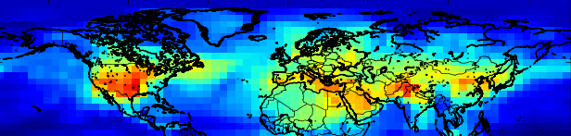
EPRI International Transport Visibility Contribution Project
Ou Nopmongcol, Maria Zatko and Ralph Morris, Ramboll
Eladio Knipping and Naresh Kumar, EPRI
April 5, 2019

Slide 14
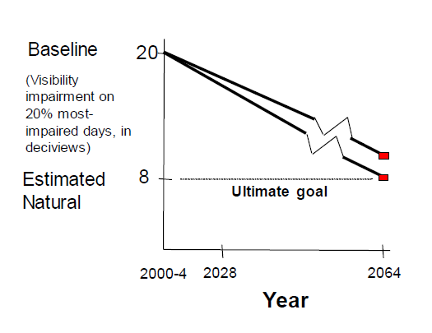
OBJECTIVES
Idealized Uniform Rate of Progress Glide Slope
Estimate the contributions of international anthropogenic emissions to visibility impairment at Class I Areas (CIAs) for the Most Impaired Days (MIDs)
Current EPA guidance allows an adjustment in the 2064 Natural Conditions end point in the Uniform Rate of Progress Glide Slope to account for the contributions of international anthropogenic emissions
International
Contributions

Slide 15
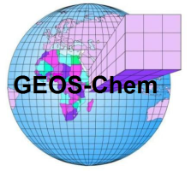
EPRI Regional Haze Approach
3 GEOS-Chem simulations
  Provide international transport contributions through CAMx boundary conditions (BCs)
    2016 Baseline
    2028 Base Case
    2028 Scenario with all anthropogenic emissions outside the U.S. set to zero
    (Zero Out Rest of World run; ZROW)
  Global anthropogenic emissions based on the CEDS and regional inventories
  Natural emissions driven by 2016 meteorology (in-line)
3 CAMx 36/12-km simulations with respective GEOS-Chem BCs
  2016 Baseline; 2028 Base Case; 2028 ZROW
  Build off State/Federal Collaborative 2016 modeling database
  Develop 2016 natural emissions
Visibility analysis

Slide 16
Scientific Review Panel
Multi-jurisdictional organizations
  CENSARA, LADCO, MARAMA, METRO4/SESARM, WRAP/WESTAR
State representatives, Indian tribes, federal agencies (e.g., National Park Service)
Provide input and feedback to ensure that results address the needs of the broad stakeholder community
  Leverage data resources; other in-house resources?
  Refine methodology
  Full transparency
Review interim and final modeling results
Use results as needed

Slide 17
Current Status on GEOS-Chem Modeling
Baseline 2016 modeling completed
  Model performance evaluation focusing on rural sites (due to the coarse grid resolution)
    Surface sites: CASTNET and IMPROVE sites
Future-year 2028 modeling
  Literature Review for emission projections
  Base 2028 simulation completed
  Zero-out simulation completed

Slide 18
Non-US Emissions : Baseline
Region | Inventory | Latest year | 2016 simulation
Canada | APEI | 2014 | No projection
China | MEIC | 2015, 2016, 2017 | 2016
Global; rest of the world | CEDS (GEOS-Chem default) | 2014 | 2014
Aircraft | AEIC | 2005 | Projected 2016 (RCP4.5)
Shipping | NEI, EMEP, HTAP2 | 2011, 2012, 2010 | Projected 2016 (RCP4.5)
Biomass | QFED2 | 2016 | 2016
Volcanic SO2 | Aerocom | 2009 | Degassing emissions only
soil NOx, sea-salt aerosol, oceanic DMS, biogenic VOC, wind-blown dust, short-lived bromo-carbon | On-line |  | Meteorology-driven
Notes:
HTAP2 which is built off EDGARv4.3. There is a major sulfur content reduction in 2005 which we may not capture if using ICOADS (2002).

Slide 19
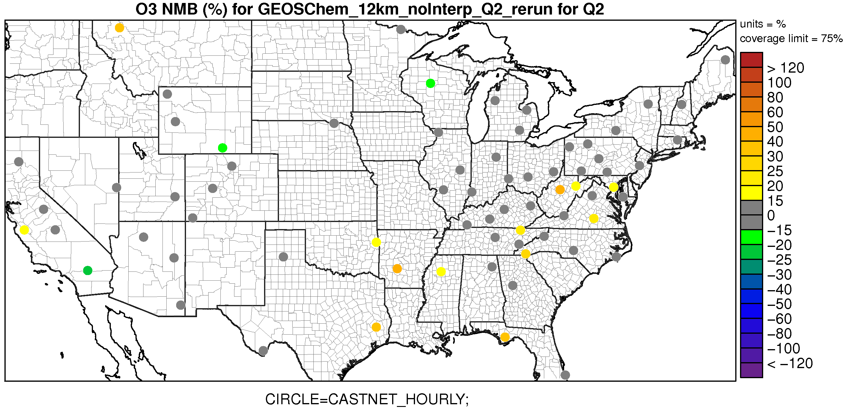
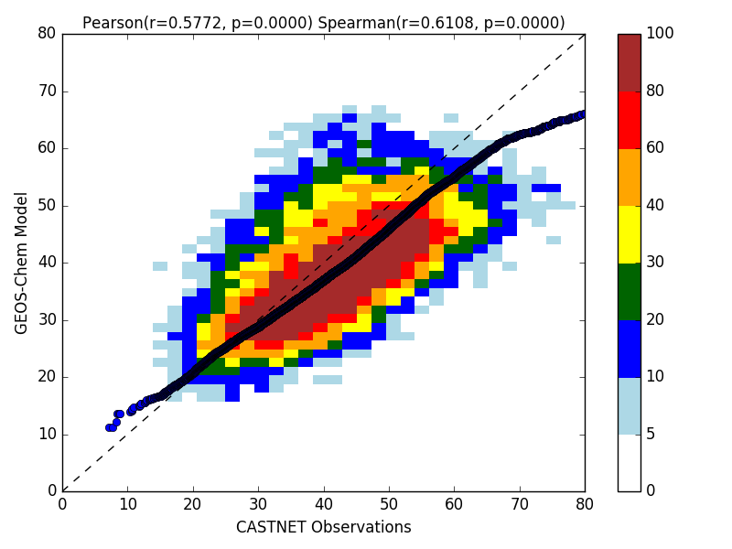
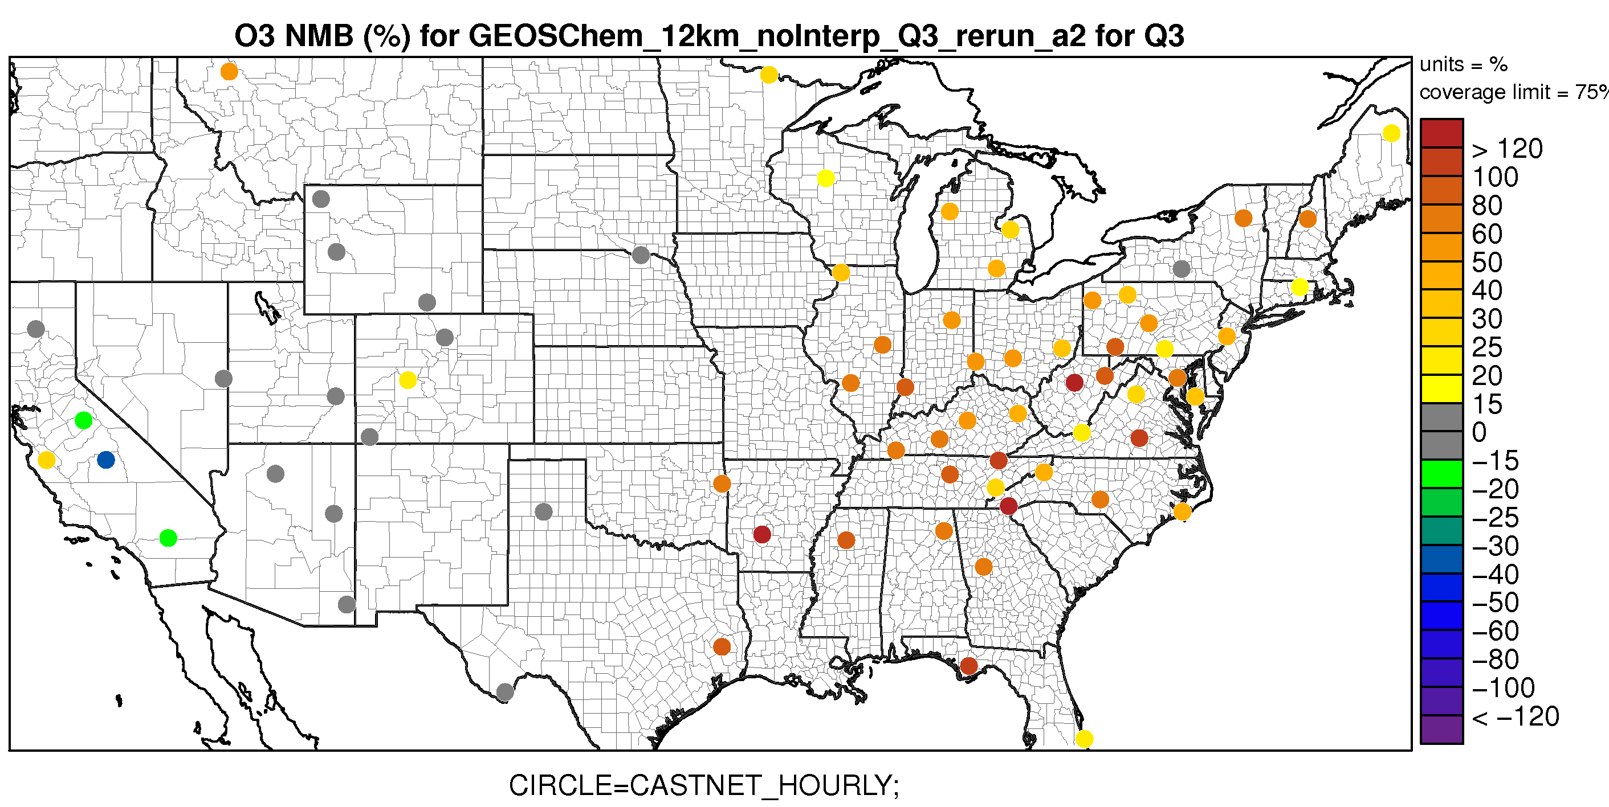
Baseline 2016 Model Performance
Ozone
Ozone predictions are within reasonable ranges
  r=0.6; tendency to underestimate
all hours all sites
Q2
Q3
Biases (NMB) generally within 15%
Overprediction in Q3 in the east influenced by local emissions
Notes:
Travis et al. (2016) suggested that the US NOx emissions in the 2011 NEI is biased high by a factor of two

Slide 20
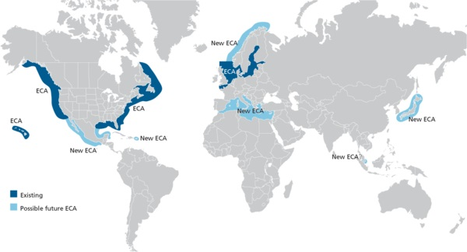
Baseline 2016 Model Performance
Key takeaways
Ozone predictions are within reasonable ranges
  NMB generally within 15%
  Biased high in the eastern US likely related to local (US) emissions
PM_{2.5} performance is not as good
  Driven largely by local sources
  Not clear how PM performance affects CAMx boundary conditions
Emission assumptions could affect model performance
  Shipping ECA zones not considered
  They will be in CAMx simulations

Slide 21
Non-U.S. Global Emissions: 2028
Region | Inventory | Base year | 2028 simulation
Canada | APEI | 2014 | ECCC’s projections (2013 to 2025)
China | MEIC | 2016 | Wang et al., (2014)
Global; rest of the world | CEDS (GEOS-Chem default) | 2014 | RCP4.5
Aircraft | AEIC | 2005 | RCP4.5
Shipping | NEI, EMEP, HTAP | 2011, 2012, 2010 | RCP4.5
Biomass | QFED2 | 2016 | 2016
Volcanic SO2 | Aerocom | 2009 | Degassing emissions only
soil NOx, sea-salt aerosol, oceanic DMS, biogenic VOC, wind-blown dust, short-lived bromo-carbon | On-line |  | Meteorology-driven
Notes:
HTAP2 which is built off EDGARv4.3. There is a major sulfur content reduction in 2005 which we may not capture if using ICOADS (2002).

Slide 22
Current Status on CAMx Modeling
CAMx modeling will rely on State/Federal Inventory Collaborative 2016 modeling platform
  2016a was available in 2018 but based on 2014 emissions
  2016b now available (delayed from Oct/Dec 2018/Jan 2019)
    2016b with 2023 and 2028 emission projections coming soon
  2016 version 1 with 2028 projections by May 2019 (?)
Natural Emissions
  Fires from the 2016 modeling platform
  MEGAN biogenic emissions
  Existing tool for sea salt
  Stand-alone tools for wind-blown dust, ocean DMS, lightning NOx
Notes:
Alpha – starts from NEI2014v2; includes 2016 CEM, biogenic, fire
Beta – oil&gas, nonroad, onroad, ag NH3
EPA 2016 CAMx platform will not include Windblown Dust (WBD), oceanic dimethyl sulfide (DMS), or lightning NOx emissions

Slide 23
Natural Emissions for CAMx
Sources | Our approach | Note
Day-specific Wildfire | 2016 Modeling Platform
Biogenic VOC | MEGAN modeling
Sea-salt | Ramboll’s sea salt pre-processor using a scheme described by Ovadnevaite et al. (2014) | Uses CAMx met and landuse inputs (and global oceanic chlorophyll-A if generating halo-methanes)
Windblown Dust | Ramboll’s wind blown dust pre-processor using a scheme described by Klingmüller et al. (2017) | Uses new CAMx met, landuse, and soil moisture inputs; uses global fields for emissive areas, LAI, clay content and mineral fraction
Oceanic dimethyl sulfide (DMS) | Updating the current sea-salt pre-processor to include DMS | Uses CAMx met files and Lana et al. (2011) global DMS concentrations
Lightning NOx | Lightning NOx pre-processor | Uses new CAMx met files and other inputs (flash rates, yields per flash, cloud-to-grid ratio) from literature
Notes:
Klingmüller, K., Metzger, S., Abdelkader, M., Karydis, V., Stenchikov, G.L., Pozzer, A. and Lelieveld, J., 2017. Revised mineral dust emissions in the atmospheric chemistry-climate model EMAC (based on MESSy 2.52).
WBD processor
Land use is from the camx input file, however that is developed (direct from wrf or gis processing of nlcd or...). Soil moisture is newly added to wrfcamx, it comes from wrf NOAH or PX LSM schemes

Slide 24
Glidepath
2000-2004 baseline
EPA’s Most Impaired Days (MID) Visibility Metric
  Flexibility on a percentile value (EPA’s default is 95th) to assign episodic events
  Lower value for areas with a high frequency of episodic wildfire smoke or dust impacts even in the “low wildfire” or “low dust storm year“
  Higher value if the lowest year has no episodic impacts
2064 end point set to the average of daily natural conditions of the 20% most impaired days from 2000-2014.
  Plus impacts from international anthropogenic or wildland prescribed fires
Notes:
Identify for each year the 95th percentile 24-hour carbon (OMC + LAC) light extinction
Choose the year between 2000 and 2014 with the lowest such value. This year represents the “low wildfire” and“low dust storm”

Slide 25
EPA’s Approach to address international Anthropogenic Source contributions in RPGs
Must address International anthropogenic emission contributions by adding it on to the 2064 Natural Conditions goal changing the slope of the URP Glidepath
EPA recommends chemical transport models (CTMs)
  Base case showing reasonable performance
  Zero-out or source apportionment
  Consistency between a global and regional model
Choose a recent year
  E.g., 2011, 2014, 2016
  2028 an option since some 2028 inventories available
  Projecting international emissions is speculative
Sensitivity simulations to provide a range of estimates
EPA will review the adjustment at the full SIP submission

Slide 26
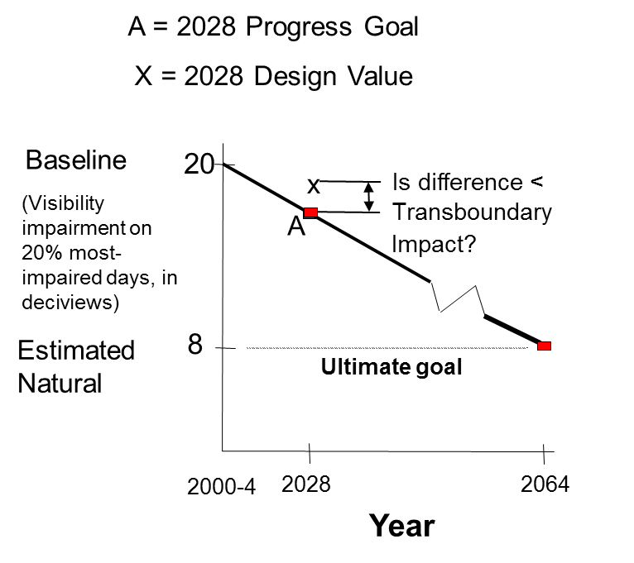
Alternative Approach?
Proposed by Some FLMs to Account for International Emissions

Slide 27
Project Schedule (assumed 2016b transferred by early April)
Proposed Tasks | Estimated Completion
Task 1. Global modeling | Dec 2018
Task 2. Regional modeling (CAMx) | April – Nov 2019
Task 3. Communication | Throughout the project (Preliminary results – Sep 2019)
Task 4. Final Report and Data Distribution | Nov/Dec 2019 (Est.)
Notes:
GEOS-Chem schedule is slightly delayed due to some bugs in the latest source codes, new data format, and longer runtime due to additional chemistry.

