Slide 1
WRAP Results Webinar # 8 WRAP TSS Modeling Express Tools Update Regional and State Source Apportionment
April 1, 2021

Slide 2
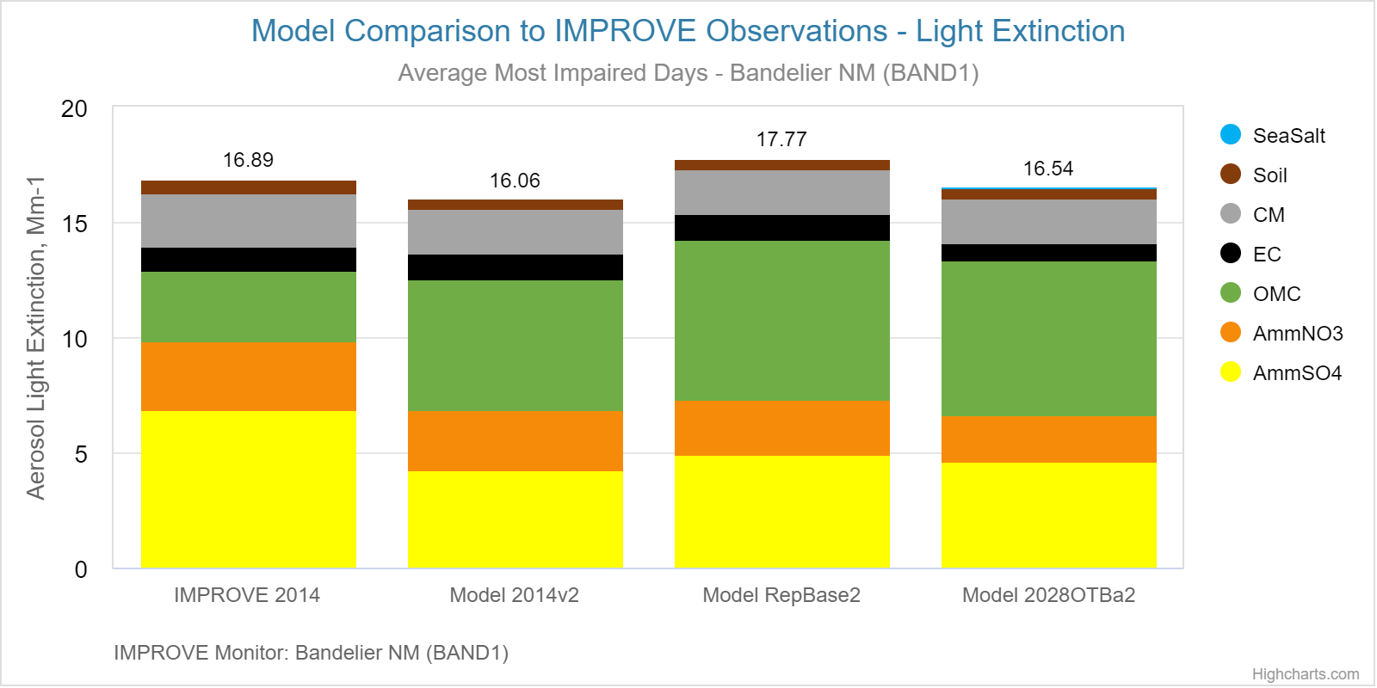
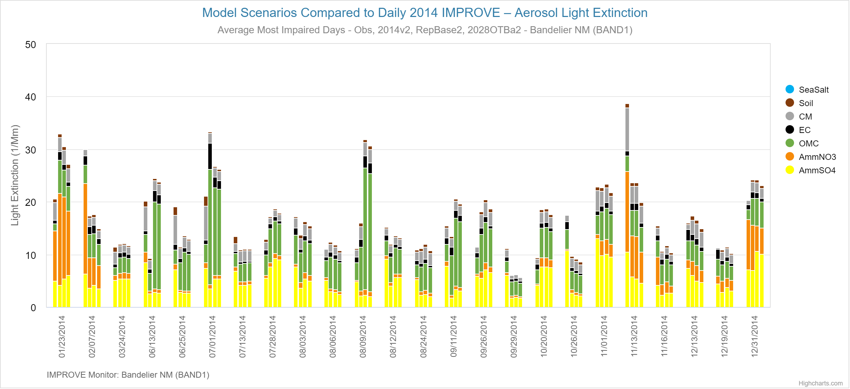
Example Application of TSS Modeling Express Tools – Bandelier National Monument
TSS Modeling Chart 1: Model to Observations – Most Impaired Days
TSS Modeling Chart 2: Model to Observations – MID
2014 IMPROVE compared to 2014v2 Modeled:
Generally good performance for average MID
On some individual days
AmmSO4 and AmmNO3 underestimated
Organic Mass from Carbon overestimated
RepBase2 and 2028OTBa2:
Little change in AmmSO4 or AmmNO3

Slide 3
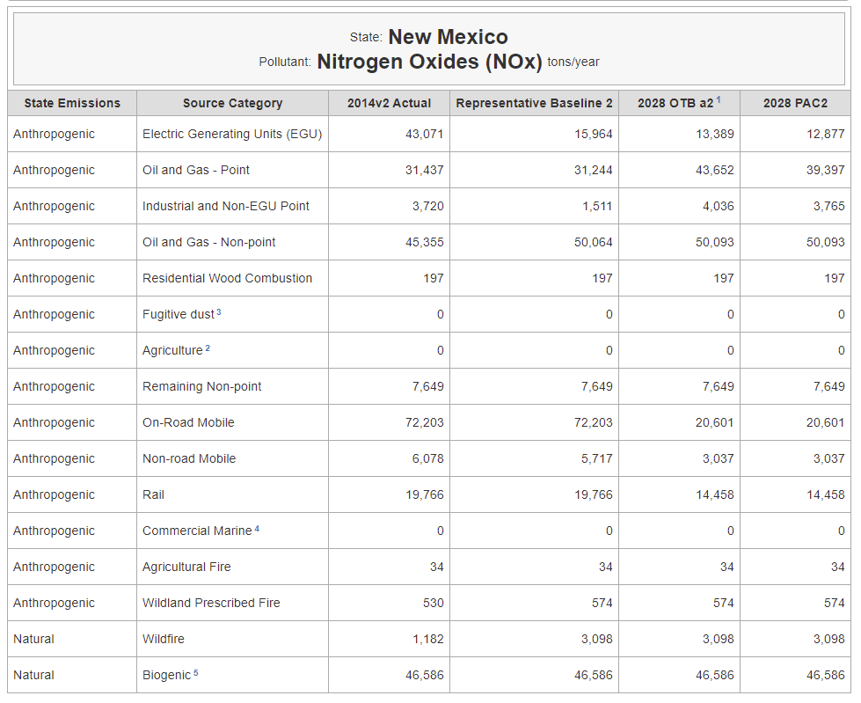
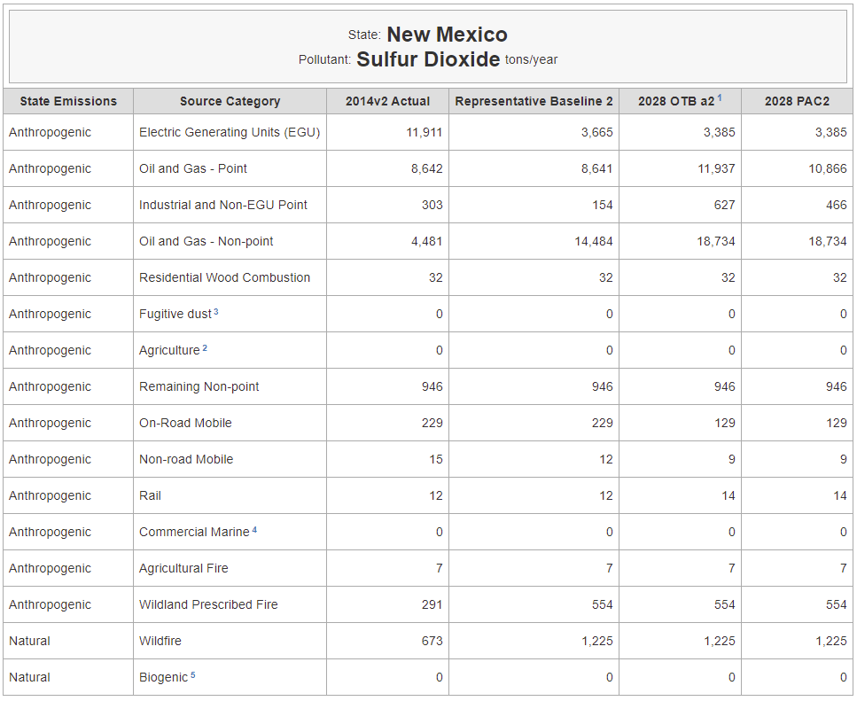
Changes in NM Anthropogenic Emissions between 2014v2 and 2028OTBa2
The Anthropogenic Emission Sectors are combined in State by Source Group

Slide 4
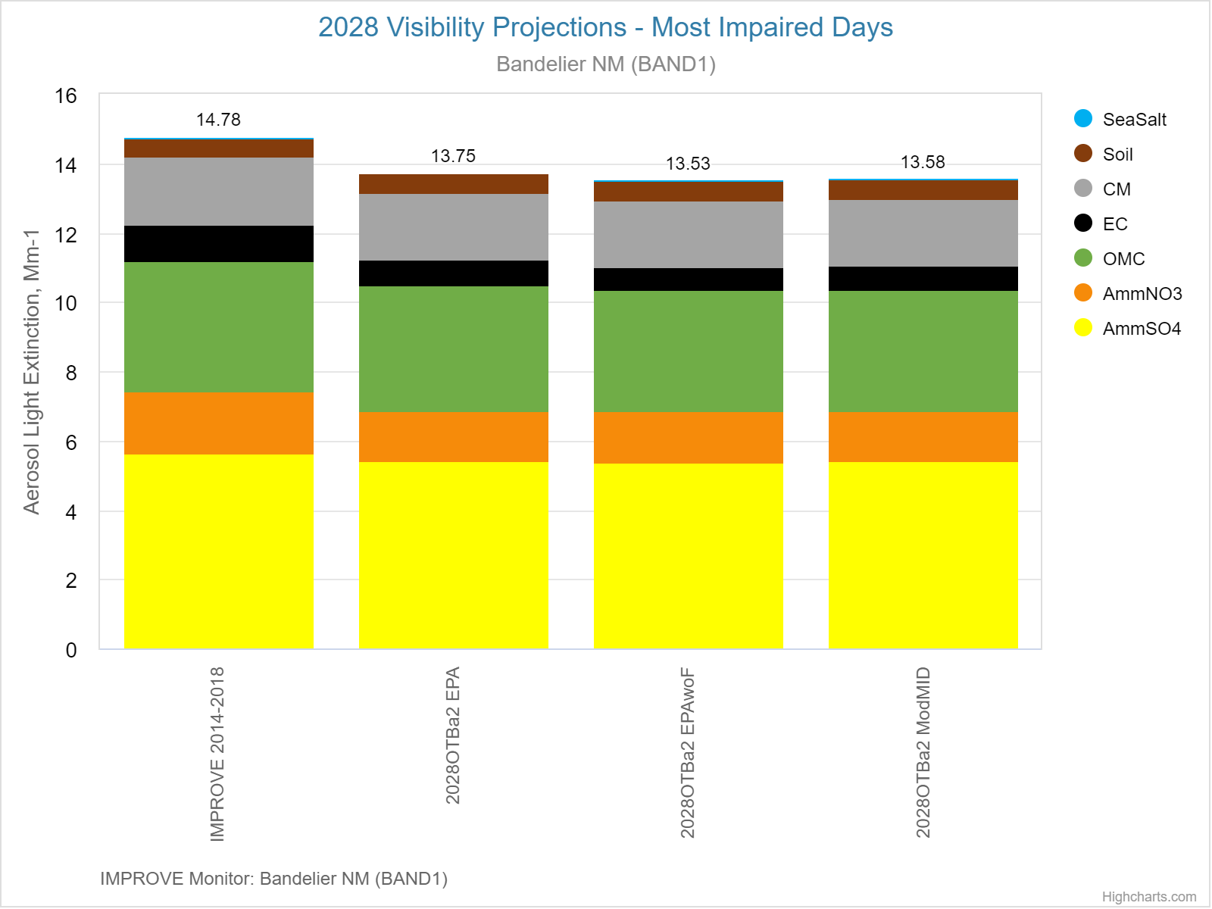
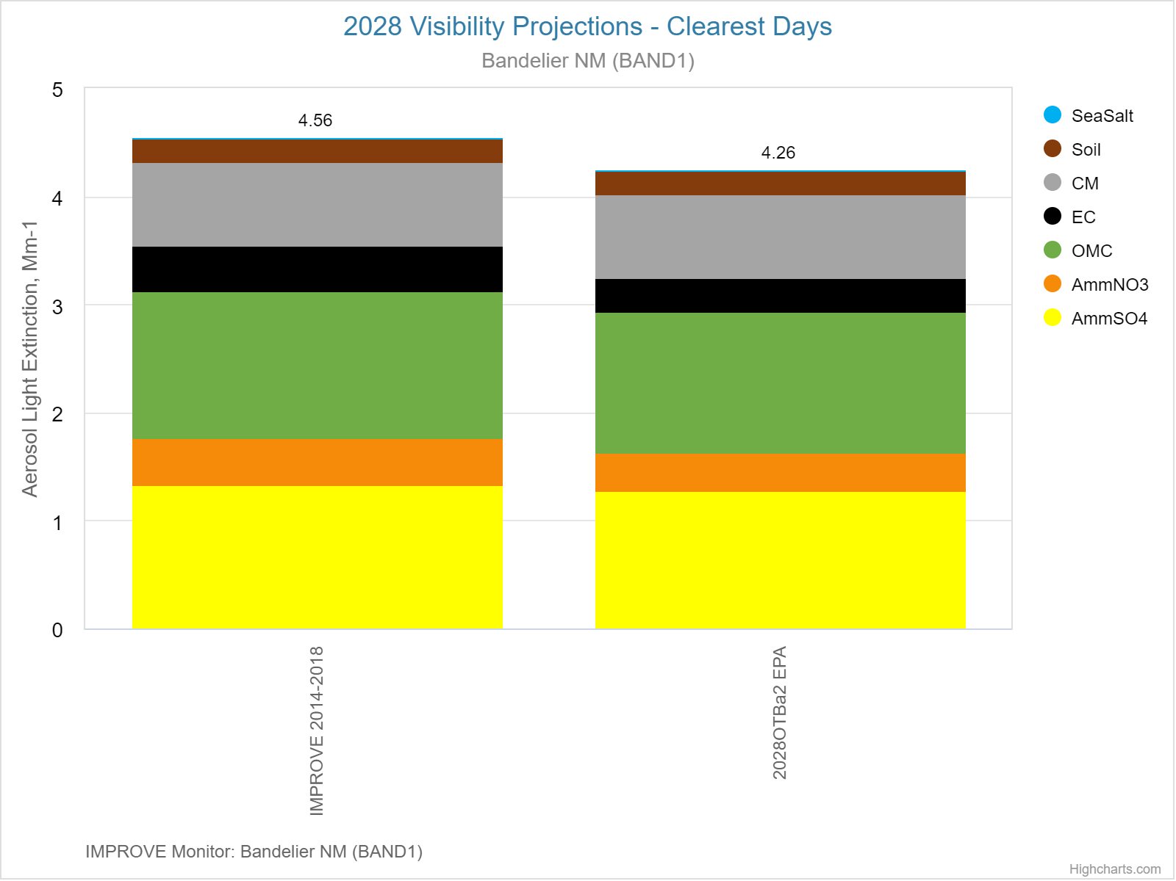
TSS Modeling Chart 3: 2028 Visibility Projections – MID and clearest days
– Example: Bandelier National Monument
2014-2018 IMPROVE compared to 2028 Projections: 2028 model results normalized to IMPROVE per EPA guidance
3 projection methods for Most Impaired days: EPA, EPA without fire, Modeled US Anthro
Only EPA projection method for Clearest days
Very small changes between IMPROVE 2014-2018 and 2028OTBa2 for AmmNO3 and AmmSO4

Slide 5
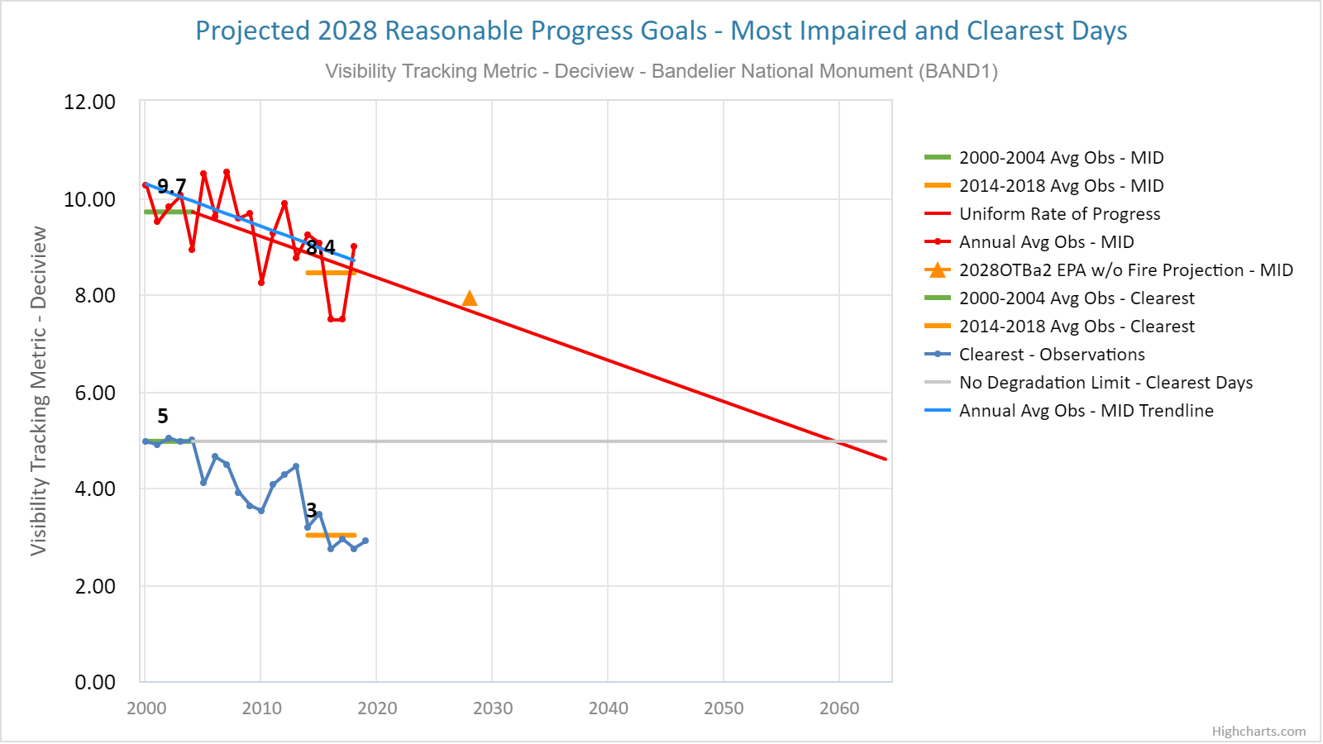
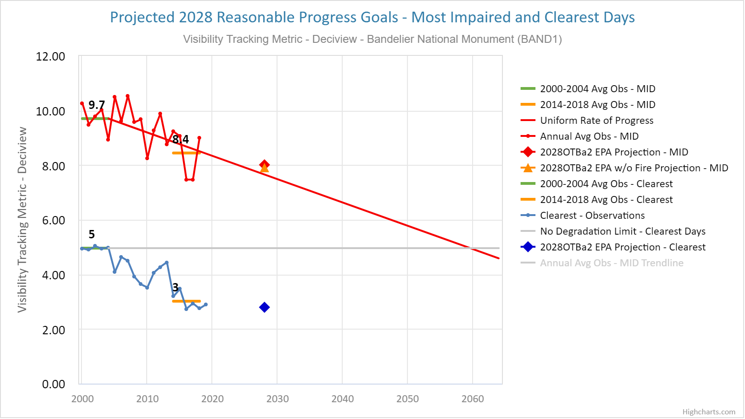
TSS Modeling Chart 4: 2028 Visibility Projections – MID
User selections in chart below:
Select 2028OTBa2 for EPA and EPA without fire
projection methods
Deselect Monitoring Trend line (future revision)
Default settings for chart above:
2028 OTBa2 EPA without fire projections

Slide 6
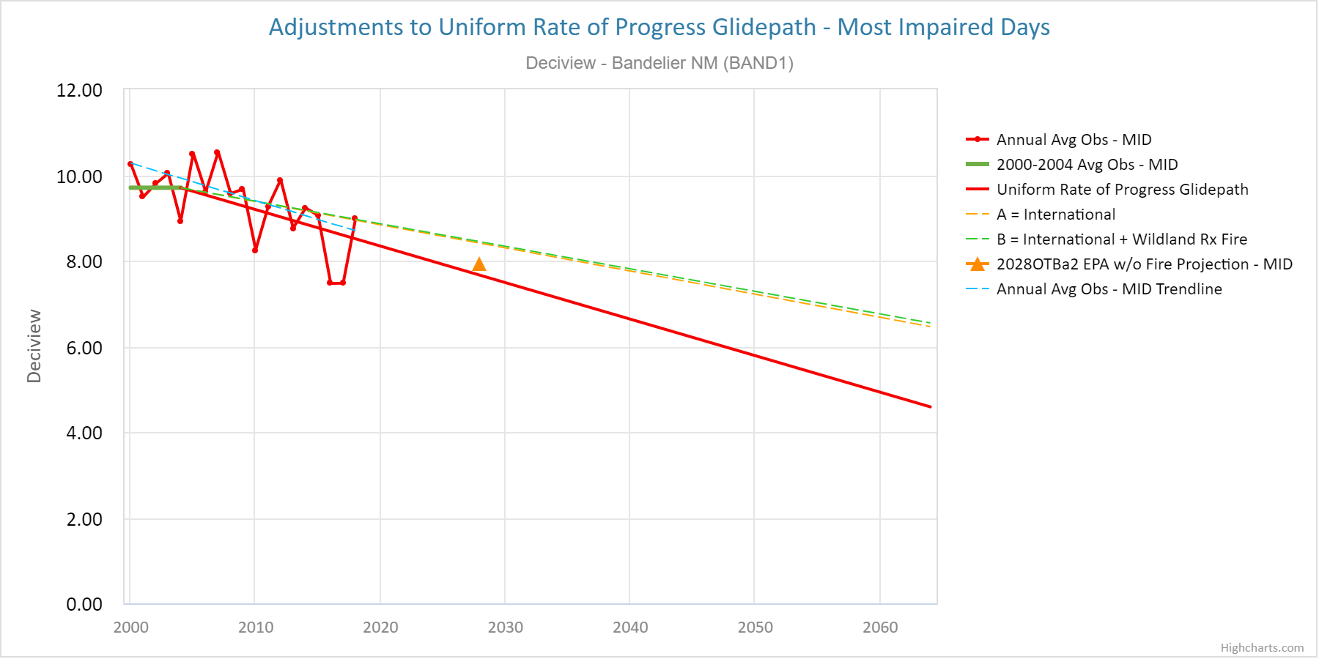
TSS Modeling Chart 5: Glidepath Adjustments – MID
Add 2014-2018 5 yr ave
Default settings for chart above:
User request add 2014-2018 5 yr ave as in Chart 4

Slide 7
Please utilize the form at: TSS Contact Us (colostate.edu) to report any problems or ask questions about TSS displays and content.

Slide 8
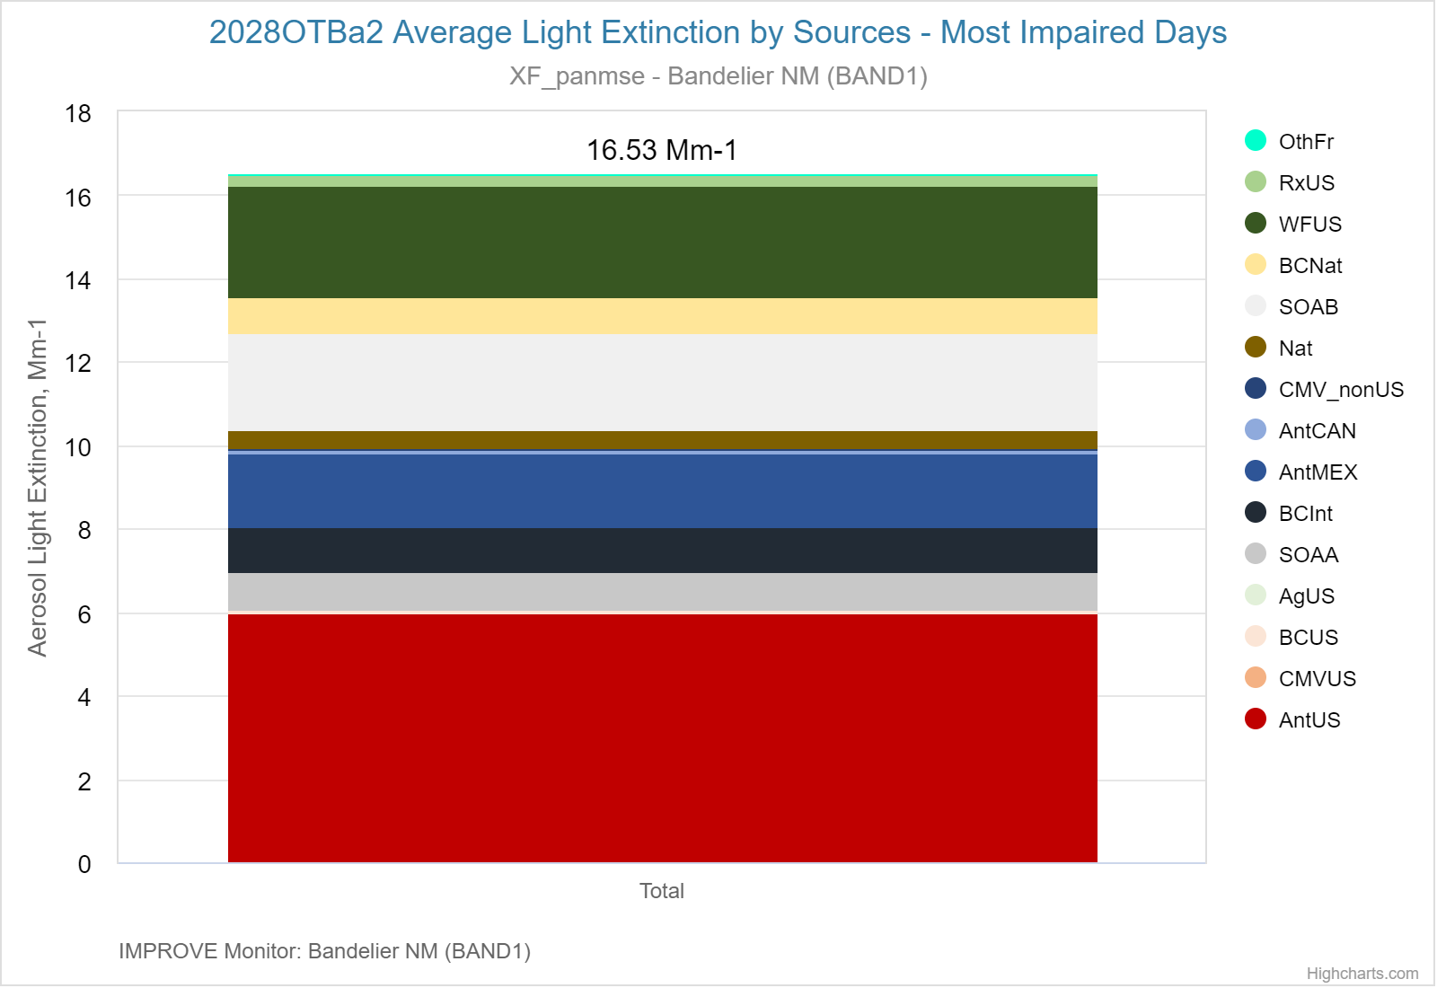
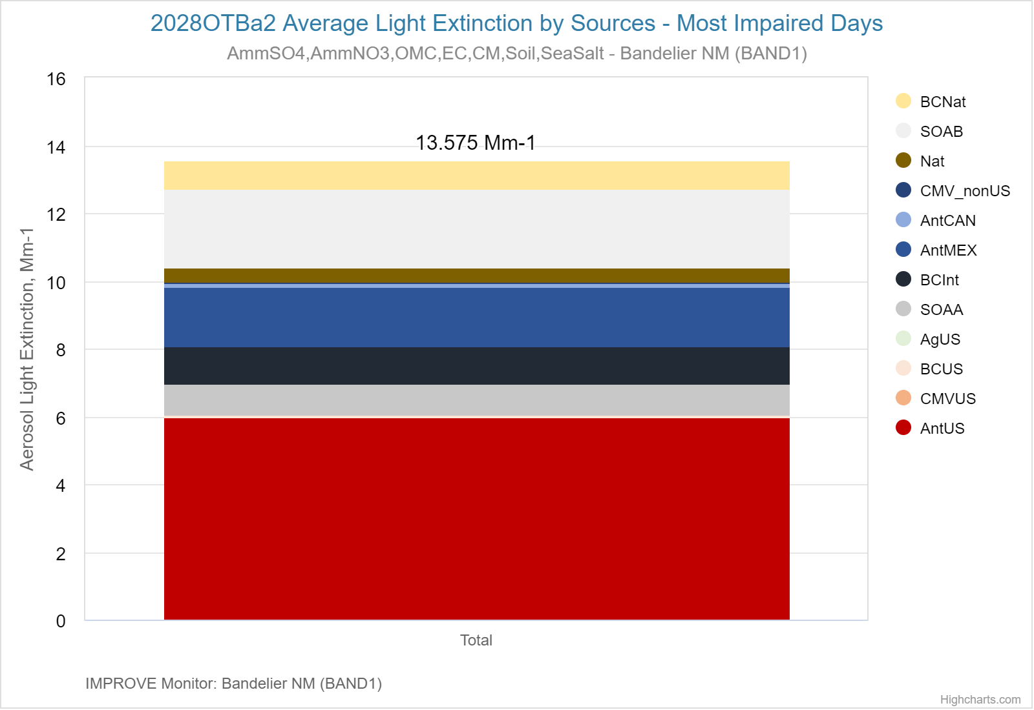
Regional Source Apportionment – Comparing Projection Methods
TSS Modeling Chart 9: Regional Source Groups – Most Impaired Days (MID)
Modeled extinction not normalized to IMPROVE
TSS Modeling Chart 9: Regional Source Groups –
EPA without Fire projection method (MID)
2028 projection = 2014-2018 IMPROVE x relative response factor (2028OTBa2/RepBase2)

Slide 9
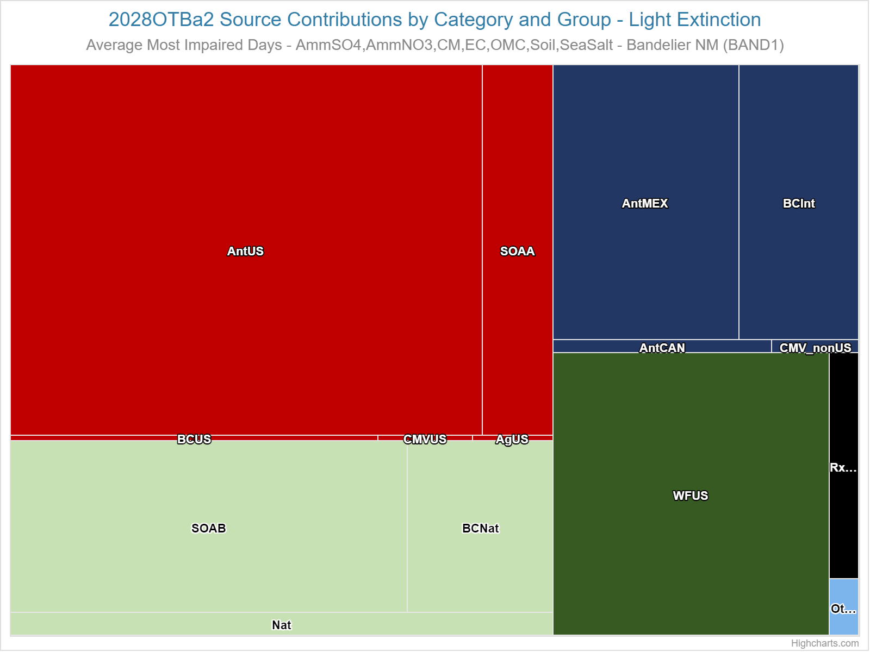
Regional Source Apportionment by Category and Group
TSS Modeling Chart 13: Regional Sources by Category and Group

Slide 10
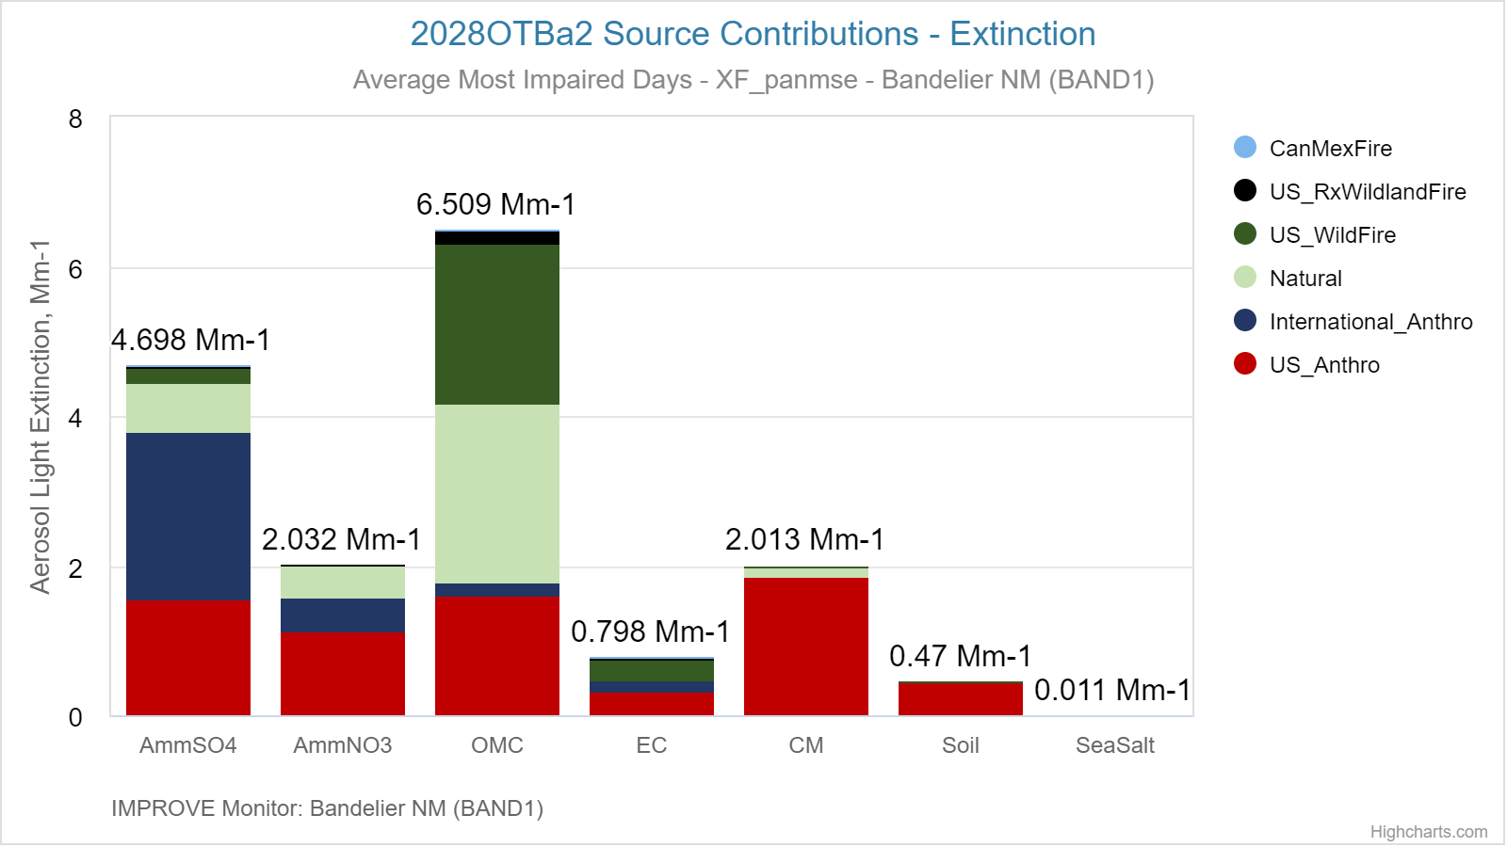
Regional Source Apportionment by Category – Bandelier NM
TSS Modeling Chart 13:
Regional Sources by Category and Group
TSS Modeling Chart 11: Regional Sources by Category

Slide 11
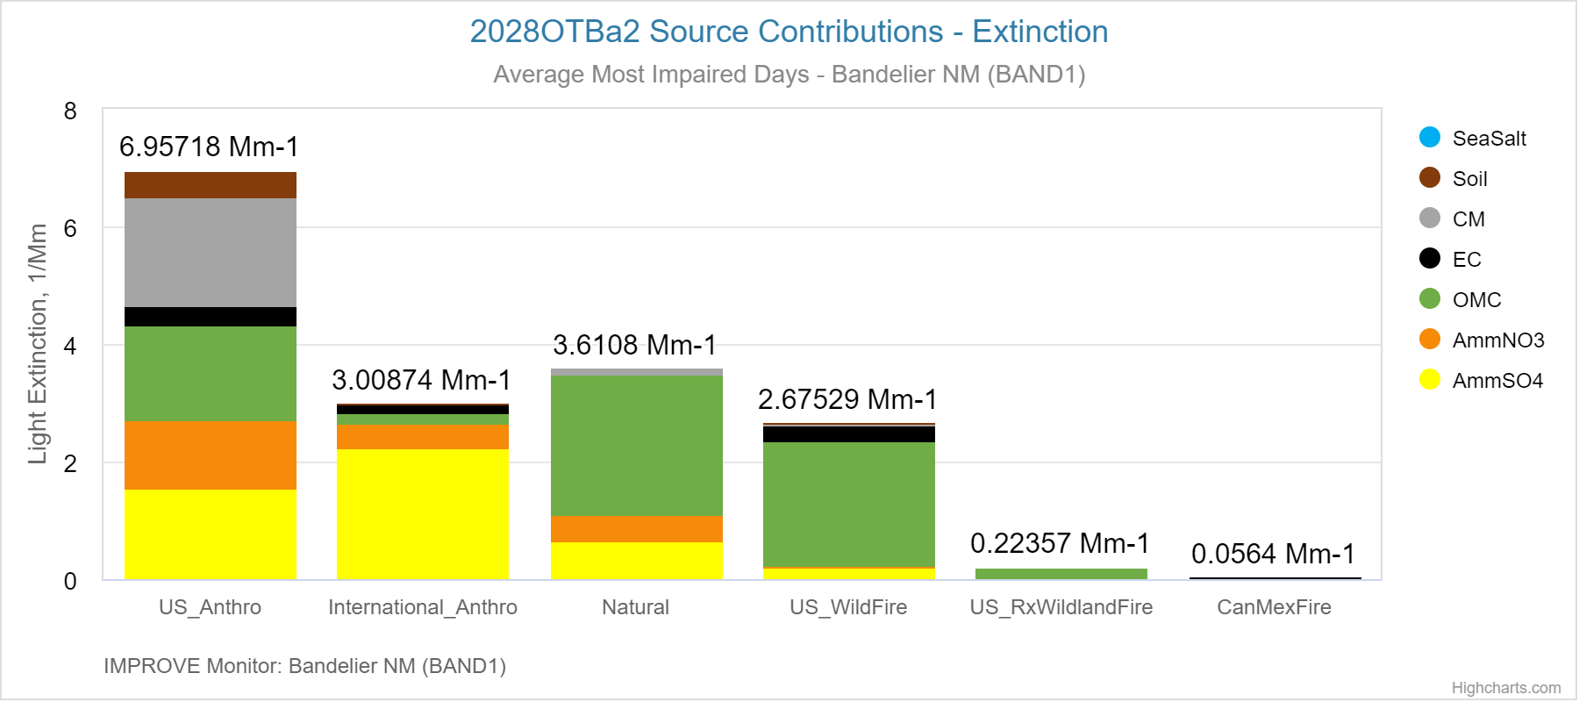
Regional Source Apportionment by Category
TSS Modeling Chart 11: Regional Sources by Category
TSS Modeling Chart 10: Regional Sources by Species

Slide 12
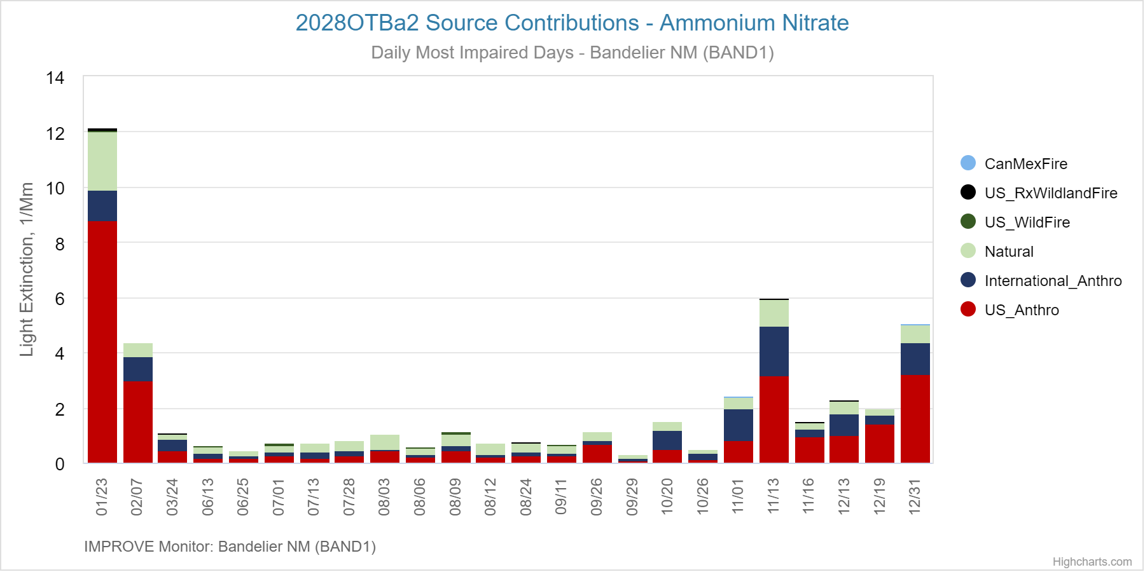
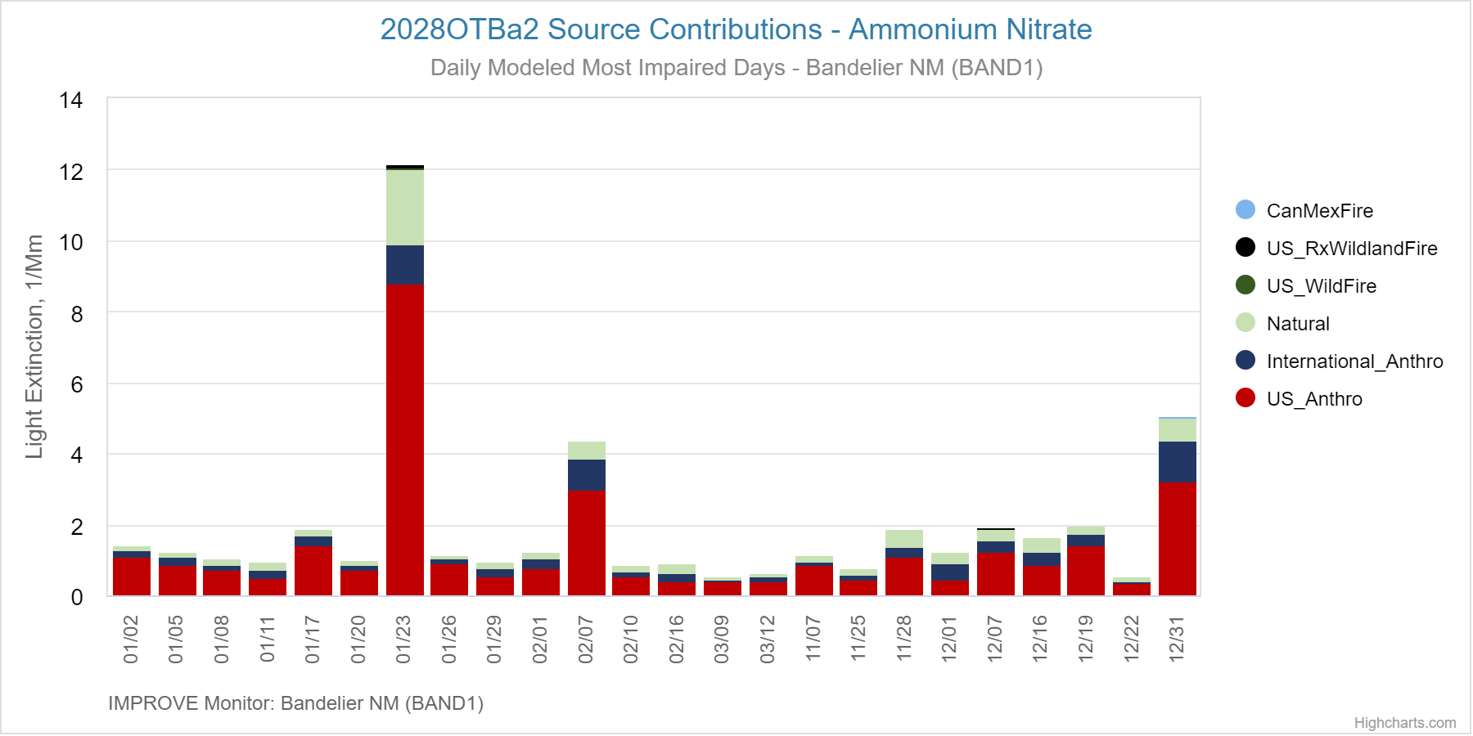
Regional Source Apportionment by Category – Bandelier NM
TSS Modeling Chart 11: Daily
Sources Apportionment
Most Impaired Days
Modeled US Anthro Most Impaired Days

Slide 13
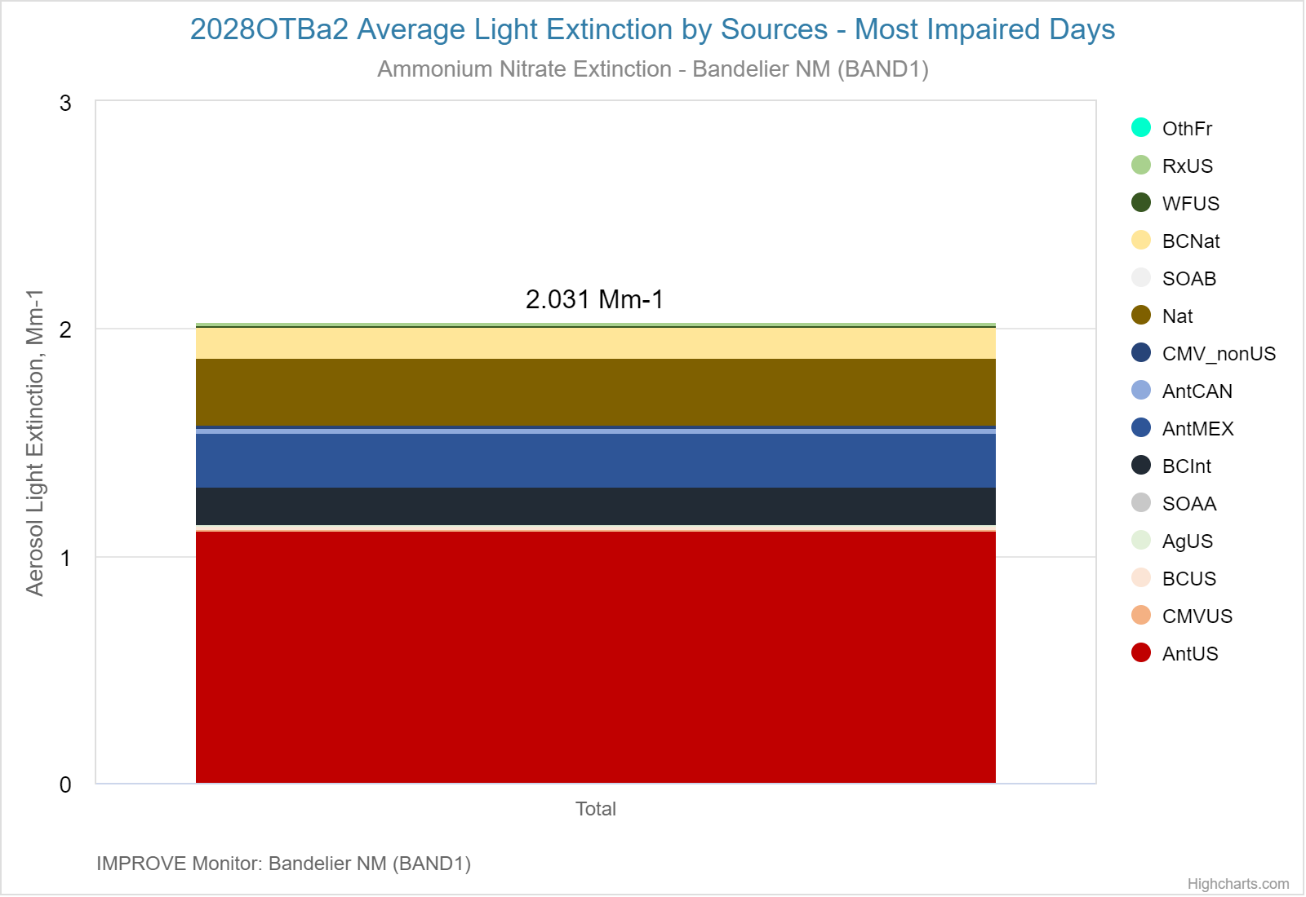
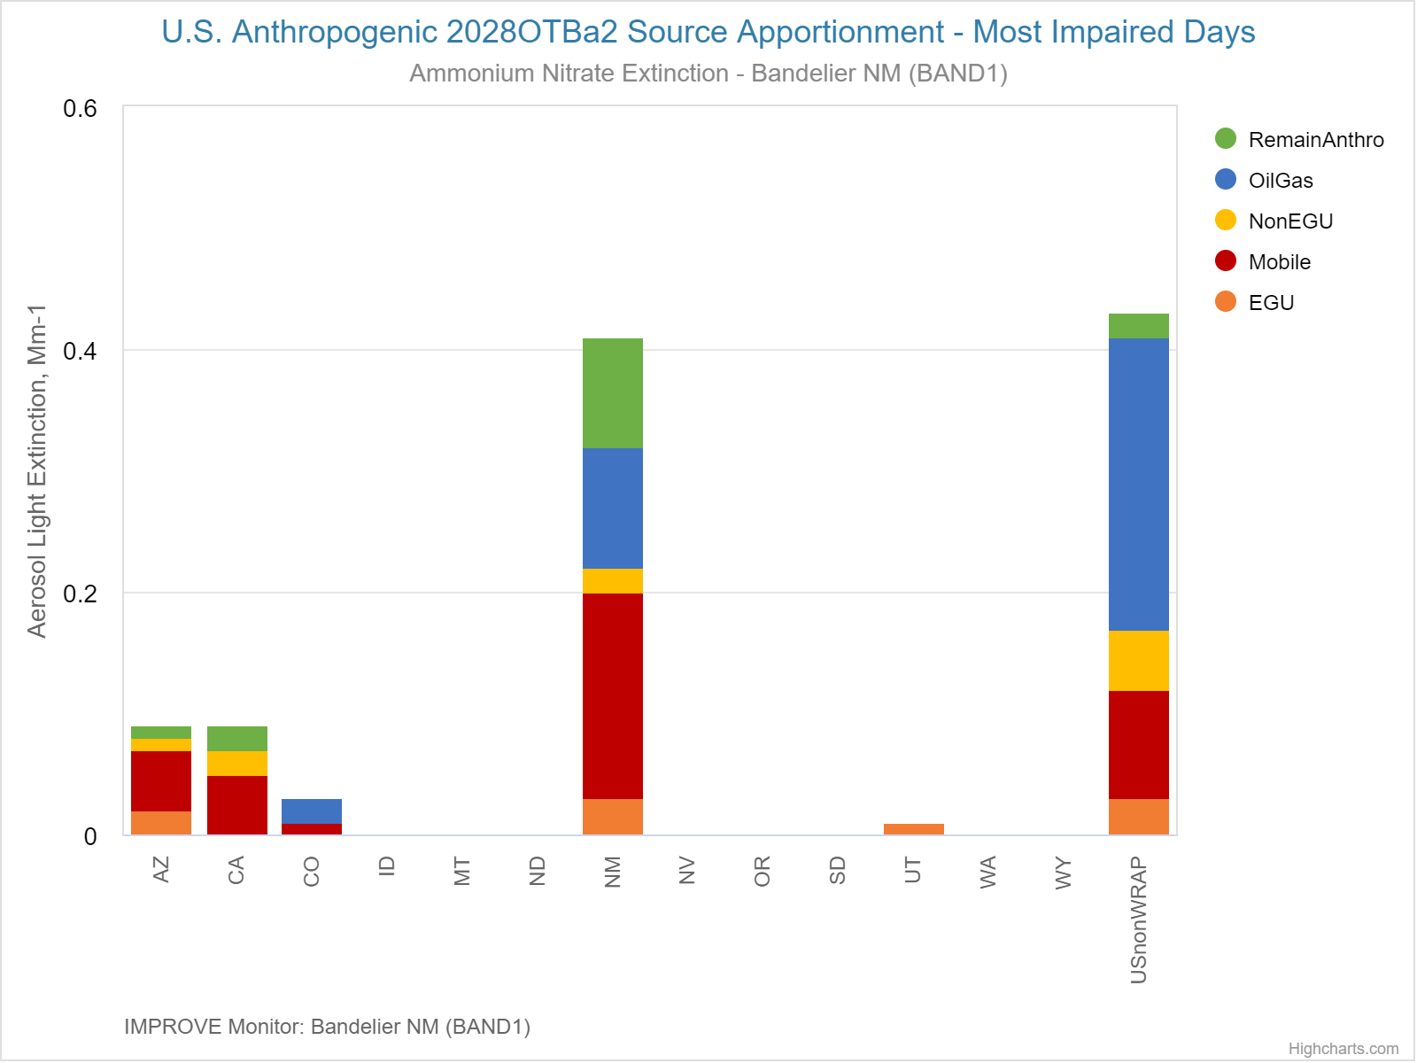
Source Apportionment for AmmNO3 – Bandelier NM
TSS Modeling Chart 9: Regional Source Groups – MID
AmmNO3
TSS Modeling Chart 8: US Anthro Sources – MID WRAP State and Non-WRAP US
AmmNO3

Slide 14
Source Apportionment for AmmNO3 – Bandelier NM
TSS Modeling Chart 9: Regional Source Groups – MID
AmmNO3
TSS Modeling Chart 8: US Anthro Sources – MID WRAP State and Non-WRAP US
AmmNO3

Slide 15
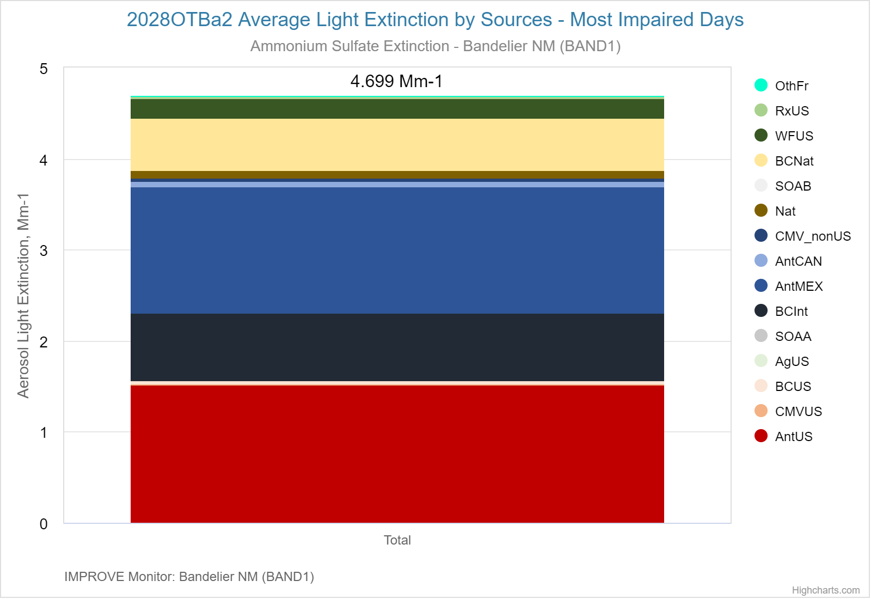
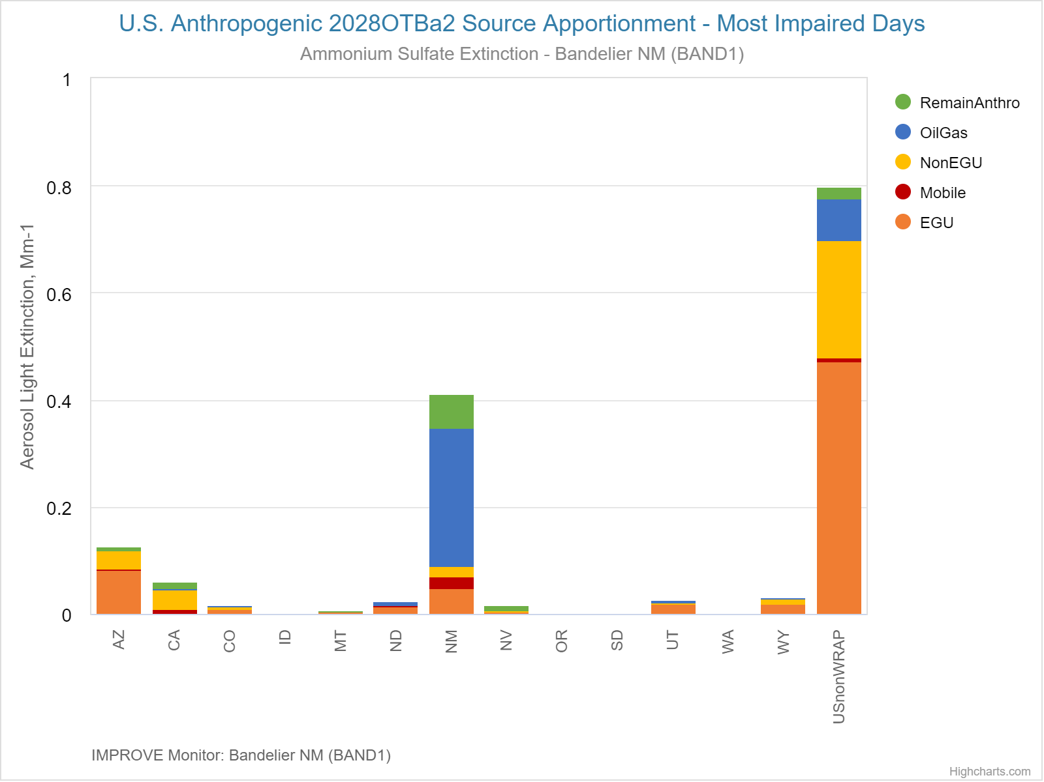
Source Apportionment for AmmSO4 – Bandelier NM
TSS Modeling Chart 9: Regional Source Groups – MID
AmmSO4
TSS Modeling Chart 8: State by Source – AmmSO4

