Slide 1
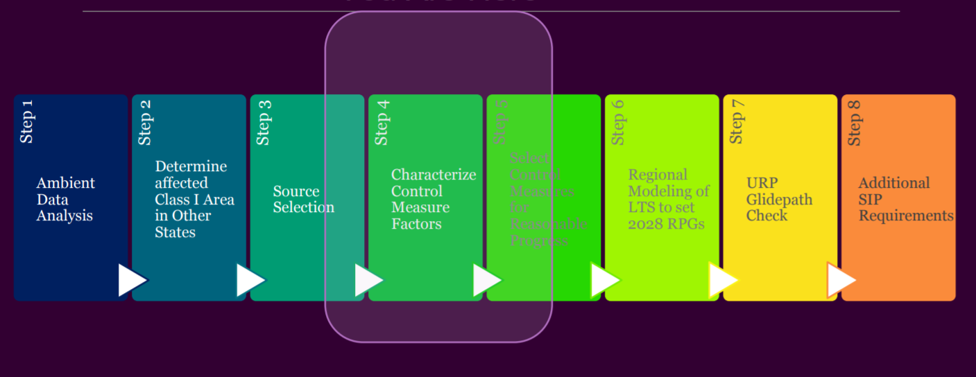
WRAP Regional Haze Delivery Process*
Coord + Glidepath
RTO/Control Measures
States
RTO/Em+Protocol
RTO/Coord +Glidepath
WRAP
Steps follow RHR and EPA Guidance
Q/d,
WEP
Ramboll
CIRA, ARS
Ramboll
CIRA
Review, Coordination, Consultation
Coord + Glidepath
*Original graphic from WESTAR Fall Meeting Nov 6, 2019; Roles Added for Coordination and Glidepath Subcommittee Call Nov 14, 2019

Slide 2
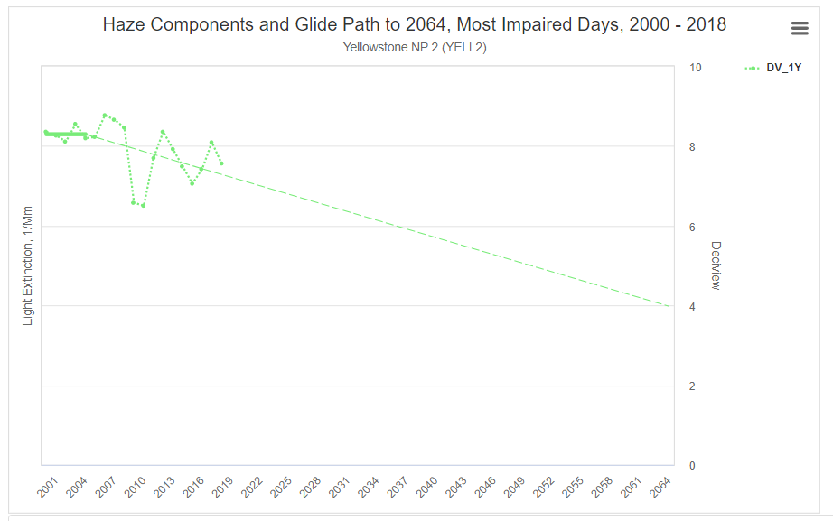
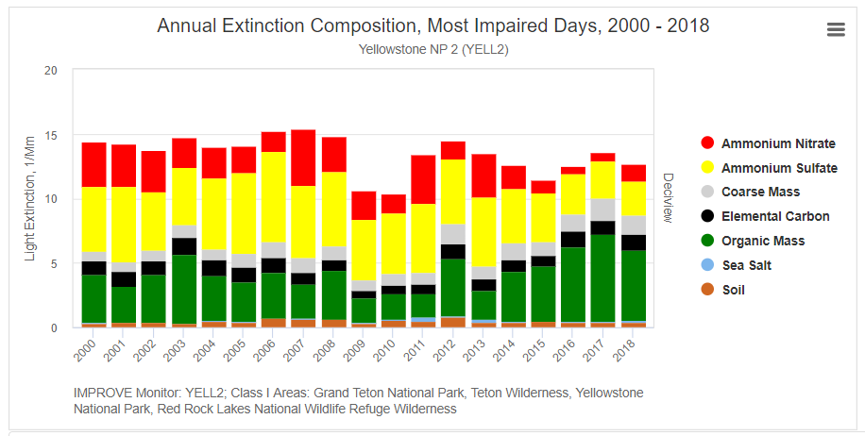
Regional Haze Glide Path to 2064 for most impaired days
10
Yellowstone National Park
8.3
2000-2004 5 yr ave
7.4
8
2014-2018 5 yr ave
Deciview, dv
6
EPA Uniform Rate of Progress
4
2
0

Slide 3
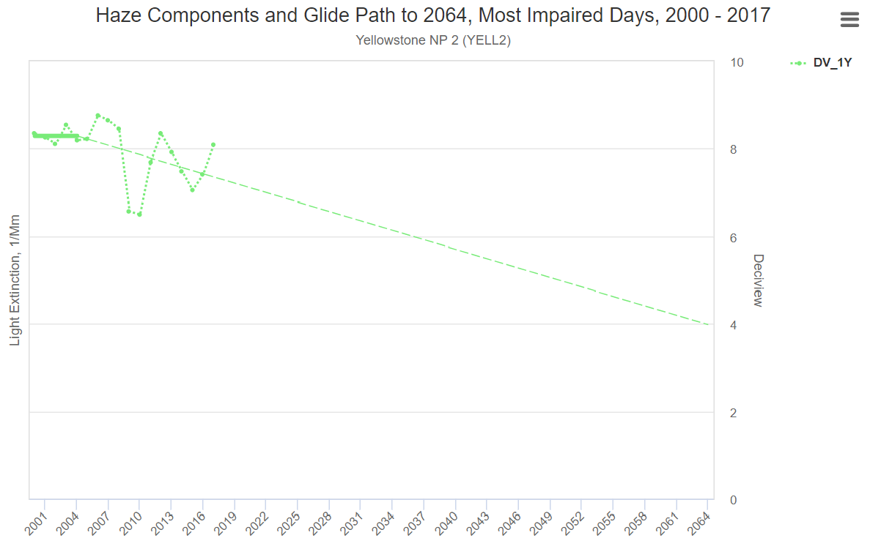
B. CAMx (Raw Model Data): 2014v2 Actual, Baseline, and 2028 Visibility Progress compared to EPA Uniform Rate of Progress Glidepath
Regional Haze Glide Path to 2064 for most impaired days, compared to CAMx Raw Model Data
IMPROVE monitoring
10
2000-2004 5 yr ave
Yellowstone National Park
2014-2018 5 yr ave
8
8.3
2064 EPA Natural Conditions
EPA Uniform Rate of Progress
7.4
C
2064 EPA Natural Conditions
EPA Uniform Rate of Progress
6
Deciview, dv
CAMx Modeling
A2) 2014v2 Actual
B) Baseline
C1) 2028 OTB w 2014v2 Fires
C2) 2028 OTB w Baseline Fires
C3) 2028 Controls w Baseline Fires
C4) 2028 OTB + Wildfire
C5) 2028 OTB + Prescribed Fire
4.0
4
C
Hypothetical values, not model results
2
0

Slide 4
C. CAMx 2028 Visibility Progress Goals (Model Adjusted by Relative Response Factor) compared to EPA Uniform Rate of Progress Glidepath
*Format drop down menu so user can select raw model results or RPG, but never both in same chart.
Regional Haze Glide Path to 2064 for most impaired days, compared to IMPROVE monitoring data 2000-2018
IMPROVE monitoring
10
2000-2004 5 yr ave
Yellowstone National Park
2014-2018 5 yr ave
8
8.3
2064 EPA Natural Conditions
EPA Uniform Rate of Progress
7.4
C
C
6
Deciview, dv
CAMx Modeling
A2) 2014v2 Actual
B) Baseline
C1) RPG 2028 OTBw14v2Fire
C2) RPG 2028 OTBwRepFire
C3) RPG 2028 OTB+Controls
wRepFire
4
Hypothetical values, not model results
4.0
C
2
0

Slide 5
(in progress: identify responsibility, objective, methods, delivery schedule)
Class I Area Summary
Monitoring
Emissions
Modeling
MID 2000-2018 Annual aerosol contributions (bext)
MID 2014 Daily aerosol contributions (bext)
MID 2014 Monthly aerosol contributions and # days/month MID
Daily aerosol 2000-2004, MID-only (retain seasonality, separate charts per year or one long landscape chart w 5 yrs)
show #MID per month per year and per month 5 yr ave
Tables of Trends by source sector (rows), years (columns), by State and by WRAP Region:
WRAP archive 2002/2008/2011
2014 v2 Actual
Rep Baseline
2028 OTBw14v2Fires
2028 OTBwRepfires
2028 OTB+Controls
2028 OTB+Wildfire
2028 OTB+Rxfire
2014 Model Performance Evaluation by aerosol mass and bext
Daily, all IMPROVE days
Daily, Most impaired days
Average MID
Median/mean all IMPROVE days
Best model performance
Visibility results: 2014 v2, Rep Baseline 2028 projections
MID based on model
MID based on EPA method
Visibility projections: relative response factors for 2028
2014v2 to 2028w14v2fires
Baseline to 2028wRepfires….
Source Contributions….

