Slide 1
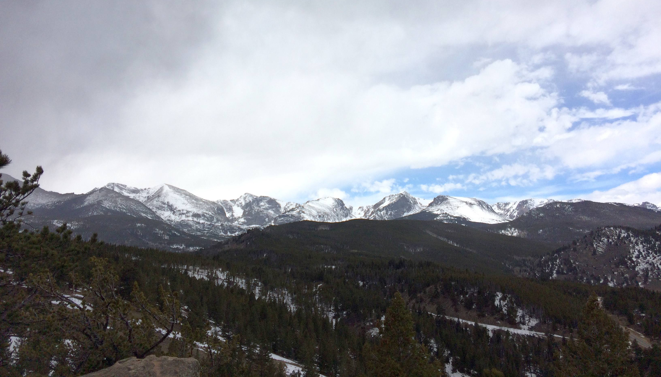
Western Regional Modeling and Analysis Platform
Phase II Modeling Plan and Recommendations
Ralph Morris, Tejas Shah, Marco Rodriguez and Pradeepa Vennam
Ramboll
B.H Baek
UNC

Slide 2
Task 1: Modeling Plan
Phase I: 2014 WRAP Shake-Out Modeling Plan
  Draft 2014 Shake-Out Modeling Plan – December 31, 2018
  Updated Draft 2014 Shake-Out Modeling Plan and Response-to-Comments – February 2, 2019
  Second Updated Draft 2014 Shake-Out Modeling Plan and Response-to-Comments – March 9, 2019
    Will post Second Updated Draft and Response-to-Comments on IWDW next week
Phase II: Modeling Plan Addendum
  Lessons learned in past modeling studies:
    2008 WestJumpAQMS; 2011 WAQS; 2011, 2014 & 2016b EPA; 2014 WRAP Shake-Out
  2014v2 – Potential Improvements to 2014 Platform
  2016b & 2016v1 EPA Platform – EPA Schedule and Potential Improvements

Slide 3
2014 Shake-Out Model Improvements for 2014v2
Boundary Conditions (BC) – 2014 GEOS-Chem
  Systematic ozone overestimation bias
  Too high sulfur BCs – other issues?
Meteorology – 2014 WRF 12-km WAQS 12WUS2 vs. EPA 12US2
  Selected WAQS 12WUS2 based on better precipitation performance
    Evaluation confounded by GCBCs performance issues
    Carry EPA 12US2 database throughout process
Emissions – Updated 2014NEIv2; MEGANvsBEIS; Oceanic; LNOx; WBD
  WRAP 2014v2 updates (CA etc.)
  MEGAN vs. BEIS – BEIS selected based on better OA performance (Not Locked In)
    Need to examine more closely and make sure not getting the right answer for the wrong reason
  Other emissions updates (e.g., Oceanic SSA-PSO4 & DMS)

Slide 4
2014v2 Shake-Out Improvements – Boundary Conditions (BCs)
BCs based on EPA’s 2014 GEOS-Chem run exhibit several model performance issues:
  Systematic overstatement of ozone concentrations year-round
  Overstated sulfur (SO2/SO4) concentrations, even when eruptions corrected
  Two potential ‘fixes” to BCs
    Scale ozone and potentially SO4 BCs to eliminate bias (Fast and Cheap)
    Rerun 2014 GEOS-Chem with updates developed using 2016 GEOS-Chem
Short-Term Cheap Fix
  Ozone BCs overstated by 15-20%. Simple correction could be scaling by 0.75-0.80
  Similar scaling for SO4?

Slide 5
2014v2 Shake-Out Improvements – Boundary Conditions (BCs)
Rerun 2014 GEOS-Chem using updates developed as part of 2016 GEOS-Chem
  Updated source code, with halogen chemistry
  Updated HTAP anthropogenic emissions
    Lower NOx and SO2 emissions (e.g., Russia fisheries)
  New LNOx emissions
    Caused GEOS-Chem ozone overestimation bias in past
  Other updates?
  4 x 5 degree (~440 km) fairly coarse, 2016 using 1 x 1.5 (~220 km) resolution
    Run time implications
  Modify GCBC processor to look outside of the CAMx/CMAQ domain to avoid including U.S. impacts in BCs due to coarse GC resolution – may not be needed if use finer grid size

Slide 6
2014v2 Shake-Out Improvements – Meteorology/Domains
Final 2014 Shake-Out Configuration used 12-km WAQS WRF 12WUS2
  Model performance from CAMx Jan/Jul WAQS vs. EPA 12-km WRF sensitivity modeling inconclusive due to overstated ozone and SO4 from GCBCs
  Selected WAQS 12-km WRF for final runs because of EPA 12-km WRF overstated precipitation
    EPA WRF actually produced better ozone performance, PM performance mixed
Will deliver both 12-km WAQS 12WUS2 and EPA 12US2 CAMx and CMAQ meteorological inputs to IMWD so both databases are available
  If fix other aspects in 2014v1 modeling platform (e.g., BCs and emissions), recommend revisit the 12-km WAQS vs. EPA WRF meteorological issues with annual CAMx and CMAQ simulations
    Better performing 12-km meteorology will be easier to identify w/o high ozone and So4 BCs

Slide 7
2014v2 Shake-Out Improvements – Natural Emissions (1 of 3)
CAMx Oceanic Emissions Pre-Processor Emissions
  Overstated SO4 at coastal sites in CAMx but not CMAQ, especially in summer
    Did not identify in CAMx Jul sensitivity modeling due to BCs contaminated by 2009 volcano eruption
  Isolate cause of high SO4 over ocean:
    Direct PSO4 emissions from Sea Salt ;and/or
    DMS Emissions renamed as SO2
Oceanic Processor fairly new, but did not show SO4 overestimation issues in other studies:
  BOEM Arctic Seas Modeling
  BOEM GOMR OCS Modeling
  These studies do not have the fetch and high wind speeds of the vast Pacific Ocean
Review emissions to identify causes of overstated SO4 at coastal sites and fix:
  Explicit DMS chemistry coming soon in CAMx

Slide 8
2014v2 Shake-Out Improvements – Natural Emissions (2 of 3)
MEGAN vs. BEIS Biogenic Emissions
  BEIS selected for 2014 Shake-Out final configuration due to better OA performance in CAMx Jan/Jul sensitivity tests
    Final runs show CMAQ OA overestimation and many sites. See Obs, CAMx, CMAQ annual PHX OA
In WESTUS, BEIS has 4-5x TERP and SESQ emissions that MEGAN has
  BEIS high TERP/SESQ in areas we would not expect high emissions (e.g., dessert SW, Las Vegas)
  Need review BEIS and MEGAN emissions and formulations in more detail
  Previous WRAP MEGAN WESTUS study found BEIS inappropriate WESTUS EFs
  Ramboll, Alex Guenther and EPA in discussions on this issue

Slide 9
2014v2 Shake-Out Improvements – Natural Emissions (3 of 3)
Open land fire Plume Rise
  2014 Shake-Out runs used the 2014 NEI Bluesky fire emissions modified by F&SWG (AirSci) with Briggs plume rise
    CMAQ in-line Briggs plume rise using EPA Briggs approach designed to work with Bluesky fires
    CAMx fire emissions based on SMOKE modeling Briggs plume rise that generated millions of virtual stacks and many TB of disk space – very cumbersome and long processing
  Original plan was to do a WRAP fire plume rise sensitivity test while final 2014 annual Shake-Out runs were going
    Ran out of time as fixing the 2014 Jun/Jul GEOS-Chem sulfur BCs took hire priority
    CAMx designed to operate efficiently with WRAP plume rise approach using in-line vertical distribution

Slide 10
2014v2 Shake-Out Improvements – Anthropogenic Emissions)
WRAP 2014v2 updates – discussed earlier in emissions section

Slide 11
Potential CAMx and CMAQ Updates for 2014v2
Possible CAMx Updates
  Currently using CAMx v6.5 (Apr 2018)
  Bidi ammonia flux (Zhang)
  Explicit DMS chemistry
  Boundary Conditions Source Apportionment Capability
    For example, separately track BC concentrations due to anthropogenic and natural sources from GEOS-Chem zero-out runs
Possible CMAQ Updates
  Currently using CMAQ v5.2.1
  Ammonia bi-directional flux for in-line deposition
  CMAQ in-line WBD algorithm
    Instead of using CAMx off-line WBD pre-processor
  CMAQ v5.3 (currently beta) finalized ~Jul 2019
    Halogen chemistry
    New AERO7/&I aerosol chemistry

Slide 12
Current 2014v2 Base Case Recommended Improvements
Final annual 2014 Shake-Out runs completed less than a week so still undergoing review so additional recommendations may be forthcoming
Revised 2014 GEOS-Chem Base Case using 2016 Geos-Chem configuration and updates
  Implement same updates that Ramboll implemented in 2016 GEOS-Chem modeling that reduced ozone and SO4 BC overestimation
  Use higher 1 x 1.5 degree (~110 km)
Identify source of high SO4 and update Oceanic Emissions Processor
Revisit MEGA vs. BEIS biogenic emissions sensitivity from theoretical basis (Ramboll, Guenther, EPA discussions), emissions analysis and CAMx/CMAQ annual MPE using BEIS
Revised SMOKE 12-km 12US2 emissions modeling using WRAP 2014v2 emissions
Configure CAMx with 36/12-km two-way grid nesting using WAQS WRF?
Revised 2014v2 CAMx and CMAQ annual simulations using both 12-km WAQS 12WUS2 and EPA 12US2 WRF meteorological inputs
  MPE and transfer databases and outputs to IWDW

Slide 13
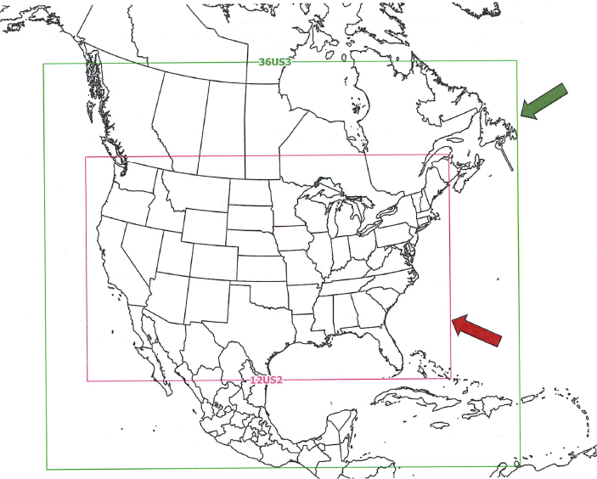
2016 Modeling Platform – EPA/MJO Collaborative
EPA 2014 beta (2014b) modeling platform:
  EPA/MJO 2016, 2023, 2028 Emissions
  36-km 36US3 Expanded NA Domain →
  12-km 12US2 CONUS domain
  BCs based on hemispheric CMAQ (CMAQ-HEMI)
EPRI International Emissions Study
  Same EPA 2014b 36/12-km CAMx
  BCs based on 2016 GEOS-Chem
Denver RAQC/CDPHE Ozone SIP Modeling
  Same 36/12-km domain and emissions as EPA
  New WRF 36/12/4-km meteorological modeling
    36/12/4-km domains consistent so can use two-way grid nesting
    4-km Colorado domain with traffic data

Slide 14
Current 2016 Base Case Recommendations
Track and follow EPA, EPRI and Denver 2016 (and potentially others?) modeling efforts
  Let them do the heavy lifting ($$$) to develop and do initial evaluation of the 2016 36/12-km CAMx/CMAQ databases
  Potentially low-level work on MPE of interest to WRAP (e.g., MPE at western IMPROVE sites)
  Decide how want to use 2016 platform at later date?
Future Year Emissions
  EPA/MJO developing 36/12-km 36US3/12US2 model-ready emissions for 2028 and 2023 future years
  Can use directly with 2016 36/12-km CAMx/CMAQ databases
  Can window emissions for 2014 35/12-km CAMx/CMAQ database
  Since 2016beta emissions were built of 2014NEIv2, then 2023 and 2028 projections are consistent with 2014NEI emissions
  May want to have states review 2028 emissions projections

Slide 15
Source Apportionment (SA) Modeling
Lessons learned from WestJumpAQMS and WAQS
  Perform several Rounds of SA rather than try to run a gigantic configuration
  Allows one to take advantage of corrections and updates to modeling platform
SA Round 1: 2014 International and Anthro vs. Natural
  Purpose: Can compare current year (2014) modeled vs. statistical anthropogenic impairment including MIDs. Provides estimate of background (natural) conditions.
  APCA ozone + PSAT with no SOA (SOA, SOB) -- Source Groups (~10) – will run relatively fast:
    U.S. Anthropogenic Emissions
    [Rx+Ag fires separately?]
    Mexico Anthropogenic
    Canada Anthropogenic
    Natural Emissions for 36/12-km Domain (Biogenic, LNOx, WBD, SSA/DMS, and WF)
    [track WFs as separate source group, possibly SSA/DMS as well?]
    SA BCs by Anthropogenic vs. Other from GEOS-Chem Zero-Out (if available)

Slide 16
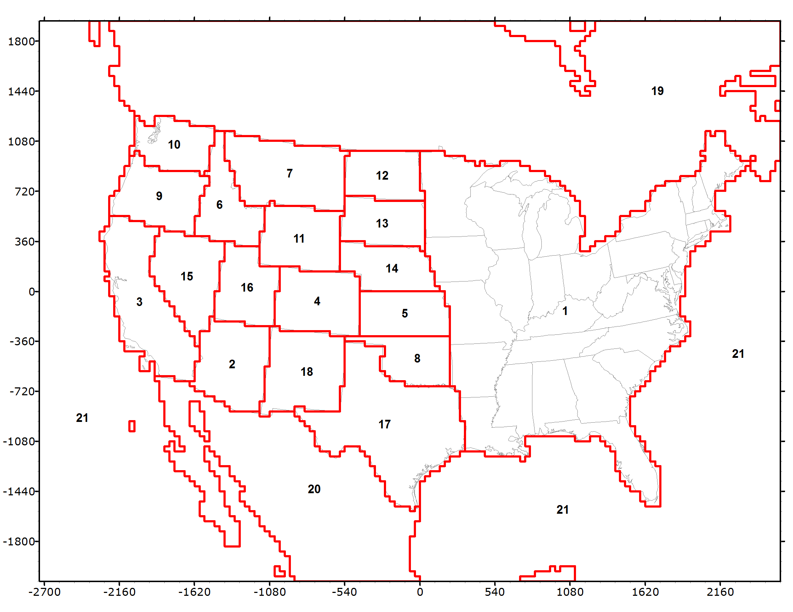
Source Apportionment (SA) Modeling
SA Round 2: Geographic Contributions
  Purpose: Can conduct CSAPR-type analysis for ozone and PM2.5. Estimate State anthropogenic emissions contribution to visibility impairment on MIDs at CIAs (state consultation). 2014 and/or 2028 year.
  46 Source Groups:
    21 Source Regions
    4 Source Categories: Anthro; WF; Rx+AG; Natural (Biogenic; LNOX; WBD; SSA/DMS)
    46 = 21 x 4 + 2 (IC/BC)

Slide 17
Source Apportionment (SA) Modeling
SA Round 3: Source Sector Contributions
  Purpose: Obtain source sector contributions to ozone, PM2.5 and regional haze.
  APCA + PSAT
  11 Source Groups:
    Natural (Biogenic, LNOX, WBD, SSA/.?DMS)
    Wildfires (WF)
    Other Fires (Rx+Ag)
    Mexico Anthro
    Canada Anthro
    EGU Point
    O&G
    Other Point
    On-Road Mobile
    Non-Road Mobile
    Other Anthropogenic
SA Round 4: Refined Analysis
  Combine geographic and source sector to address specific issues

Slide 18
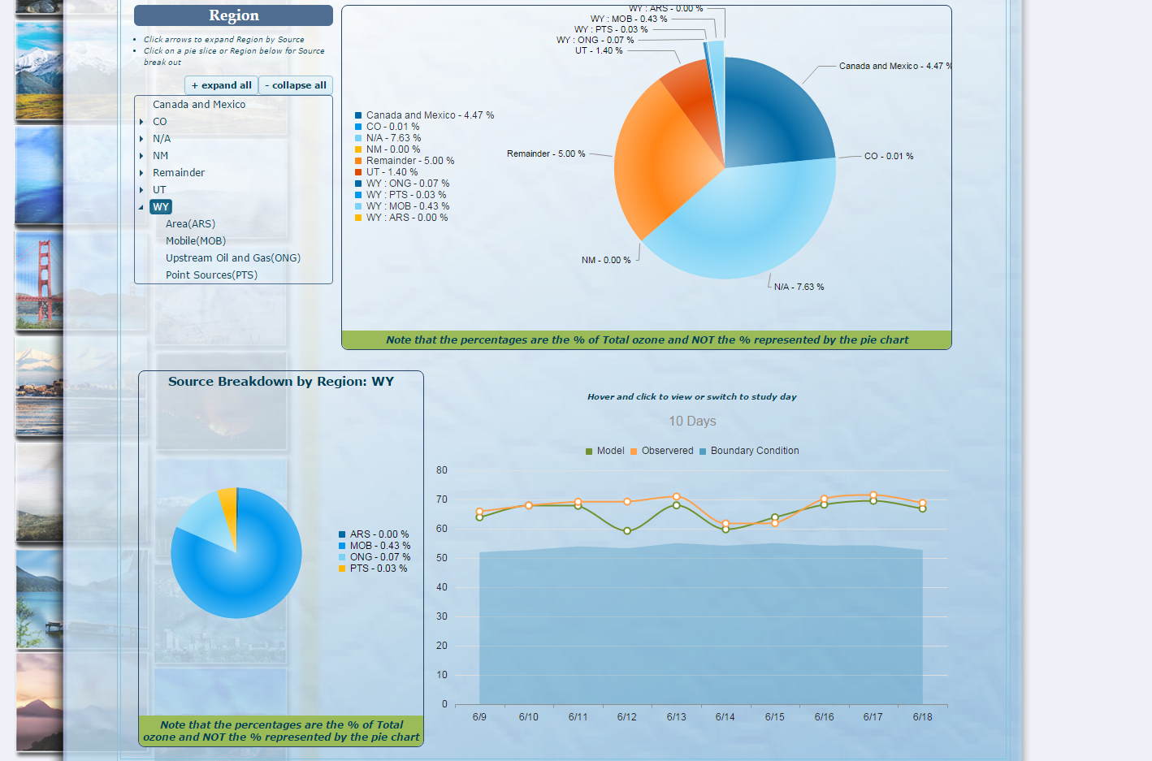
Visualization of Source Apportionment Results
Can port SA results at sites to interactive Excel spreadsheets with drop down menus and bar and pie charts (WestJumpAQMS)
Or load data into SA Visualization Tool pos on the IMWD as was done in WSAQS and Denver ozone SIP modeling

