Slide 1
WESTAR-WRAP Regional Modeling and Analysis Platform
2028 emissions changes and corrections
WRAP RTOWG Webinar
July 15, 2020

Slide 2
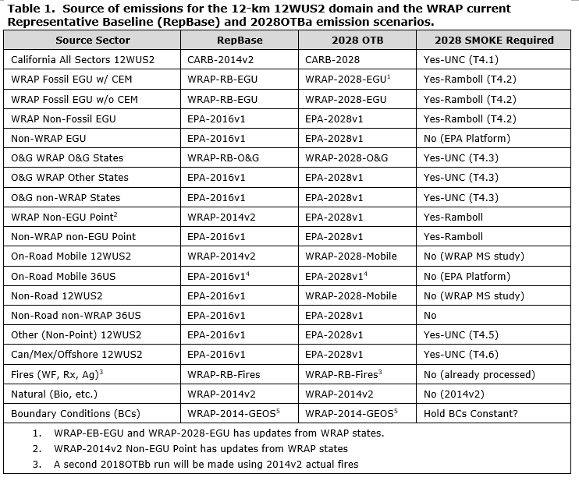
2028 Future Emissions Data Sources

Slide 3
2028OTB Emissions
Presented 2028OTB emissions on February 26th RTOWG call
Datasets for WESTAR-WRAP state point source 2028 projections
WRAP OGWG provided upstream/midstream O&G point source projections
2016 National Emissions Modeling Platform v1 2028 projections data used for non-EGU point sources
WESTAR-WRAP EGU Emissions Analysis project with state updates for coal and gas EGU sources

Slide 4
Duplicate O&G Source issue
New Mexico found duplicate sources in the Rank Point file (WEP/AOI product) built from the 2028OTB point source inventory data.
EPA also identified 16 facilities (all of them are in New Mexico) double counted in both 2016v1 platform non-EGU and WRAP point O&G inventory
NMED found duplicates in addition to the 16 identified by EPA
Double counted emissions NOx: 8,034 TPY and SO2: 7,504 TPY
Represents approximately 9% (NOx) and 24% (SO2) of the New Mexico 2028 O&G emissions
Duplicates in the WRAP O&G inventory: NM AQB provided Title V and minor point O&G sources datasets for the OGWG work. Some sources were present in both the datasets.
Double counted emissions NOx: 1,927 TPY and SO2: 942 TPY

Slide 5
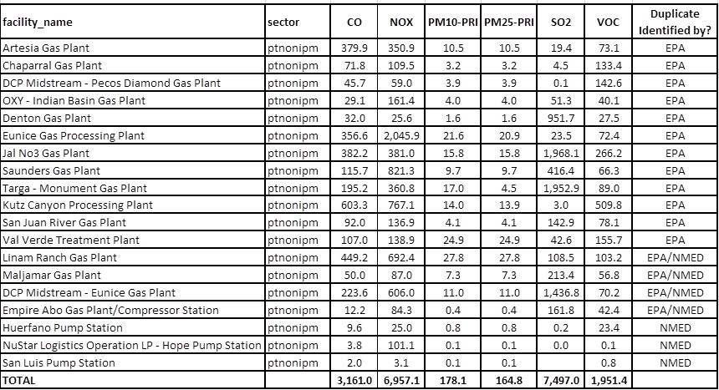
Duplicate O&G Sources

Slide 6
identifying double count sources
Identified a list of duplicate O&G sources in the 2028OTB “ptnonipm” inventory by combining the following information
EPA “Readme” file
NMED’s review
O&G NAICS code search in the non-EGU inventory, and then verify whether those facilities exist in the OGWG inventory based on FIPS, name, lat/long and emissions
Key word search: “Gas Plant”, “Gas Processing Plant” and “Compressor Station”
Duplicate records in 2014v2 and RepBase account for 141 TPY NOx and 1 TPY SO2 (5 facilities) so not enough to worry about.
This indicates that O&G duplication problem was introduced with the 2016 platform.

Slide 7
O&G sources identified in non-EGU inventory based on naics codes

Slide 8
Providing data updates for 2028OTBa2
Review information to verify and update 2028OTB point source projection emissions (Tom’s email on July 13th)
To facilitate your review, we aggregated harmonized inventory data to the facility level by summing point/process-level emissions.
Comments and any data changes in the form of FF10 files with the emissions to use in the 2028OTB re-run are due by close of business Tuesday July 21st

Slide 9
Schedule for new 2028OTBa2 Scenario
Assuming all state updates on 2028 emissions are provided by July 21st in FF10 format:
2028OTBa2 SMOKE emissions modeling finished by August 4
CAMx 2028OTBa2 standard model run finished by August 11
Revised 2028OTBa2 projections on TSS by August 13
CAMx 2028OTBa2 high-level source apportionment run finished by August 31
U.S. vs. International anthropogenic, fires and natural contributions
Adjust URP Glidepath for International Emissions and Wildland Prescribed Fires
Use for Dynamic Evaluation U.S. anthropogenic emissions extinction Glidepath from 2002 to zero in 2064 with 2016 (RepBase) and 2028 (OTBa2) visibility projections
CAMx 2028OTBa2 low-level source apportionment run finished in October
State-specific and Source Sector-specific contributions

