Slide 1
Navajo Nation Minor Source Regulations
Tennille Denetdeel, Sr. Environmental Specialist

Slide 2
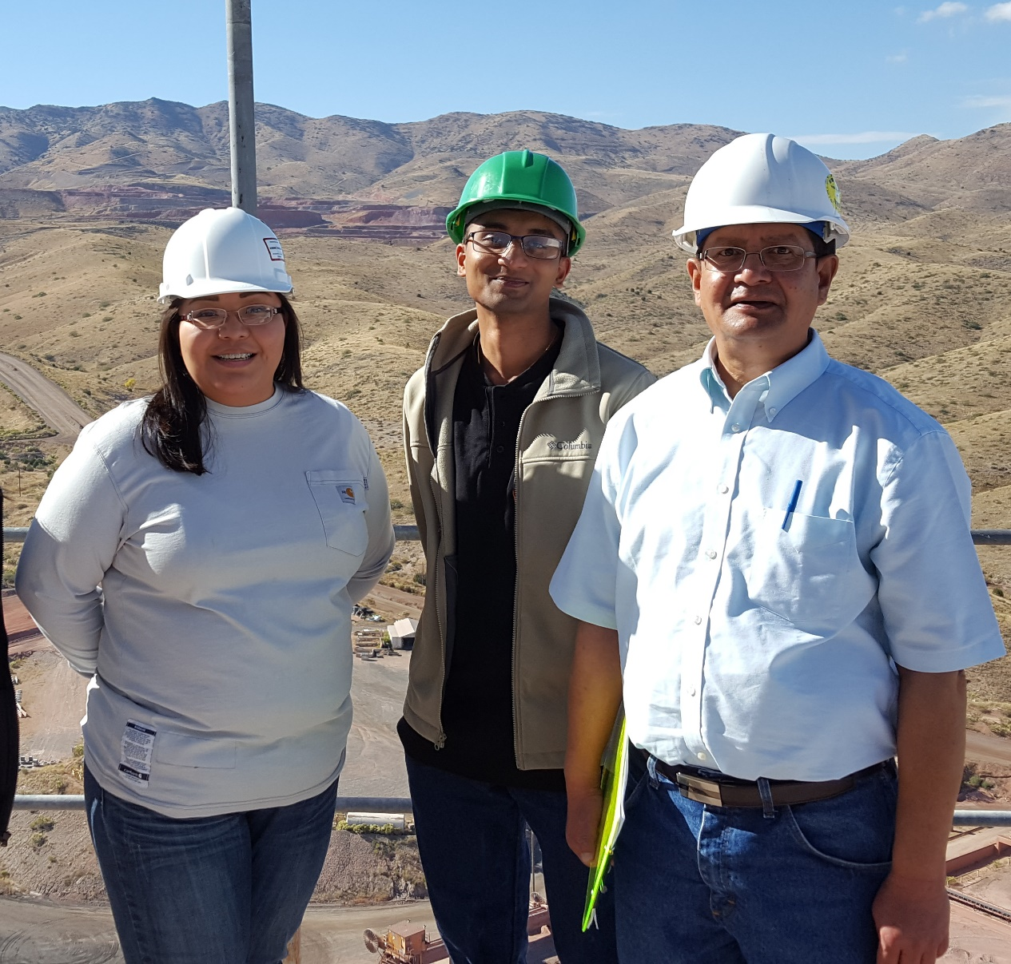
Operating Permit Program
Navajo Nation EPA – Air Quality Control Program
Operating Permit Program
On April 24, 2004, the Navajo Nation Council enacted the Navajo Air Pollution Prevention and Control Act.
The Act created a program to control current and future sources of air pollution on the Navajo Nation.
October 2004 and March 2006, USEPA approved a Clean Air Act program for the NNEPA to administer a Title V Operating Permit Program (Part 71 Permit Program)
The Program issues Title V permits to the major sources on the Navajo Nation

Slide 3
Proposed Navajo Nation Minor Source Regulations
The Navajo Nation Minor Source Regulations
Require all new minor sources and those under going a modification to obtain a “unitary permit” – contain both preconstruction and operating permit
Existing sources must obtain a operating permit if they are above the minor source threshold
Sources below the minor source threshold must register

Slide 4
Current Permitting Mechanism in Indian County – Navajo Nation
Tribal Minor New Source Review Rule
Federal Implementation Plan in Indian Country that establishes a preconstruction permitting program for minor sources in Indian country.
Sources that have the potential to emit above the TNSR thresholds, must register if they are an existing source, or obtain a permit prior to commencing construction.
General permits
Permits by rule
Oil and Natural Gas – Federal Implementation Plan

Slide 5
Transition from the Tribal New Source Review to Navajo Nation Minor Source Program
The Tribal Minor New Source review rule will remain in place until the NN Minor Source Rule has been approved
The NNEPA – AQCP/OPP will respond to comments
Take the regulations and get approval from the Navajo Nation Resource and Development Committee
Submit an application to U.S. EPA for approval of these regulations

Slide 6
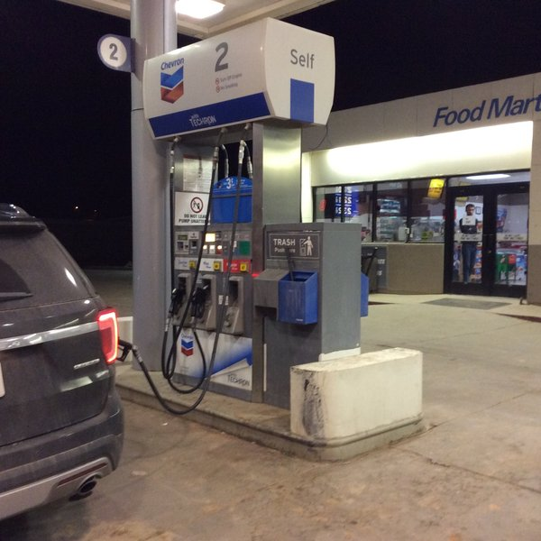
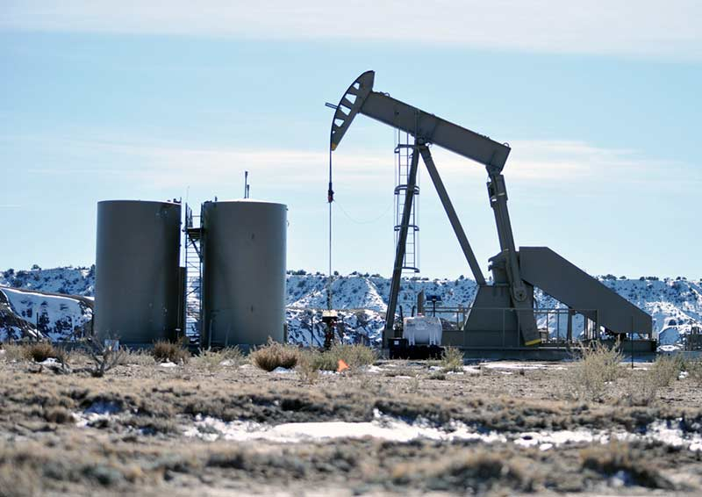
Navajo Nation Minor Source Permitting Mechanisms
Registration Program – existing sources below the threshold
General Permits – preconstruction and operating requirements for new or modified sources
Oil and Gas
Gasoline Dispensing Facilities
Site Specific Permits
Fee requirements

Slide 7
Navajo Nation Minor Source Program General Permits
General permits will cover preconstruction review and operating requirements for emission units that are similar in nature
Source Categories
Oil and natural gas production and natural gas processing segments of oil and natural gas sector
Gasoline dispensing facilities
Existing Sources
The general permit will cover the operational content of the permit and not the preconstruction content
New Sources
Will have both the operating conditions and the preconstruction content
Requesting Coverage
Owner/operators that qualify for coverage under a general permit may submit a request for coverage under the general permit. The Director will have 90 days to make a final determination on the request.

Slide 8
Navajo Nation Minor Source Program Site Specific Permits
New true minor sources, new synthetic minor sources and existing sources under going modifications triggering a preconstruction review must apply for a unitary permit that will cover both the preconstruction review and operation of the affected emission units
Existing true minor sources and existing synthetic minor sources that are not undergoing a modification triggering preconstruction review must apply and obtain only the operating permit component of a site specific minor source permit.

Slide 9
Minor Sources on Navajo Nation

Slide 10
Oil and Gas – Allowable Emission; Tribal NSR Registration
The emissions are in TPY of allowable emissions reported through registration submittals to USEPA Tribal Minor New Source Registration

Slide 11
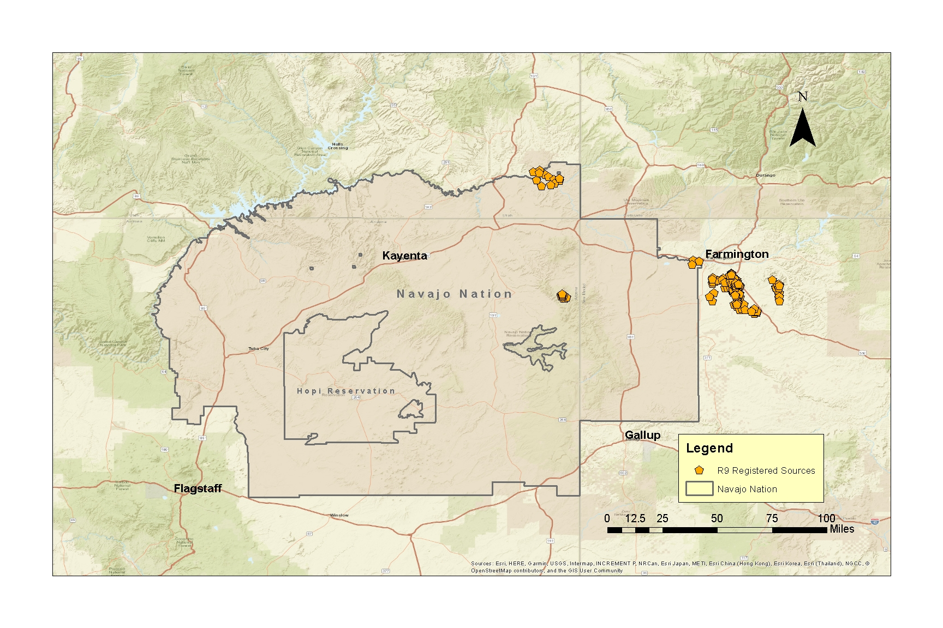

Slide 12
Thank You
Tennille Denetdeel, Sr Environmental Specialist
Navajo Nation EPA Operating Permit Program
Email: tbbegay@navajo-nsn.gov
928-729-4248

