Slide 1
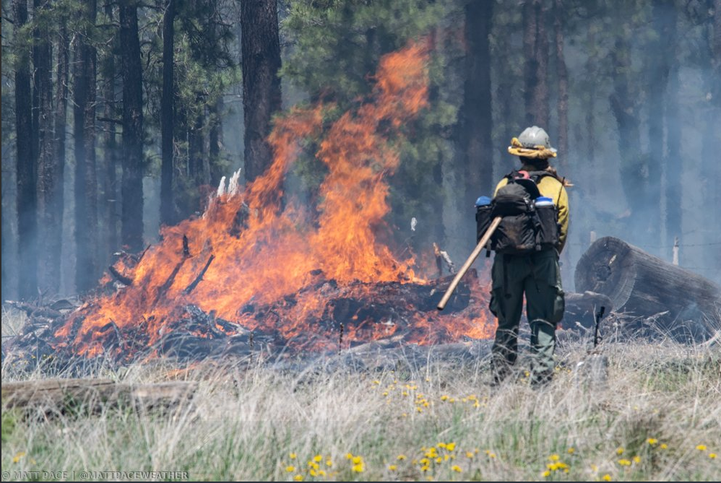
ADEQ Smoke Management & Wildfire Smoke Forecasts
Matt Pace – Meteorologist
Email: Pace.Matthew@azdeq.gov
Phone: 602.771.4831
Mobile: 602.622-9171

Slide 2
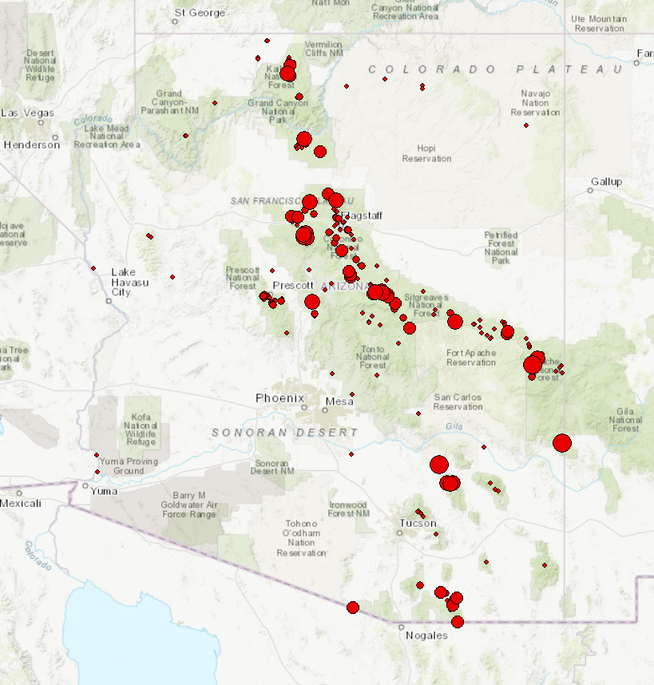
ADEQ SMOKE MANAGEMENT
ADEQ Smoke Management
Average: 500-700 burn requests per year
Approve on average 150,000-225,000 acres per year
Team of four meteorologists
Hourly AQI Forecasts
Exceptional Events
Support for the agency

Slide 3
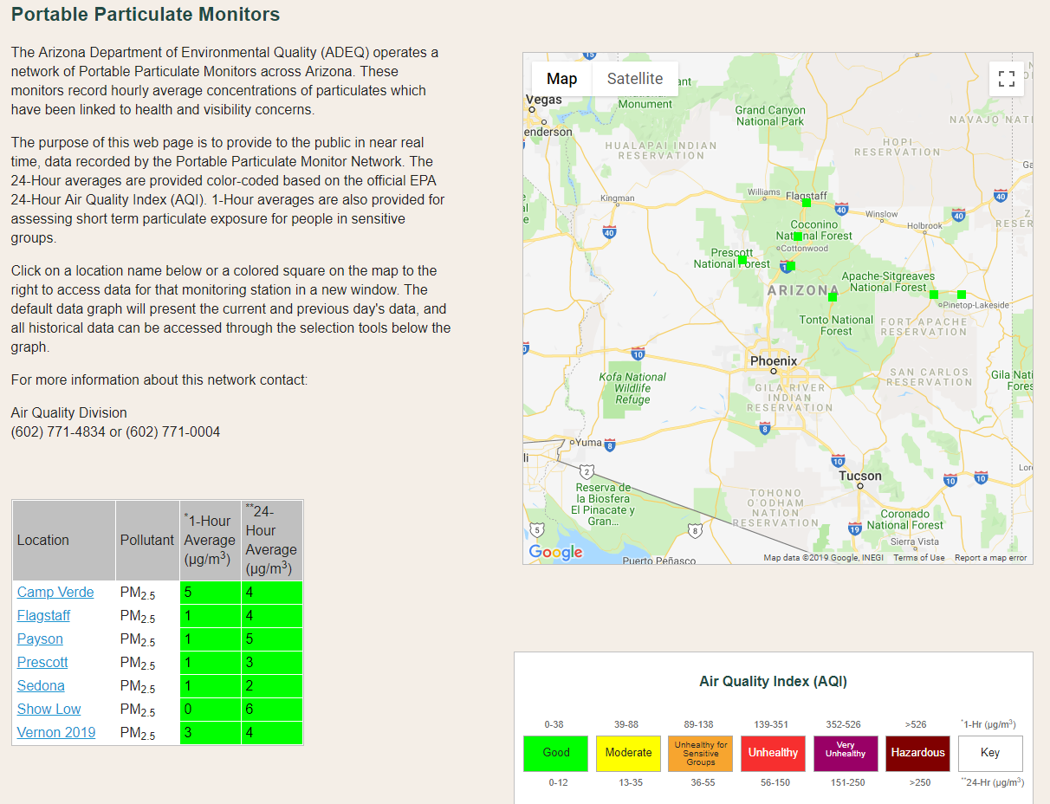
Portable Particulate Monitors

Slide 4
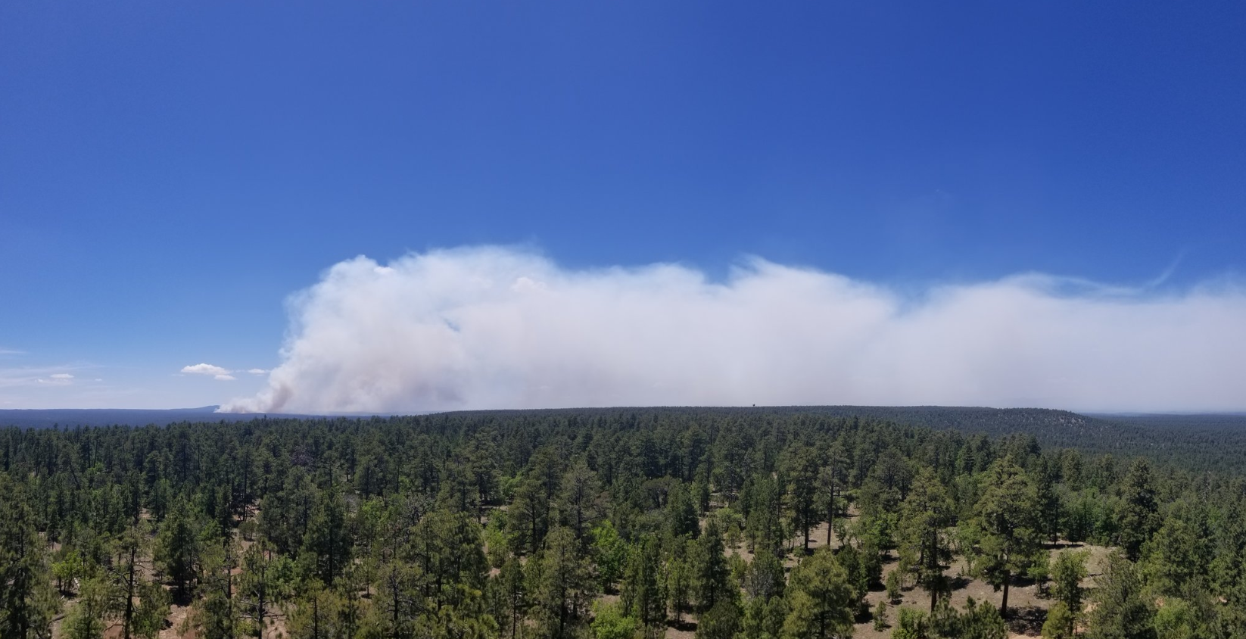
Wildfire Smoke Forecasting Project
Problem Statement
Wildland fire smoke forecasts are only completed and distributed to the public by USFS Air Resource Advisors (ARA's) and are only available for some, not all, significant wildland fires. In 2019, 50% of significant wildfires in Arizona had ARA's assigned. Out of those, 75% had air quality impacts before the ARA arrived. This means smoke impacts are not communicated to the public in a timely and effective way, 87% of the time.

Slide 5
Wildfire Smoke Forecasting Project
THE KEY IS COMMUNICATING ACCURATE INFORMATION
Communication
Communication
Communication
Communication
Communication
Communication
Communication
Communication

Slide 6
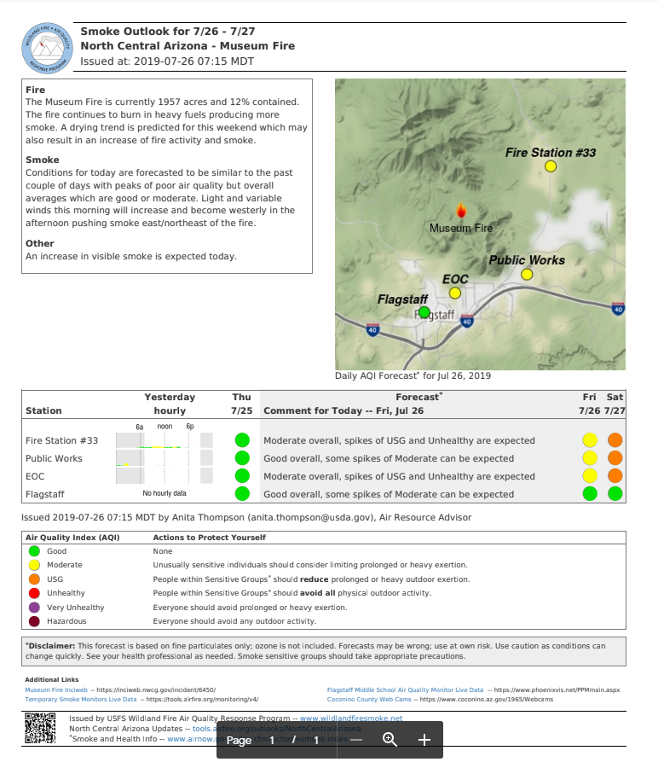
ARA Forecasts

Slide 7
ARA Forecasts
What parts of the
day?
Can’t read graphs &
info is from
yesterday
Trying to link
AQI without
Forecasting AQI

Slide 8
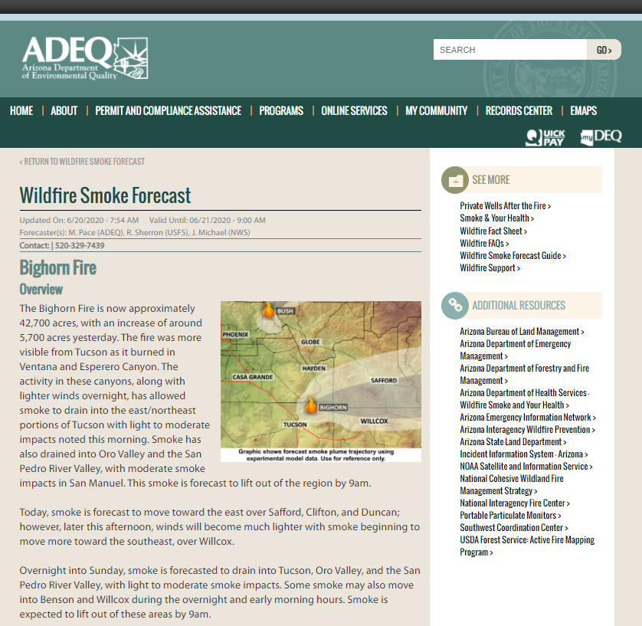
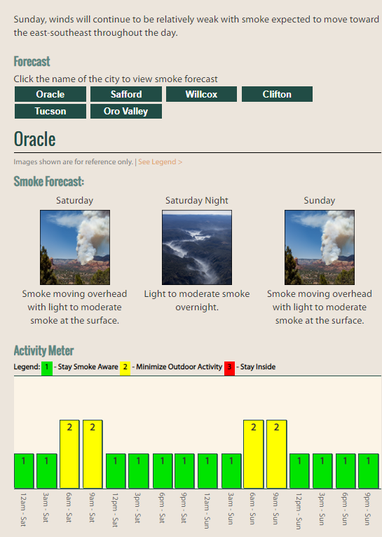
ADEQ Wildfire Smoke Forecast
http://azdeq.gov/wildfireforecast?fire=bighornfire&month=06&day=20&year=2020
http://azdeq.gov/wildfireforecast?fire=tussockfire&month=05&day=12&year=2021

Slide 9
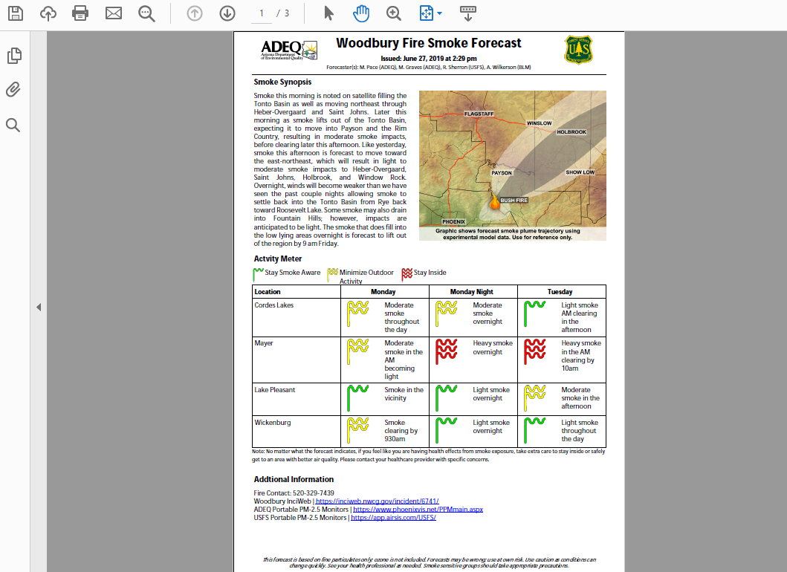
ADEQ Wildfire Smoke Forecast
PDF Version of the Forecast (simplified)

Slide 10
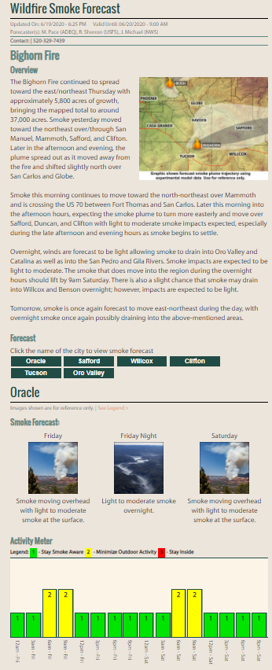
ADEQ Wildfire Smoke Forecast
Launched June 17, 2020
ADEQ issued 72 wildfire smoke forecasts to the public between June 17th and Oct 22nd

Slide 11
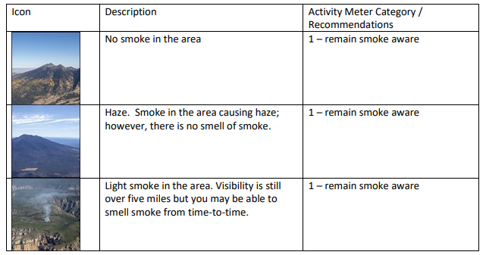
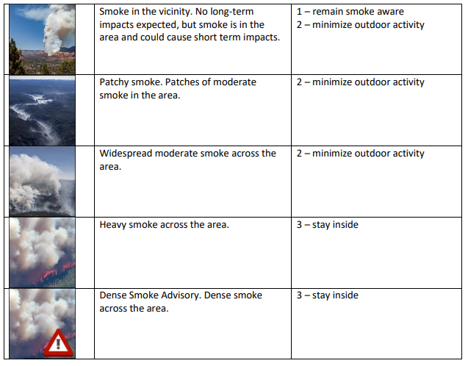
ADEQ Wildfire Smoke Forecast

Slide 12
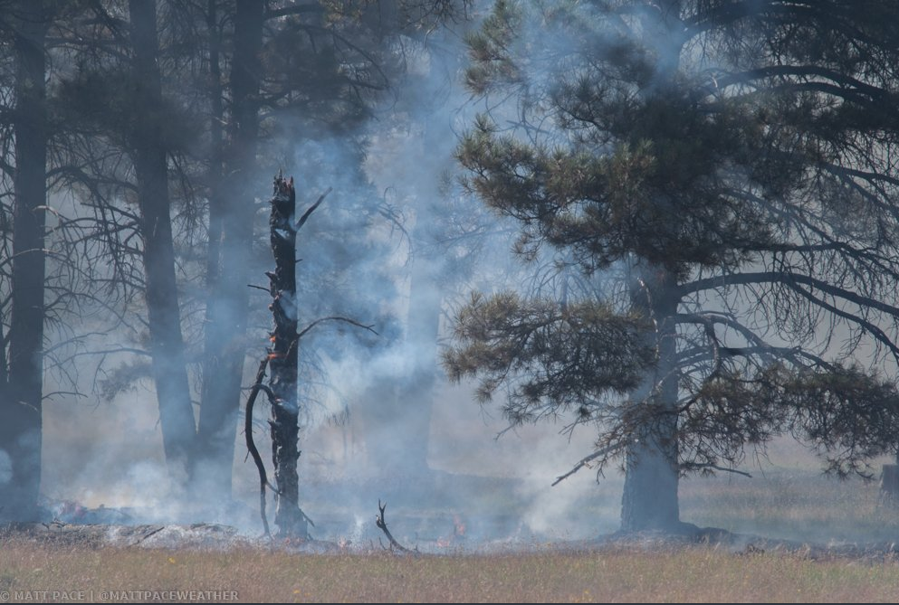
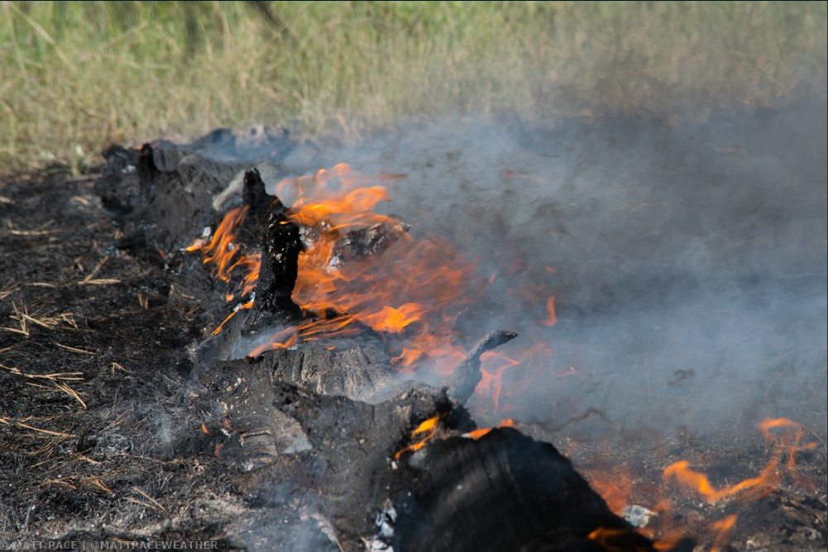
Questions?
Matt Pace
Pace.Matthew@azdeq.gov
Office: 602-771-4834
Cell: 602-622-9171

